Slide 1
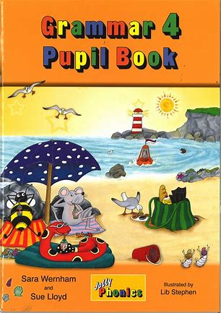
Jolly Grammar
4a-3

Slide 2
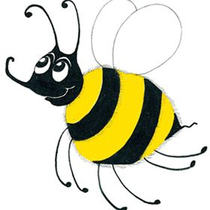
Spelling
Homophones

Slide 3
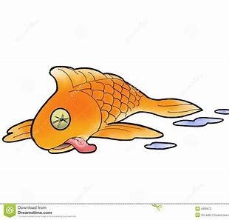
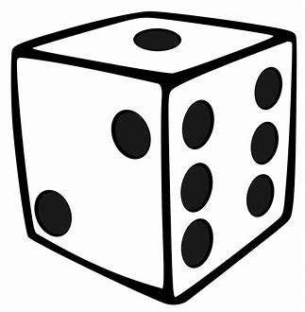
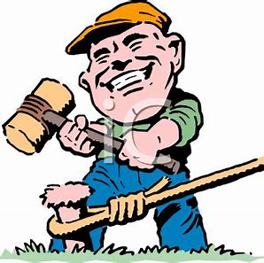
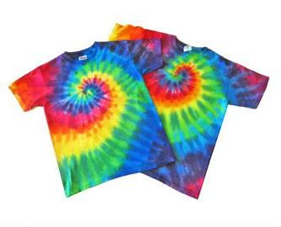
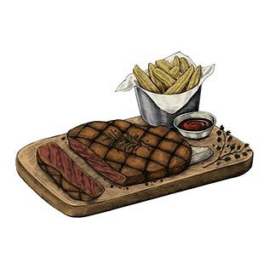
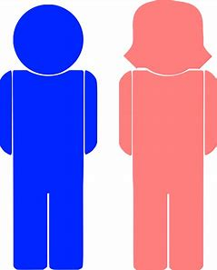
die mail stake
dye male steak

Slide 4
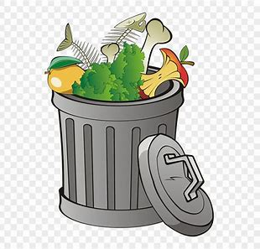
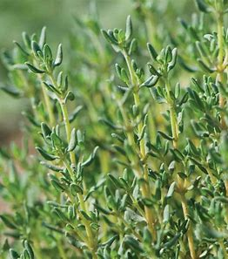
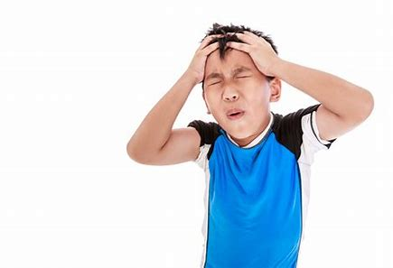
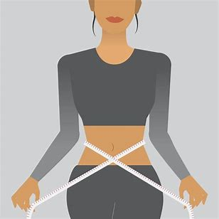
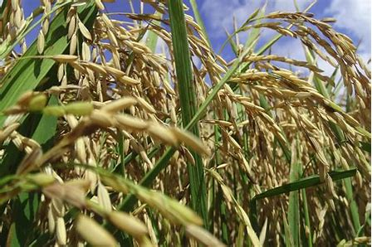
waste thyme groan
waist time grown

Slide 5
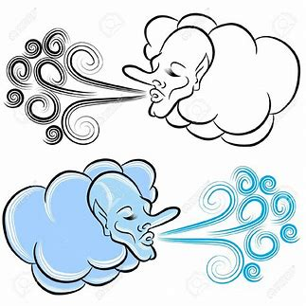
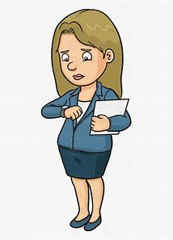
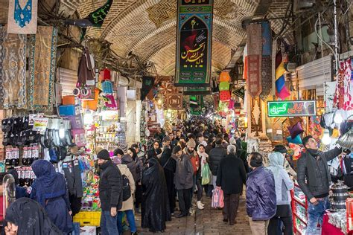
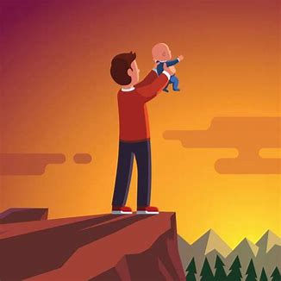
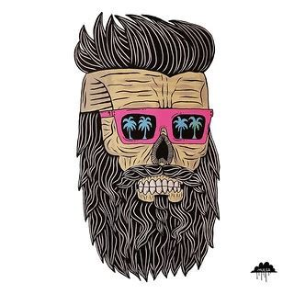
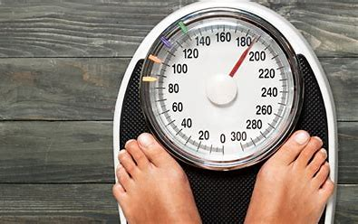
air wait bazaar
heir weight bizarre

Slide 7
Write down the different meanings.

Slide 8
Read each homophone and draw a picture.

Slide 9
stairs
stares
eight
ate
flour
flower
hair
hare

Slide 10
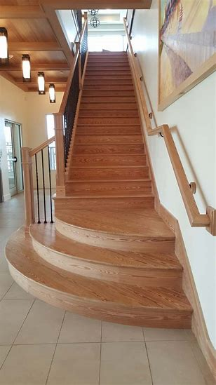
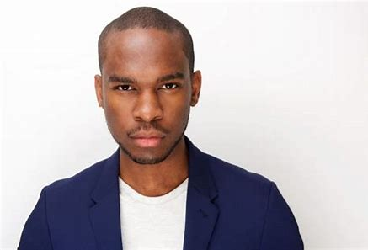
stairs
stares
eight
ate
flour
flower
hair
hare

Slide 11
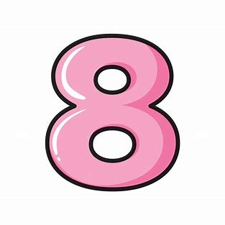
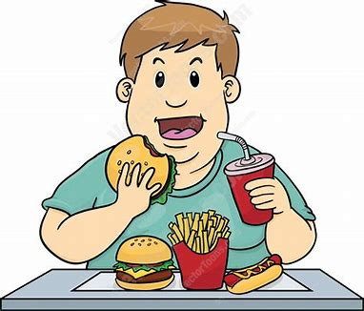
stairs
stares
eight
ate
flour
flower
hair
hare

Slide 12
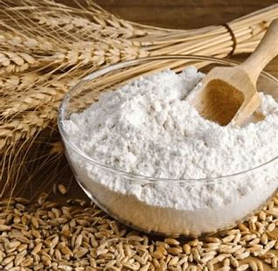
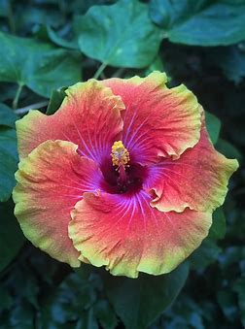
stairs
stares
eight
ate
flour
flower
hair
hare

Slide 13
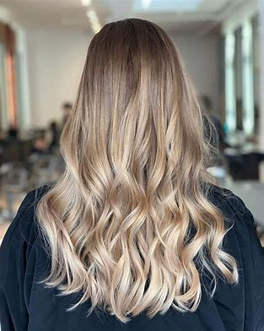
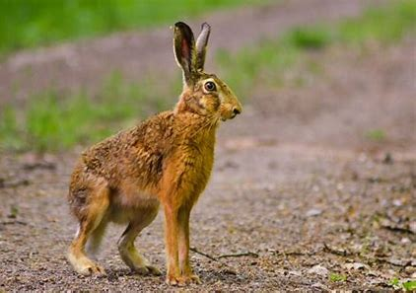
stairs
stares
eight
ate
flour
flower
hair
hare

Slide 14
parsing

Slide 15
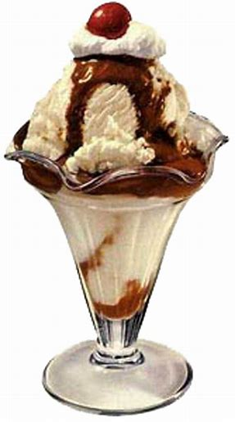
He will treat Zack to an ice-cream sundae on Sunday.

Slide 16
He will treat Zack to an ice-cream sundae on Sunday.

Slide 17
He will treat Zack to an ice-cream sundae on Sunday.

Slide 18
He will treat Zack to an ice-cream sundae on Sunday.

Slide 19
He will treat Zack to an ice-cream sundae on Sunday.

Slide 20
He will treat Zack to an ice-cream sundae on Sunday.

Slide 21
He will treat Zack to an ice-cream sundae on Sunday.

Slide 22
He will treat Zack to an ice-cream sundae on Sunday.

Slide 23
He will treat Zack to an ice-cream sundae on Sunday.

Slide 24
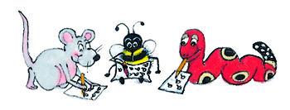
Dictation

Slide 25
Dictation
1.
2.
3.

Slide 26
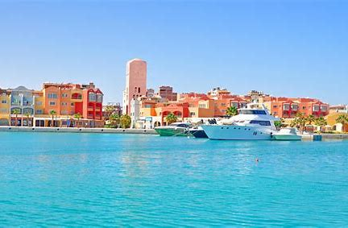

Slide 27
We went on two trips to see the sea.

Slide 28
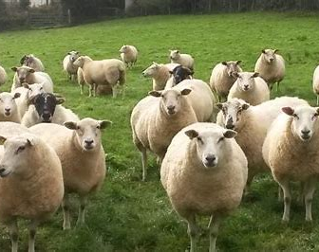

Slide 29
“You have two hundred ewes on the farm,” said Tom.

Slide 30
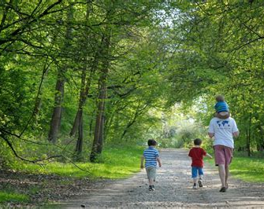

Slide 31
Sally asked, “Would you like a walk in the wood?”

