Slide 1
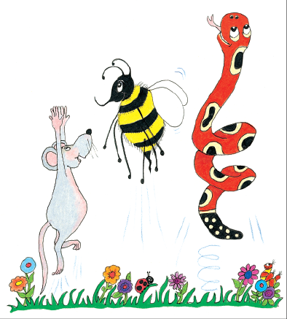
Jolly Grammar
4a-2

Slide 2
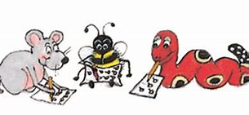
Spelling Test 1

Slide 3
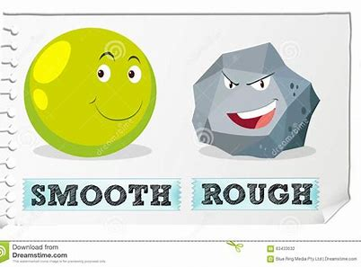
smooth

Slide 4
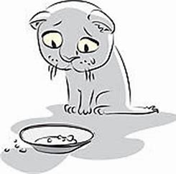
smooth
famish

Slide 5
smooth
famish
thorny

Slide 6
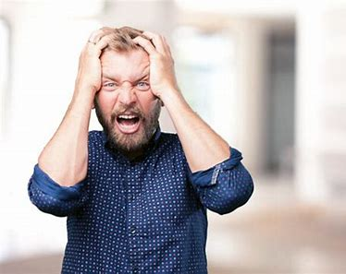
smooth
famish
thorny
loathing

Slide 7
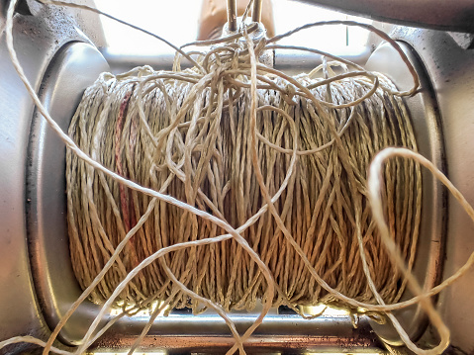
smooth
famish
thorny
loathing
backlash

Slide 8
smooth
famish
thorny
loathing
backlash
cheerless

Slide 9
smooth
famish
thorny
loathing
backlash
cheerless
7.benchark

Slide 10
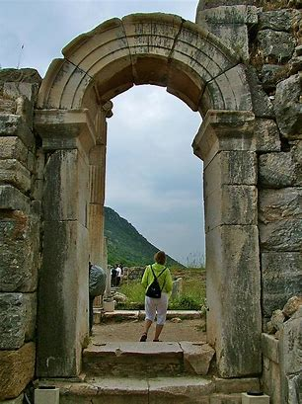
smooth
famish
thorny
loathing
backlash
cheerless
7.benchark
8.archway

Slide 11
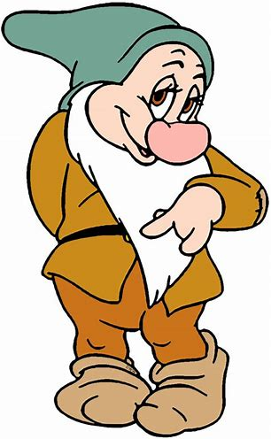
smooth
famish
thorny
loathing
backlash
cheerless
7.benchark
8.archway
9.bashful

Slide 12
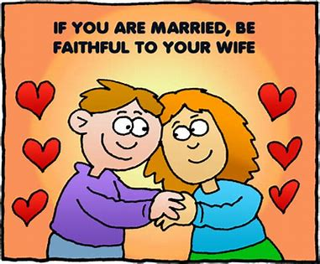
smooth
famish
thorny
loathing
backlash
cheerless
7.benchark
8.archway
9.bashful
10.faithful

Slide 13
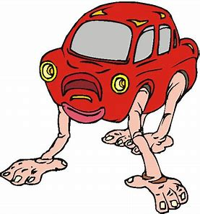
smooth
famish
thorny
loathing
backlash
cheerless
7.benchark
8.archway
9.bashful
10.faithful
11.outlandish

Slide 14
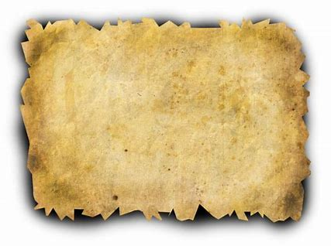
smooth
famish
thorny
loathing
backlash
cheerless
7.benchark
8.archway
9.bashful
10.faithful
11.outlandish
12.parchment

Slide 15
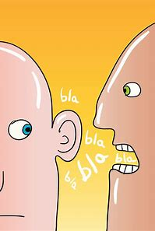
smooth
famish
thorny
loathing
backlash
cheerless
7.benchark
8.archway
9.bashful
10.faithful
11.outlandish
12.parchment
13.gibberish

Slide 16
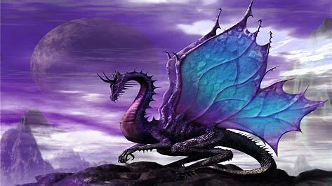
smooth
famish
thorny
loathing
backlash
cheerless
7.benchark
8.archway
9.bashful
10.faithful
11.outlandish
12.parchment
13.gibberish
14.mythical

Slide 17
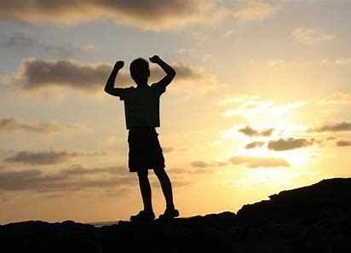
smooth
famish
thorny
loathing
backlash
cheerless
7.benchark
8.archway
9.bashful
10.faithful
11.outlandish
12.parchment
13.gibberish
14.mythical
15.achieve

Slide 18
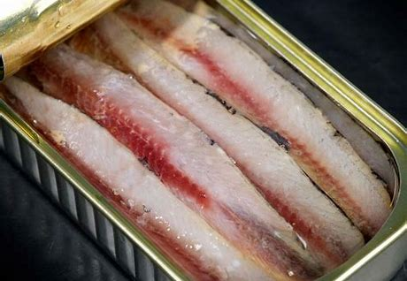
smooth
famish
thorny
loathing
backlash
cheerless
7.benchark
8.archway
9.bashful
10.faithful
11.outlandish
12.parchment
13.gibberish
14.mythical
15.achieve
16.anchovy

Slide 19
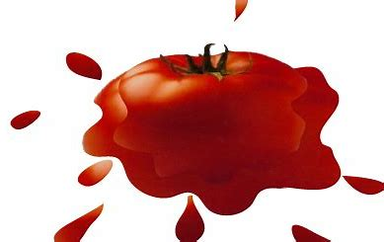
smooth
famish
thorny
loathing
backlash
cheerless
7.benchark
8.archway
9.bashful
10.faithful
11.outlandish
12.parchment
13.gibberish
14.mythical
15.achieve
16.anchovy
17.squashed

Slide 20
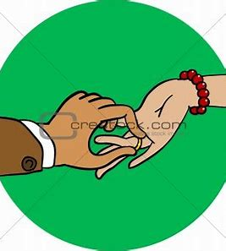
smooth
famish
thorny
loathing
backlash
cheerless
7.benchark
8.archway
9.bashful
10.faithful
11.outlandish
12.parchment
13.gibberish
14.mythical
15.achieve
16.anchovy
17.squashed
18.betrothed

Slide 21
Activity Page:
Verb Tenses

Slide 22
Thank you!

