Slide 1
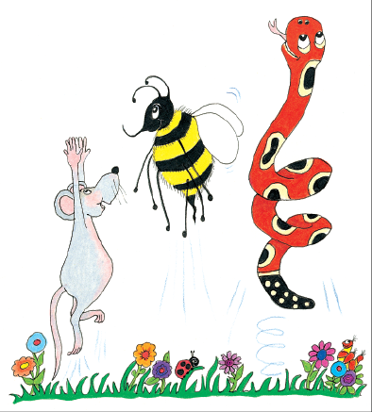
Jolly Grammar
4a-6

Slide 2
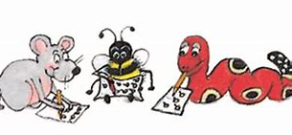
Spelling Test 3

Slide 3
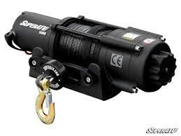
winch

Slide 4
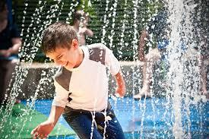
winch
drench

Slide 5
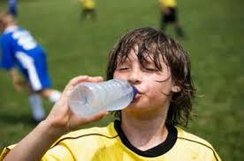
winch
drench
quench

Slide 6
winch
drench
quench
stench

Slide 7
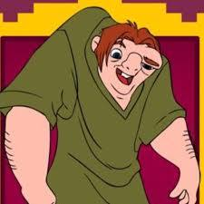
winch
drench
quench
stench
hunch

Slide 8
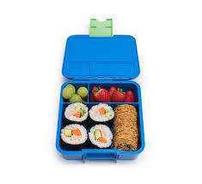
winch
drench
quench
stench
hunch
lunchbox

Slide 9
winch
drench
quench
stench
hunch
lunchbox
7.scrunch

Slide 10
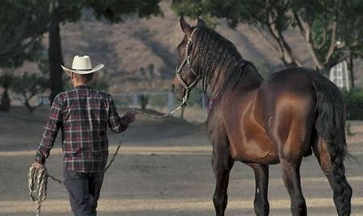
winch
drench
quench
stench
hunch
lunchbox
7.scrunch
8.rancher

Slide 11
winch
drench
quench
stench
hunch
lunchbox
7.scrunch
8.rancher
9.flinch

Slide 12
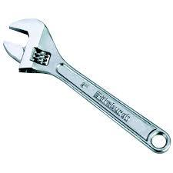
winch
drench
quench
stench
hunch
lunchbox
7.scrunch
8.rancher
9.flinch
10.wrench

Slide 13
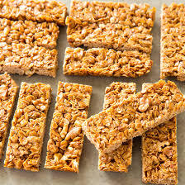
winch
drench
quench
stench
hunch
lunchbox
7.scrunch
8.rancher
9.flinch
10.wrench
11.crunchy

Slide 14
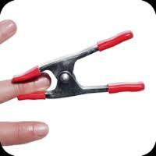
winch
drench
quench
stench
hunch
lunchbox
7.scrunch
8.rancher
9.flinch
10.wrench
11.crunchy
12.pinched

Slide 15
winch
drench
quench
stench
hunch
lunchbox
7.scrunch
8.rancher
9.flinch
10.wrench
11.crunchy
12.pinched
13.launch

Slide 16
winch
drench
quench
stench
hunch
lunchbox
7.scrunch
8.rancher
9.flinch
10.wrench
11.crunchy
12.pinched
13.launch
14.franchise

Slide 17
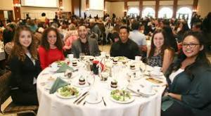
winch
drench
quench
stench
hunch
lunchbox
7.scrunch
8.rancher
9.flinch
10.wrench
11.crunchy
12.pinched
13.launch
14.franchise
15.luncheon

Slide 18
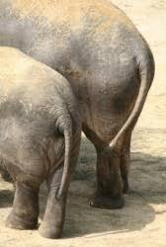
winch
drench
quench
stench
hunch
lunchbox
7.scrunch
8.rancher
9.flinch
10.wrench
11.crunchy
12.pinched
13.launch
14.franchise
15.luncheon
16.haunches

Slide 19
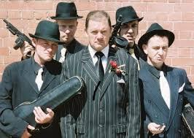
winch
drench
quench
stench
hunch
lunchbox
7.scrunch
8.rancher
9.flinch
10.wrench
11.crunchy
12.pinched
13.launch
14.franchise
15.luncheon
16.haunches
17.henchmen

Slide 20
winch
drench
quench
stench
hunch
lunchbox
7.scrunch
8.rancher
9.flinch
10.wrench
11.crunchy
12.pinched
13.launch
14.franchise
15.luncheon
16.haunches
17.henchmen
18.enchanted

Slide 21
Let’s revise sentences.

Slide 22
The snake eggs.

Slide 23
The snake eats eggs.

Slide 24
s
The snake eats eggs.

Slide 25
s
The snake eats eggs.
o

Slide 26
s
The snake eats them.
o

Slide 27
s
The snake eats.

Slide 28
Let’s work
in pairs.

