Slide 1
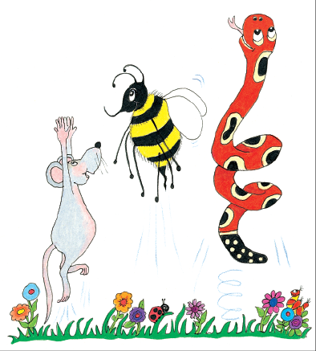
Jolly Grammar
4a-5

Slide 2
Spelling
<nch>

Slide 3
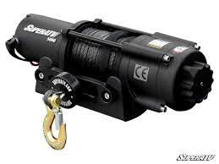
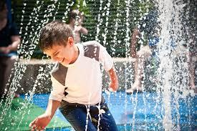
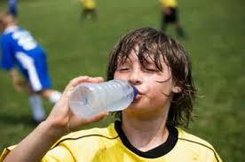
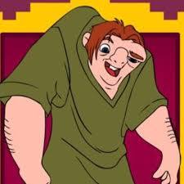
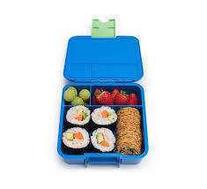
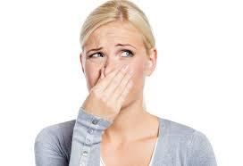
winch drench quench
stench hunch lunchbox

Slide 4
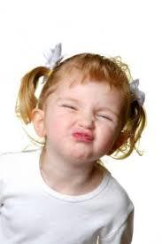
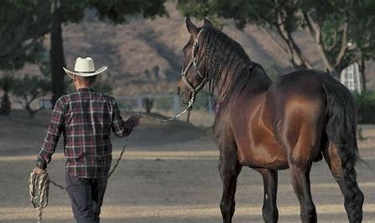
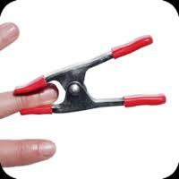
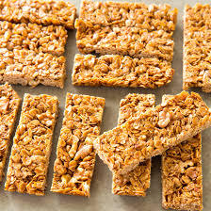
scrunch rancher flinch
wrench crunchy pinched

Slide 5
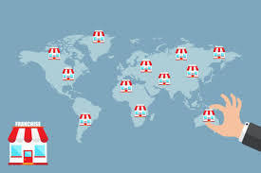
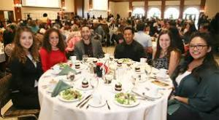
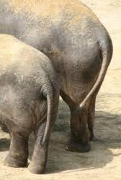
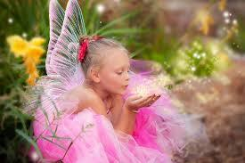
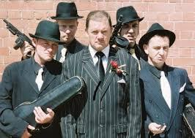
launch franchise luncheon
haunches henchmen enchantment

Slide 7
Unscramble the letters.

Slide 8
parsing

Slide 9
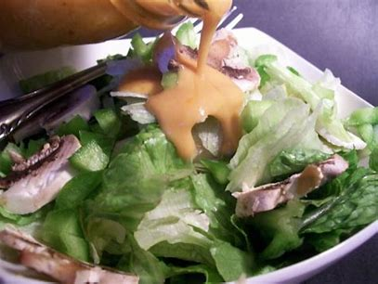
I drenched the crunchy lettuce in my lunchbox in French dressing.

Slide 10
I drenched the crunchy lettuce in my lunchbox in French dressing.

Slide 11
I drenched the crunchy lettuce in my lunchbox in French dressing.

Slide 12
I drenched the crunchy lettuce in my lunchbox in French dressing.

Slide 13
I drenched the crunchy lettuce in my lunchbox in French dressing.

Slide 14
I drenched the crunchy lettuce in my lunchbox in French dressing.

Slide 15
I drenched the crunchy lettuce in my lunchbox in French dressing.

Slide 16
I drenched the crunchy lettuce in my lunchbox in French dressing.

Slide 17
I drenched the crunchy lettuce in my lunchbox in French dressing.

Slide 18
I drenched the crunchy lettuce in my lunchbox in French dressing.

Slide 19
I drenched the crunchy lettuce in my lunchbox in French dressing.

Slide 20
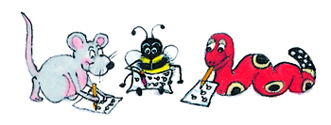
Dictation

Slide 21
Dictation
1.
2.
3.

Slide 22
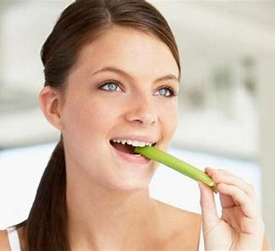

Slide 23
The celery was munchy and crunchy.

Slide 24
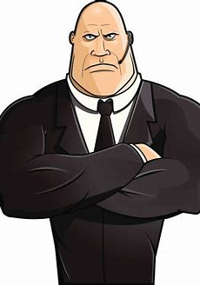

Slide 25
“Stand in a bunch,” ordered the henchman.

Slide 26
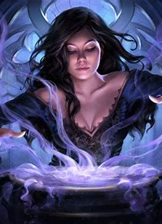
The witch put an enchantment on the castle.

