Slide 1
Jolly Grammar 3a-28

Slide 2
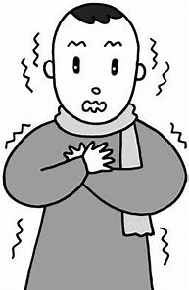
quiver

Slide 3
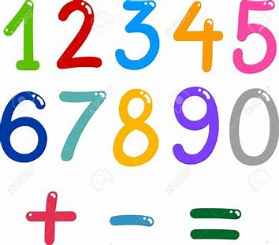
quiver
equal

Slide 4
quiver
equal
request

Slide 5
quiver
equal
request
quote

Slide 6
quiver
equal
request
quote
liquid

Slide 7
quiver
equal
request
quote
liquid
squeak

Slide 8
quiver
equal
request
quote
liquid
squeak
7. quite

Slide 9
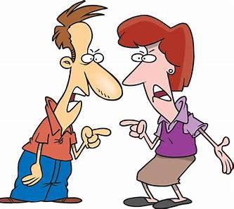
quiver
equal
request
quote
liquid
squeak
7. quite
8. quarrel

Slide 10
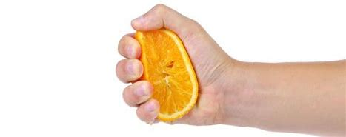
quiver
equal
request
quote
liquid
squeak
7. quite
8. quarrel
9. squeeze

Slide 11
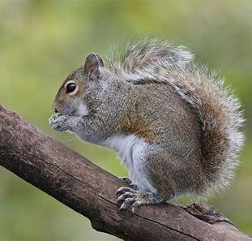
quiver
equal
request
quote
liquid
squeak
7. quite
8. quarrel
9. squeeze
10. squirrel

Slide 12
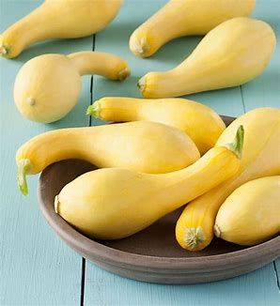
quiver
equal
request
quote
liquid
squeak
7. quite
8. quarrel
9. squeeze
10. squirrel
11. squash

Slide 13
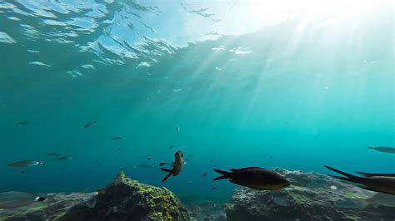
quiver
equal
request
quote
liquid
squeak
7. quite
8. quarrel
9. squeeze
10. squirrel
11. squash
12. aquatic

Slide 14
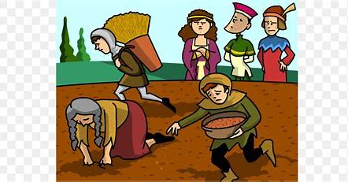
quiver
equal
request
quote
liquid
squeak
7. quite
8. quarrel
9. squeeze
10. squirrel
11. squash
12. aquatic
13. conquest

Slide 15
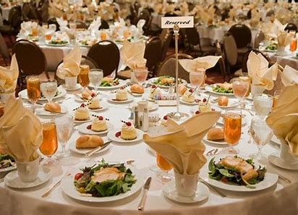
quiver
equal
request
quote
liquid
squeak
7. quite
8. quarrel
9. squeeze
10. squirrel
11. squash
12. aquatic
13. conquest
14. banquet

Slide 16
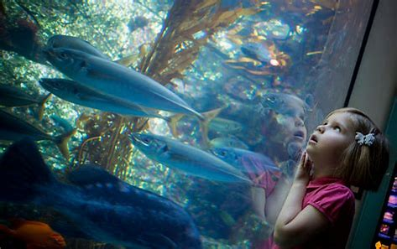
quiver
equal
request
quote
liquid
squeak
7. quite
8. quarrel
9. squeeze
10. squirrel
11. squash
12. aquatic
13. conquest
14. banquet
15. aquarium

Slide 17
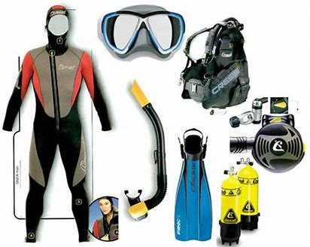
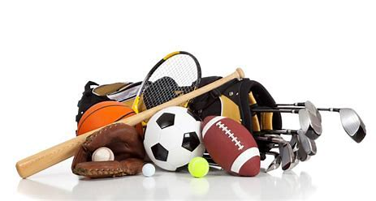
quiver
equal
request
quote
liquid
squeak
7. quite
8. quarrel
9. squeeze
10. squirrel
11. squash
12. aquatic
13. conquest
14. banquet
15. aquarium
16. equipment

Slide 18
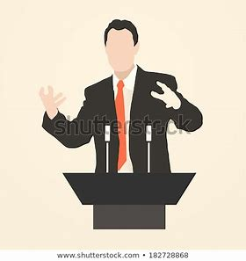
quiver
equal
request
quote
liquid
squeak
7. quite
8. quarrel
9. squeeze
10. squirrel
11. squash
12. aquatic
13. conquest
14. banquet
15. aquarium
16. equipment
17. eloquent

Slide 19
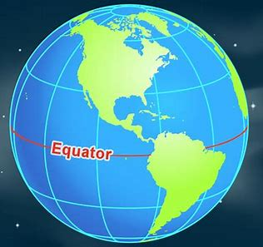
quiver
equal
request
quote
liquid
squeak
7. quite
8. quarrel
9. squeeze
10. squirrel
11. squash
12. aquatic
13. conquest
14. banquet
15. aquarium
16. equipment
17. eloquent
18. equator

Slide 20
Activity Page:
Paragraphs
(All About Me)

Slide 21
Me and My Family
There are five members in my family. My parents are very kind.
My brother is cute and small. We play computer games together on weekends.

Slide 22
Me and My Family
indented
There are five members in my family. My parents are very kind.
My brother is cute and small. We play computer games together on weekends.

Slide 23
Where I Live
indented
I live in Kokura. Kokura is famous for Kokura Castle. I like this city because people are nice.

Slide 24
My Hobbies
indented
I like shopping. I go to the 100yen shop for art supplies, toys, and snacks. I usually go shopping by myself.

Slide 25
Thank you!

