Slide 1
Jolly Grammar 3a-27

Slide 2
Let’s Read about your life.

Slide 3
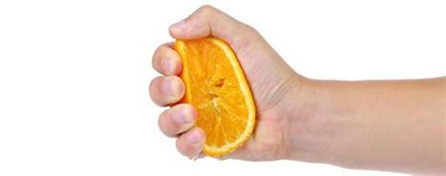
squeeze
/qu/

Slide 4
Spelling List
Spelling <qu>

Slide 5
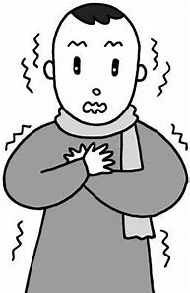
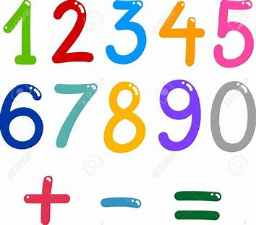
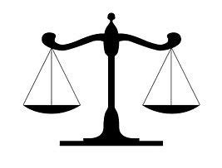
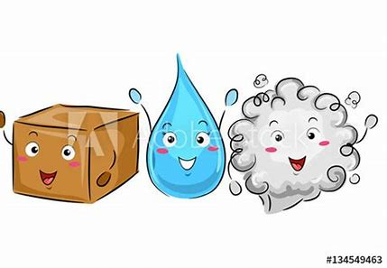
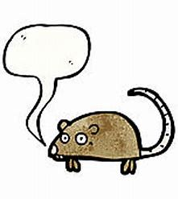
quiver equal request
quote liquid squeak

Slide 6
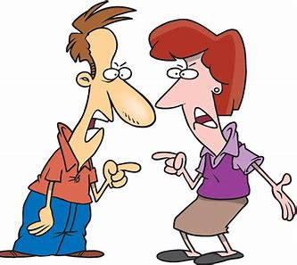
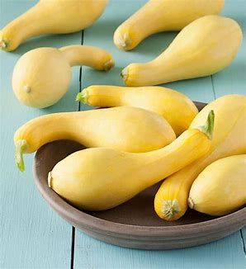
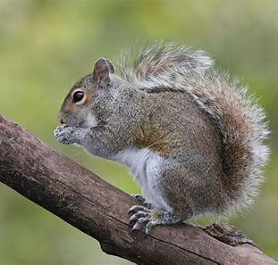
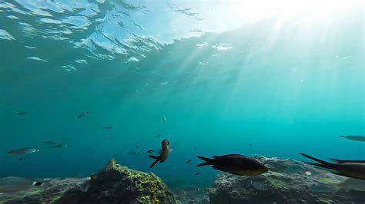
quite quarrel squeeze
squirrel squash aquatic

Slide 7
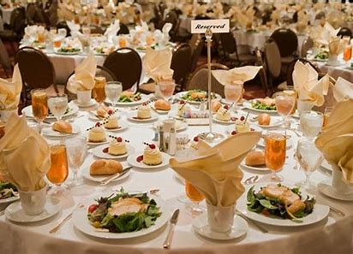
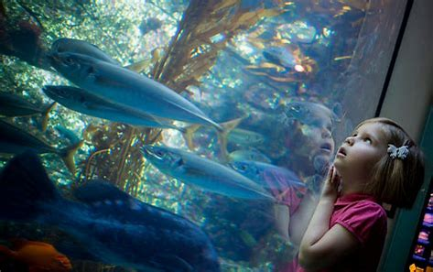
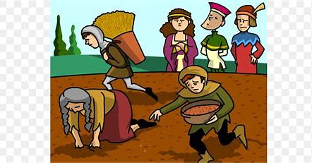
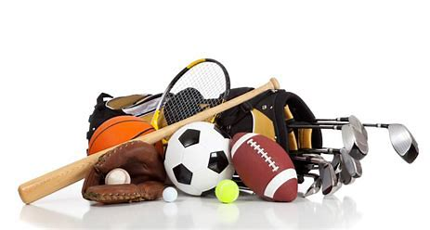
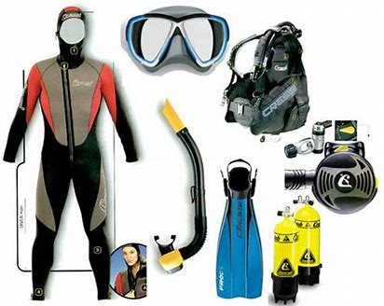
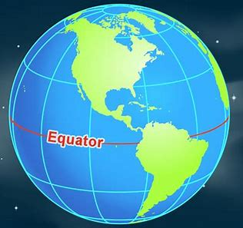
conquest banquet aquarium
equipment eloquent equator

Slide 8
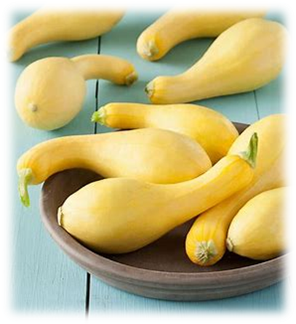
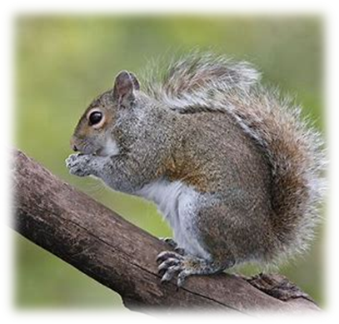
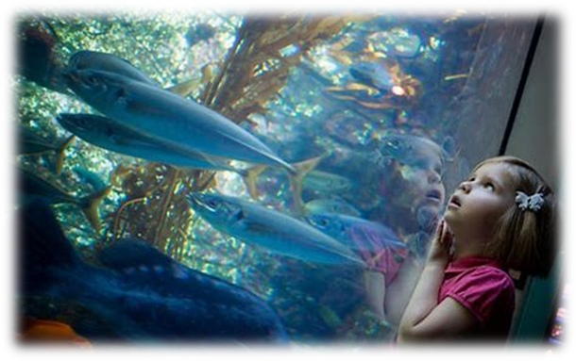

Slide 9
Activity Page:
Which words I the spelling list match these descriptions?

Slide 10
Split these words into syllables.

Slide 11
request
squeak
squeeze
frequent
equipment

Slide 12
request
squeak
squeeze
frequent
equipment

Slide 13
request
squeak
squeeze
frequent
equipment

Slide 14
request
squeak
squeeze
frequent
equipment

Slide 15
Let’s parse
sentences.

Slide 16
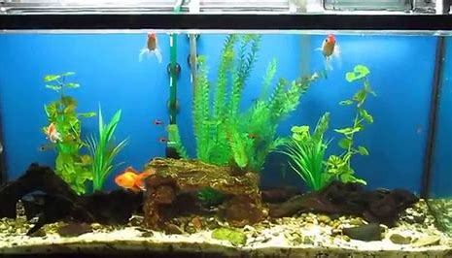
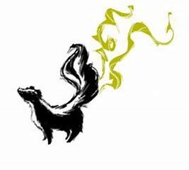
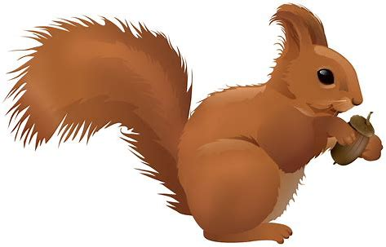
Parse these sentences.
I bought a new aquarium
for my goldfish.
The red squirrel quivered and squeaked at the smelly skunk.

Slide 17
Parse these sentences.
I bought a new aquarium
for my goldfish.
The red squirrel quivered and squeaked at the smelly skunk.

Slide 18
Parse these sentences.
I bought a new aquarium
for my goldfish.
The red squirrel quivered and squeaked at the smelly skunk.

Slide 19
Parse these sentences.
I bought a new aquarium
for my goldfish.
The red squirrel quivered and squeaked at the smelly skunk.

Slide 20
Parse these sentences.
I bought a new aquarium
for my goldfish.
The red squirrel quivered and squeaked at the smelly skunk.

Slide 21
Parse these sentences.
I bought a new aquarium
for my goldfish.
The red squirrel quivered and squeaked at the smelly skunk.

Slide 22
Parse these sentences.
I bought a new aquarium
for my goldfish.
The red squirrel quivered and squeaked at the smelly skunk.

Slide 23
Parse these sentences.
I bought a new aquarium
for my goldfish.
The red squirrel quivered and squeaked at the smelly skunk.

Slide 24
Parse these sentences.
I bought a new aquarium
for my goldfish.
The red squirrel quivered and squeaked at the smelly skunk.

Slide 25
Parse these sentences.
I bought a new aquarium
for my goldfish.
The red squirrel quivered and squeaked at the smelly skunk.

Slide 26
Parse these sentences.
I bought a new aquarium
for my goldfish.
The red squirrel quivered and squeaked at the smelly skunk.

Slide 27
Parse these sentences.
I bought a new aquarium
for my goldfish.
The red squirrel quivered and squeaked at the smelly skunk.

Slide 28
Parse these sentences.
I bought a new aquarium
for my goldfish.
The red squirrel quivered and squeaked at the smelly skunk.

Slide 29
Parse these sentences.
I bought a new aquarium
for my goldfish.
The red squirrel quivered and squeaked at the smelly skunk.

Slide 30
Parse these sentences.
I bought a new aquarium
for my goldfish.
The red squirrel quivered and squeaked at the smelly skunk.

Slide 31
Parse these sentences.
I bought a new aquarium
for my goldfish.
The red squirrel quivered and squeaked at the smelly skunk.

Slide 32
Dictation

Slide 33
Dictation
1.
2.
3.

Slide 34
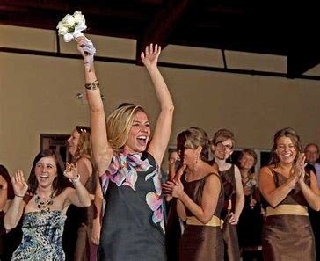

Slide 35
Queen Nooka quickly caught the bunch of flowers.

Slide 36
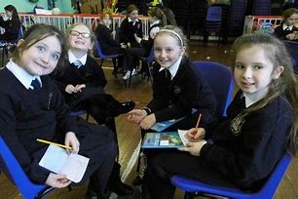

Slide 37
Class Two won the table quiz.

Slide 38
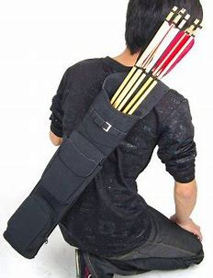

Slide 39
An archer keeps arrows in a quiver.

Slide 40
Thank you!

