Slide 1
Jolly Grammar 3a-26

Slide 2
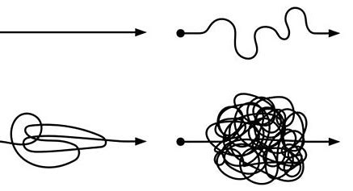
simple

Slide 3
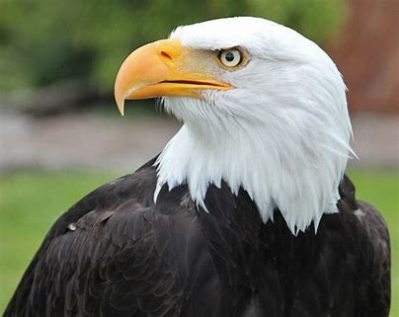
simple
eagle

Slide 4
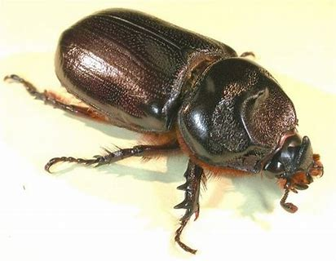
simple
eagle
beetle

Slide 5
simple
eagle
beetle
handle

Slide 6
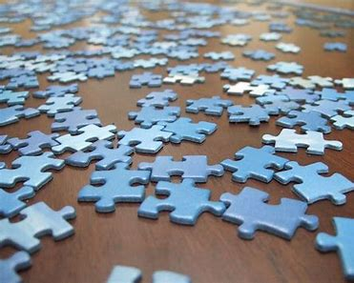
simple
eagle
beetle
handle
puzzle

Slide 7
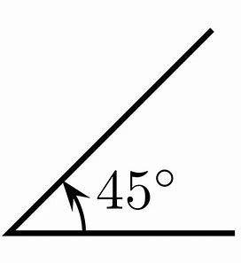
simple
eagle
beetle
handle
puzzle
angle

Slide 8
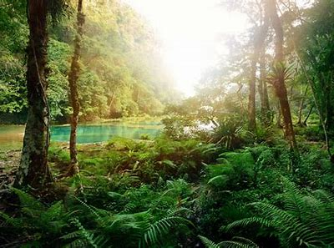
simple
eagle
beetle
handle
puzzle
angle
7. jungle

Slide 9
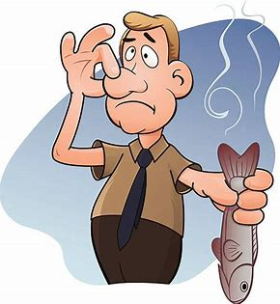
simple
eagle
beetle
handle
puzzle
angle
7. jungle
8. horrible

Slide 10
simple
eagle
beetle
handle
puzzle
angle
7. jungle
8. horrible
9. terrible

Slide 11
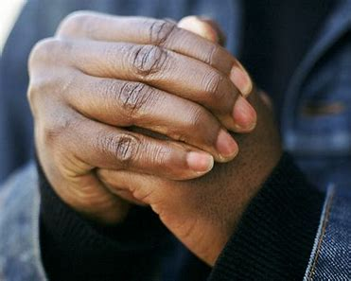
simple
eagle
beetle
handle
puzzle
angle
7. jungle
8. horrible
9. terrible
10. knuckle

Slide 12
simple
eagle
beetle
handle
puzzle
angle
7. jungle
8. horrible
9. terrible
10. knuckle
11. disable

Slide 13
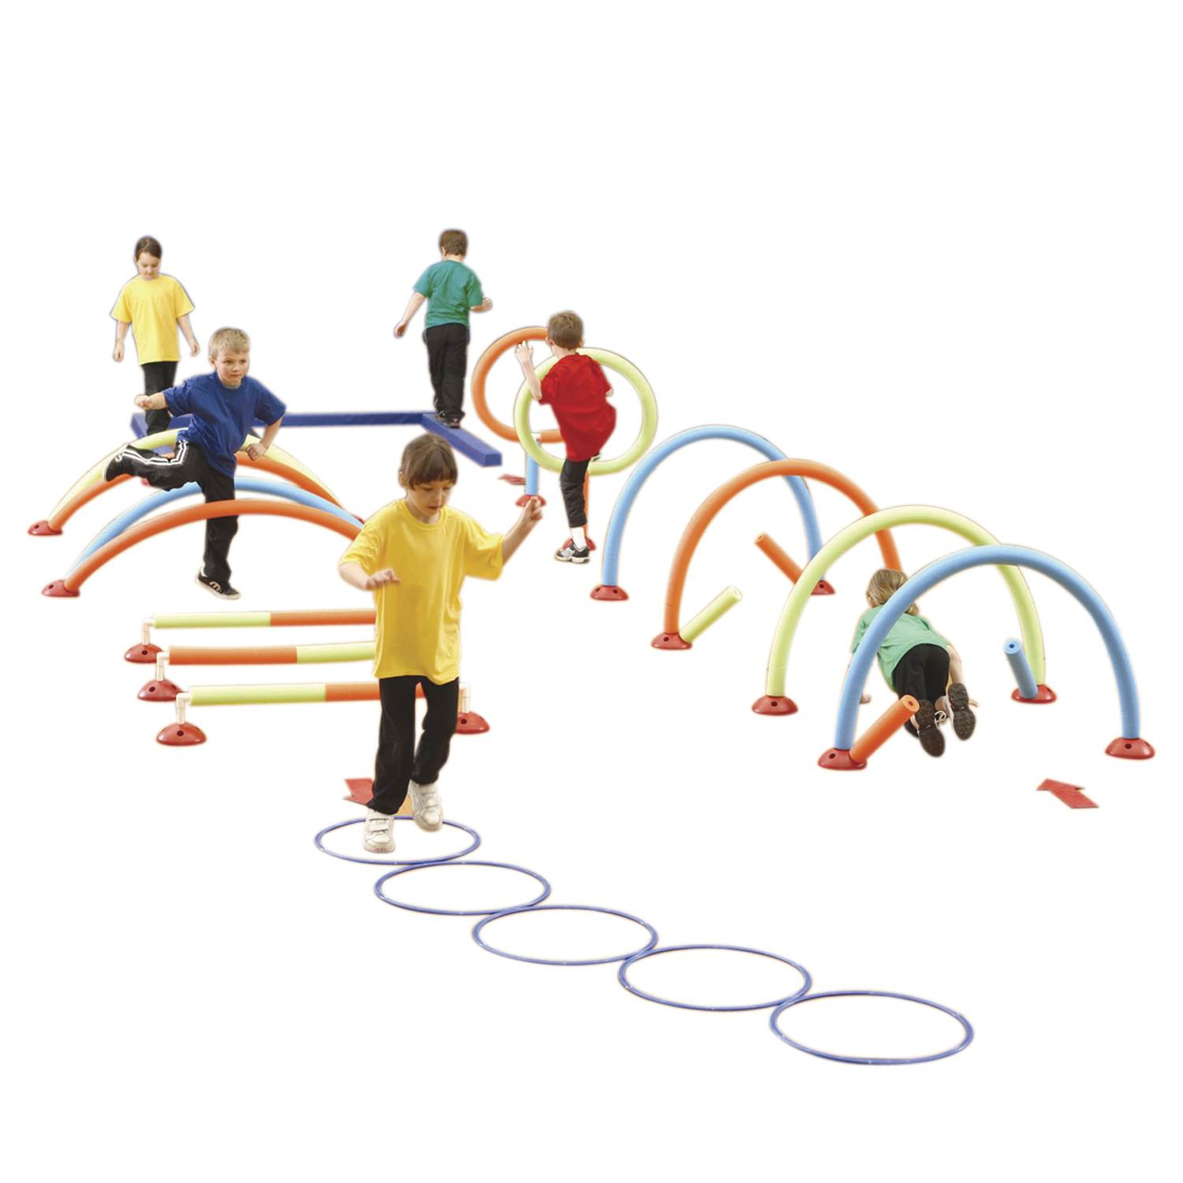
simple
eagle
beetle
handle
puzzle
angle
7. jungle
8. horrible
9. terrible
10. knuckle
11. disable
12. obstacle

Slide 14
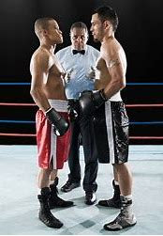
simple
eagle
beetle
handle
puzzle
angle
7. jungle
8. horrible
9. terrible
10. knuckle
11. disable
12. obstacle
13. formidable

Slide 15
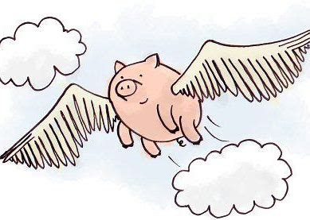
simple
eagle
beetle
handle
puzzle
angle
7. jungle
8. horrible
9. terrible
10. knuckle
11. disable
12. obstacle
13. formidable
14. improbable

Slide 16
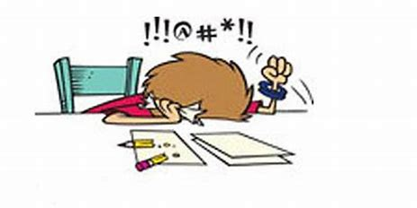
simple
eagle
beetle
handle
puzzle
angle
7. jungle
8. horrible
9. terrible
10. knuckle
11. disable
12. obstacle
13. formidable
14. improbable
15. impossible

Slide 17
simple
eagle
beetle
handle
puzzle
angle
7. jungle
8. horrible
9. terrible
10. knuckle
11. disable
12. obstacle
13. formidable
14. improbable
15. impossible
16. rectangle

Slide 18
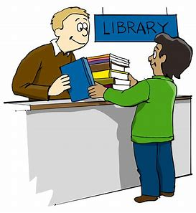
simple
eagle
beetle
handle
puzzle
angle
7. jungle
8. horrible
9. terrible
10. knuckle
11. disable
12. obstacle
13. formidable
14. improbable
15. impossible
16. rectangle
17. believable

Slide 19
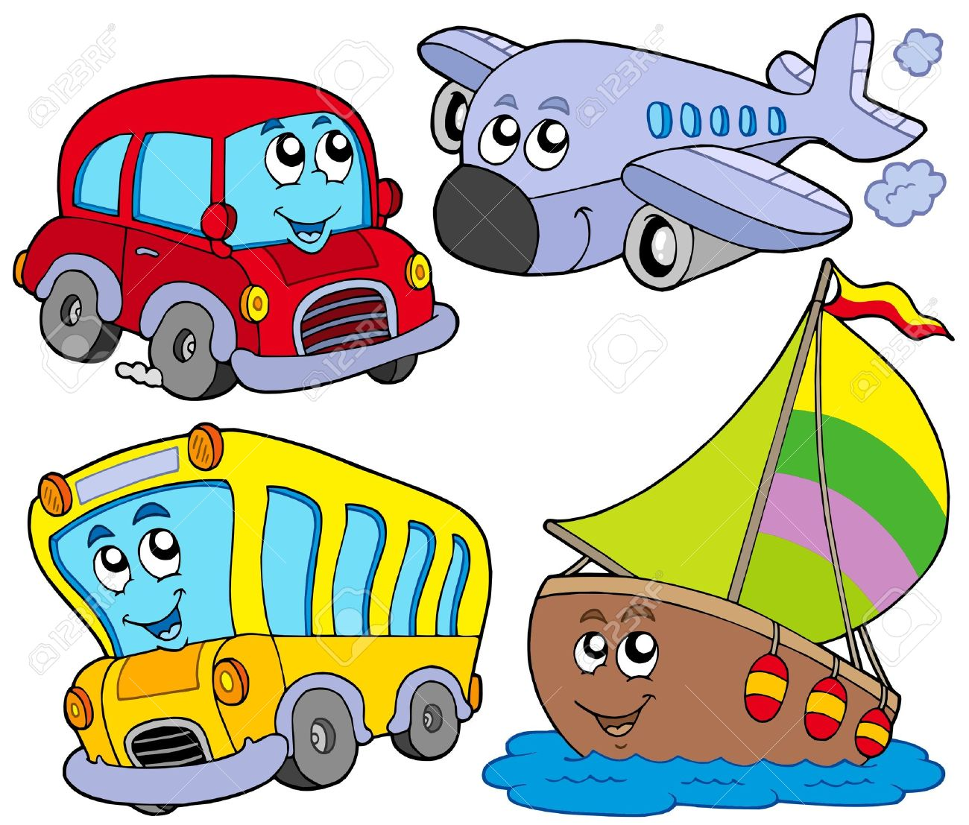
simple
eagle
beetle
handle
puzzle
angle
7. jungle
8. horrible
9. terrible
10. knuckle
11. disable
12. obstacle
13. formidable
14. improbable
15. impossible
16. rectangle
17. believable
18. vehicle

Slide 20
Let’s look at paragraphs in books.

Slide 21
Activity Page:
Paragraphs
(organizing information)

Slide 22
Me and My Family
Where I Live
My Life
My Hobbies

Slide 23
Me and My Family
There are five members in my family. My parents are very kind. My brother is cute and small. We play computer games together on weekends.

Slide 24
Me and My Family
There are three members in my family, my mother, my father, and myself. We play cards together before bedtime.

Slide 25
Where I Live
I live in Kokura. Kokura is famous for Kokura Castle. I like this city because people are nice.

Slide 26
Where I Live
I live in Kitakyushu city. My apartment is near Mikuni Stadium. I like it here because it is near the station and I can see fireworks sometimes.

Slide 27
My Hobbies
I like relaxing in my free time. For example, touching slime makes me happy. The slime should not be too soft of hard. It should be just right.

Slide 28
My Hobbies
I like shopping. I go to the 100yen shop for art supplies, toys, and snacks. I usually go shopping by myself.

Slide 29
My Friends
My School
My Pets
The Sports I Play
My Dream

Slide 30
Thank you!

