Slide 1
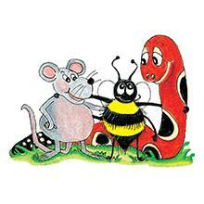
Jolly Grammar 3a-25

Slide 2
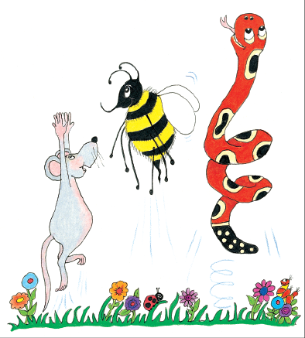
Let’s review syllables.

Slide 3
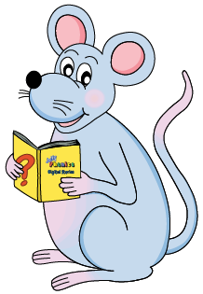
・Double consonants
puppet happen bitten rotten humming
・<ck> words
cracker rocket chicken cricket
・＜le＞words
candle saddle ramble ankle temple
pickle cackle buckle

Slide 4
・Double consonants
puppet happen bitten rotten humming
・<ck> words
cracker rocket chicken cricket
・＜le＞words
candle saddle ramble ankle temple
pickle cackle buckle

Slide 5
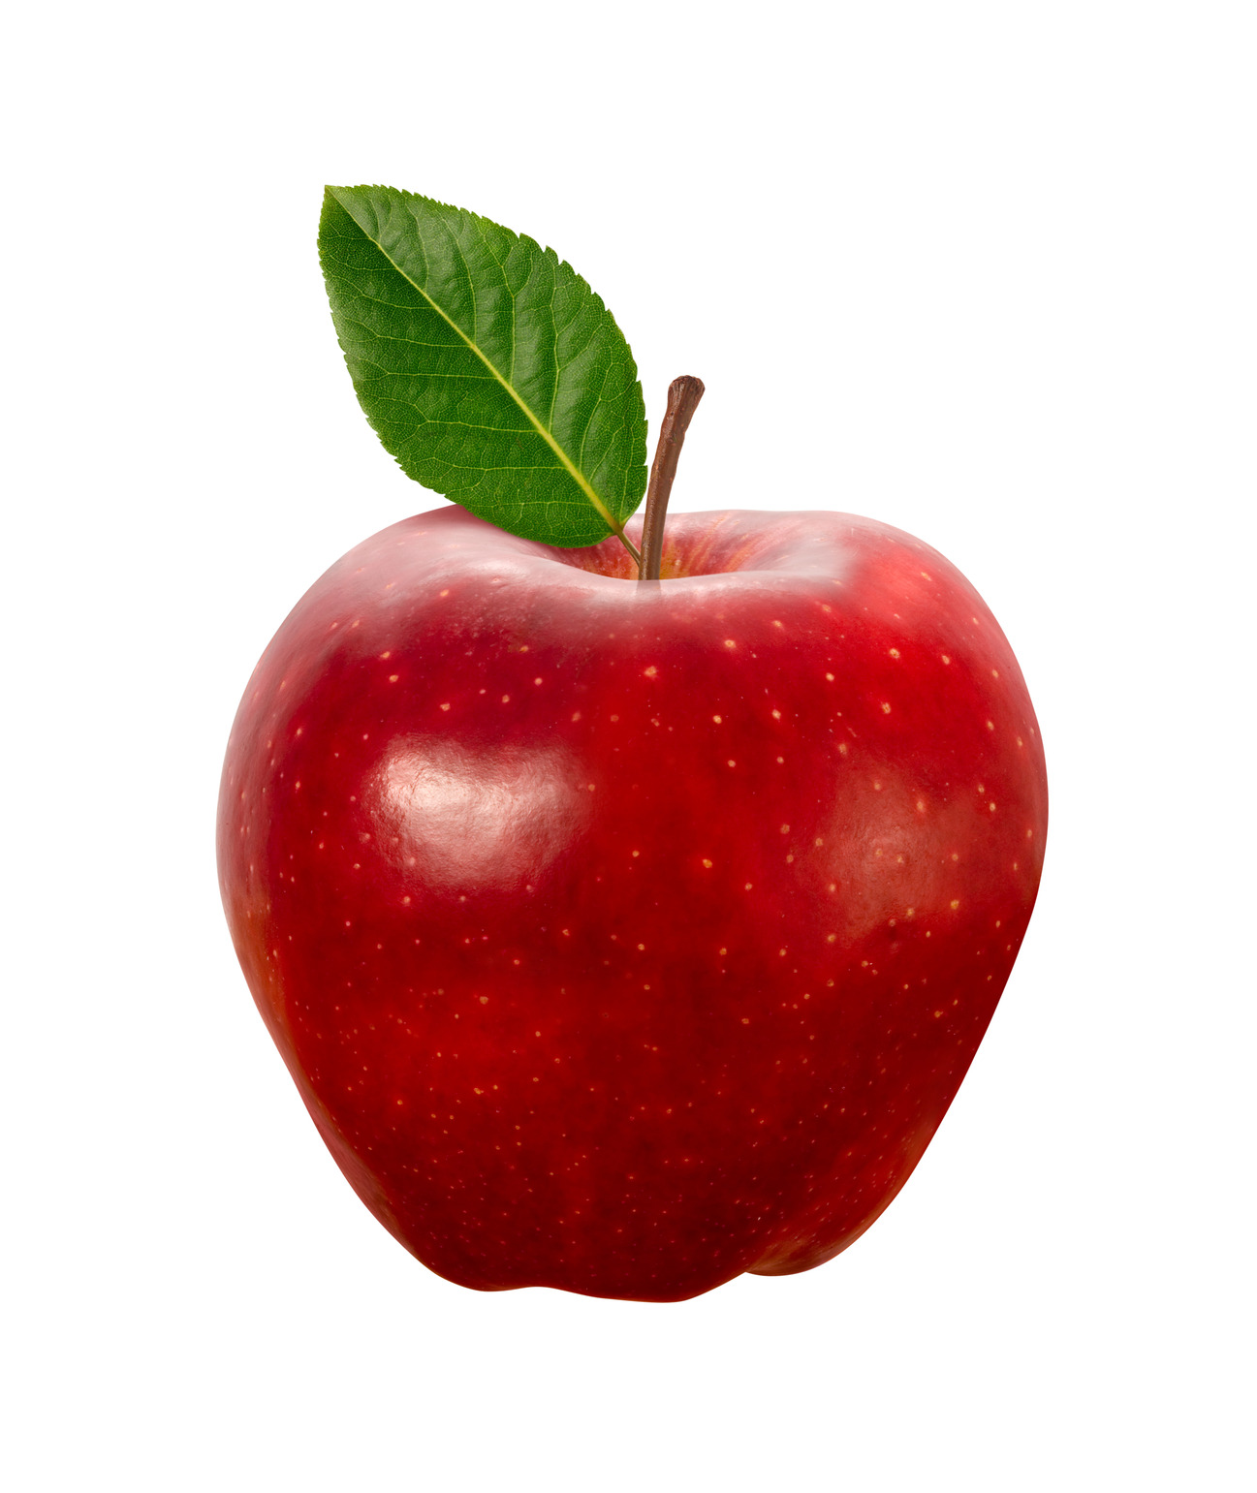
apple
/ool/

Slide 6
Spelling List
Spelling <le>

Slide 7
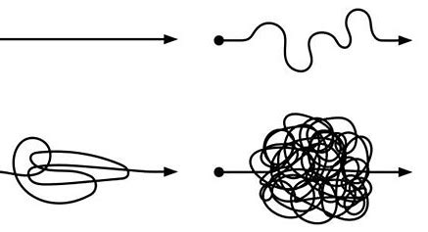
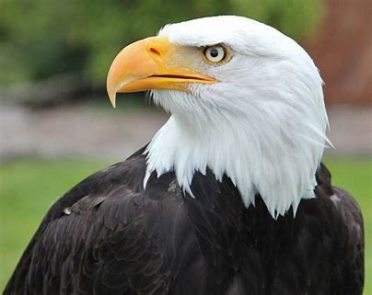
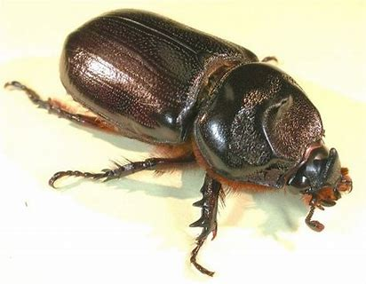
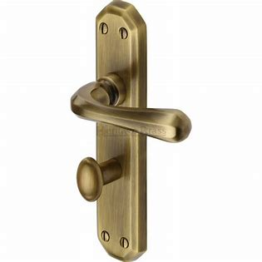
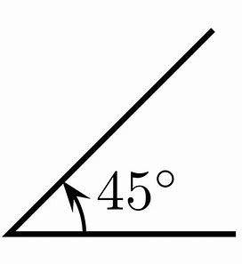
simple eagle beetle
handle puzzle angle

Slide 8
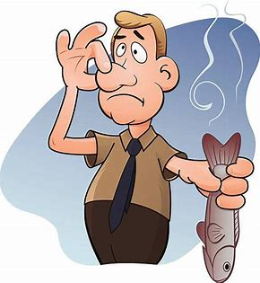
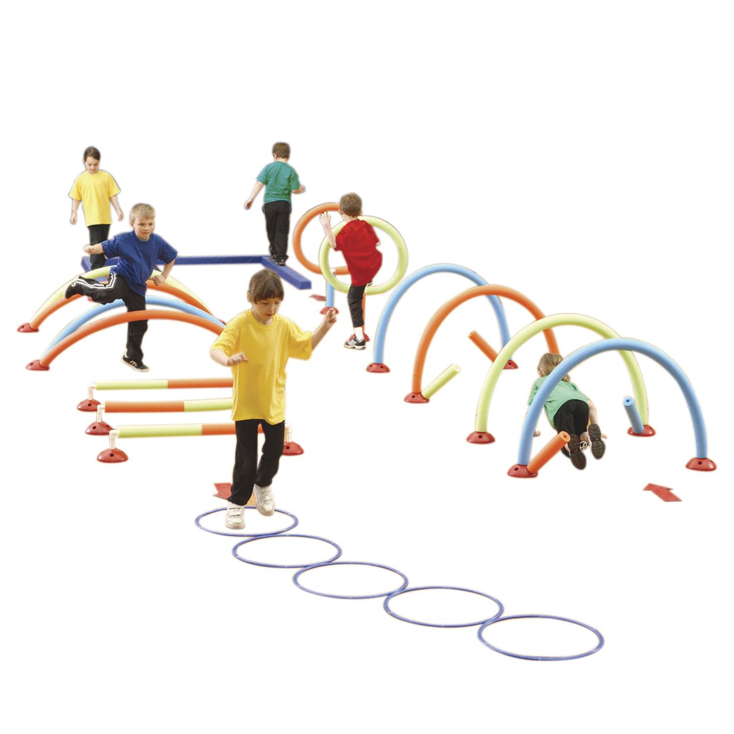
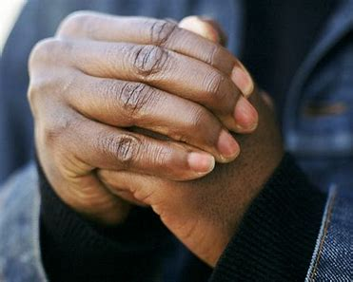
jungle horrible terrible
knuckle disable obstacle

Slide 9
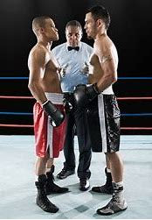
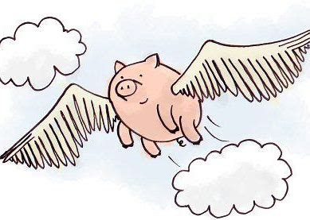
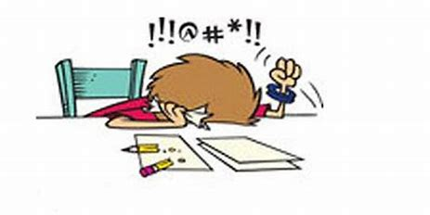
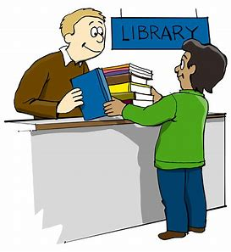
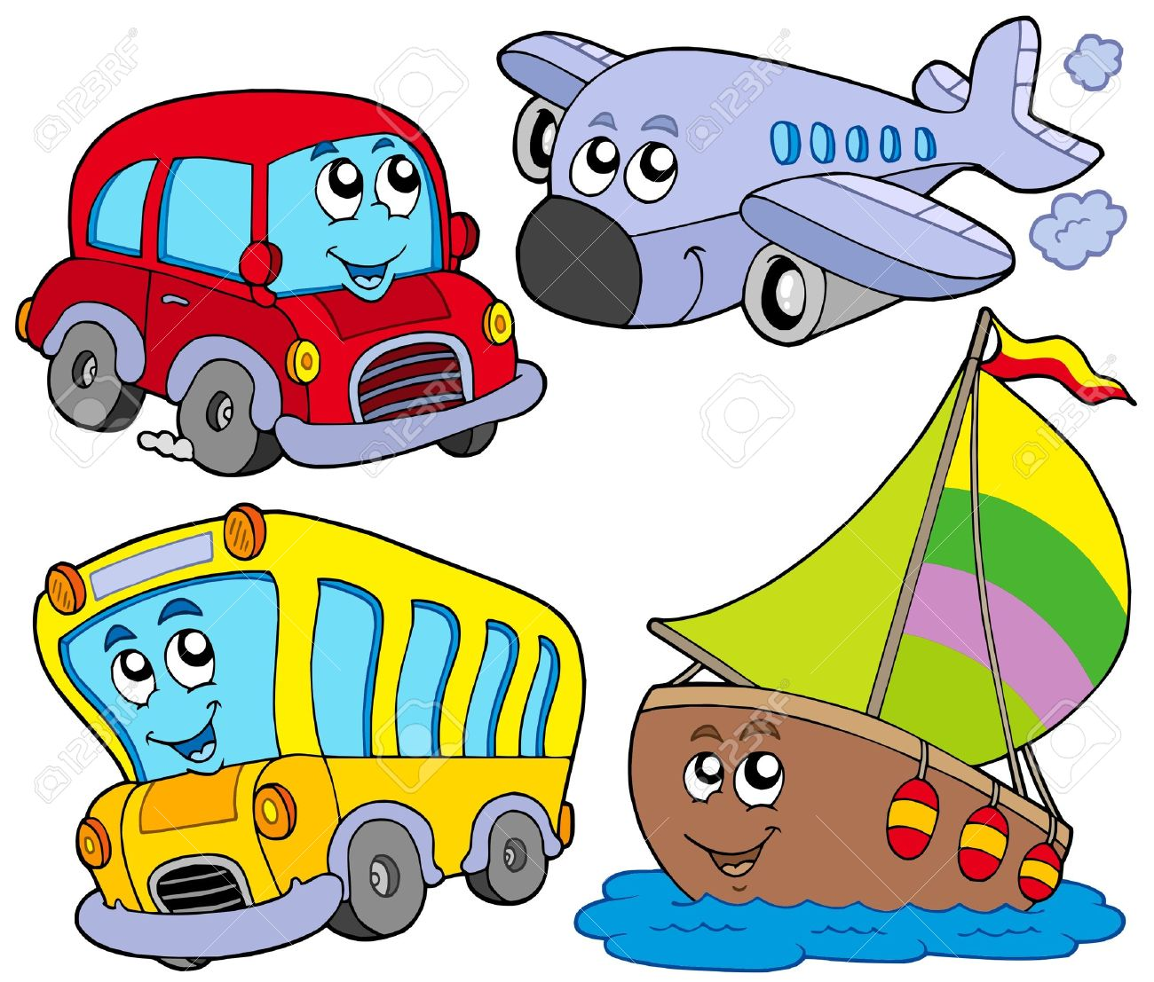
formidable improbable impossible
rectangle believable vehicle

Slide 10
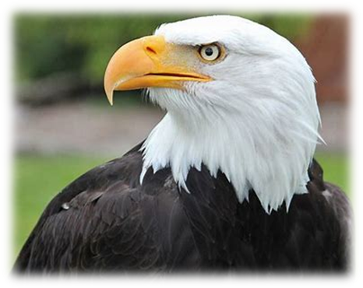
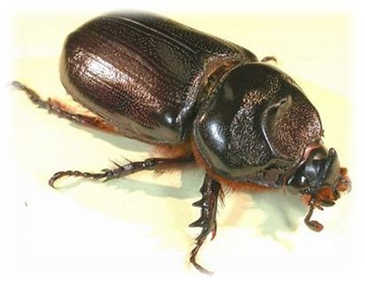
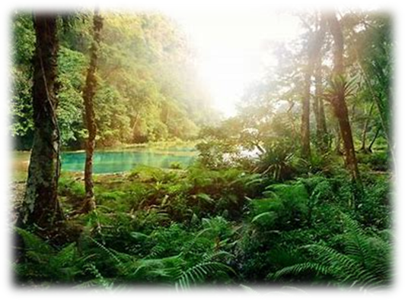
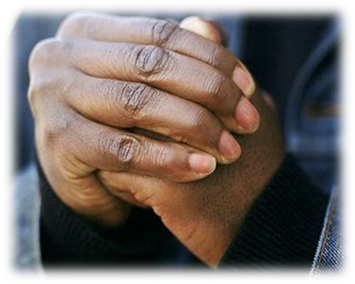
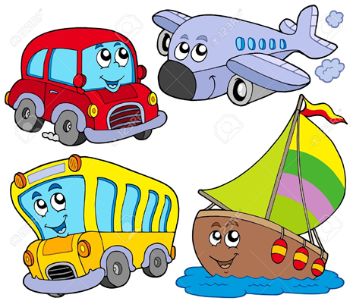
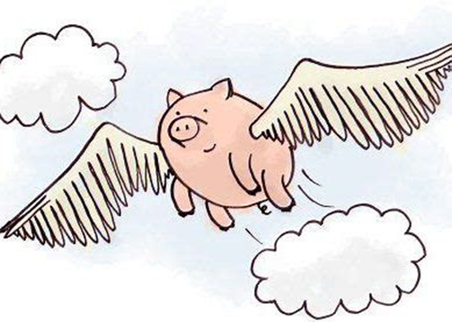

Slide 11
Let’s review
syllables.

Slide 12
eagle
tickle
handle
saddle
rectangle

Slide 13
Let’s parse
sentences.

Slide 14
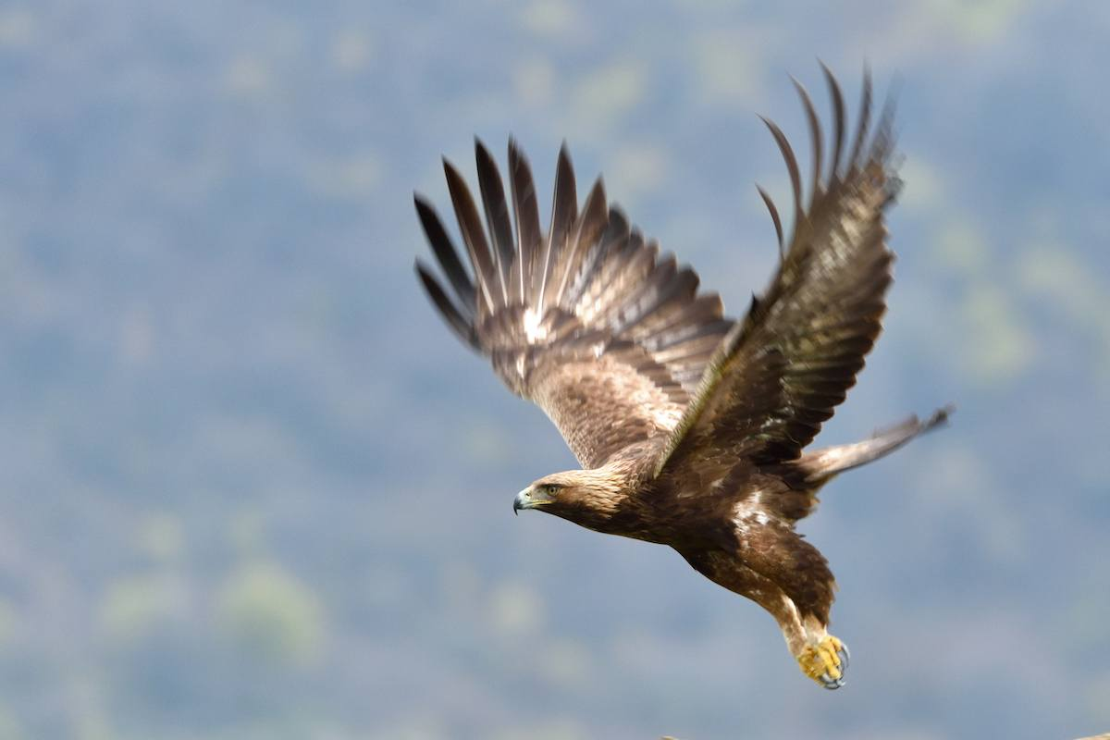
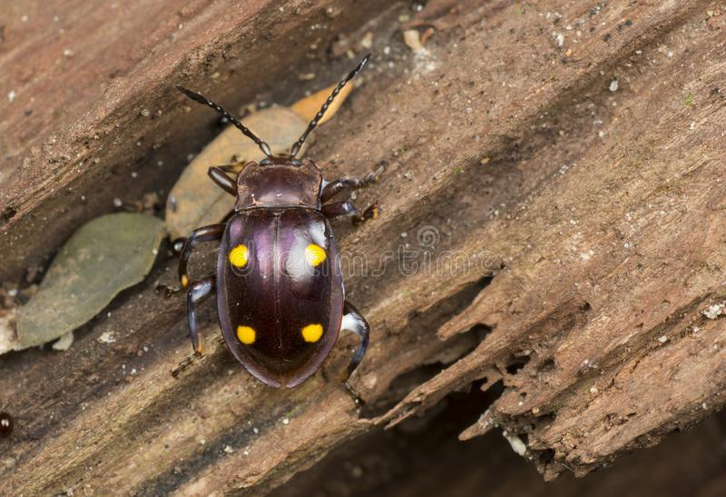
Parse these sentences.
The Scottish eagle floated
lazily on the breeze.
The tiny black beetle scuttle
quickly under the rotten log.

Slide 15
Parse these sentences.
The Scottish eagle floated
lazily on the breeze.
The tiny black beetle scuttle
quickly under the rotten log.

Slide 16
Parse these sentences.
The Scottish eagle floated
lazily on the breeze.
The tiny black beetle scuttle
quickly under the rotten log.

Slide 17
Parse these sentences.
The Scottish eagle floated
lazily on the breeze.
The tiny black beetle scuttle
quickly under the rotten log.

Slide 18
Parse these sentences.
The Scottish eagle floated
lazily on the breeze.
The tiny black beetle scuttle
quickly under the rotten log.

Slide 19
Parse these sentences.
The Scottish eagle floated
lazily on the breeze.
The tiny black beetle scuttle
quickly under the rotten log.

Slide 20
Parse these sentences.
The Scottish eagle floated
lazily on the breeze.
The tiny black beetle scuttle
quickly under the rotten log.

Slide 21
Parse these sentences.
The Scottish eagle floated
lazily on the breeze.
The tiny black beetle scuttle
quickly under the rotten log.

Slide 22
Parse these sentences.
The Scottish eagle floated
lazily on the breeze.
The tiny black beetle scuttle
quickly under the rotten log.

Slide 23
Parse these sentences.
The Scottish eagle floated
lazily on the breeze.
The tiny black beetle scuttle
quickly under the rotten log.

Slide 24
Parse these sentences.
The Scottish eagle floated
lazily on the breeze.
The tiny black beetle scuttle
quickly under the rotten log.

Slide 25
Parse these sentences.
The Scottish eagle floated
lazily on the breeze.
The tiny black beetle scuttle
quickly under the rotten log.

Slide 26
Parse these sentences.
The Scottish eagle floated
lazily on the breeze.
The tiny black beetle scuttle
quickly under the rotten log.

Slide 27
Parse these sentences.
The Scottish eagle floated
lazily on the breeze.
The tiny black beetle scuttle
quickly under the rotten log.

Slide 28
Parse these sentences.
The Scottish eagle floated
lazily on the breeze.
The tiny black beetle scuttle
quickly under the rotten log.

Slide 29
Dictation

Slide 30
Dictation
1.
2.
3.

Slide 31
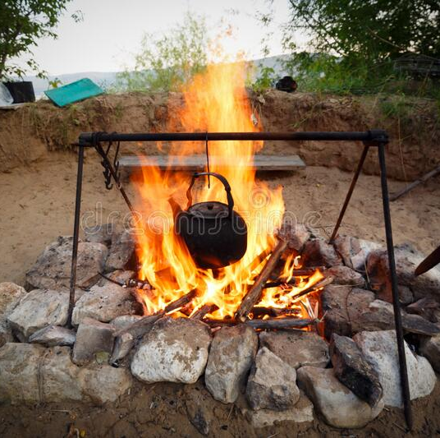

Slide 32
The kettle was boiling on the fire.

Slide 33
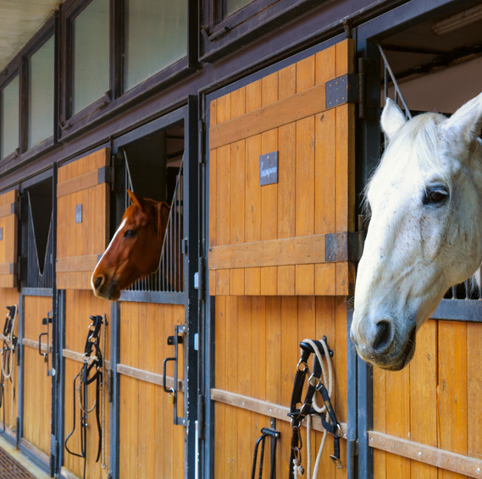

Slide 34
My uncle has a stable for his horse.

Slide 36
There was an apple in the middle of the table.

Slide 37
Thank you!

