Slide 1
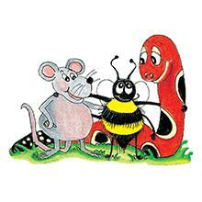
Jolly Grammar 3a-23

Slide 2
Let’s revise
Proper adjectives

Slide 3
Japan
Australia
Spain
Britain
America
Canada
France
China
India

Slide 4
Japan
Australia
Spain
Britain
America
Canada
France
China
India
Japanese
Australian
Spanish
British
American
Canadian
French
Chinese
Indian

Slide 5
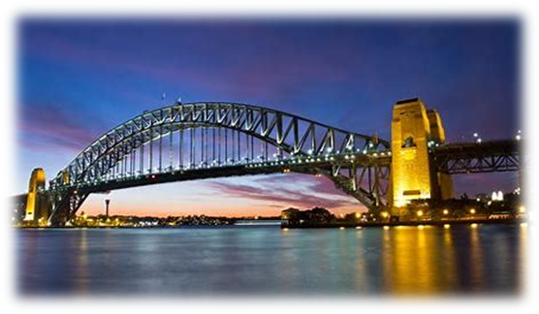
bridge
/j/

Slide 6
Spelling List
The <dge> Spelling of the /j/ Sound

Slide 7
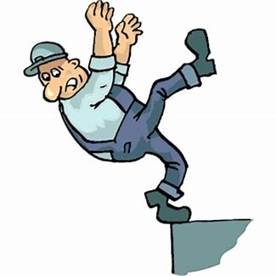
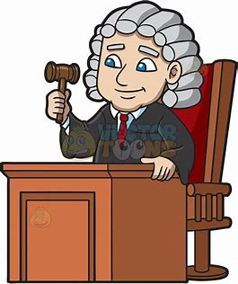
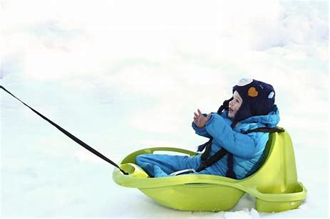
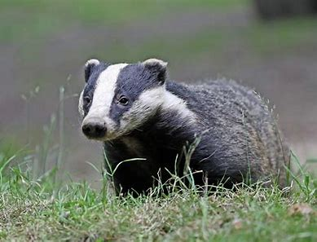
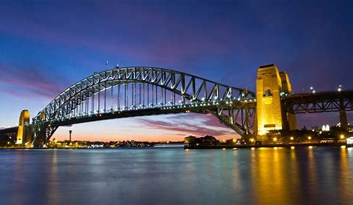
edge judge sledge
badge badger bridge

Slide 8
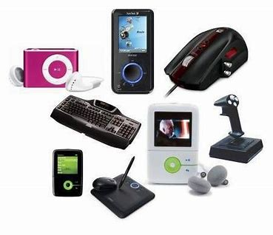
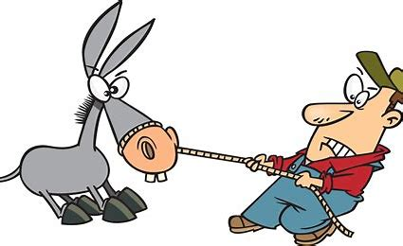
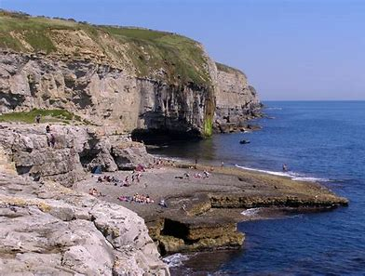
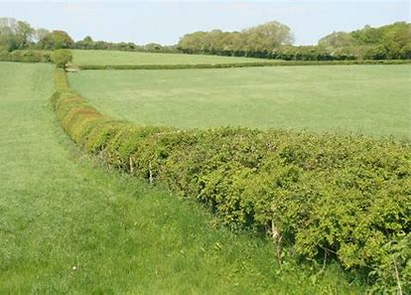
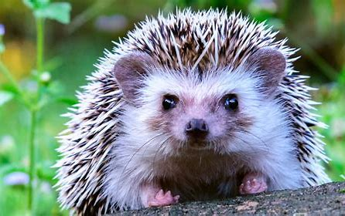
gadget budge fidget
ledge hedgerow hedgehog

Slide 9
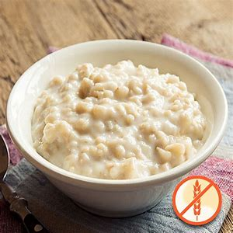
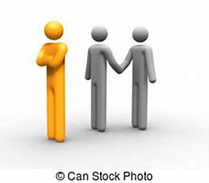
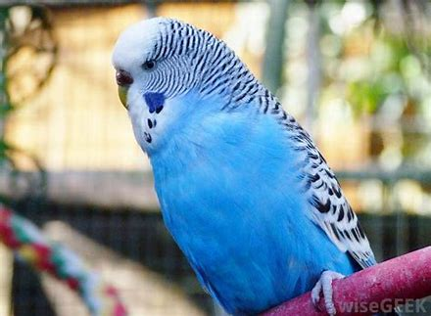
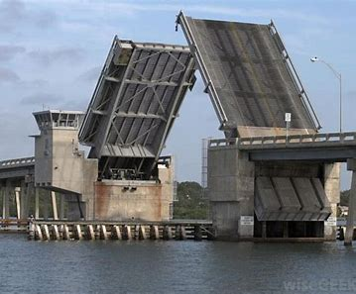
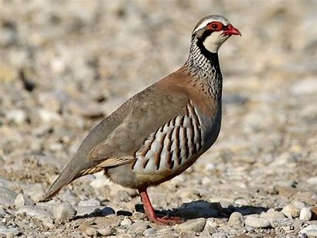
knowledge begrudge porridge
budgerigar drawbridge partridge

Slide 10
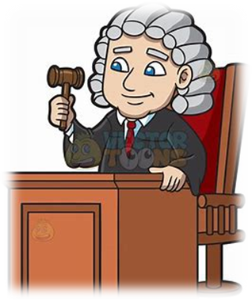
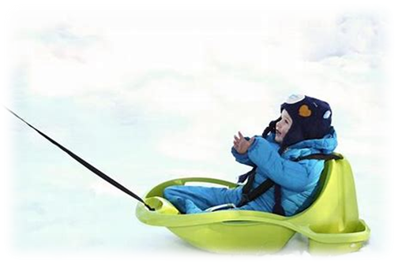
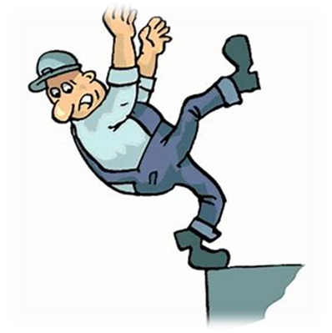
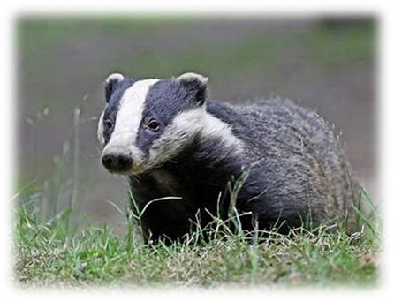
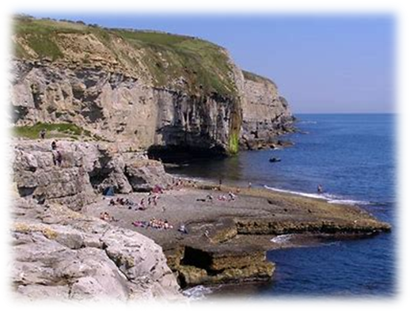
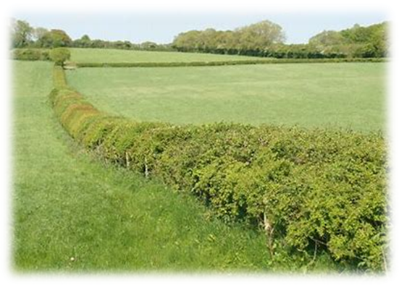
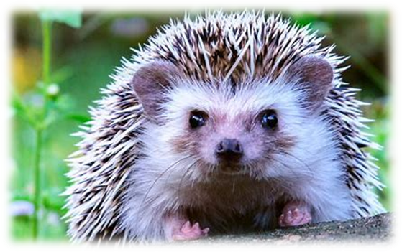
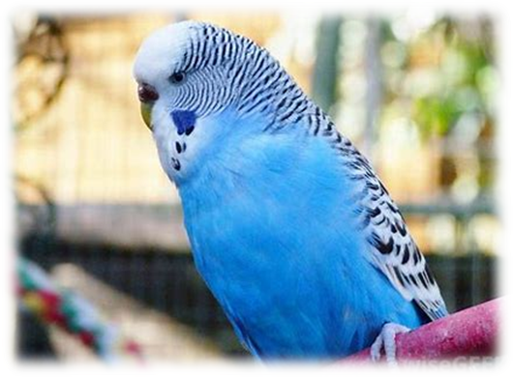
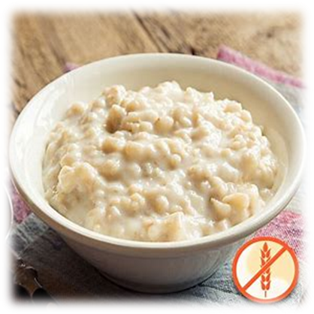
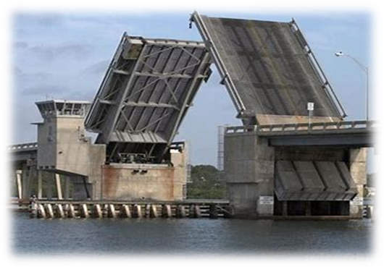
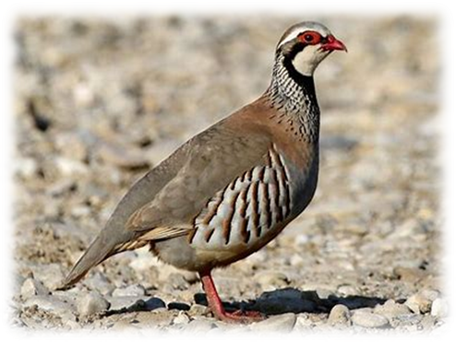

Slide 11
Add <dge>to complete each word and then draw a pictue.

Slide 12
bridge badge
sledge badger
budgerigar hedgehog

Slide 13
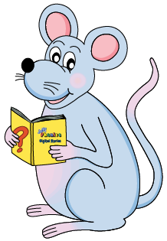
Let’s parse
sentences.

Slide 14
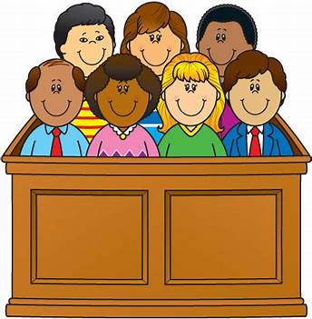
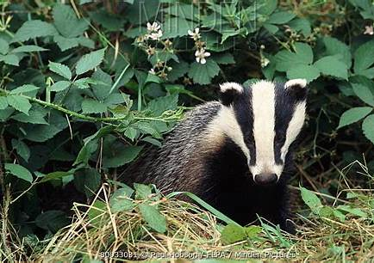
Parse these sentences.
We are waiting eagerly
for the judge.
The badger quickly disappeared
through the hedge.

Slide 15
Parse these sentences.
We are waiting eagerly
for the judge.
The badger quickly disappeared
through the hedge.

Slide 16
Parse these sentences.
We are waiting eagerly
for the judge.
The badger quickly disappeared
through the hedge.

Slide 17
Parse these sentences.
We are waiting eagerly
for the judge.
The badger quickly disappeared
through the hedge.

Slide 18
Parse these sentences.
We are waiting eagerly
for the judge.
The badger quickly disappeared
through the hedge.

Slide 19
Parse these sentences.
We are waiting eagerly
for the judge.
The badger quickly disappeared
through the hedge.

Slide 20
Parse these sentences.
We are waiting eagerly
for the judge.
The badger quickly disappeared
through the hedge.

Slide 21
Parse these sentences.
We are waiting eagerly
for the judge.
The badger quickly disappeared
through the hedge.

Slide 22
Parse these sentences.
We are waiting eagerly
for the judge.
The badger quickly disappeared
through the hedge.

Slide 23
Parse these sentences.
We are waiting eagerly
for the judge.
The badger quickly disappeared
through the hedge.

Slide 24
Parse these sentences.
We are waiting eagerly
for the judge.
The badger quickly disappeared
through the hedge.

Slide 25
Dictation

Slide 26
Dictation
1.
2.
3.

Slide 27
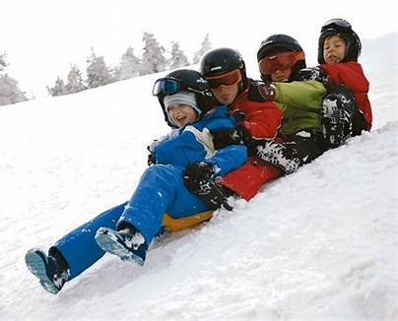

Slide 28
We had fun in the snow playing on our sledge.

Slide 29
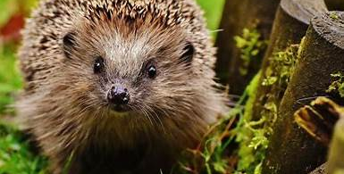
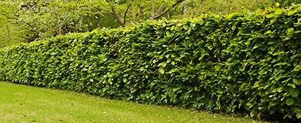

Slide 30
I saw a hedgehog hiding under the hedge.

Slide 31
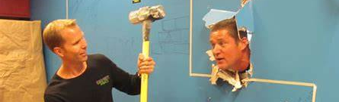

Slide 32
The sledgehammer was very big and heavy.

Slide 33
Thank you!

