Slide 1
Jolly Grammar 3a-22

Slide 2
Spelling Test 11

Slide 3
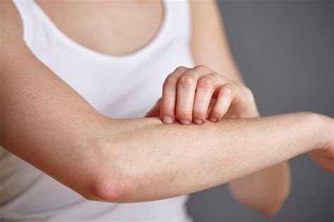
itch

Slide 4
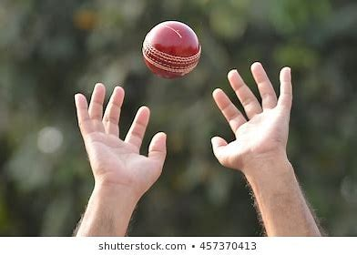
itch
catch

Slide 5
itch
catch
fetch

Slide 6
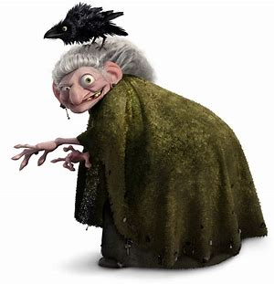
itch
catch
fetch
witch

Slide 7
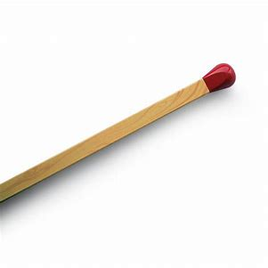
itch
catch
fetch
witch
match

Slide 8
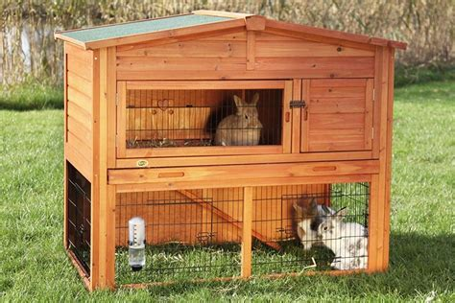
itch
catch
fetch
witch
match
hutch

Slide 9
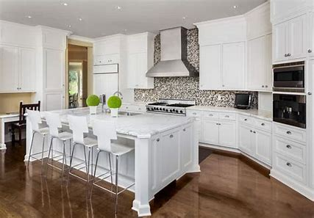
itch
catch
fetch
witch
match
hutch
7. kitchen

Slide 10
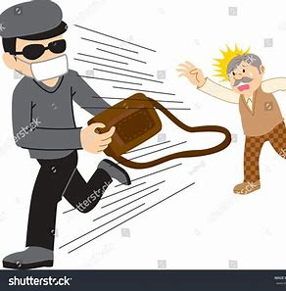
itch
catch
fetch
witch
match
hutch
7. kitchen
8. snatch

Slide 11
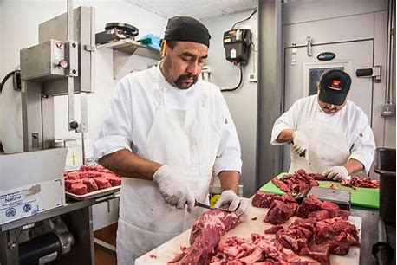
itch
catch
fetch
witch
match
hutch
7. kitchen
8. snatch
9. butcher

Slide 12
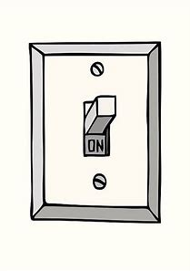
itch
catch
fetch
witch
match
hutch
7. kitchen
8. snatch
9. butcher
10. switch

Slide 13
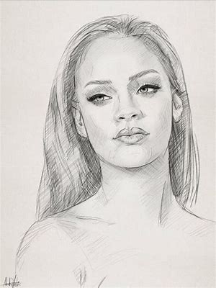
itch
catch
fetch
witch
match
hutch
7. kitchen
8. snatch
9. butcher
10. switch
11. sketch

Slide 14
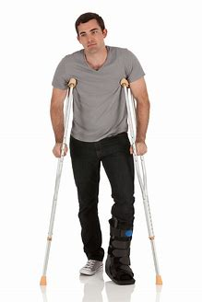
itch
catch
fetch
witch
match
hutch
7. kitchen
8. snatch
9. butcher
10. switch
11. sketch
12. crutches

Slide 15
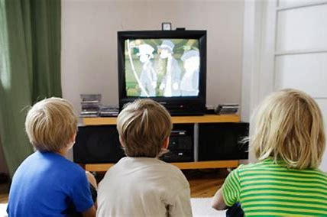
itch
catch
fetch
witch
match
hutch
7. kitchen
8. snatch
9. butcher
10. switch
11. sketch
12. crutches
13. watching

Slide 16
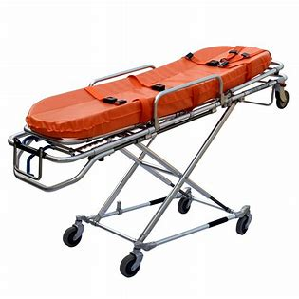
itch
catch
fetch
witch
match
hutch
7. kitchen
8. snatch
9. butcher
10. switch
11. sketch
12. crutches
13. watching
14. stretcher

Slide 17
itch
catch
fetch
witch
match
hutch
7. kitchen
8. snatch
9. butcher
10. switch
11. sketch
12. crutches
13. watching
14. stretcher
15. ketchup

Slide 18
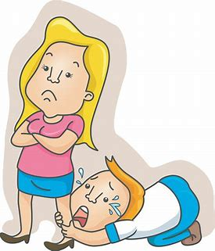
itch
catch
fetch
witch
match
hutch
7. kitchen
8. snatch
9. butcher
10. switch
11. sketch
12. crutches
13. watching
14. stretcher
15. ketchup
16. wretched

Slide 19
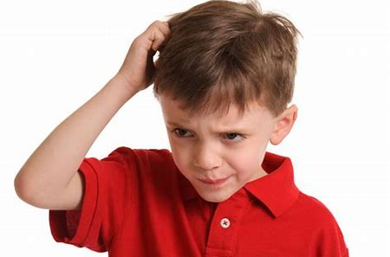
itch
catch
fetch
witch
match
hutch
7. kitchen
8. snatch
9. butcher
10. switch
11. sketch
12. crutches
13. watching
14. stretcher
15. ketchup
16. wretched
17. scratching

Slide 20
itch
catch
fetch
witch
match
hutch
7. kitchen
8. snatch
9. butcher
10. switch
11. sketch
12. crutches
13. watching
14. stretcher
15. ketchup
16. wretched
17. scratching
18. stretching

Slide 21
Let’s review
Proper Nouns
& Adjectives.

Slide 23
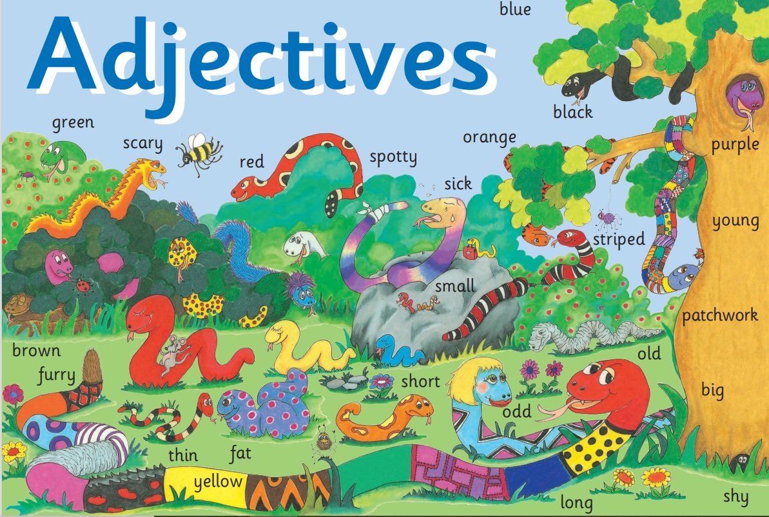

Slide 24
Activity Page:
Proper Adjectives

Slide 25
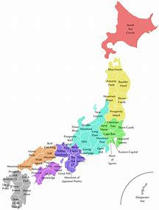

Slide 26
Japan

Slide 27
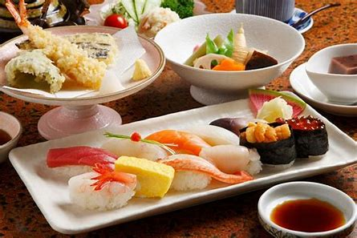
Japan

Slide 28
Japan
food

Slide 29
Japan
food
Japanese food

Slide 30
Japan
Australia
Spain
Britain
America
Canada
France
China
India

Slide 31
Japan
Australia
Spain
Britain
America
Canada
France
China
India
Japanese

Slide 32
Japan
Australia
Spain
Britain
America
Canada
France
China
India
Japanese
Australian

Slide 33
Japan
Australia
Spain
Britain
America
Canada
France
China
India
Japanese
Australian
Spanish

Slide 34
Japan
Australia
Spain
Britain
America
Canada
France
China
India
Japanese
Australian
Spanish
British

Slide 35
Japan
Australia
Spain
Britain
America
Canada
France
China
India
Japanese
Australian
Spanish
British
American

Slide 36
Japan
Australia
Spain
Britain
America
Canada
France
China
India
Japanese
Australian
Spanish
British
American
Canadian

Slide 37
Japan
Australia
Spain
Britain
America
Canada
France
China
India
Japanese
Australian
Spanish
British
American
Canadian
French

Slide 38
Japan
Australia
Spain
Britain
America
Canada
France
China
India
Japanese
Australian
Spanish
British
American
Canadian
French
Chinese

Slide 39
Japan
Australia
Spain
Britain
America
Canada
France
China
India
Japanese
Australian
Spanish
British
American
Canadian
French
Chinese
Indian

Slide 40
Thailand
Korea
Peru
Egypt
South Africa
Wales
Great Britain
Sweden
Nigeria
Japan
Australia
Spain
Britain
America
Canada
France
China
India
Thai
Korean
Peruvian
Egyptian
South African
Welsh
British
Swedish
Nigerian
Japanese
Australian
Spanish
British
American
Canadian
French
Chinese
Indian

Slide 41
Thank you!
See you!

