Slide 1
Jolly Grammar 3a-20

Slide 2
Spelling Test 9

Slide 3
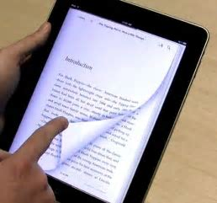
page

Slide 4
page
margin

Slide 5
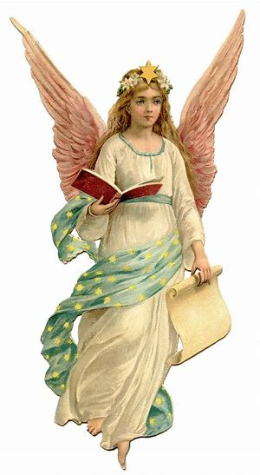
page
margin
angel

Slide 6
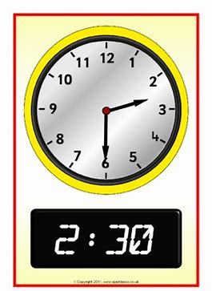
page
margin
angel
digital

Slide 7
page
margin
angel
digital
germ

Slide 8
page
margin
angel
digital
germ
stage

Slide 9
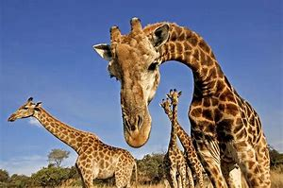
page
margin
angel
digital
germ
stage
7. giraffe

Slide 10
page
margin
angel
digital
germ
stage
7. giraffe
8. engine

Slide 11
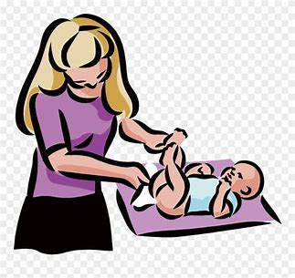
page
margin
angel
digital
germ
stage
7. giraffe
8. engine
9. change

Slide 12
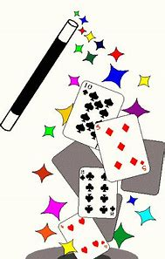
page
margin
angel
digital
germ
stage
7. giraffe
8. engine
9. change
10. magical

Slide 13
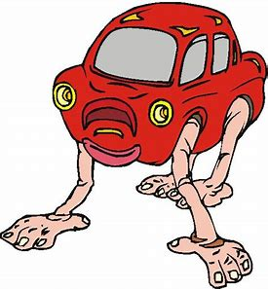
page
margin
angel
digital
germ
stage
7. giraffe
8. engine
9. change
10. magical
11. strange

Slide 14
page
margin
angel
digital
germ
stage
7. giraffe
8. engine
9. change
10. magical
11. strange
12. energy

Slide 15
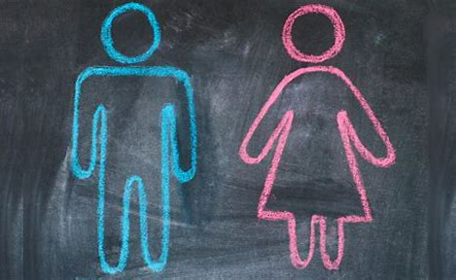
page
margin
angel
digital
germ
stage
7. giraffe
8. engine
9. change
10. magical
11. strange
12. energy
13. gender

Slide 16
page
margin
angel
digital
germ
stage
7. giraffe
8. engine
9. change
10. magical
11. strange
12. energy
13. gender
14. genetic

Slide 17
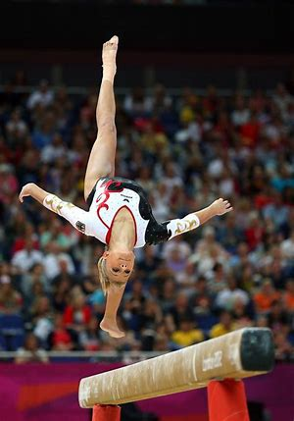
page
margin
angel
digital
germ
stage
7. giraffe
8. engine
9. change
10. magical
11. strange
12. energy
13. gender
14. genetic
15. gymnastics

Slide 18
page
margin
angel
digital
germ
stage
7. giraffe
8. engine
9. change
10. magical
11. strange
12. energy
13. gender
14. genetic
15. gymnastics
16. emergency

Slide 19
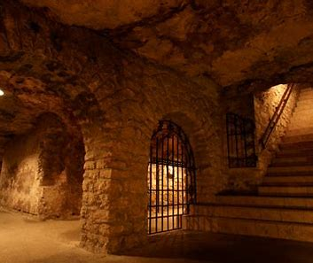
page
margin
angel
digital
germ
stage
7. giraffe
8. engine
9. change
10. magical
11. strange
12. energy
13. gender
14. genetic
15. gymnastics
16. emergency
17. dungeon

Slide 20
page
margin
angel
digital
germ
stage
7. giraffe
8. engine
9. change
10. magical
11. strange
12. energy
13. gender
14. genetic
15. gymnastics
16. emergency
17. dungeon
18. urgency

Slide 21
Let’s review
Proper Nouns.

Slide 22
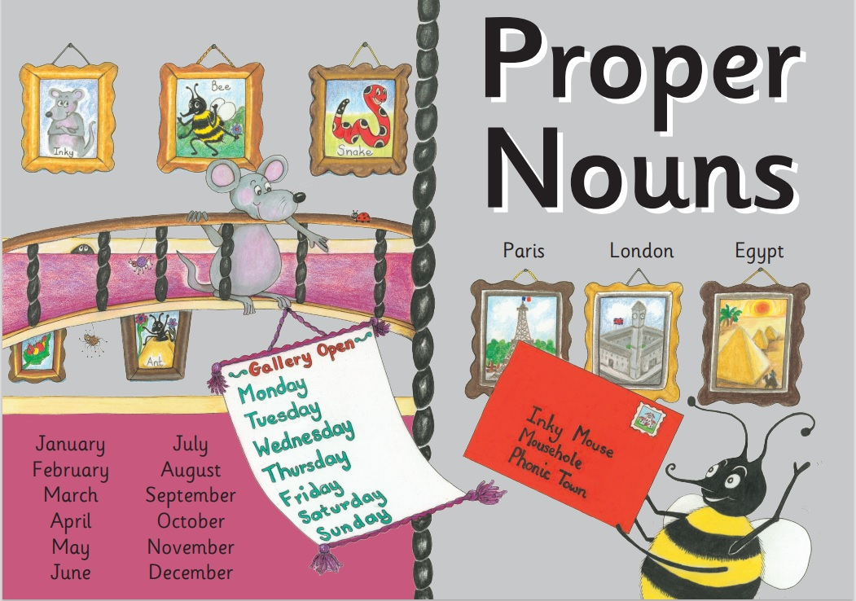

Slide 23
Activity Page:
Places as Proper Nouns

Slide 24
Mt. Fuji
Tokyo Disney Land
Tokyo Sky Tree
Japan China America France Russia
UAE Canada Egypt Netherland Australia England

Slide 25
Tokyo
Universal Studio Japan
Tokyo Disney Sea
Tokyo Tower
Tokyo Disney Land
Itozu Zoo
Kokura Castle
Haikaratto Yokocho
Hokkaido
Kyushu Fukuoka Kumamoto

Slide 26
Japan Dazaifu Shrine
Kosuke’s house Disney Land
Sun Live Universal Studio Japan
Itozu Zoo Osaka
Mr. Max Yamada Denki
Costco AEON
Ikea
Kokura Castle
Nishimoji Elementary School

Slide 27
China Kenya America Italy Greece
Ice land Ireland Netherland France
Japan India Chile Singapore Iran
Canada Kazakhstan Nigeria Czech
Malaysia Korea Mongolia Argentina
Russia Australia Greenland Brazil Spain Mexico Afghanistan

Slide 28
India Russia Japan China Czech Republic
Australia Mongolia Ukraine Thailand
Afghanistan Yemen Egypt North Korea
Penang Green Land

Slide 29
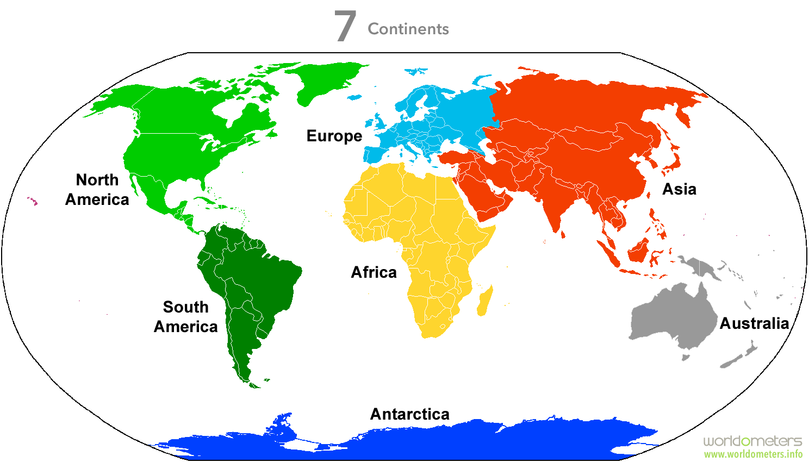

Slide 30
Dear Aunty Pam and Uncle Horace,
We are having a lovely time on holiday in
Summershire. We have visited the beautiful
village of Sheldown and the town of Brington.
Yesterday we went to the Happywood Hills
Home for Horses. Dan sponsored a donkey
called Merry.
Lots of love from,
Suzie, Will, Dan and Ruby
Mr and Mrs H Smith,
8 Hill Road,
Frickleton,
Suffolk,
England, Europe, Earth

Slide 31
Thank you!

