Slide 1
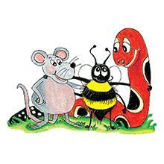
Jolly Grammar 3a-19

Slide 2
Let’s review
Past continuous.

Slide 3
Join each sentence to the correct tense.
They play in the park.
They played in the park.
They are playing in the park.
They were playing in the park.

Slide 4
Join each sentence to the correct tense.
They play in the park.
They played in the park.
They are playing in the park.
They were playing in the park.
Simple present

Slide 5
Join each sentence to the correct tense.
They play in the park.
They played in the park.
They are playing in the park.
They were playing in the park.
Simple present
Simple past

Slide 6
Join each sentence to the correct tense.
They play in the park.
They played in the park.
They are playing in the park.
They were playing in the park.
Simple present
Simple past
Present continuous

Slide 7
Join each sentence to the correct tense.
They play in the park.
They played in the park.
They are playing in the park.
They were playing in the park.
Simple present
Simple past
Present continuous
Past continuous

Slide 8
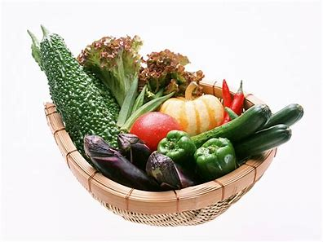
vegetables
soft /g/

Slide 9
Spelling List
Soft <g>

Slide 10
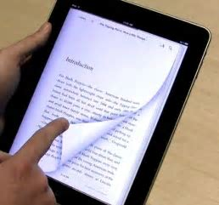
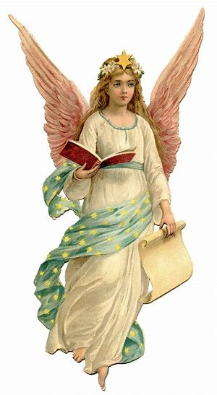
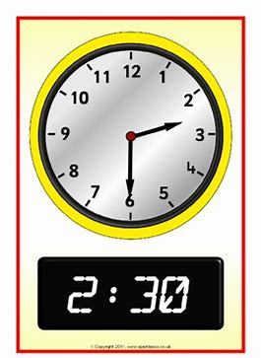
page margin angel
digital germ stage

Slide 11
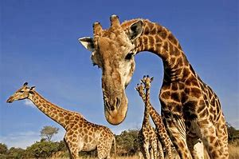
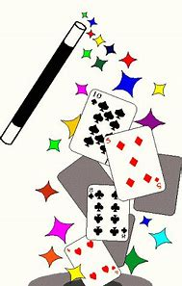
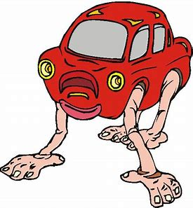
giraffe engine change
magical strange energy

Slide 12
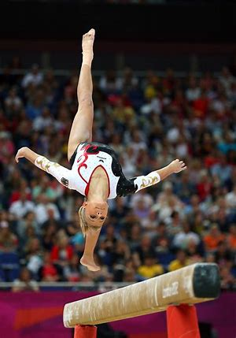
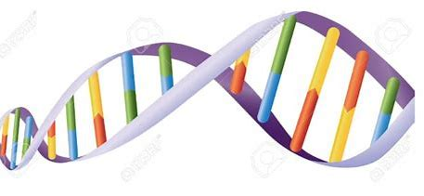
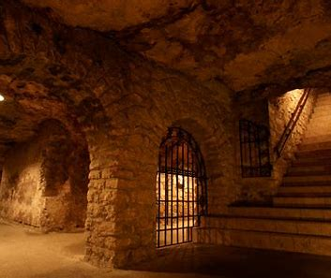
gender genetic gymnastics
emergency dungeon urgency

Slide 13
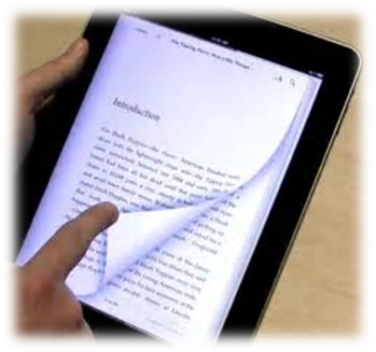
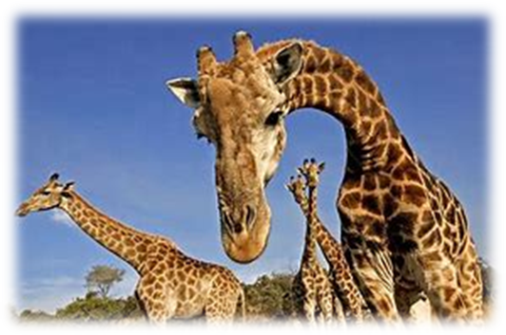
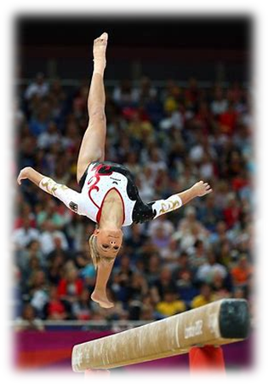
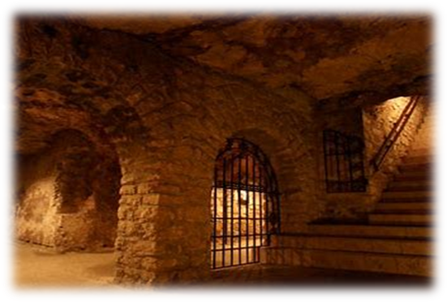

Slide 14
Fill in the missing letters.

Slide 15
margin gender
angel giraffe
magic dungeon
stranger page
urgent stage
magical energy
genetic stage
gymnastics

Slide 16
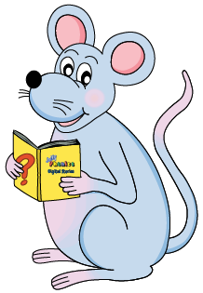
Let’s split these words into syllables.

Slide 17
margin
stage
page
gender
urgency

Slide 18
margin
stage
page
gender
urgency

Slide 19
margin
stage
page
gender
urgency

Slide 20
margin
stage
page
gender
urgency

Slide 21
Let’s parse
sentences.

Slide 22
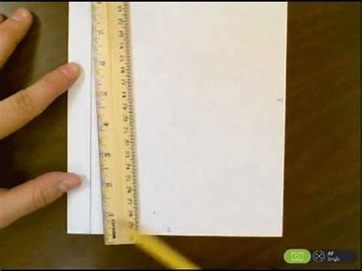
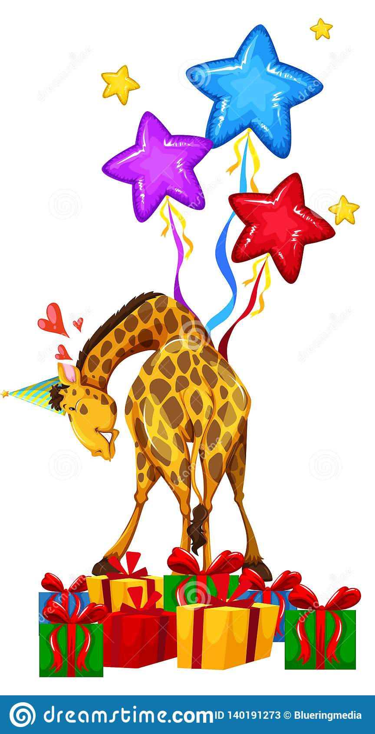
Parse these sentences.
I neatly drew a margin
on the next page .
The giant giraffe danced
energetically at the magical party.

Slide 23
Parse these sentences.
I neatly drew a margin
on the next page .
The giant giraffe danced
energetically at the magical party.

Slide 24
Parse these sentences.
I neatly drew a margin
on the next page .
The giant giraffe danced
energetically at the magical party.

Slide 25
Parse these sentences.
I neatly drew a margin
on the next page .
The giant giraffe danced
energetically at the magical party.

Slide 26
Parse these sentences.
I neatly drew a margin
on the next page .
The giant giraffe danced
energetically at the magical party.

Slide 27
Parse these sentences.
I neatly drew a margin
on the next page .
The giant giraffe danced
energetically at the magical party.

Slide 28
Parse these sentences.
I neatly drew a margin
on the next page .
The giant giraffe danced
energetically at the magical party.

Slide 29
Parse these sentences.
I neatly drew a margin
on the next page .
The giant giraffe danced
energetically at the magical party.

Slide 30
Parse these sentences.
I neatly drew a margin
on the next page .
The giant giraffe danced
energetically at the magical party.

Slide 31
Parse these sentences.
I neatly drew a margin
on the next page .
The giant giraffe danced
energetically at the magical party.

Slide 32
Parse these sentences.
I neatly drew a margin
on the next page .
The giant giraffe danced
energetically at the magical party.

Slide 33
Parse these sentences.
I neatly drew a margin
on the next page .
The giant giraffe danced
energetically at the magical party.

Slide 34
Parse these sentences.
I neatly drew a margin
on the next page .
The giant giraffe danced
energetically at the magical party.

Slide 35
Parse these sentences.
I neatly drew a margin
on the next page .
The giant giraffe danced
energetically at the magical party.

Slide 36
Parse these sentences.
I neatly drew a margin
on the next page .
The giant giraffe danced
energetically at the magical party.

Slide 37
Dictation

Slide 38
Dictation
1.
2.
3.

Slide 39
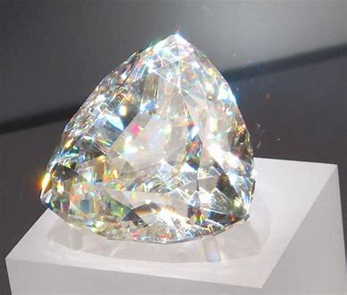

Slide 40
The large gem was a logical choice.

Slide 41
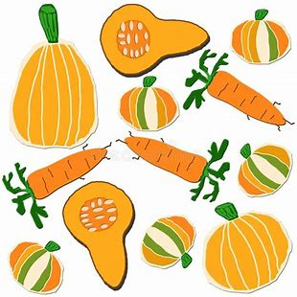

Slide 42
There was a page on giant orange vegetables.

Slide 44
It was urgent they were told of the danger.

Slide 45
Thank you!

