Slide 1
Jolly Grammar 3a-12

Slide 2
Mini Test 5

Slide 3
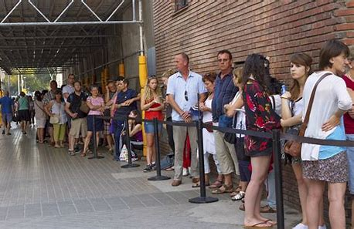
cue

Slide 4
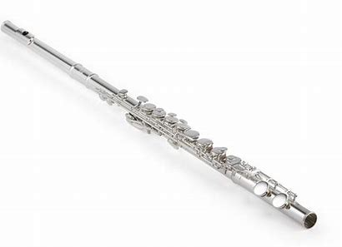
cue
flute

Slide 5
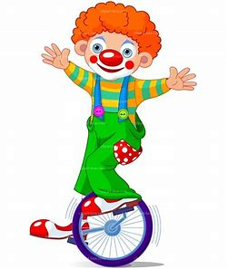
cue
flute
amuse

Slide 6
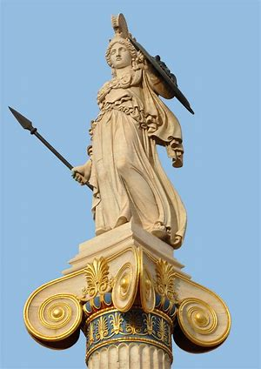
cue
flute
amuse
statue

Slide 7
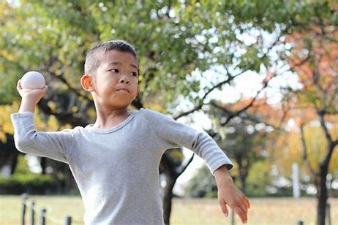
cue
flute
amuse
statue
threw

Slide 8
cue
flute
amuse
statue
threw
fewer

Slide 9
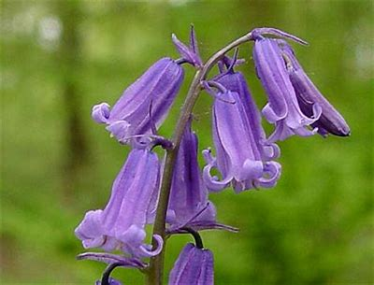
cue
flute
amuse
statue
threw
fewer
7. bluebell

Slide 10
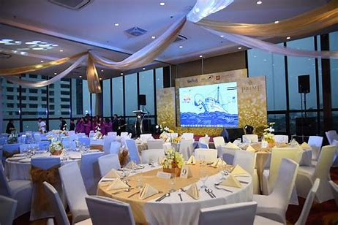
cue
flute
amuse
statue
threw
fewer
7. bluebell
8. venue

Slide 11
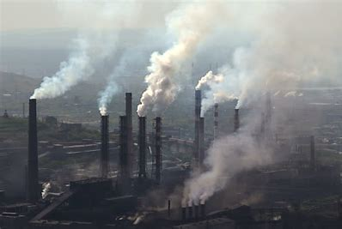
cue
flute
amuse
statue
threw
fewer
7. bluebell
8. venue
9. pollute

Slide 12
cue
flute
amuse
statue
threw
fewer
7. bluebell
8. venue
9. pollute
10. volume

Slide 13
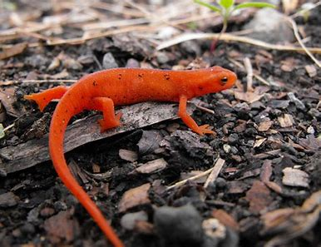
cue
flute
amuse
statue
threw
fewer
7. bluebell
8. venue
9. pollute
10. volume
11. newt

Slide 14
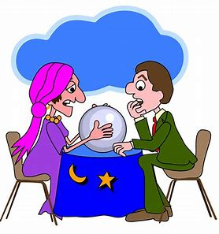
cue
flute
amuse
statue
threw
fewer
7. bluebell
8. venue
9. pollute
10. volume
11. newt
12. fortune

Slide 15
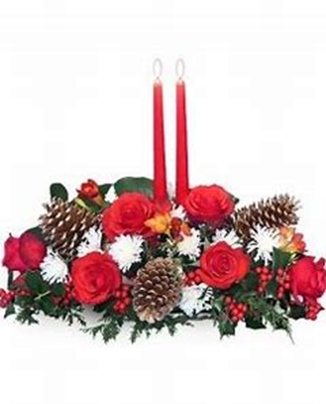
cue
flute
amuse
statue
threw
fewer
7. bluebell
8. venue
9. pollute
10. volume
11. newt
12. fortune
13. Yuletide

Slide 16
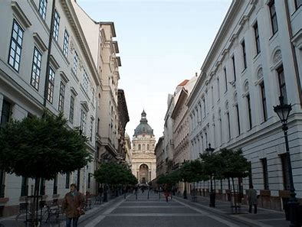
cue
flute
amuse
statue
threw
fewer
7. bluebell
8. venue
9. pollute
10. volume
11. newt
12. fortune
13. Yuletide
14. avenue

Slide 17
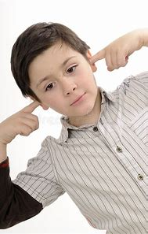
cue
flute
amuse
statue
threw
fewer
7. bluebell
8. venue
9. pollute
10. volume
11. newt
12. fortune
13. Yuletide
14. avenue
15. attitude

Slide 18
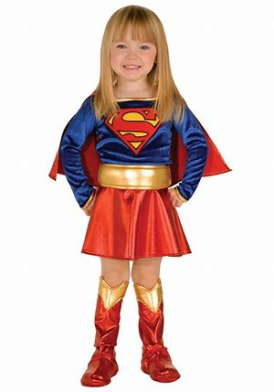
cue
flute
amuse
statue
threw
fewer
7. bluebell
8. venue
9. pollute
10. volume
11. newt
12. fortune
13. Yuletide
14. avenue
15. attitude
16. costume

Slide 19
cue
flute
amuse
statue
threw
fewer
7. bluebell
8. venue
9. pollute
10. volume
11. newt
12. fortune
13. Yuletide
14. avenue
15. attitude
16. costume
17. absolute

Slide 20
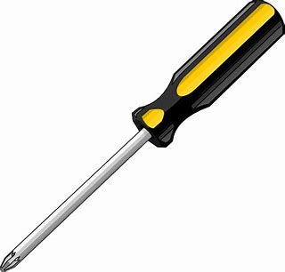
cue
flute
amuse
statue
threw
fewer
7. bluebell
8. venue
9. pollute
10. volume
11. newt
12. fortune
13. Yuletide
14. avenue
15. attitude
16. costume
17. absolute
18. screwdriver

Slide 21
Let’s review
Compound Words.

Slide 22
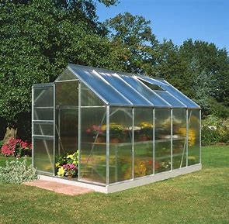
greenhouse

Slide 23
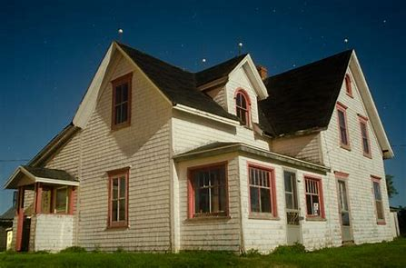
green house
＋

Slide 24
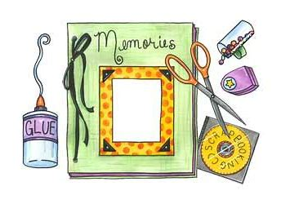
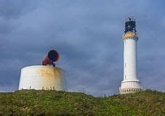
green house
oil can
with out
land mark
fog horn
scrap book
rain drop
milk man
snow ball
foot step

Slide 25
green house
unkind

Slide 26
green house
un kind

Slide 27
green house
un kind
wish ing
thank ful

Slide 28
green house
un kind
wish ing
thank ful
dis ag ree

Slide 29
green house
ran
un kind
wish ing
thank ful
dis ag ree

Slide 30
Activity Page:
Syllables

Slide 31
bluebell farmyard playtime hairbrush
jigsaw weekend breakfast seaweed
unkind dislike thankful disagree
unless undo prefix slowly

Slide 32
bluebell farmyard playtime hairbrush
jigsaw weekend breakfast seaweed
unkind dislike thankful disagree
unless undo prefix slowly

Slide 33
man leek footstep badly skip
goalkeeper hopeful lighthouse
hop clockwise rain teacher
clap earthworm play toilet
swim sleeveless boat uneventful run
unimportant yesterday handkerchief

Slide 34
man leek footstep badly skip
goalkeeper hopeful lighthouse
hop clockwise rain teacher
clap earthworm play toilet
swim sleeveless boat uneventful run
unimportant yesterday handkerchief

Slide 35
Thank you!

