Slide 1
Jolly Grammar 3a-11

Slide 2
Write a sentence of your own, using the verb to be.
I am tall.
My mother is kind.
We are good friends.

Slide 3
Spelling List <ue><ew><u-e>

Slide 4
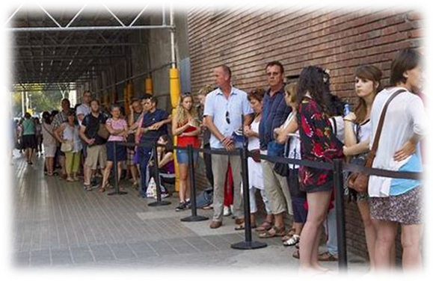
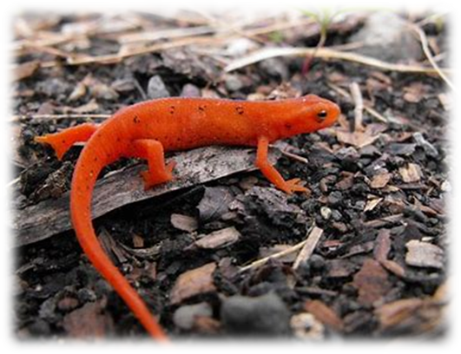
cue
/ue/
newt
/ue/
costume
/ue/

Slide 5
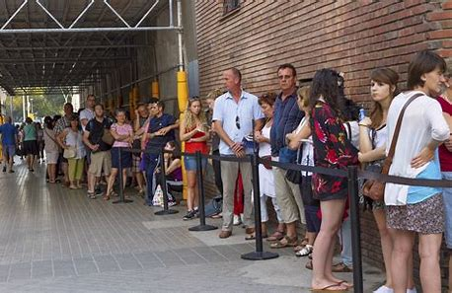
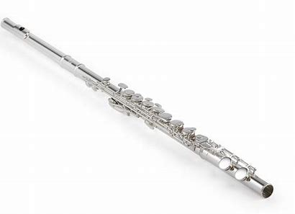
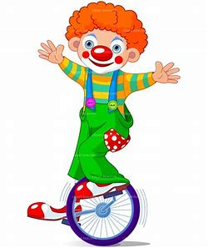
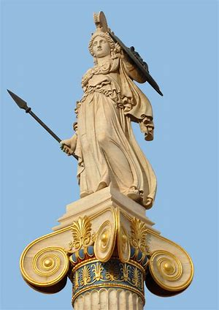
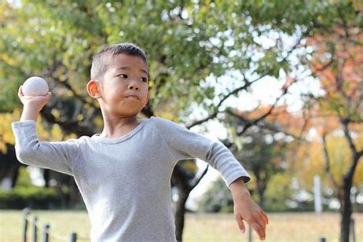
cue flute amuse
statue threw fewer

Slide 6
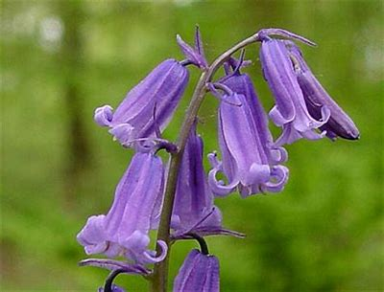
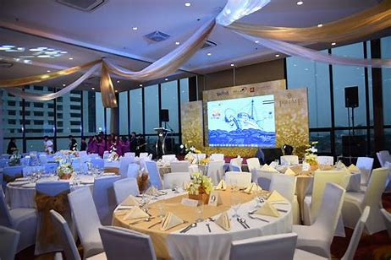
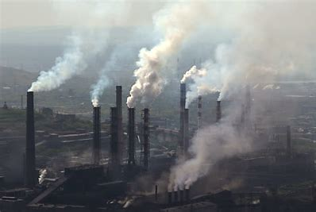
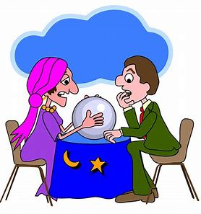
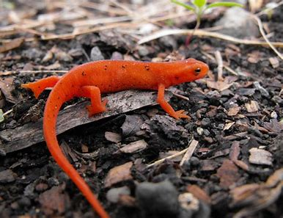
bluebell venue pollute
volume newt fortune

Slide 7
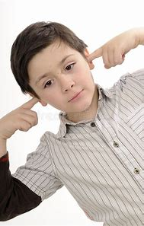
Yuletide avenue attitude
costume absolute screwdriver

Slide 8
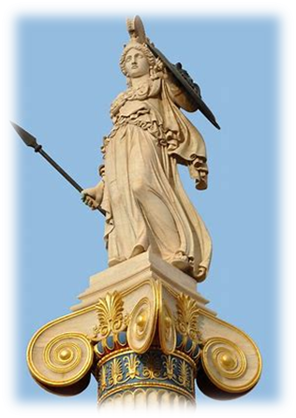
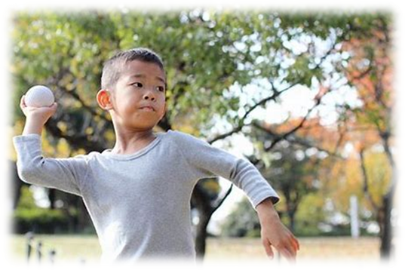
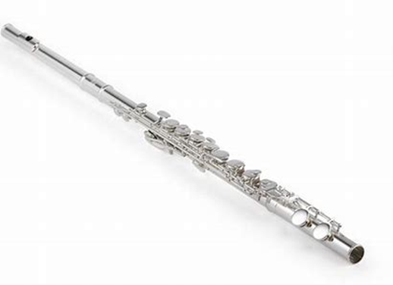
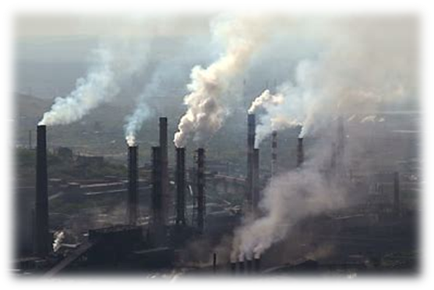
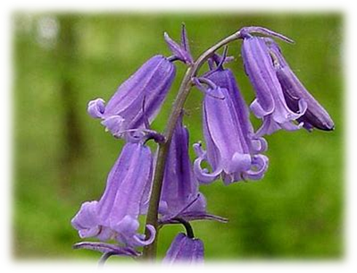
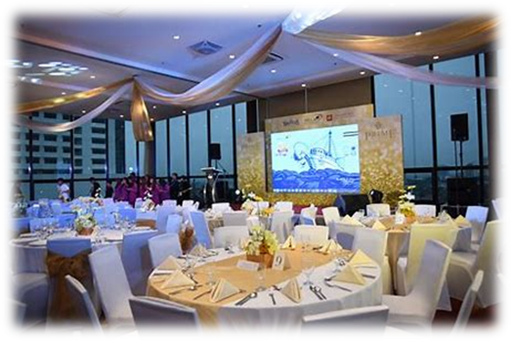

Slide 9
Put he words in the spelling list.

Slide 10
Let’s parse
sentences.

Slide 11
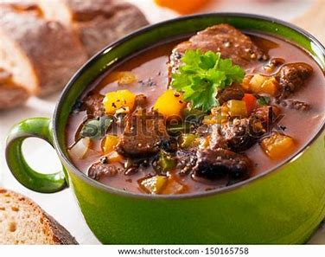
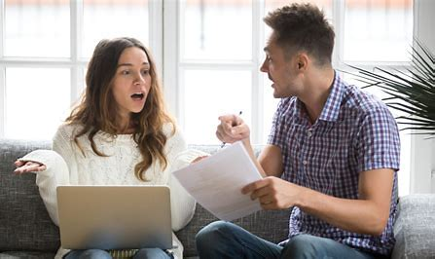
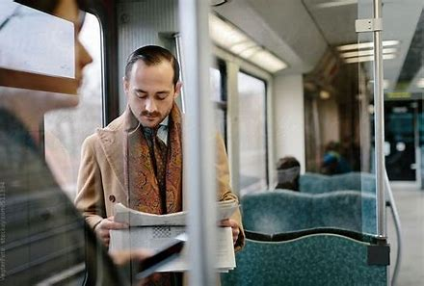
Parse these sentences.
The tasty stew cooked slowly.
He argued angrily
with his little sister.
My dad reads his daily newspaper
while he is on the train.

Slide 12
Parse these sentences.
The tasty stew cooked slowly.
He argued angrily
with his little sister.
My dad reads his daily newspaper
while he is on the train.

Slide 13
Parse these sentences.
The tasty stew cooked slowly.
He argued angrily
with his little sister.
My dad reads his daily newspaper
while he is on the train.

Slide 14
Parse these sentences.
The tasty stew cooked slowly.
He argued angrily
with his little sister.
My dad reads his daily newspaper
while he is on the train.

Slide 15
Parse these sentences.
The tasty stew cooked slowly.
He argued angrily
with his little sister.
My dad reads his daily newspaper
while he is on the train.

Slide 16
Parse these sentences.
The tasty stew cooked slowly.
He argued angrily
with his little sister.
My dad reads his daily newspaper
while he is on the train.

Slide 17
Parse these sentences.
The tasty stew cooked slowly.
He argued angrily
with his little sister.
My dad reads his daily newspaper
while he is on the train.

Slide 18
Parse these sentences.
The tasty stew cooked slowly.
He argued angrily
with his little sister.
My dad reads his daily newspaper
while he is on the train.

Slide 19
Parse these sentences.
The tasty stew cooked slowly.
He argued angrily
with his little sister.
My dad reads his daily newspaper
while he is on the train.

Slide 20
Parse these sentences.
The tasty stew cooked slowly.
He argued angrily
with his little sister.
My dad reads his daily newspaper
while he is on the train.

Slide 21
Parse these sentences.
The tasty stew cooked slowly.
He argued angrily
with his little sister.
My dad reads his daily newspaper
while he is on the train.

Slide 22
Parse these sentences.
The tasty stew cooked slowly.
He argued angrily
with his little sister.
My dad reads his daily newspaper
while he is on the train.

Slide 23
Parse these sentences.
The tasty stew cooked slowly.
He argued angrily
with his little sister.
My dad reads his daily newspaper
while he is on the train.

Slide 24
Parse these sentences.
The tasty stew cooked slowly.
He argued angrily
with his little sister.
My dad reads his daily newspaper
while he is on the train.

Slide 25
Parse these sentences.
The tasty stew cooked slowly.
He argued angrily
with his little sister.
My dad reads his daily newspaper
while he is on the train.

Slide 26
Parse these sentences.
The tasty stew cooked slowly.
He argued angrily
with his little sister.
My dad reads his daily newspaper
while he is on the train.

Slide 27
Parse these sentences.
The tasty stew cooked slowly.
He argued angrily
with his little sister.
My dad reads his daily newspaper
while he is on the train.

Slide 28
Parse these sentences.
The tasty stew cooked slowly.
He argued angrily
with his little sister.
My dad reads his daily newspaper
while he is on the train.

Slide 29
Parse these sentences.
The tasty stew cooked slowly.
He argued angrily
with his little sister.
My dad reads his daily newspaper
while he is on the train.

Slide 30
Parse these sentences.
The tasty stew cooked slowly.
He argued angrily
with his little sister.
My dad reads his daily newspaper
while he is on the train.

Slide 31
Parse these sentences.
The tasty stew cooked slowly.
He argued angrily
with his little sister.
My dad reads his daily newspaper
while he is on the train.

Slide 32
Parse these sentences.
The tasty stew cooked slowly.
He argued angrily
with his little sister.
My dad reads his daily newspaper
while he is on the train.

Slide 33
Parse these sentences.
The tasty stew cooked slowly.
He argued angrily
with his little sister.
My dad reads his daily newspaper
while he is on the train.

Slide 34
Dictation

Slide 35
Dictation
1.
2.
3.

Slide 36
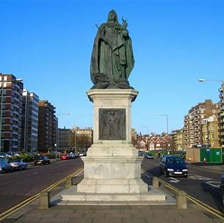

Slide 37
There is a huge statue in the avenue.

Slide 38
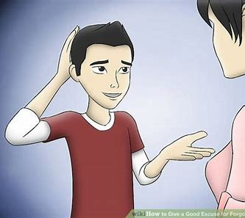

Slide 39
Can you give our excuses for Tuesday?

Slide 40
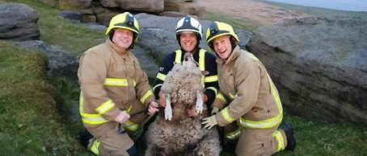
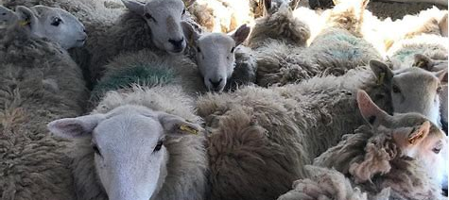

Slide 41
The firemen had to rescue a few ewes.

Slide 42
Thank you!

