Slide 1
Jolly Grammar 3a-10

Slide 2
Mini Test 4

Slide 3
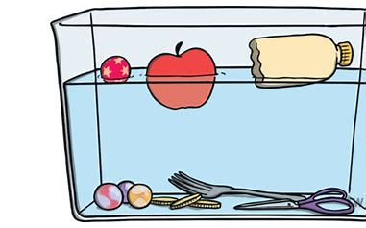
float

Slide 4
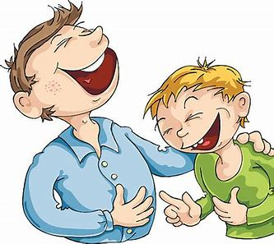
float
joke

Slide 5
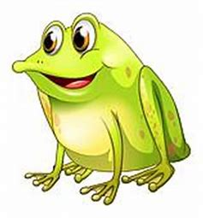
float
joke
croak

Slide 6
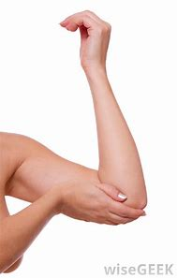
float
joke
croak
elbow

Slide 7
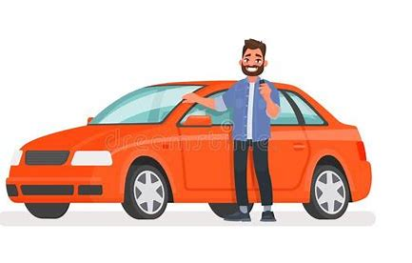
float
joke
croak
elbow
owner

Slide 8
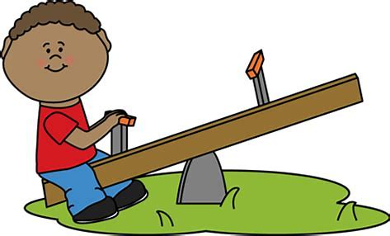
float
joke
croak
elbow
owner
alone

Slide 9
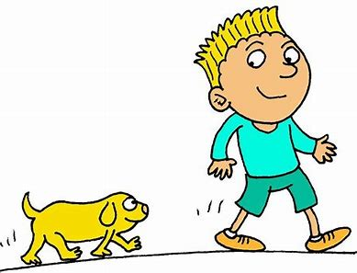
float
joke
croak
elbow
owner
alone
7. follow

Slide 10
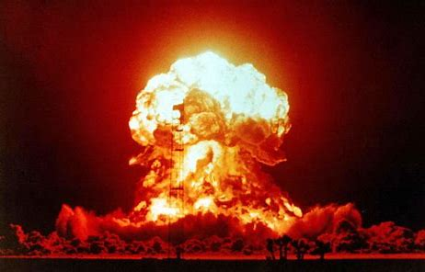
float
joke
croak
elbow
owner
alone
7. follow
8. explode

Slide 11
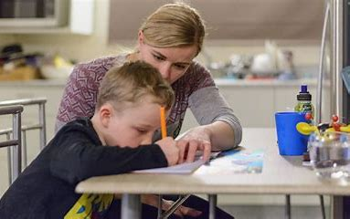
float
joke
croak
elbow
owner
alone
7. follow
8. explode
9. homework

Slide 12
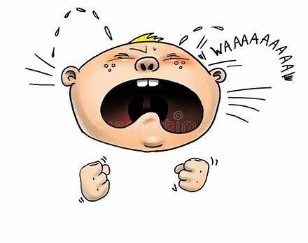
float
joke
croak
elbow
owner
alone
7. follow
8. explode
9. homework
10. moaning

Slide 13
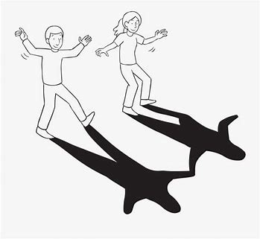
float
joke
croak
elbow
owner
alone
7. follow
8. explode
9. homework
10. moaning
11. shadow

Slide 14
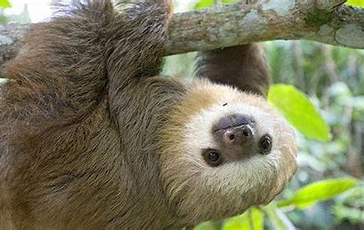
float
joke
croak
elbow
owner
alone
7. follow
8. explode
9. homework
10. moaning
11. shadow
12. slowest

Slide 15
float
joke
croak
elbow
owner
alone
7. follow
8. explode
9. homework
10. moaning
11. shadow
12. slowest
13. rainbow

Slide 16
float
joke
croak
elbow
owner
alone
7. follow
8. explode
9. homework
10. moaning
11. shadow
12. slowest
13. rainbow
14. approach

Slide 17
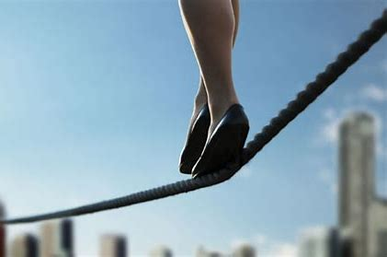
float
joke
croak
elbow
owner
alone
7. follow
8. explode
9. homework
10. moaning
11. shadow
12. slowest
13. rainbow
14. approach
15. tightrope

Slide 18
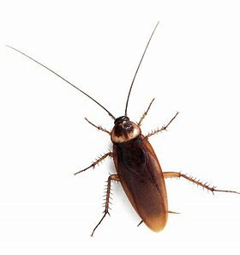
float
joke
croak
elbow
owner
alone
7. follow
8. explode
9. homework
10. moaning
11. shadow
12. slowest
13. rainbow
14. approach
15. tightrope
16. cockroach

Slide 19
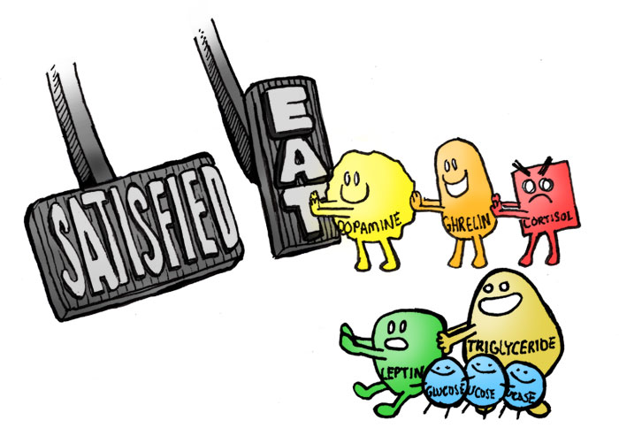
float
joke
croak
elbow
owner
alone
7. follow
8. explode
9. homework
10. moaning
11. shadow
12. slowest
13. rainbow
14. approach
15. tightrope
16. cockroach
17. hormone

Slide 20
float
joke
croak
elbow
owner
alone
7. follow
8. explode
9. homework
10. moaning
11. shadow
12. slowest
13. rainbow
14. approach
15. tightrope
16. cockroach
17. hormone
18. envelope

Slide 22
Let’s review
Tricky Pasts.

Slide 23
to cook
to drink
to ride
to speak
to dig
to make
to throw
to lose
to say
to run
to hide
to ring
to write
to be
cooked

Slide 24
to cook
to drink
to ride
to speak
to dig
to make
to throw
to lose
to say
to run
to hide
to ring
to write
to be
cooked
drank

Slide 25
to cook
to drink
to ride
to speak
to dig
to make
to throw
to lose
to say
to run
to hide
to ring
to write
to be
cooked
drank
rode

Slide 26
to cook
to drink
to ride
to speak
to dig
to make
to throw
to lose
to say
to run
to hide
to ring
to write
to be
cooked
drank
rode
spoke

Slide 27
to cook
to drink
to ride
to speak
to dig
to make
to throw
to lose
to say
to run
to hide
to ring
to write
to be
cooked
drank
rode
spoke
dug

Slide 28
to cook
to drink
to ride
to speak
to dig
to make
to throw
to lose
to say
to run
to hide
to ring
to write
to be
cooked
drank
rode
spoke
dug
made

Slide 29
to cook
to drink
to ride
to speak
to dig
to make
to throw
to lose
to say
to run
to hide
to ring
to write
to be
cooked
drank
rode
spoke
dug
made
threw

Slide 30
to cook
to drink
to ride
to speak
to dig
to make
to throw
to lose
to say
to run
to hide
to ring
to write
to be
cooked
drank
rode
spoke
dug
made
threw
lost

Slide 31
to cook
to drink
to ride
to speak
to dig
to make
to throw
to lose
to say
to run
to hide
to ring
to write
to be
cooked
drank
rode
spoke
dug
made
threw
lost
said

Slide 32
to cook
to drink
to ride
to speak
to dig
to make
to throw
to lose
to say
to run
to hide
to ring
to write
to be
cooked
drank
rode
spoke
dug
made
threw
lost
said
ran

Slide 33
to cook
to drink
to ride
to speak
to dig
to make
to throw
to lose
to say
to run
to hide
to ring
to write
to be
cooked
drank
rode
spoke
dug
made
threw
lost
said
ran
hid

Slide 34
to cook
to drink
to ride
to speak
to dig
to make
to throw
to lose
to say
to run
to hide
to ring
to write
to be
cooked
drank
rode
spoke
dug
made
threw
lost
said
ran
hid
rang

Slide 35
to cook
to drink
to ride
to speak
to dig
to make
to throw
to lose
to say
to run
to hide
to ring
to write
to be
cooked
drank
rode
spoke
dug
made
threw
lost
said
ran
hid
rang
wrote

Slide 36
to cook
to drink
to ride
to speak
to dig
to make
to throw
to lose
to say
to run
to hide
to ring
to write
to be
cooked
drank
rode
spoke
dug
made
threw
lost
said
ran
hid
rang
wrote
was, were

Slide 37
‘to be’
 | past | present | future
I
you
he / she / it
we
you
they

Slide 38
‘to be’
 | past | present | future
I |  | am
you
he / she / it
we
you
they

Slide 39
‘to be’
 | past | present | future
I |  | am
you |  | are
he / she / it
we
you
they

Slide 40
‘to be’
 | past | present | future
I |  | am
you |  | are
he / she / it |  | is
we
you
they

Slide 41
‘to be’
 | past | present | future
I |  | am
you |  | are
he / she / it |  | is
we |  | are
you
they

Slide 42
‘to be’
 | past | present | future
I |  | am
you |  | are
he / she / it |  | is
we |  | are
you |  | are
they

Slide 43
‘to be’
 | past | present | future
I |  | am
you |  | are
he / she / it |  | is
we |  | are
you |  | are
they |  | are

Slide 44
‘to be’
 | past | present | future
I | was | am
you |  | are
he / she / it |  | is
we |  | are
you |  | are
they |  | are

Slide 45
‘to be’
 | past | present | future
I | was | am
you | were | are
he / she / it |  | is
we |  | are
you |  | are
they |  | are

Slide 46
‘to be’
 | past | present | future
I | was | am
you | were | are
he / she / it | was | is
we |  | are
you |  | are
they |  | are

Slide 47
‘to be’
 | past | present | future
I | was | am
you | were | are
he / she / it | was | is
we | were | are
you |  | are
they |  | are

Slide 48
‘to be’
 | past | present | future
I | was | am
you | were | are
he / she / it | was | is
we | were | are
you | were | are
they |  | are

Slide 49
‘to be’
 | past | present | future
I | was | am
you | were | are
he / she / it | was | is
we | were | are
you | were | are
they | were | are

Slide 50
‘to be’
 | past | present | future
I | was | am | shall / will be
you | were | are
he / she / it | was | is
we | were | are
you | were | are
they | were | are

Slide 51
‘to be’
 | past | present | future
I | was | am | shall / will be
you | were | are | will be
he / she / it | was | is
we | were | are
you | were | are
they | were | are

Slide 52
‘to be’
 | past | present | future
I | was | am | shall / will be
you | were | are | will be
he / she / it | was | is | will be
we | were | are
you | were | are
they | were | are

Slide 53
‘to be’
 | past | present | future
I | was | am | shall / will be
you | were | are | will be
he / she / it | was | is | will be
we | were | are | shall / will be
you | were | are
they | were | are

Slide 54
‘to be’
 | past | present | future
I | was | am | shall / will be
you | were | are | will be
he / she / it | was | is | will be
we | were | are | shall / will be
you | were | are | will be
they | were | are

Slide 55
‘to be’
 | past | present | future
I | was | am | shall / will be
you | were | are | will be
he / she / it | was | is | will be
we | were | are | shall / will be
you | were | are | will be
they | were | are | will be

Slide 56
Identify the verb in each sentence.
We were on the bus.
She is happy.
They are cold.
You will be seven.

Slide 57
Identify the verb in each sentence.
We were on the bus.
She is happy.
They are cold.
You will be seven.

Slide 58
Identify the verb in each sentence.
We were on the bus.
She is happy.
They are cold.
You will be seven.

Slide 59
Identify the verb in each sentence.
We were on the bus.
She is happy.
They are cold.
You will be seven.

Slide 60
Identify the verb in each sentence.
We were on the bus.
She is happy.
They are cold.
You will be seven.

Slide 61
Activity Page:
Verb ‘to be’

Slide 62
It was cold last night. past

Slide 63
It was cold last night. past
We were happy. past

Slide 64
It was cold last night. past
We were happy. past
She is very intelligent. present

Slide 65
It was cold last night. past
We were happy. past
She is very intelligent. present
They will be at the concert. future

Slide 66
It was cold last night. past
We were happy. past
She is very intelligent. present
They will be at the concert. future
You were very good at Grandma’s house. past

Slide 67
It was cold last night. past
We were happy. past
She is very intelligent. present
They will be at the concert. future
You were very good at Grandma’s house. past
The cat is tabby and white. present

Slide 68
It was cold last night. past
We were happy. past
She is very intelligent. present
They will be at the concert. future
You were very good at Grandma’s house. past
The cat is tabby and white. present
I was sad when the holidays ended. past

Slide 69
It was cold last night. past
We were happy. past
She is very intelligent. present
They will be at the concert. future
You were very good at Grandma’s house. past
The cat is tabby and white. present
I was sad when the holidays ended. past
I am in the school play. present

Slide 70
It was cold last night. past
We were happy. past
She is very intelligent. present
They will be at the concert. future
You were very good at Grandma’s house. past
The cat is tabby and white. present
I was sad when the holidays ended. past
I am in the school play. present
We shall be in town at the weekend. future

Slide 71
Thank you

