Slide 1
Jolly Grammar 3a-9

Slide 2
Let’s review
Verb ending in /-y/.

Slide 3
 | past | present | future
I |  | worry
you
he / she / it
we
you
they

Slide 4
 | past | present | future
I |  | worry
you |  | worry
he / she / it
we
you
they

Slide 5
 | past | present | future
I |  | worry
you |  | worry
he / she / it |  | worries
we
you
they

Slide 6
 | past | present | future
I |  | worry
you |  | worry
he / she / it |  | worries
we |  | worry
you
they

Slide 7
 | past | present | future
I |  | worry
you |  | worry
he / she / it |  | worries
we |  | worry
you |  | worry
they

Slide 8
 | past | present | future
I |  | worry
you |  | worry
he / she / it |  | worries
we |  | worry
you |  | worry
they |  | worry

Slide 9
 | past | present | future
I | worried | worry
you |  | worry
he / she / it |  | worries
we |  | worry
you |  | worry
they |  | worry

Slide 10
 | past | present | future
I | worried | worry
you | worried | worry
he / she / it |  | worries
we |  | worry
you |  | worry
they |  | worry

Slide 11
 | past | present | future
I | worried | worry
you | worried | worry
he / she / it | worried | worries
we |  | worry
you |  | worry
they |  | worry

Slide 12
 | past | present | future
I | worried | worry
you | worried | worry
he / she / it | worried | worries
we | worried | worry
you |  | worry
they |  | worry

Slide 13
 | past | present | future
I | worried | worry
you | worried | worry
he / she / it | worried | worries
we | worried | worry
you | worried | worry
they |  | worry

Slide 14
 | past | present | future
I | worried | worry
you | worried | worry
he / she / it | worried | worries
we | worried | worry
you | worried | worry
they | worreid | worry

Slide 15
 | past | present | future
I | worried | worry | shall/will worry
you | worried | worry
he / she / it | worried | worries
we | worried | worry
you | worried | worry
they | worried | worry

Slide 16
 | past | present | future
I | worried | worry | shall/will worry
you | worried | worry | will worry
he / she / it | worried | worries
we | worried | worry
you | worried | worry
they | worreid | worry

Slide 17
 | past | present | future
I | worried | worry | shall/will worry
you | worried | worry | will worry
he / she / it | worried | worries | will worry
we | worried | worry
you | worried | worry
they | worreid | worry

Slide 18
 | past | present | future
I | worried | worry | shall/will worry
you | worried | worry | will worry
he / she / it | worried | worries | will worry
we | worried | worry | shall/will worry
you | worried | worry
they | worreid | worry

Slide 19
 | past | present | future
I | worried | worry | shall/will worry
you | worried | worry | will worry
he / she / it | worried | worries | will worry
we | worried | worry | shall/will worry
you | worried | worry | will worry
they | worreid | worry | will worry

Slide 20
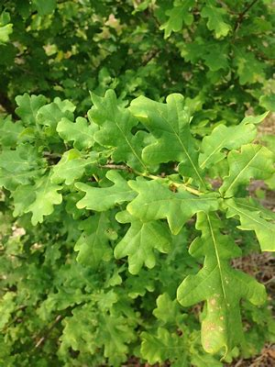
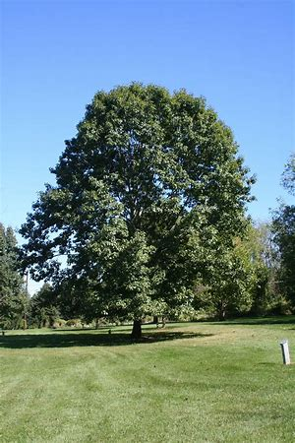
oak
/oa/

Slide 21
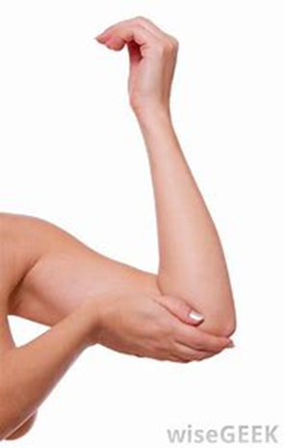
oak
/oa/
elbow
/oa/

Slide 22
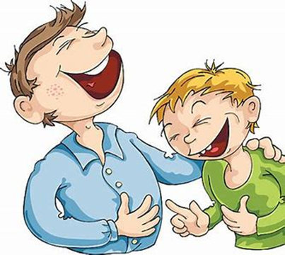
oak
/oa/
elbow
/oa/
joke
/oa/

Slide 23
Spelling List <oa><ow><o-e>

Slide 24
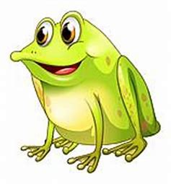
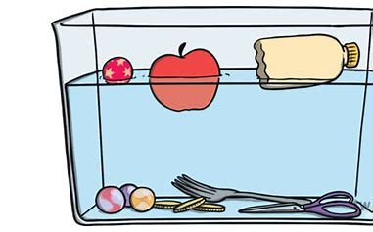
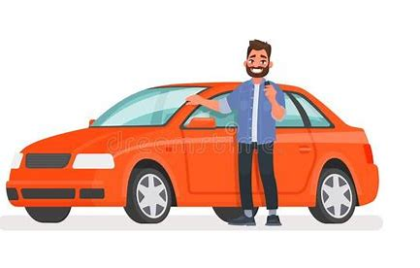
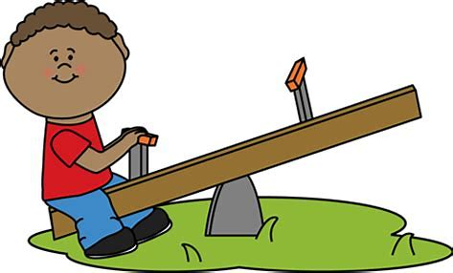
float joke croak
elbow owner alone

Slide 25
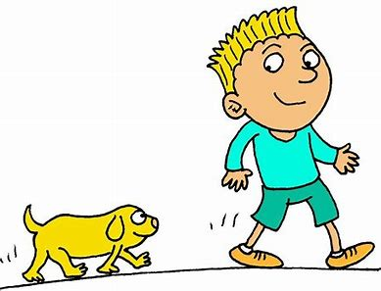
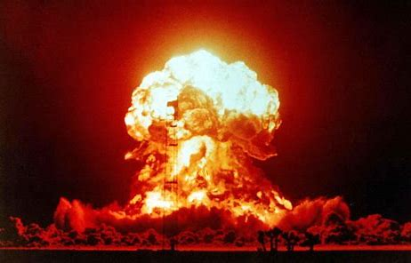
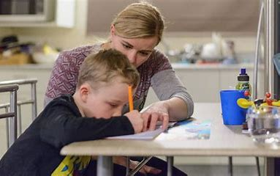
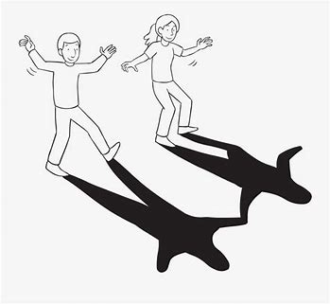
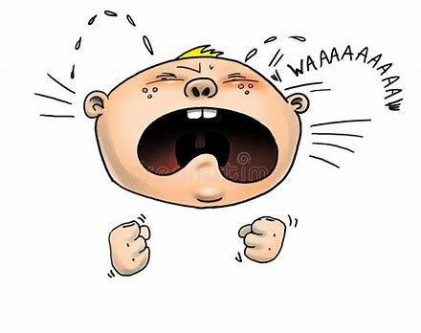
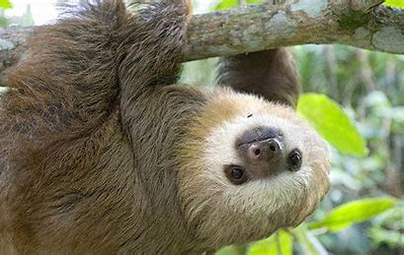
follow explode homework
moaning shadow slowest

Slide 26
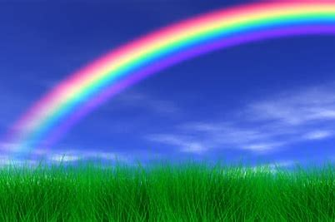
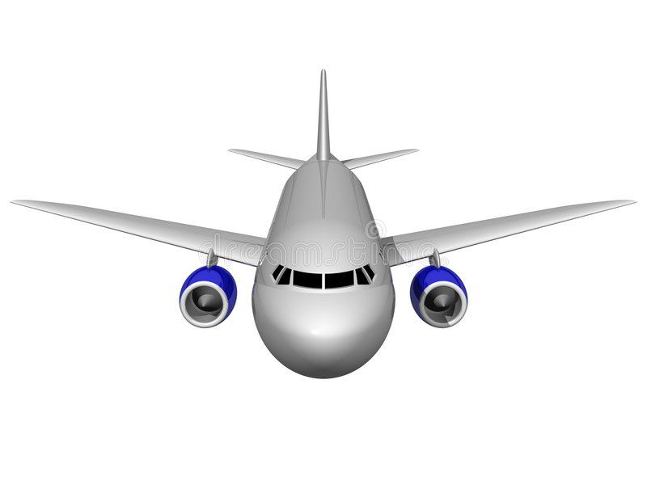
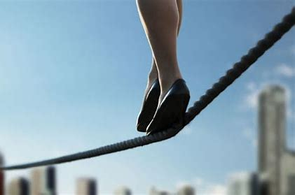
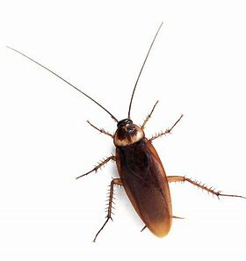
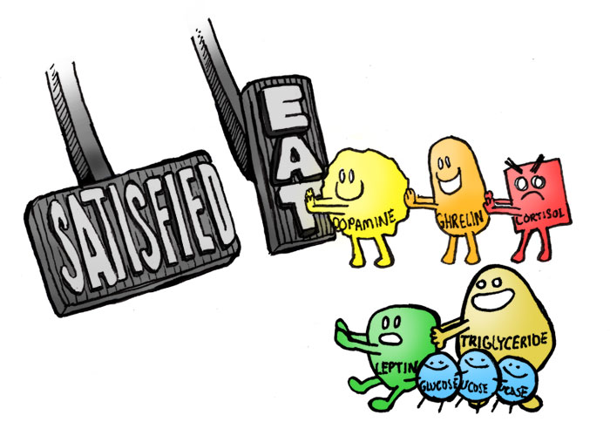
rainbow approach tightrope
cockroach hormone envelope

Slide 27
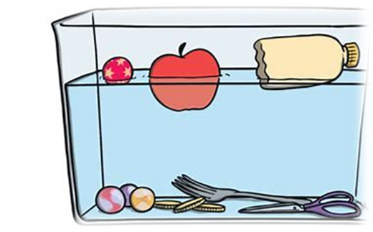
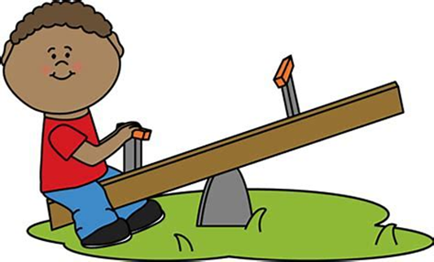
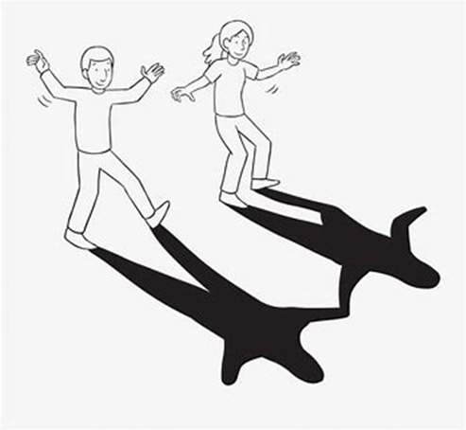
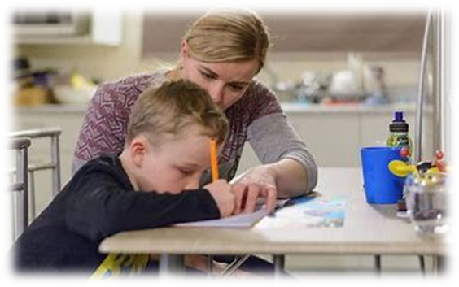
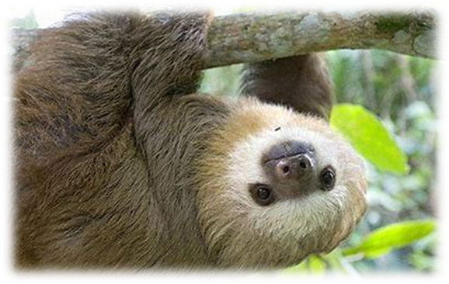
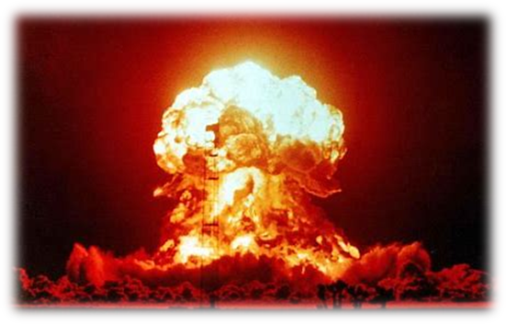
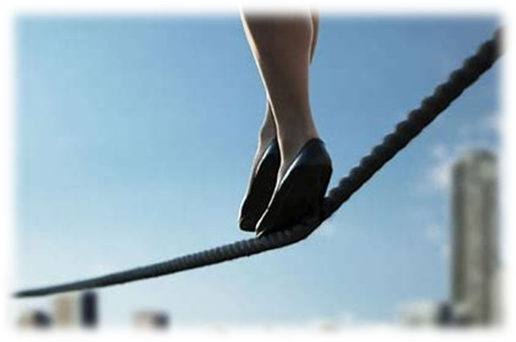
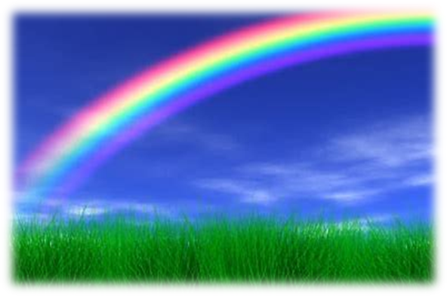

Slide 28
Let’s parse
sentences.

Slide 29
Which words in the spelling list match these descriptions?

Slide 30
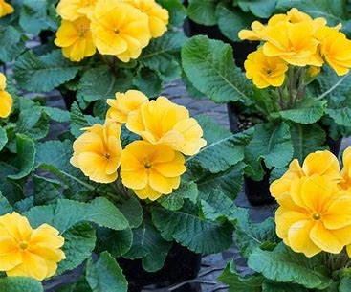
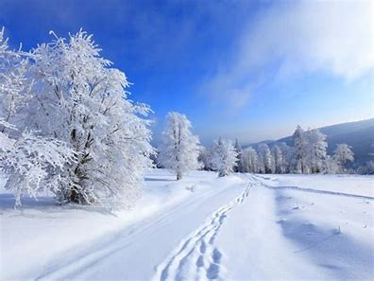
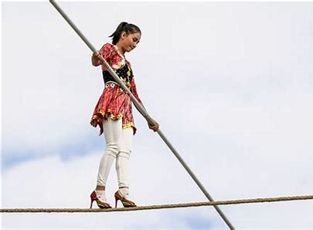
Parse these sentences.
She will grow yellow primroses.
The snow fell thickly on the road.
The fearless acrobat walked slowly
across the tightrope.

Slide 31
Parse these sentences.
She will grow yellow primroses.
The snow fell thickly on the road.
The fearless acrobat walked slowly
across the tightrope.

Slide 32
Parse these sentences.
She will grow yellow primroses.
The snow fell thickly on the road.
The fearless acrobat walked slowly
across the tightrope.

Slide 33
Parse these sentences.
She will grow yellow primroses.
The snow fell thickly on the road.
The fearless acrobat walked slowly
across the tightrope.

Slide 34
Parse these sentences.
She will grow yellow primroses.
The snow fell thickly on the road.
The fearless acrobat walked slowly
across the tightrope.

Slide 35
Parse these sentences.
She will grow yellow primroses.
The snow fell thickly on the road.
The fearless acrobat walked slowly
across the tightrope.

Slide 36
Parse these sentences.
She will grow yellow primroses.
The snow fell thickly on the road.
The fearless acrobat walked slowly
across the tightrope.

Slide 37
Parse these sentences.
She will grow yellow primroses.
The snow fell thickly on the road.
The fearless acrobat walked slowly
across the tightrope.

Slide 38
Parse these sentences.
She will grow yellow primroses.
The snow fell thickly on the road.
The fearless acrobat walked slowly
across the tightrope.

Slide 39
Parse these sentences.
She will grow yellow primroses.
The snow fell thickly on the road.
The fearless acrobat walked slowly
across the tightrope.

Slide 40
Parse these sentences.
She will grow yellow primroses.
The snow fell thickly on the road.
The fearless acrobat walked slowly
across the tightrope.

Slide 41
Parse these sentences.
She will grow yellow primroses.
The snow fell thickly on the road.
The fearless acrobat walked slowly
across the tightrope.

Slide 42
Parse these sentences.
She will grow yellow primroses.
The snow fell thickly on the road.
The fearless acrobat walked slowly
across the tightrope.

Slide 43
Parse these sentences.
She will grow yellow primroses.
The snow fell thickly on the road.
The fearless acrobat walked slowly
across the tightrope.

Slide 44
Parse these sentences.
She will grow yellow primroses.
The snow fell thickly on the road.
The fearless acrobat walked slowly
across the tightrope.

Slide 45
Parse these sentences.
She will grow yellow primroses.
The snow fell thickly on the road.
The fearless acrobat walked slowly
across the tightrope.

Slide 46
Dictation

Slide 47
Dictation
1.
2.
3.

Slide 48
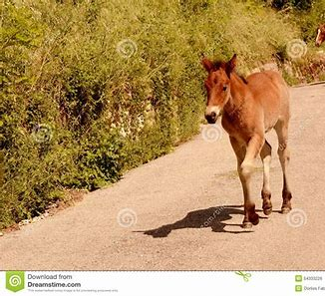

Slide 49
The foal ran across the road.

Slide 50
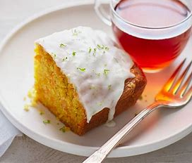
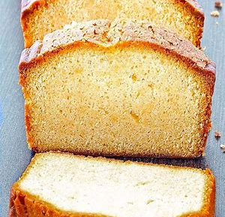

Slide 51
They baked homemade cake for tea.

Slide 52
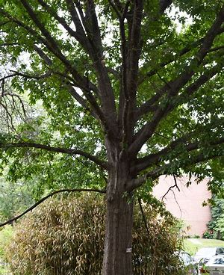
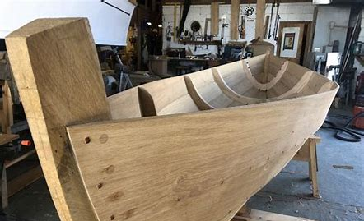

Slide 53
Is the boat made of oak?

Slide 54
Thank you

