Slide 1
Jolly Grammar 3a-8

Slide 2
Mini Test 3

Slide 3
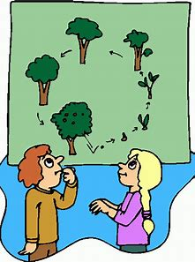
life

Slide 4
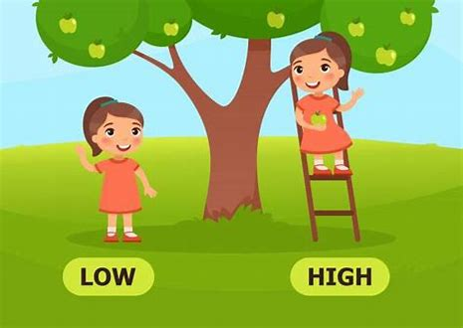
life
high

Slide 5
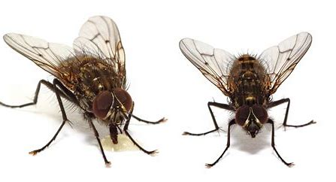
life
high
flies

Slide 6
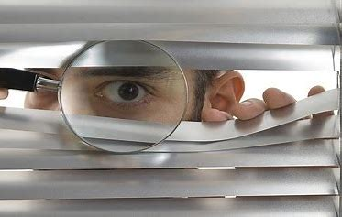
life
high
flies
spying

Slide 7
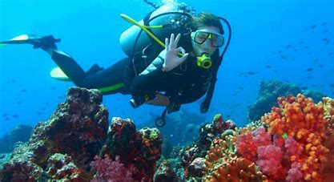
life
high
flies
spying
dive

Slide 8
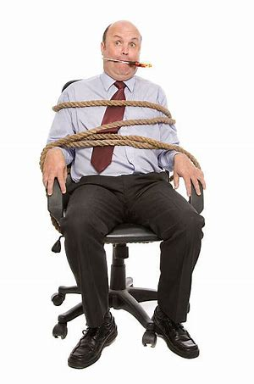
life
high
flies
spying
dive
tied

Slide 9
life
high
flies
spying
dive
tied
7. dryer

Slide 10
life
high
flies
spying
dive
tied
7. dryer
8. tried

Slide 11
life
high
flies
spying
dive
tied
7. dryer
8. tried
9. alright

Slide 12
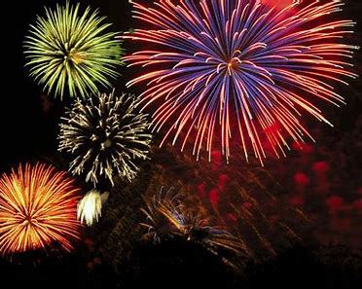
life
high
flies
spying
dive
tied
7. dryer
8. tried
9. alright
10. firework

Slide 13
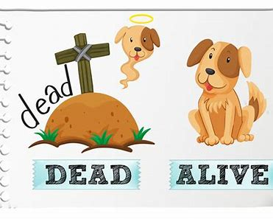
life
high
flies
spying
dive
tied
7. dryer
8. tried
9. alright
10. firework
11. alive

Slide 14
life
high
flies
spying
dive
tied
7. dryer
8. tried
9. alright
10. firework
11. alive
12. delight

Slide 15
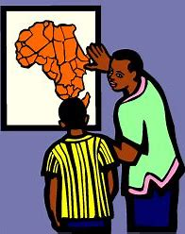
life
high
flies
spying
dive
tied
7. dryer
8. tried
9. alright
10. firework
11. alive
12. delight
13. describe

Slide 16
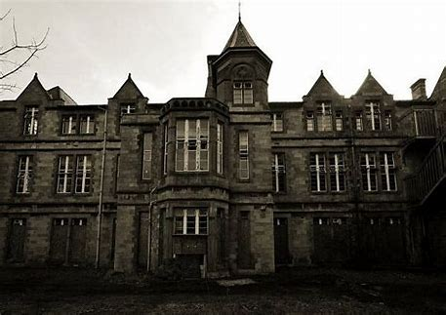
life
high
flies
spying
dive
tied
7. dryer
8. tried
9. alright
10. firework
11. alive
12. delight
13. describe
14. asylum

Slide 17
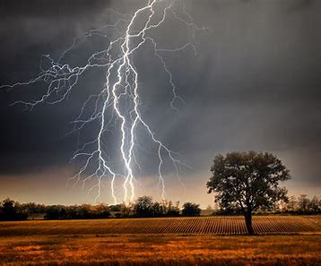
life
high
flies
spying
dive
tied
7. dryer
8. tried
9. alright
10. firework
11. alive
12. delight
13. describe
14. asylum
15. lightning

Slide 18
life
high
flies
spying
dive
tied
7. dryer
8. tried
9. alright
10. firework
11. alive
12. delight
13. describe
14. asylum
15. lightning
16. frightening

Slide 19
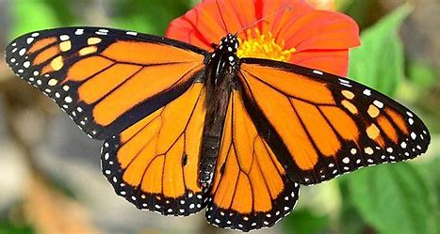
life
high
flies
spying
dive
tied
7. dryer
8. tried
9. alright
10. firework
11. alive
12. delight
13. describe
14. asylum
15. lightning
16. frightening
17. butterfly

Slide 20
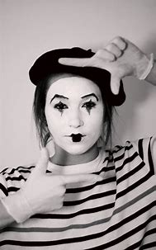
life
high
flies
spying
dive
tied
7. dryer
8. tried
9. alright
10. firework
11. alive
12. delight
13. describe
14. asylum
15. lightning
16. frightening
17. butterfly
18. pantomime

Slide 21
Let’s review
Personal Pronouns.
(with big book)

Slide 22
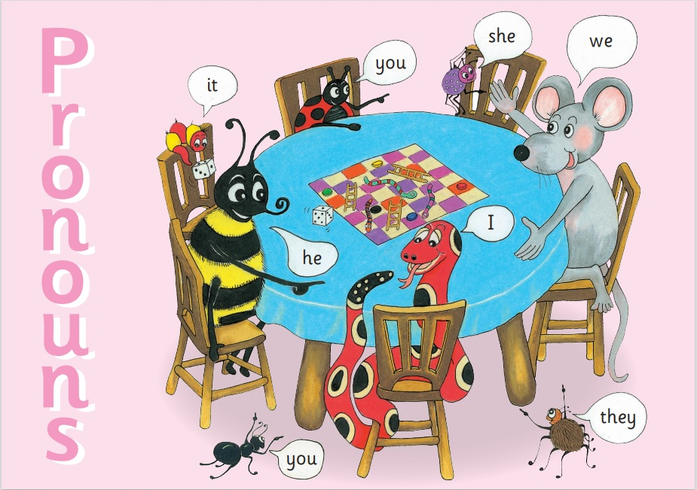

Slide 23
I
you
he / she / it
we
you
they
cook

Slide 24
I
you
he / she / it
we
you
they
cook
cook

Slide 25
I
you
he / she / it
we
you
they
cook
cook
cooks

Slide 26
I
you
he / she / it
we
you
they
cook
cook
cooks
cook

Slide 27
I
you
he / she / it
we
you
they
cook
cook
cooks
cook
cook

Slide 28
I
you
he / she / it
we
you
they
cook
cook
cooks
cook
cook
cook

Slide 29
 | past | present | future
I |  | cook
you
he / she / it
we
you
they

Slide 30
 | past | present | future
I |  | cook
you |  | cook
he / she / it
we
you
they

Slide 31
 | past | present | future
I |  | cook
you |  | cook
he / she / it |  | cooks
we
you
they

Slide 32
 | past | present | future
I |  | cook
you |  | cook
he / she / it |  | cooks
we |  | cook
you
they

Slide 33
 | past | present | future
I |  | cook
you |  | cook
he / she / it |  | cooks
we |  | cook
you |  | cook
they

Slide 34
 | past | present | future
I |  | cook
you |  | cook
he / she / it |  | cooks
we |  | cook
you |  | cook
they |  | cook

Slide 35
 | past | present | future
I | cooked | cook
you | cooked | cook
he / she / it | cooked | cooks
we | cooked | cook
you | cooked | cook
they | cooked | cook

Slide 36
 | past | present | future
I | cooked | cook | shall / will cook
you | cooked | cook | will cook
he / she / it | cooked | cooks | will cook
we | cooked | cook | shall / will cook
you | cooked | cook | will cook
they | cooked | cook | will cook

Slide 37
 | past | present | future
I | cooked | cook | shall / will cook
you | cooked | cook | will cook
he / she / it | cooked | cooks | will cook
we | cooked | cook | shall / will cook
you | cooked | cook | will cook
they | cooked | cook | will cook

Slide 38
to cook
to brush
to munch
to hiss
to fix
to dry
to copy
to worry
to try
to marry
to apply
to decay
to stray
to destroy
to enjoy
to delay
he / she / it

Slide 39
cooks
to brush
to munch
to hiss
to fix
to dry
to copy
to worry
to try
to marry
to apply
to decay
to stray
to destroy
to enjoy
to delay
he / she / it

Slide 40
cooks
to brushes
to munches
to hisses
to fixes
to dry
to copy
to worry
to try
to marry
to apply
to decay
to stray
to destroy
to enjoy
to delay
he / she / it

Slide 41
cooks
to brushes
to munches
to hisses
to fixes
to dries
to copies
to worries
to tries
to marries
to applies
to decay
to stray
to destroy
to enjoy
to delay
he / she / it

Slide 42
cooks
to brushes
to munches
to hisses
to fixes
to dries
to copies
to worries
to tries
to marries
to applies
to decays
to strays
to destroys
to enjoys
to delays
he / she / it

Slide 43
Activity Page:
Verb Ending in <-y>

Slide 44
Thank you

