Slide 1
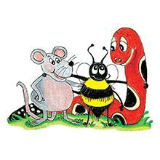
Jolly Grammar 3a-7

Slide 2
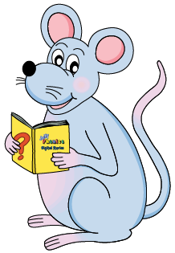
Let’s review simple tense

Slide 3
I cooked yesterday.
I cook
everyday.
I shall cook tomorrow.

Slide 4
I brush my hair.
Copy the sentence
2. Write it in the simple past
3. Write it in the simple future

Slide 5
Spelling List <ie><y><igh>
and <i-e>

Slide 6
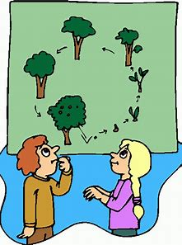
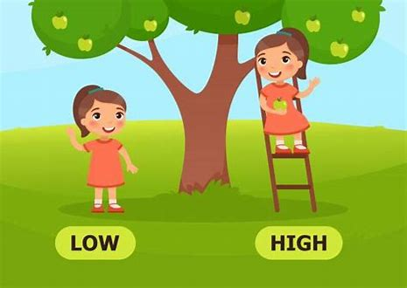
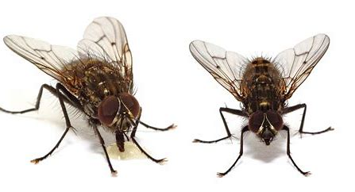
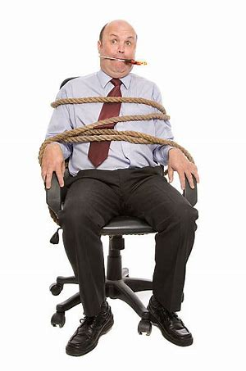
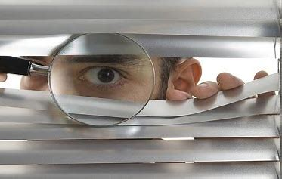
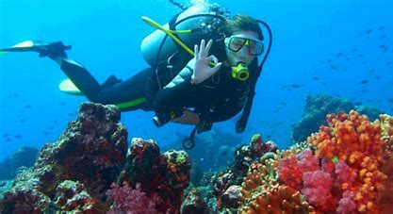
life high flies
spying dive tied

Slide 7
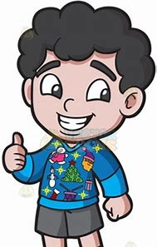
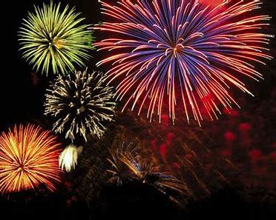
dryer tried alright
firework alive delight

Slide 8
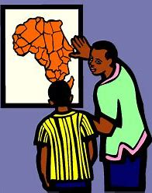
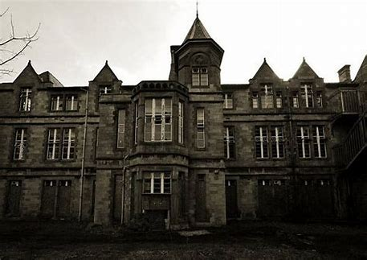
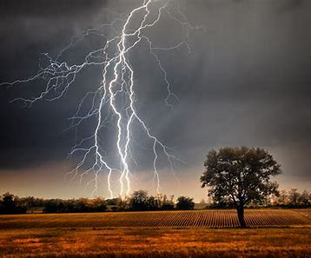
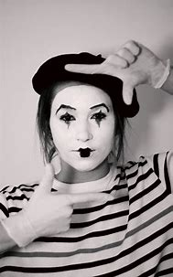
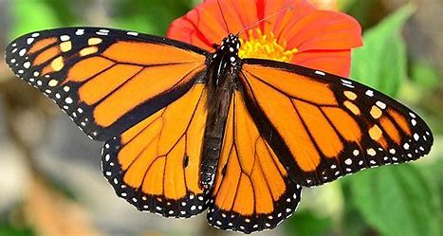
describe asylum lightning
frightening butterfly pantomime

Slide 9
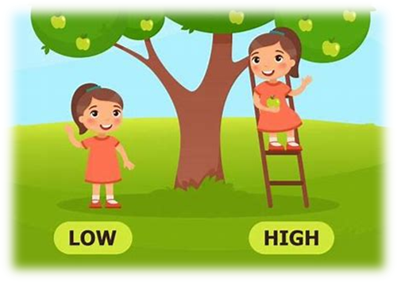
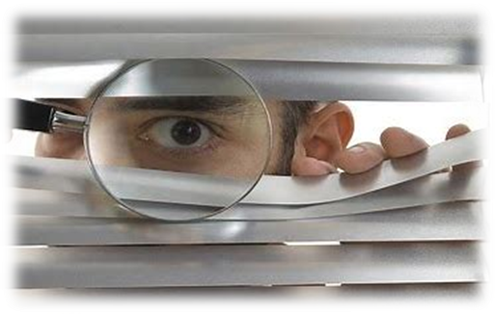
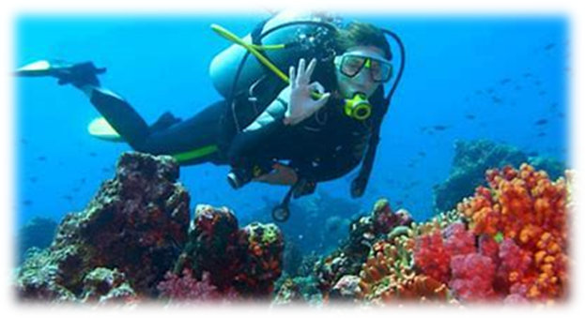
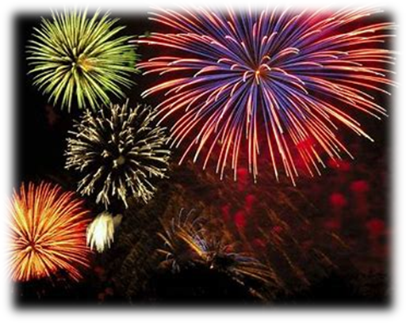
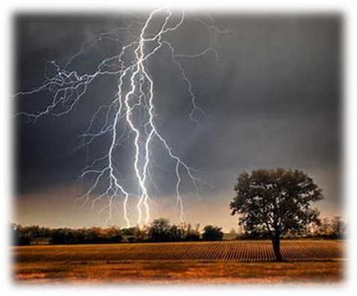
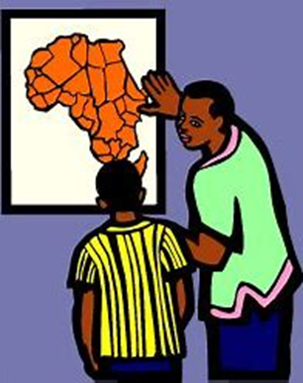
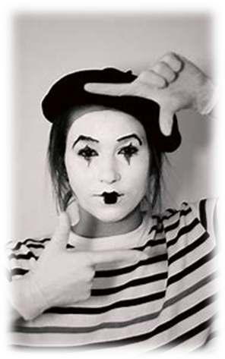
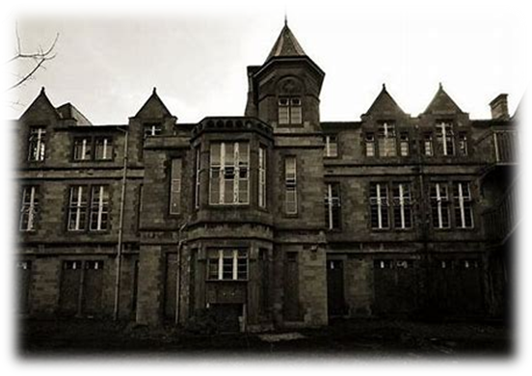
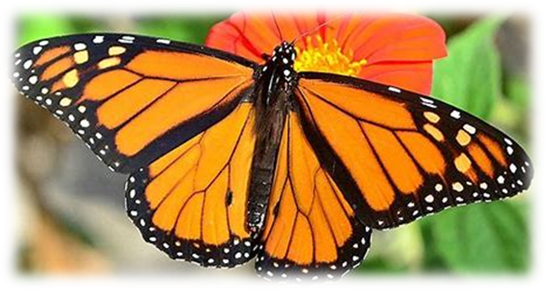

Slide 10
Let’s parse
sentences.

Slide 11
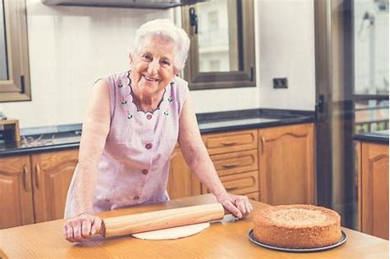
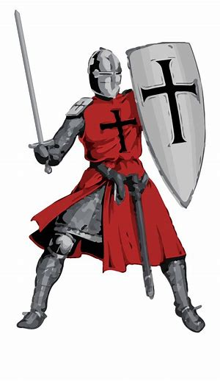
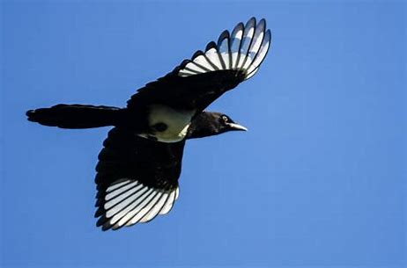
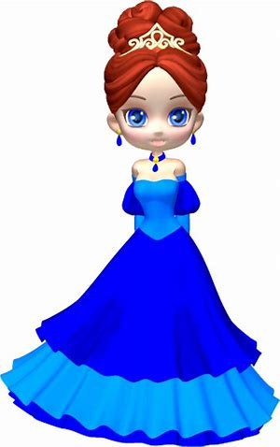
Parse these sentences.
Granny makes a tasty pie.
The brave knight swiftly rescued the princess.
The black and white magpie flies
in the blue sky.

Slide 12
Parse these sentences.
Granny makes a tasty pie.
The brave knight swiftly rescued the princess.
The black and white magpie flies
in the blue sky.

Slide 13
Parse these sentences.
Granny makes a tasty pie.
The brave knight swiftly rescued the princess.
The black and white magpie flies
in the blue sky.

Slide 14
Parse these sentences.
Granny makes a tasty pie.
The brave knight swiftly rescued the princess.
The black and white magpie flies
in the blue sky.

Slide 15
Parse these sentences.
Granny makes a tasty pie.
The brave knight swiftly rescued the princess.
The black and white magpie flies
in the blue sky.

Slide 16
Parse these sentences.
Granny makes a tasty pie.
The brave knight swiftly rescued the princess.
The black and white magpie flies
in the blue sky.

Slide 17
Parse these sentences.
Granny makes a tasty pie.
The brave knight swiftly rescued the princess.
The black and white magpie flies
in the blue sky.

Slide 18
Parse these sentences.
Granny makes a tasty pie.
The brave knight swiftly rescued the princess.
The black and white magpie flies
in the blue sky.

Slide 19
Parse these sentences.
Granny makes a tasty pie.
The brave knight swiftly rescued the princess.
The black and white magpie flies
in the blue sky.

Slide 20
Parse these sentences.
Granny makes a tasty pie.
The brave knight swiftly rescued the princess.
The black and white magpie flies
in the blue sky.

Slide 21
Parse these sentences.
Granny makes a tasty pie.
The brave knight swiftly rescued the princess.
The black and white magpie flies
in the blue sky.

Slide 22
Parse these sentences.
Granny makes a tasty pie.
The brave knight swiftly rescued the princess.
The black and white magpie flies
in the blue sky.

Slide 23
Parse these sentences.
Granny makes a tasty pie.
The brave knight swiftly rescued the princess.
The black and white magpie flies
in the blue sky.

Slide 24
Parse these sentences.
Granny makes a tasty pie.
The brave knight swiftly rescued the princess.
The black and white magpie flies
in the blue sky.

Slide 25
Parse these sentences.
Granny makes a tasty pie.
The brave knight swiftly rescued the princess.
The black and white magpie flies
in the blue sky.

Slide 26
Parse these sentences.
Granny makes a tasty pie.
The brave knight swiftly rescued the princess.
The black and white magpie flies
in the blue sky.

Slide 27
Parse these sentences.
Granny makes a tasty pie.
The brave knight swiftly rescued the princess.
The black and white magpie flies
in the blue sky.

Slide 28
Parse these sentences.
Granny makes a tasty pie.
The brave knight swiftly rescued the princess.
The black and white magpie flies
in the blue sky.

Slide 29
Dictation

Slide 30
Dictation
1.
2.
3.

Slide 31
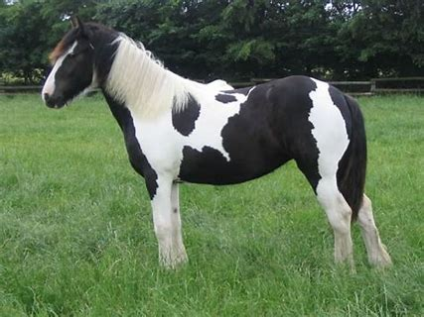
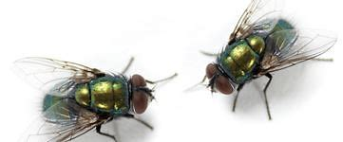

Slide 32
The piebald horse did not like flies.

Slide 34
I might have a ride on my bike.

Slide 35
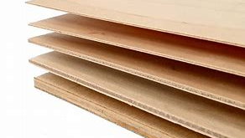
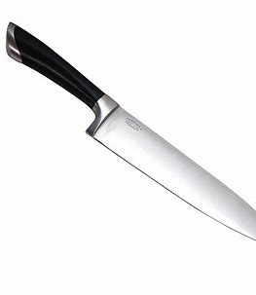

Slide 36
Can the sharp knife cut the plywood?

Slide 37
See you next week

