Slide 1
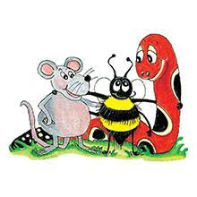
Jolly Grammar 3a-6

Slide 2
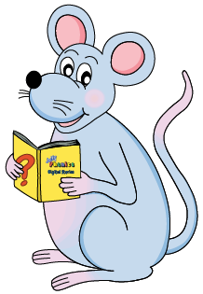
Mini Test 2

Slide 3
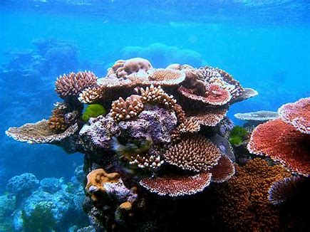
reef

Slide 4
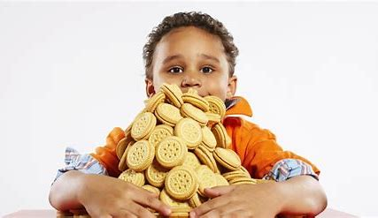
reef
greed

Slide 5
reef
greed
neat

Slide 6
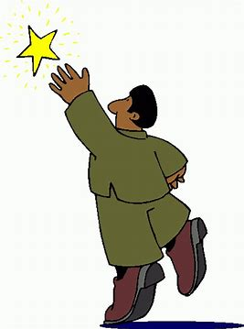
reef
greed
neat
reach

Slide 7
reef
greed
neat
reach
eve

Slide 8
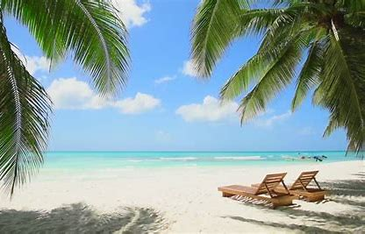
reef
greed
neat
reach
eve
beach

Slide 9
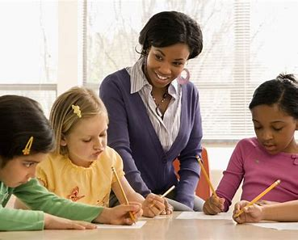
reef
greed
neat
reach
eve
beach
7. teacher

Slide 10
reef
greed
neat
reach
eve
beach
7. teacher
8. theme

Slide 11
reef
greed
neat
reach
eve
beach
7. teacher
8. theme
9. coffee

Slide 12
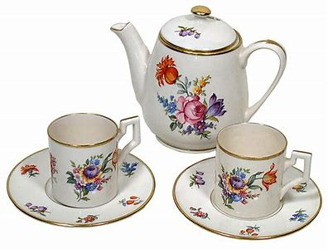
reef
greed
neat
reach
eve
beach
7. teacher
8. theme
9. coffee
10. teapot

Slide 13
reef
greed
neat
reach
eve
beach
7. teacher
8. theme
9. coffee
10. teapot
11. thirteen

Slide 14
reef
greed
neat
reach
eve
beach
7. teacher
8. theme
9. coffee
10. teapot
11. thirteen
12. evening

Slide 15
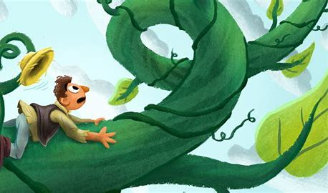
reef
greed
neat
reach
eve
beach
7. teacher
8. theme
9. coffee
10. teapot
11. thirteen
12. evening
13. beanstalk

Slide 16
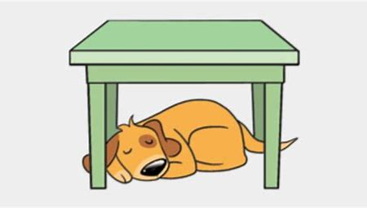
reef
greed
neat
reach
eve
beach
7. teacher
8. theme
9. coffee
10. teapot
11. thirteen
12. evening
13. beanstalk
14. underneath

Slide 17
reef
greed
neat
reach
eve
beach
7. teacher
8. theme
9. coffee
10. teapot
11. thirteen
12. evening
13. beanstalk
14. underneath
15. agreement

Slide 18
reef
greed
neat
reach
eve
beach
7. teacher
8. theme
9. coffee
10. teapot
11. thirteen
12. evening
13. beanstalk
14. underneath
15. agreement
16. seaweed

Slide 19
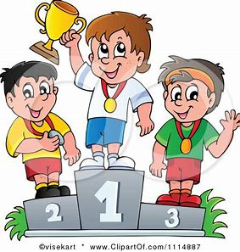
reef
greed
neat
reach
eve
beach
7. teacher
8. theme
9. coffee
10. teapot
11. thirteen
12. evening
13. beanstalk
14. underneath
15. agreement
16. seaweed
17. compete

Slide 20
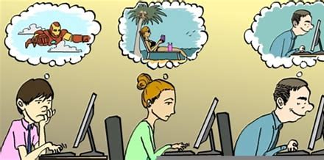
reef
greed
neat
reach
eve
beach
7. teacher
8. theme
9. coffee
10. teapot
11. thirteen
12. evening
13. beanstalk
14. underneath
15. agreement
16. seaweed
17. compete
18. daydream

Slide 21
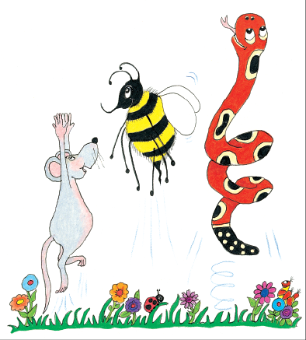
Let’s review
Verbs.

Slide 23
play
read
eat
sleep
swim
clean

Slide 24
to
to
to
to
to
to
play
read
eat
sleep
swim
clean

Slide 25
to
to
to
to
to
to
play
read
eat
sleep
swim
clean
infinitive

Slide 26
I cooked yesterday.
I cook
everyday.
I shall cook tomorrow.

Slide 27
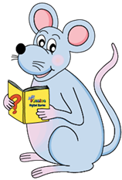
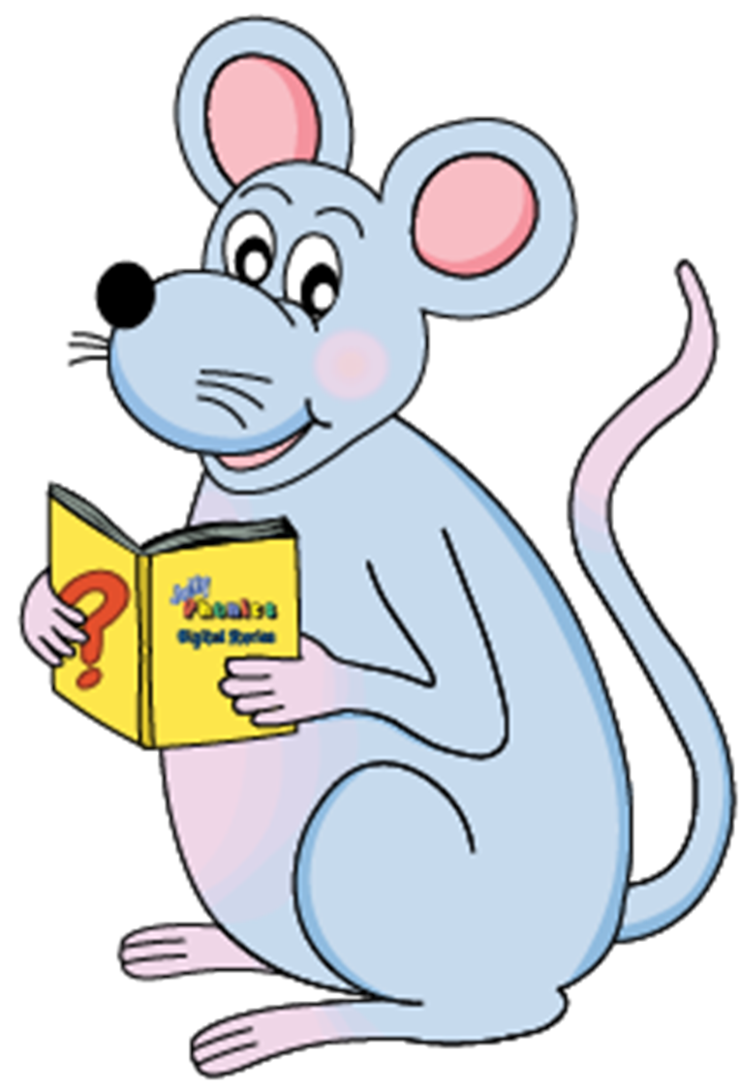
e
＋ed
double
＋ed
consonant ＋ y
y→i＋ed
＋ed
look
chew
walk
play
cook
wipe
hate
please
like
bat
hug
rip
hum
nod
empty

Slide 28
e
＋ed
double
＋ed
consonant ＋ y
y→i＋ed
＋ed
looked
chewed
walked
played
cooked
wipe
hate
please
like
bat
hug
rip
hum
nod
empty

Slide 29
e
＋ed
double
＋ed
consonant ＋ y
y→i＋ed
＋ed
looked
chewed
walked
played
cooked
wiped
hated
pleased
liked
bat
hug
rip
hum
nod
empty

Slide 30
e
＋ed
double
＋ed
consonant ＋ y
y→i＋ed
＋ed
looked
chewed
walked
played
cooked
wiped
hated
pleased
liked
batted
hugged
ripped
hummed
nodded
empty

Slide 31
e
＋ed
double
＋ed
consonant ＋ y
y→i＋ed
＋ed
looked
chewed
walked
played
cooked
wiped
hated
pleased
liked
batted
hugged
ripped
hummed
nodded
empty
↓
emptied

Slide 32
Activity Page
The simple Tenses

Slide 33
to hum to play to cook
to nod to like to tap

Slide 34
to hum to play to cook
hummed
to nod to like to tap

Slide 35
to hum to play to cook
hummed played
to nod to like to tap

Slide 36
to hum to play to cook
hummed played cooked
to nod to like to tap

Slide 37
to hum to play to cook
hummed played cooked
to nod to like to tap
nodded

Slide 38
to hum to play to cook
hummed played cooked
to nod to like to tap
nodded liked

Slide 39
to hum to play to cook
hummed played cooked
to nod to like to tap
nodded liked tapped

Slide 40
In each sentence, underline the verb in red. Then decide if the sentence is in the past, present, or future, and put a tick in the right column. Colour the bees when you have finished.

Slide 41
In each sentence, underline the verb in red. Then decide if the sentence is in the past, present, or future, and put a tick in the right column. Colour the bees when you have finished.
I shall cook dinner tomorrow.

Slide 42
In each sentence, underline the verb in red. Then decide if the sentence is in the past, present, or future, and put a tick in the right column. Colour the bees when you have finished.
I shall cook dinner tomorrow.

Slide 43
In each sentence, underline the verb in red. Then decide if the sentence is in the past, present, or future, and put a tick in the right column. Colour the bees when you have finished.
I shall cook dinner tomorrow.
future

Slide 44
I shall cook dinner tomorrow.
We played at Sam’s house.
He rides his bike in the park.
Sally eats her lunch hungrily.
She will run in the race on Saturday.
He patted his friend’s dog.
You climb up the tree.
They will go to the museum next week.
At the concert I sang a song.
Tonight we shall look at the stars.
I am good at football.
Last week we painted animals in art.

Slide 45
I shall cook dinner tomorrow.
We played at Sam’s house.
He rides his bike in the park.
Sally eats her lunch hungrily.
She will run in the race on Saturday.
He patted his friend’s dog.
You climb up the tree.
They will go to the museum next week.
At the concert I sang a song.
Tonight we shall look at the stars.
I am good at football.
Last week we painted animals in art.
future

Slide 46
I shall cook dinner tomorrow.
We played at Sam’s house.
He rides his bike in the park.
Sally eats her lunch hungrily.
She will run in the race on Saturday.
He patted his friend’s dog.
You climb up the tree.
They will go to the museum next week.
At the concert I sang a song.
Tonight we shall look at the stars.
I am good at football.
Last week we painted animals in art.
Future
past

Slide 47
I shall cook dinner tomorrow.
We played at Sam’s house.
He rides his bike in the park.
Sally eats her lunch hungrily.
She will run in the race on Saturday.
He patted his friend’s dog.
You climb up the tree.
They will go to the museum next week.
At the concert I sang a song.
Tonight we shall look at the stars.
I am good at football.
Last week we painted animals in art.
Future
Past
present

Slide 48
I shall cook dinner tomorrow.
We played at Sam’s house.
He rides his bike in the park.
Sally eats her lunch hungrily.
She will run in the race on Saturday.
He patted his friend’s dog.
You climb up the tree.
They will go to the museum next week.
At the concert I sang a song.
Tonight we shall look at the stars.
I am good at football.
Last week we painted animals in art.
Future
Past
Present
present

Slide 49
I shall cook dinner tomorrow.
We played at Sam’s house.
He rides his bike in the park.
Sally eats her lunch hungrily.
She will run in the race on Saturday.
He patted his friend’s dog.
You climb up the tree.
They will go to the museum next week.
At the concert I sang a song.
Tonight we shall look at the stars.
I am good at football.
Last week we painted animals in art.
Future
Past
Present
Present
future

Slide 50
I shall cook dinner tomorrow.
We played at Sam’s house.
He rides his bike in the park.
Sally eats her lunch hungrily.
She will run in the race on Saturday.
He patted his friend’s dog.
You climb up the tree.
They will go to the museum next week.
At the concert I sang a song.
Tonight we shall look at the stars.
I am good at football.
Last week we painted animals in art.
Future
Past
Present
Present
Future
past

Slide 51
I shall cook dinner tomorrow.
We played at Sam’s house.
He rides his bike in the park.
Sally eats her lunch hungrily.
She will run in the race on Saturday.
He patted his friend’s dog.
You climb up the tree.
They will go to the museum next week.
At the concert I sang a song.
Tonight we shall look at the stars.
I am good at football.
Last week we painted animals in art.
Future
Past
Present
Present
Future
Past
present

Slide 52
I shall cook dinner tomorrow.
We played at Sam’s house.
He rides his bike in the park.
Sally eats her lunch hungrily.
She will run in the race on Saturday.
He patted his friend’s dog.
You climb up the tree.
They will go to the museum next week.
At the concert I sang a song.
Tonight we shall look at the stars.
I am good at football.
Last week we painted animals in art.
Future
Past
Present
Present
Future
Past
Present
future

Slide 53
I shall cook dinner tomorrow.
We played at Sam’s house.
He rides his bike in the park.
Sally eats her lunch hungrily.
She will run in the race on Saturday.
He patted his friend’s dog.
You climb up the tree.
They will go to the museum next week.
At the concert I sang a song.
Tonight we shall look at the stars.
I am good at football.
Last week we painted animals in art.
Future
Past
Present
Present
Future
Past
Present
Future
past

Slide 54
I shall cook dinner tomorrow.
We played at Sam’s house.
He rides his bike in the park.
Sally eats her lunch hungrily.
She will run in the race on Saturday.
He patted his friend’s dog.
You climb up the tree.
They will go to the museum next week.
At the concert I sang a song.
Tonight we shall look at the stars.
I am good at football.
Last week we painted animals in art.
Future
Past
Present
Present
Future
Past
Present
Future
Past
future

Slide 55
I shall cook dinner tomorrow.
We played at Sam’s house.
He rides his bike in the park.
Sally eats her lunch hungrily.
She will run in the race on Saturday.
He patted his friend’s dog.
You climb up the tree.
They will go to the museum next week.
At the concert I sang a song.
Tonight we shall look at the stars.
I am good at football.
Last week we painted animals in art.
Future
Past
Present
Present
Future
Past
Present
Future
Past
Future
present

Slide 56
I shall cook dinner tomorrow.
We played at Sam’s house.
He rides his bike in the park.
Sally eats her lunch hungrily.
She will run in the race on Saturday.
He patted his friend’s dog.
You climb up the tree.
They will go to the museum next week.
At the concert I sang a song.
Tonight we shall look at the stars.
I am good at football.
Last week we painted animals in art.
Future
Past
Present
Present
Future
Past
Present
Future
Past
Future
Present
past

Slide 57
I brush my hair.
Copy the sentence
2. Write it in the simple past
3. Write it in the simple future

Slide 58
I brush my hair.
Copy the sentence
I brush my hair.
2. Write it in the simple past
3. Write it in the simple future

Slide 59
I brush my hair.
Copy the sentence
I brush my hair.
2. Write it in the simple past
I brushed my hair.
3. Write it in the simple future

Slide 60
I brush my hair.
Copy the sentence
I brush my hair.
2. Write it in the simple past
I brushed my hair.
3. Write it in the simple future
I will brush my hair.

