Slide 1
Jolly Grammar 3a-3

Slide 2
Let’s review
Alphabetical order.

Slide 3
1st
1st
2nd
2nd
3rd
3rd
1st
dragon
phoenix
2nd
yeti
3rd

Slide 4
dragon
1st
1st
2nd
2nd
3rd
3rd
1st
phoenix
2nd
yeti
3rd

Slide 5
dragon
1st
1st
phoenix
2nd
2nd
3rd
3rd
1st
2nd
yeti
3rd

Slide 6
dragon
1st
1st
phoenix
2nd
2nd
3rd
3rd
yeti
1st
china
cheese
2nd
chops
3rd

Slide 7
dragon
1st
1st
phoenix
2nd
2nd
3rd
3rd
yeti
1st
cheese
china
2nd
chops
3rd

Slide 8
dragon
1st
1st
phoenix
2nd
2nd
3rd
3rd
yeti
1st
cheese
china
2nd
chops
3rd

Slide 9
dragon
1st
1st
phoenix
2nd
2nd
3rd
3rd
yeti
1st
cheese
string
china
2nd
struck
3rd
street
chops

Slide 10
dragon
street
1st
1st
phoenix
2nd
2nd
3rd
3rd
yeti
1st
cheese
string
china
2nd
struck
3rd
chops

Slide 11
dragon
street
1st
1st
phoenix
string
2nd
2nd
3rd
3rd
yeti
1st
cheese
struck
china
2nd
3rd
chops

Slide 12
dragon
street
1st
1st
phoenix
string
2nd
2nd
3rd
3rd
yeti
struck
1st
cheese
china
2nd
3rd
chops

Slide 13
Sound Revision

Slide 14
Spelling List <ai><ay><a-e>

Slide 15
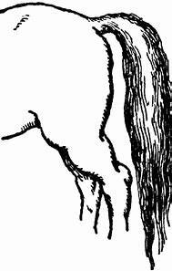
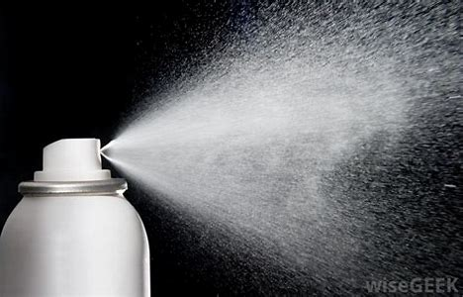
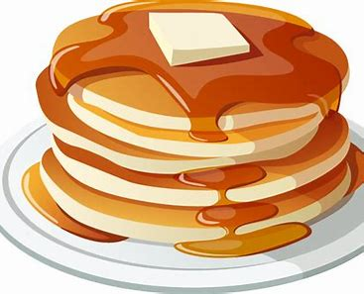
tail spray pancake

Slide 16
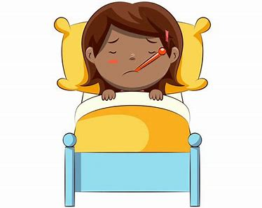
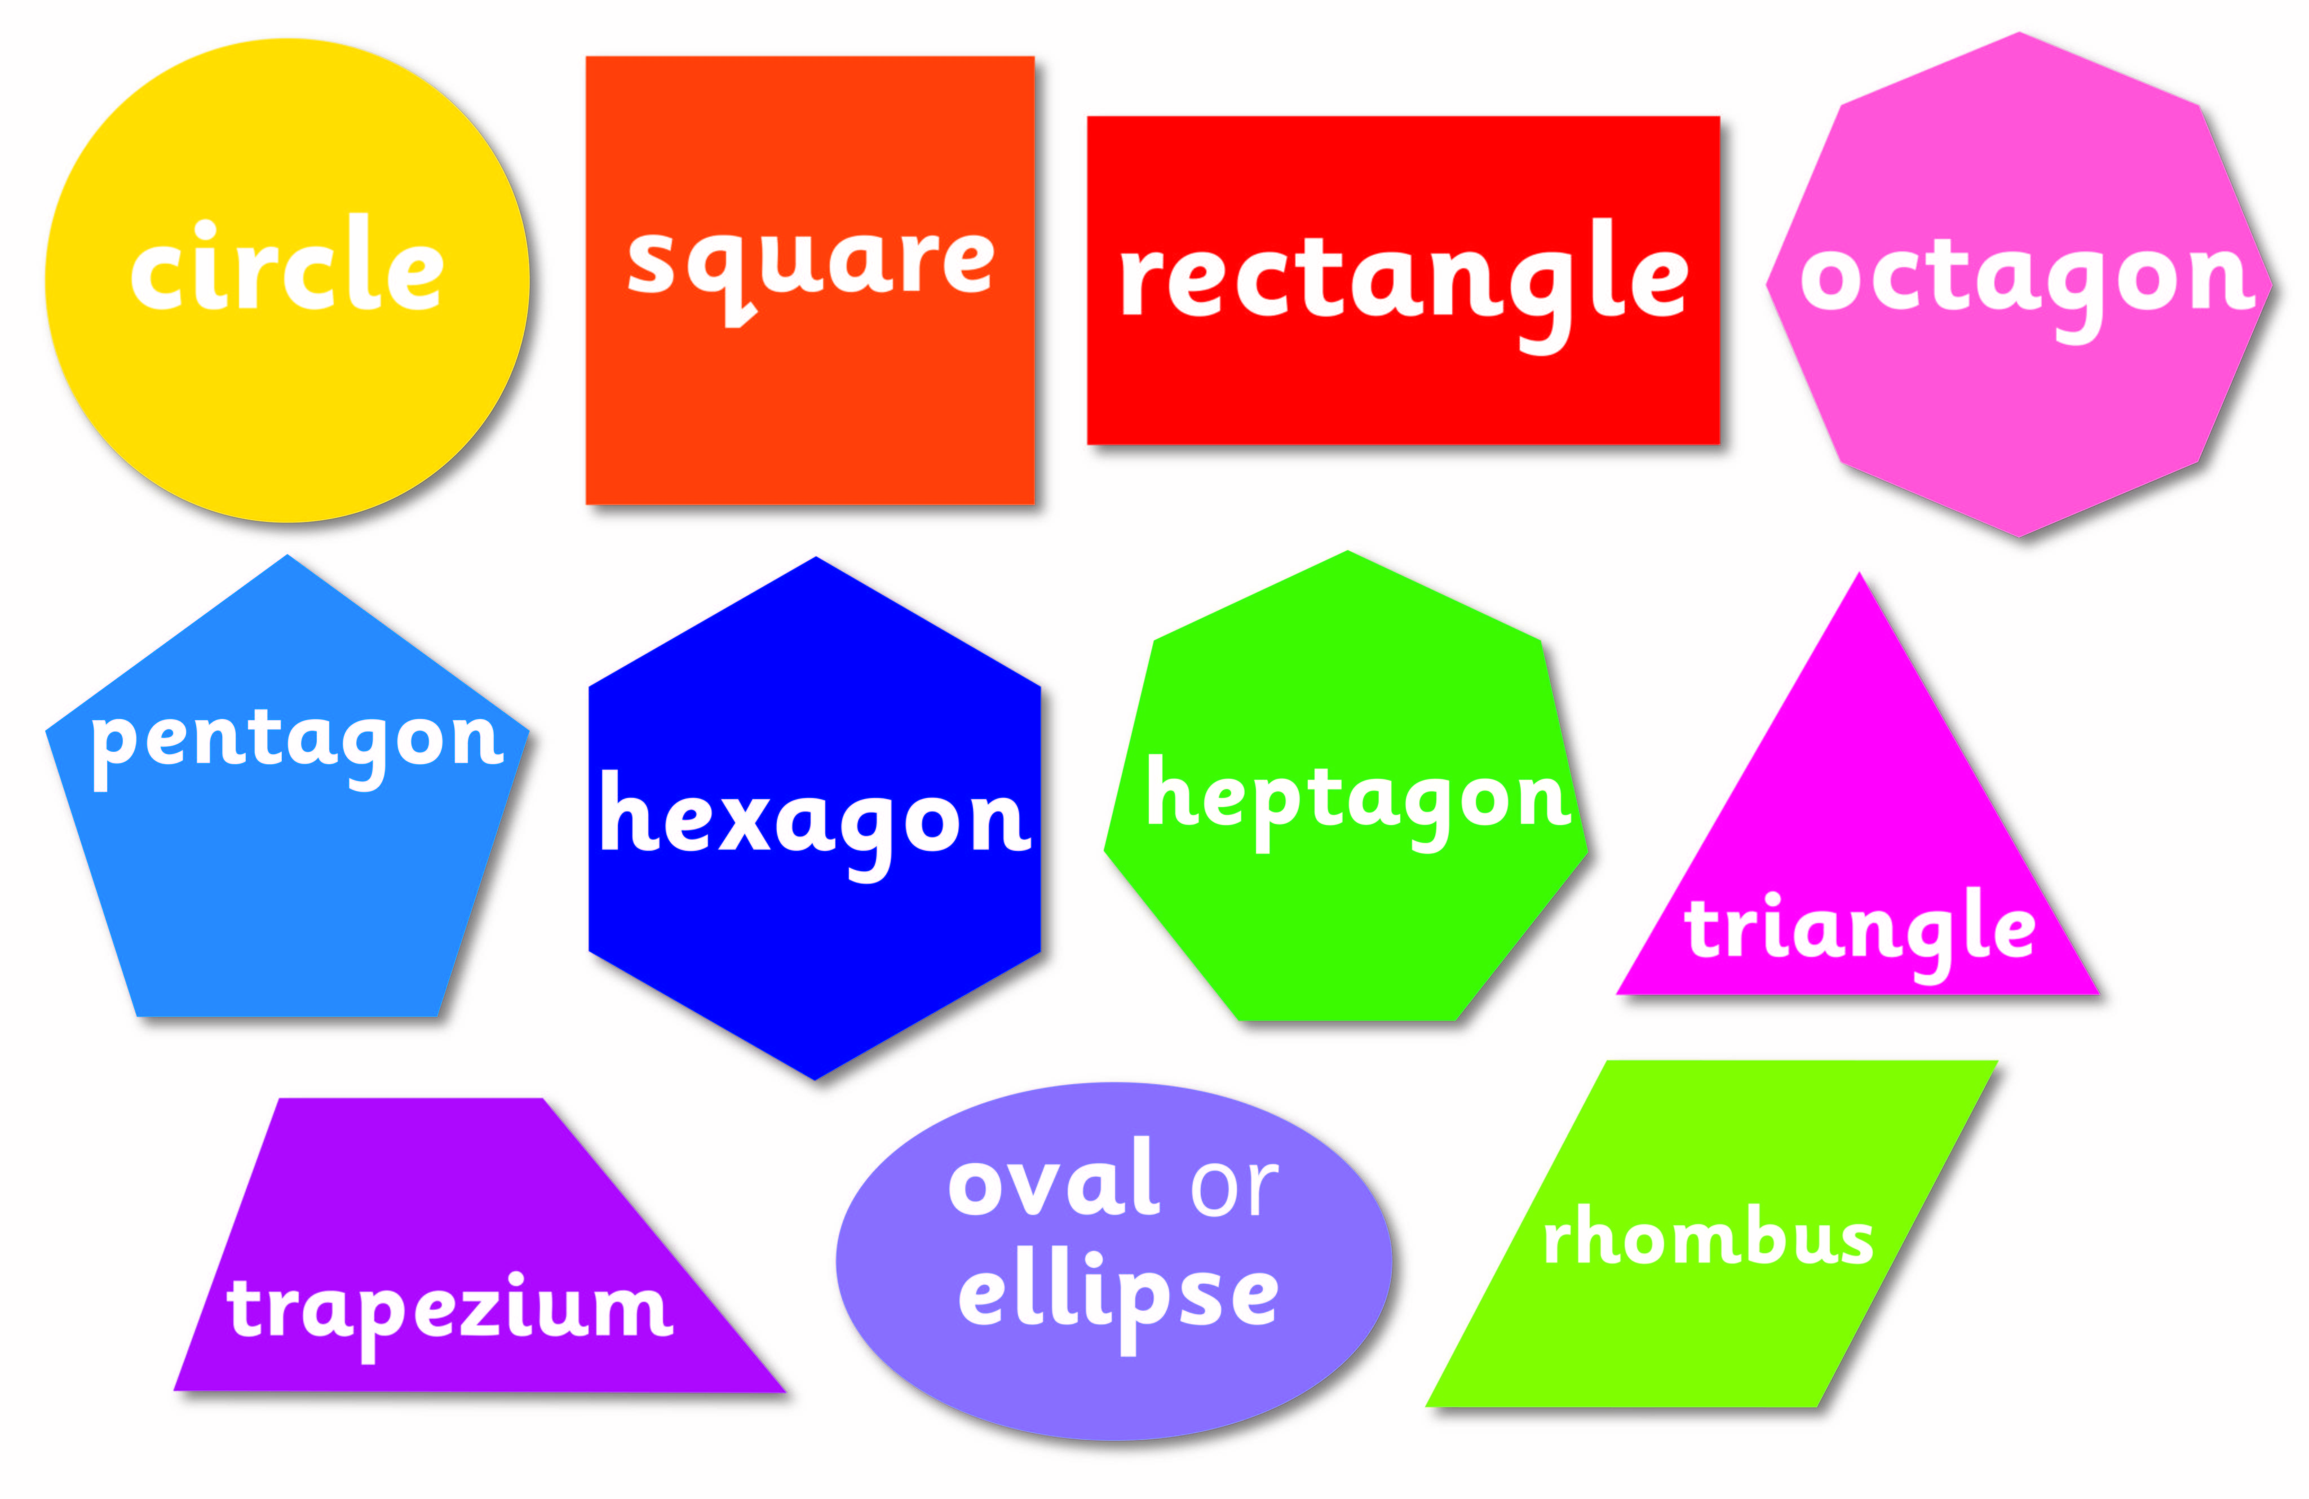
stay tail mail
male spray shape

Slide 17
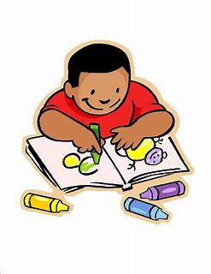
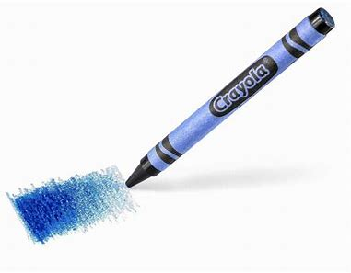
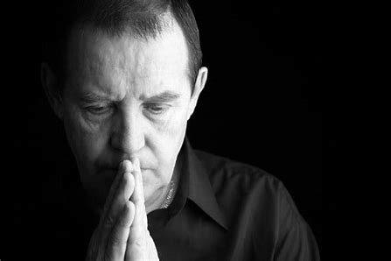
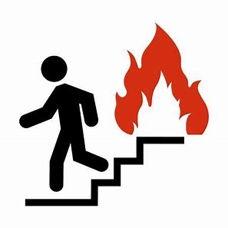
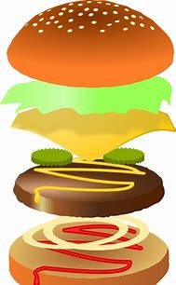
crayon praying mainly
layer escape pancake

Slide 18
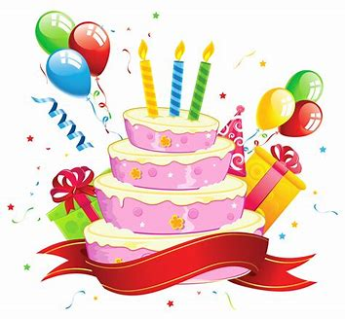
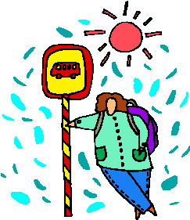
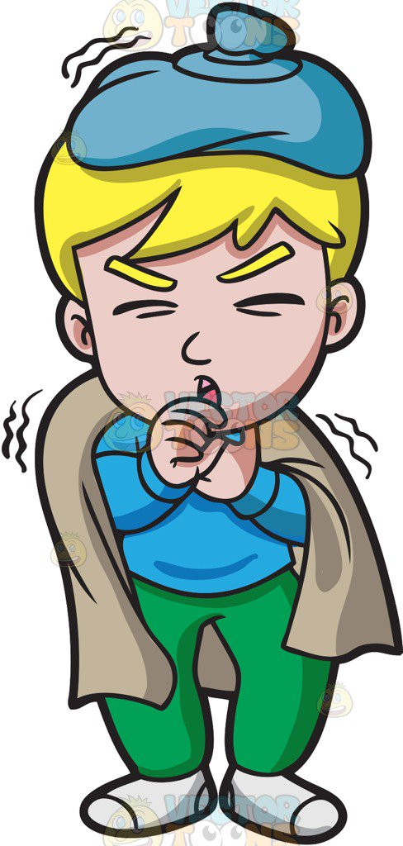
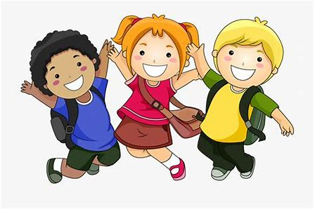
birthday yesterday waiting
ailing animate decade

Slide 19
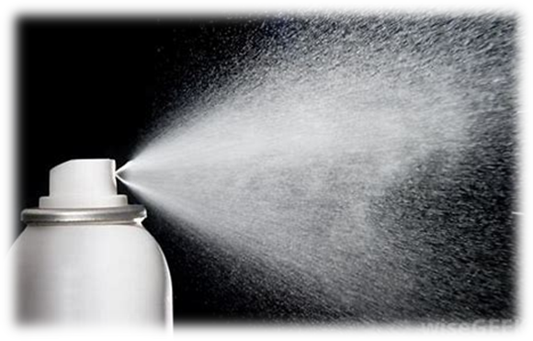
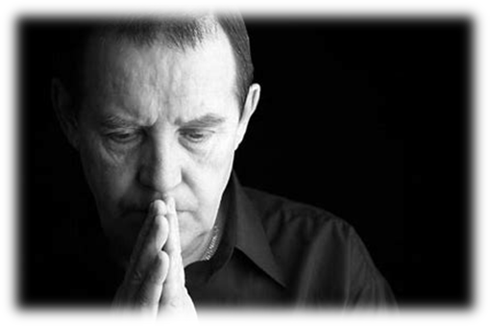
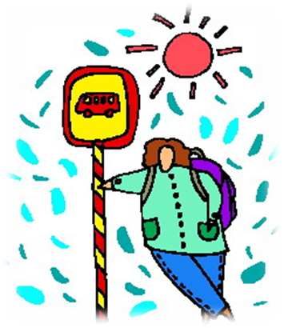

Slide 20
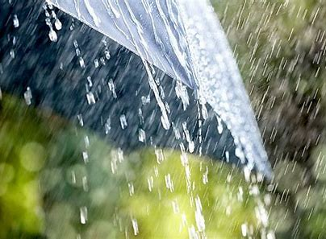
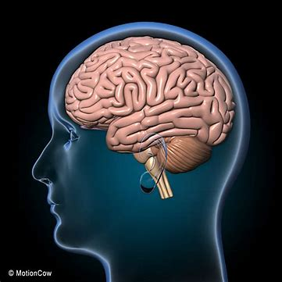
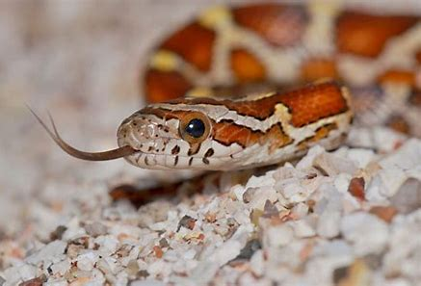
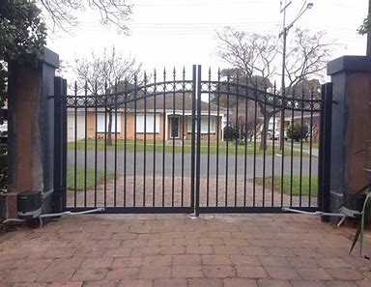
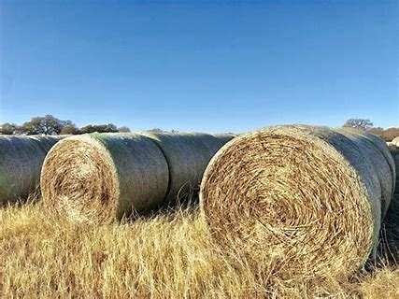
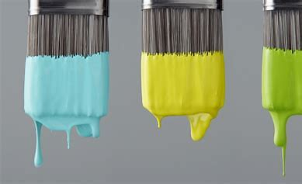

Slide 21
snake

Slide 22
snake rain

Slide 23
snake rain brain

Slide 24
snake rain brain
gate

Slide 25
snake rain brain
gate hay

Slide 26
snake rain brain
gate hay paint

Slide 27
Dictation

Slide 28
Dictation
1.
2.
3.

Slide 29
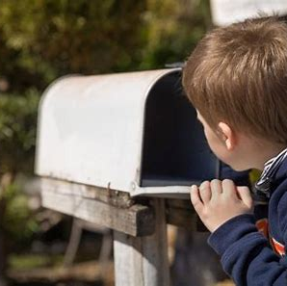

Slide 30
I was waiting for my mail.

Slide 31
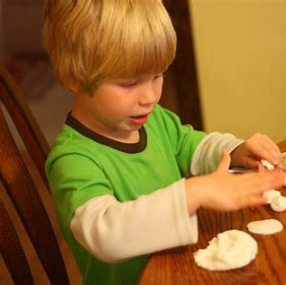

Slide 32
He makes a cake of clay.

Slide 33
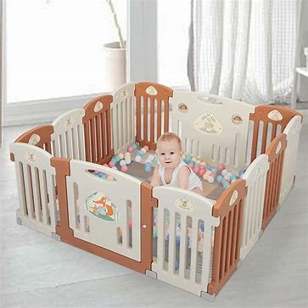

Slide 34
The boy was in the playpen.

