Slide 1
Jolly Grammar 3a-2

Slide 2
Mini Test 1

Slide 3
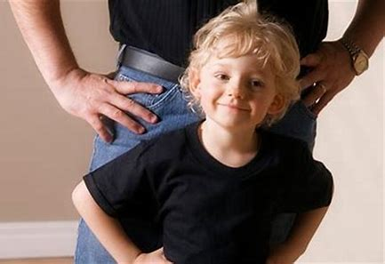
mimic

Slide 4
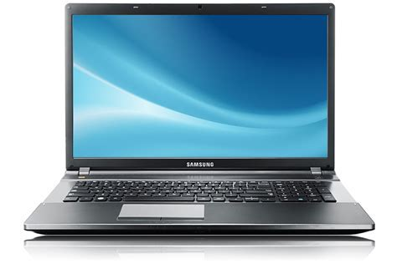
mimic
laptop

Slide 5
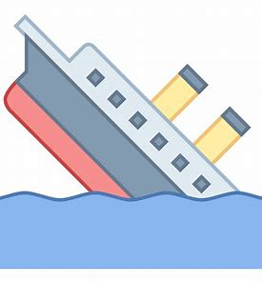
mimic
laptop
sank

Slide 6
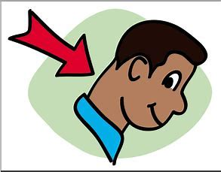
mimic
laptop
sank
neck

Slide 7
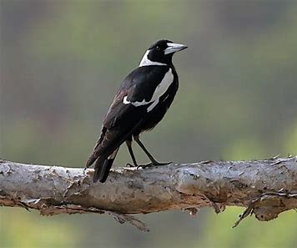
mimic
laptop
sank
neck
magpie

Slide 8
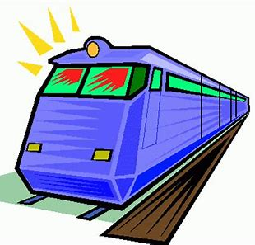
mimic
laptop
sank
neck
magpie
rapid

Slide 9
mimic
laptop
sank
neck
magpie
rapid
7.quench

Slide 10
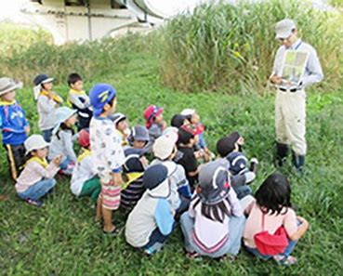
mimic
laptop
sank
neck
magpie
rapid
7.quench
8.outing

Slide 11
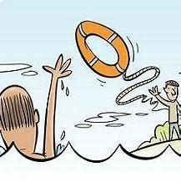
mimic
laptop
sank
neck
magpie
rapid
7.quench
8.outing
9.rescue

Slide 12
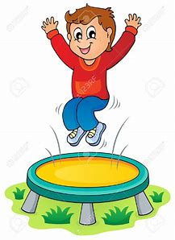
mimic
laptop
sank
neck
magpie
rapid
7.quench
8.outing
9.rescue
10.jumped

Slide 13
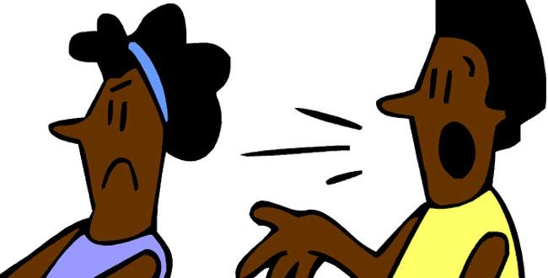
mimic
laptop
sank
neck
magpie
rapid
7.quench
8.outing
9.rescue
10.jumped
11.disagree

Slide 14
mimic
laptop
sank
neck
magpie
rapid
7.quench
8.outing
9.rescue
10.jumped
11.disagree
12.correct

Slide 15
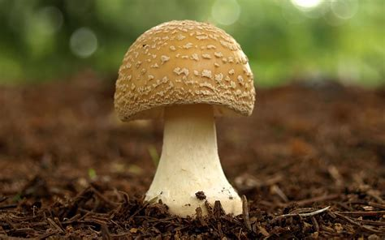
mimic
laptop
sank
neck
magpie
rapid
7.quench
8.outing
9.rescue
10.jumped
11.disagree
12.correct
13.mushroom

Slide 16
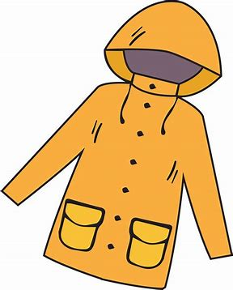
mimic
laptop
sank
neck
magpie
rapid
7.quench
8.outing
9.rescue
10.jumped
11.disagree
12.correct
13.mushroom
14.raincoat

Slide 17
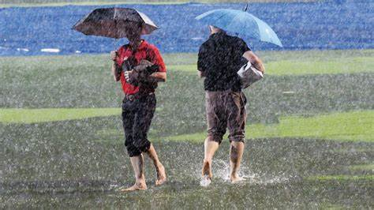
mimic
laptop
sank
neck
magpie
rapid
7.quench
8.outing
9.rescue
10.jumped
11.disagree
12.correct
13.mushroom
14.raincoat
15.spoilsport

Slide 18
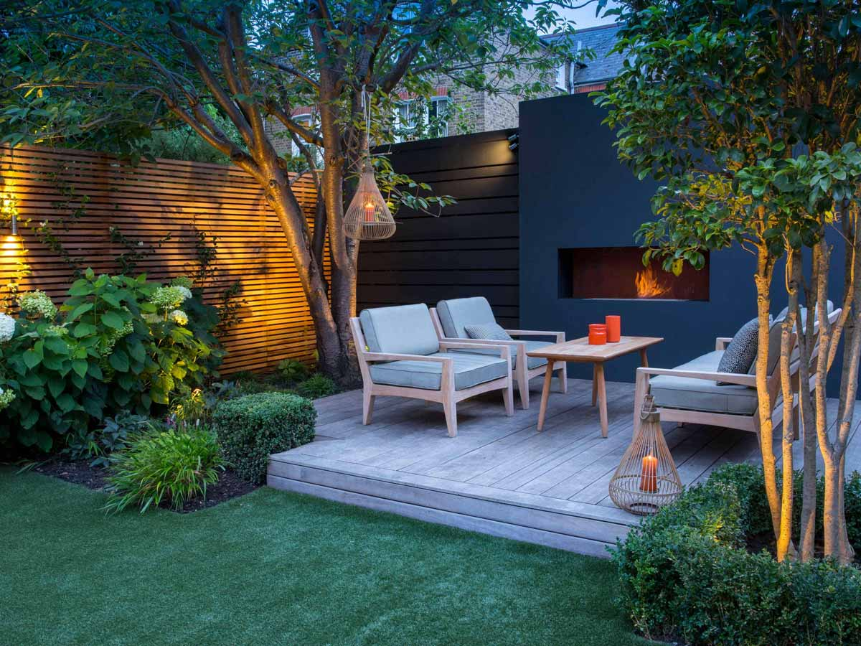
mimic
laptop
sank
neck
magpie
rapid
7.quench
8.outing
9.rescue
10.jumped
11.disagree
12.correct
13.mushroom
14.raincoat
15.spoilsport
16.backyard

Slide 19
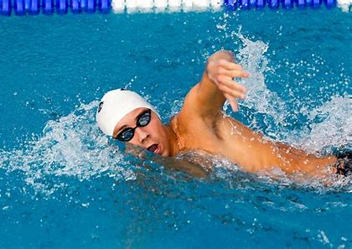
mimic
laptop
sank
neck
magpie
rapid
7.quench
8.outing
9.rescue
10.jumped
11.disagree
12.correct
13.mushroom
14.raincoat
15.spoilsport
16.backyard
17.swimming

Slide 20
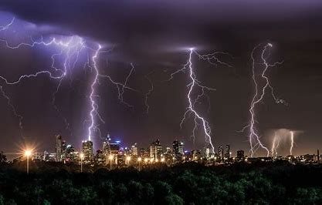
mimic
laptop
sank
neck
magpie
rapid
7.quench
8.outing
9.rescue
10.jumped
11.disagree
12.correct
13.mushroom
14.raincoat
15.spoilsport
16.backyard
17.swimming
18.thunderstorm

Slide 21
Let’s revise alphabetical order!

Slide 22
break
brush
broom

Slide 23
break
brush
broom

Slide 24
break
brush
broom

Slide 25
break
brush
broom
1st

Slide 26
break
brush
broom
1st
2nd

Slide 27
break
brush
broom
1st
3rd
2nd

Slide 28
break
brush
broom
1st
3rd
2nd
sunrise
Sunday
sunflower

Slide 29
break
brush
broom
1st
3rd
2nd
sunrise
Sunday
sunflower
1st

Slide 30
break
brush
broom
1st
3rd
2nd
sunrise
Sunday
sunflower
1st
2nd

Slide 31
break
brush
broom
1st
3rd
2nd
sunrise
Sunday
sunflower
3rd
1st
2nd

Slide 32
break
brush
broom
1st
3rd
2nd
sunrise
Sunday
sunflower
3rd
1st
2nd

Slide 33
Activity Page:
Using a Dictionary

Slide 34
spider
spark
sprout

Slide 35
spider
spark
sprout
1st

Slide 36
spider
spark
sprout
2nd
1st

Slide 37
spider
spark
sprout
2nd
1st
3rd

Slide 38
spider
spark
sprout
2nd
1st
3rd
ear
east
earn

Slide 39
spider
spark
sprout
2nd
1st
3rd
ear
east
earn
1st
3rd
2nd

Slide 40
spider
spark
sprout
2nd
1st
3rd
ear
east
earn
1st
3rd
2nd
mint
mine
mind

Slide 41
spider
spark
sprout
2nd
1st
3rd
ear
east
earn
1st
3rd
2nd
mint
mine
mind
3rd
2nd
1st

Slide 42
spider
spark
sprout
2nd
1st
3rd
ear
east
earn
1st
3rd
2nd
mint
mine
mind
3rd
2nd
1st
newt towd mermayd
peecock strawberry oter

Slide 43
spider
spark
sprout
2nd
1st
3rd
ear
east
earn
1st
3rd
2nd
mint
mine
mind
3rd
2nd
1st
newt towd mermaid
peecock strawberry oter

Slide 44
spider
spark
sprout
2nd
1st
3rd
ear
east
earn
1st
3rd
2nd
mint
mine
mind
3rd
2nd
1st
newt towd mermaid
✔
peecock strawberry oter

Slide 45
spider
spark
sprout
2nd
1st
3rd
ear
east
earn
1st
3rd
2nd
mint
mine
mind
3rd
2nd
1st
newt towd mermayd
✔ toad
peecock strawberry oter

Slide 46
spider
spark
sprout
2nd
1st
3rd
ear
east
earn
1st
3rd
2nd
mint
mine
mind
3rd
2nd
1st
newt towd mermaid
✔ toad mermaid
peecock strawberry oter

Slide 47
spider
spark
sprout
2nd
1st
3rd
ear
east
earn
1st
3rd
2nd
mint
mine
mind
3rd
2nd
1st
newt towd mermaid
✔ toad mermaid
peecock strawberry oter
peacock

Slide 48
spider
spark
sprout
2nd
1st
3rd
ear
east
earn
1st
3rd
2nd
mint
mine
mind
3rd
2nd
1st
newt towd mermaid
✔ toad mermaid
peecock strawberry oter
peacock ✔

Slide 49
spider
spark
sprout
2nd
1st
3rd
ear
east
earn
1st
3rd
2nd
mint
mine
mind
3rd
2nd
1st
newt towd mermaid
✔ toad mermaid
peecock strawberry oter
peacock ✔ otter

Slide 50
