Slide 1
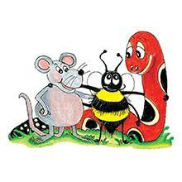
Jolly Grammar 3a-1

Slide 2
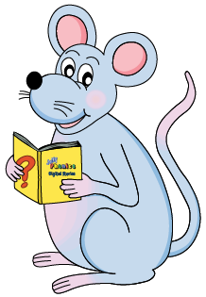
Mini Test 36
(Grammar 2)

Slide 3
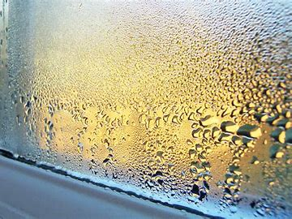
1. damp

Slide 4
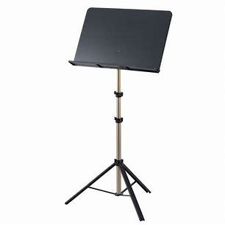
1. damp
2. stand

Slide 5
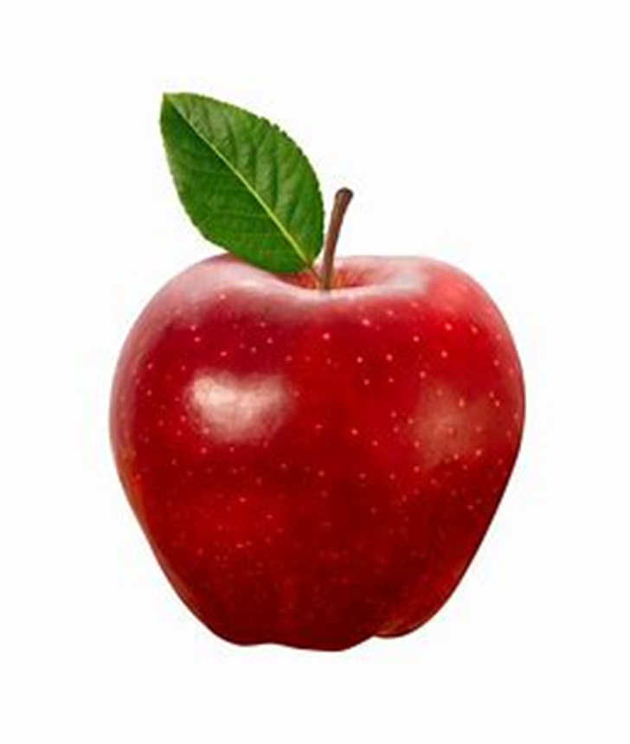
1. damp
2. stand
3. apple

Slide 6
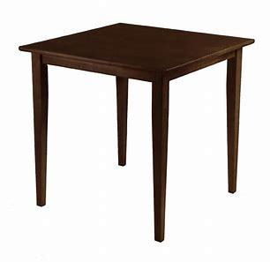
1. damp
2. stand
3. apple
4. table

Slide 7
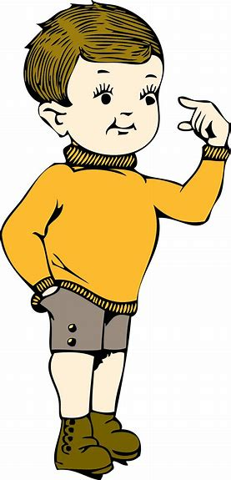
1. damp
2. stand
3. apple
4. table
5. little

Slide 8
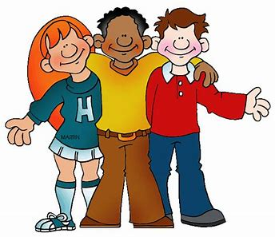
6. middle
1. damp
2. stand
3. apple
4. table
5. little

Slide 9
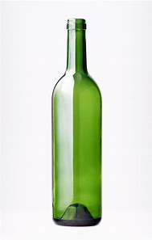
6. middle
7. bottle
1. damp
2. stand
3. apple
4. table
5. little

Slide 10
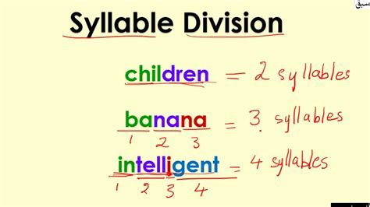
6. middle
7. bottle
8. syllable
1. damp
2. stand
3. apple
4. table
5. little

Slide 11
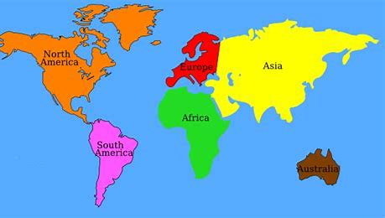
6. middle
7. bottle
8. syllable
9. continent
1. damp
2. stand
3. apple
4. table
5. little

Slide 12
6. middle
7. bottle
8. syllable
9. continent
10. world
1. damp
2. stand
3. apple
4. table
5. little

Slide 13
Mini Test 36 (Grammar 2)
Name:
6.
7.
8.
9.
10.
1. damp
2.
3.
4.
5.

Slide 14
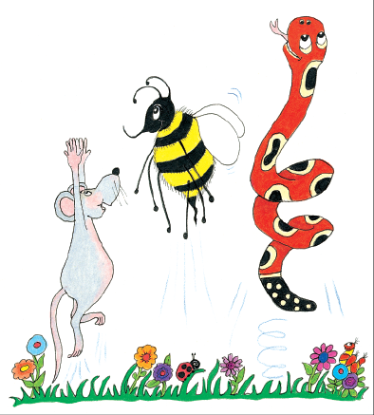
Let’s review
sounds.

Slide 15
Short Vowels
Long
Vowels

Slide 16
Short Vowels
a
e
i
o
u
Long
Vowels

Slide 17
Short Vowels
a
e
i
o
u
Long
Vowels
ai
ee
ie
oa
ue

Slide 18
Short Vowels
a
e
i
o
u
Long
Vowels
ai ay a-e
ee
ie
oa
ue

Slide 19
Short Vowels
a
e
i
o
u
Long
Vowels
ai ay a-e
ee ea e-e
ie
oa
ue

Slide 20
Short Vowels
a
e
i
o
u
Long
Vowels
ai ay a-e
ee ea e-e
ie i-e
oa
ue

Slide 21
Short Vowels
a
e
i
o
u
Long
Vowels
ai ay a-e
ee ea e-e
ie i-e
oa ow o-e
ue

Slide 22
Short Vowels
a
e
i
o
u
Long
Vowels
ai ay a-e
ee ea e-e
ie i-e
oa ow o-e
ue ew u-e

Slide 23
Short Vowels
a
e
i
o
u
Long
Vowels
ai ay a-e
ee ea e-e
ie i-e
oa ow o-e
ue ew u-e

Slide 24
cap cape brain laptop
meet meat quench din tried
mimic fox bone bone boat
bus muse met rescue
raincoat stew dine

Slide 25
Spelling List

Slide 26
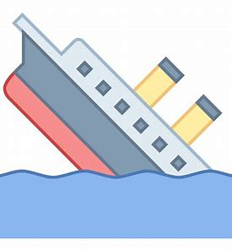
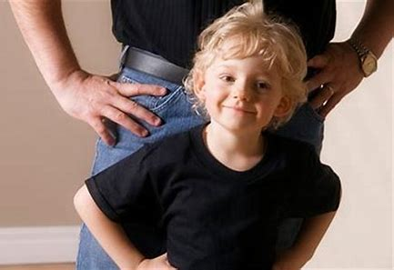
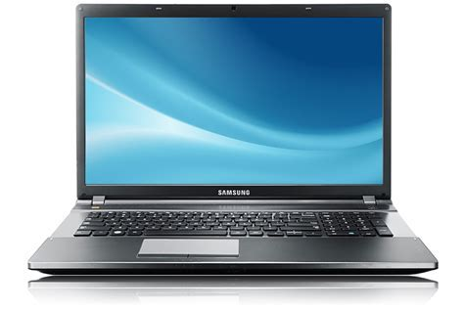
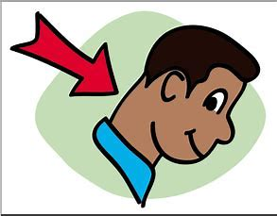
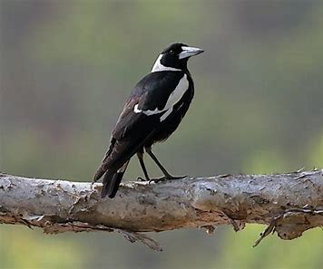
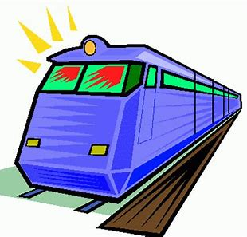
mimic laptop sank
neck magpie rapid

Slide 27
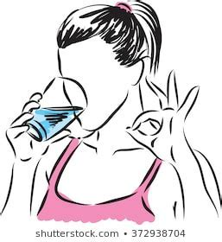
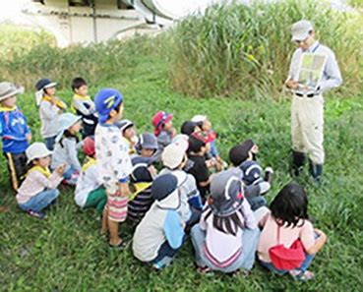
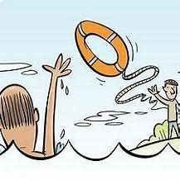
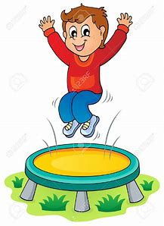
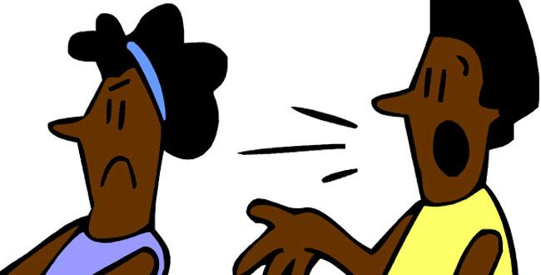
quench outing rescue
jumped disagree correct

Slide 28
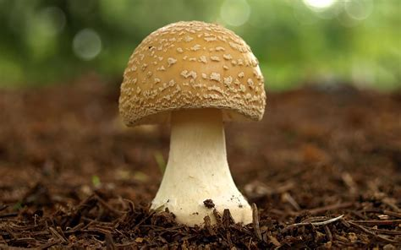
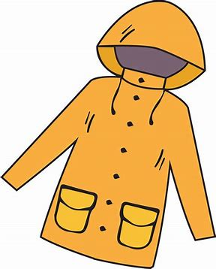
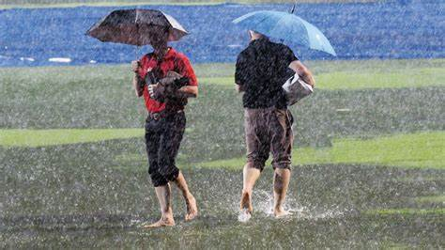
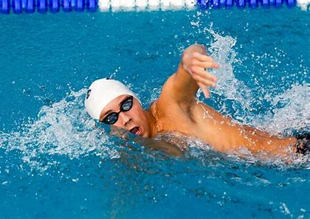
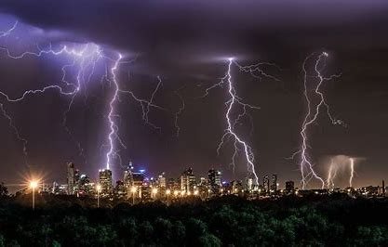
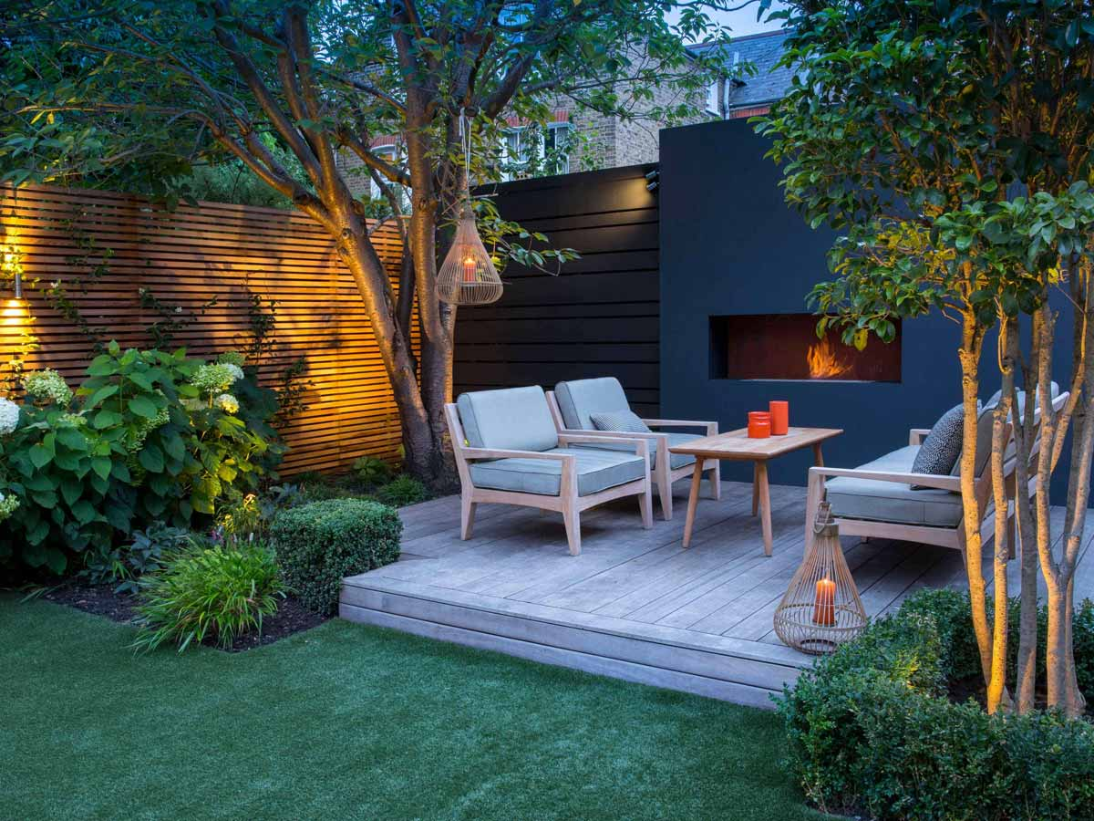
mushroom raincoat spoilsport
backyard swimming thunderstorm

Slide 29
mimic
laptop
sank
neck
magpie
rapid
quench
outing
rescue
jumped
disagree
correct
mushroom
raincoat
spoilsport
backyard
swimming
thunderstorm

Slide 30
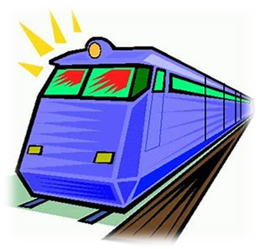
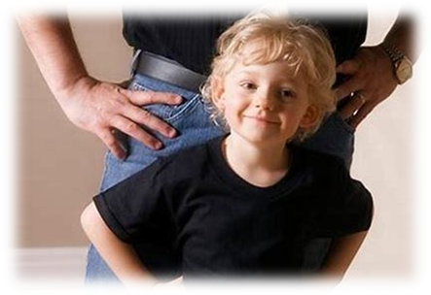
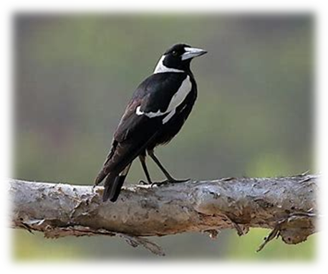
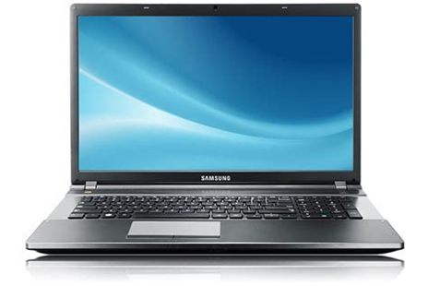
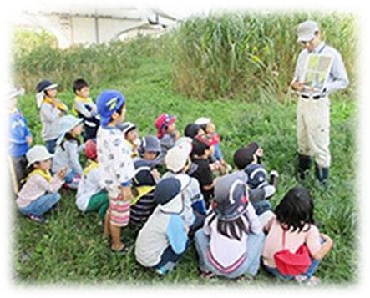
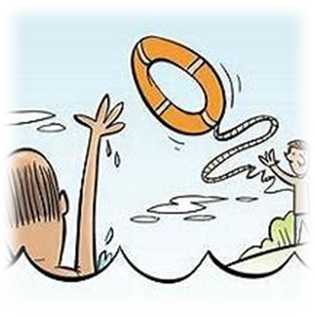
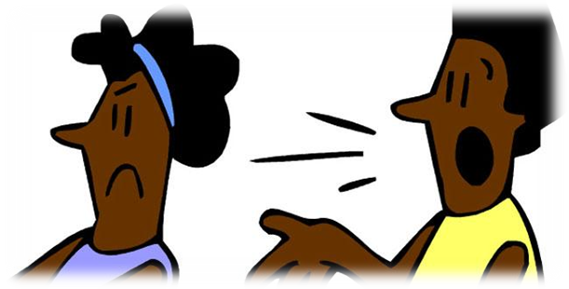
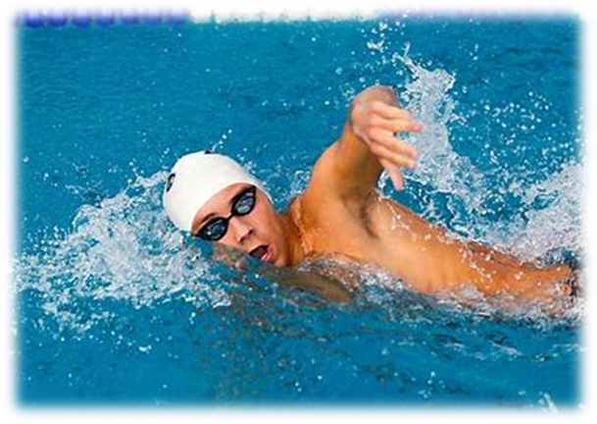
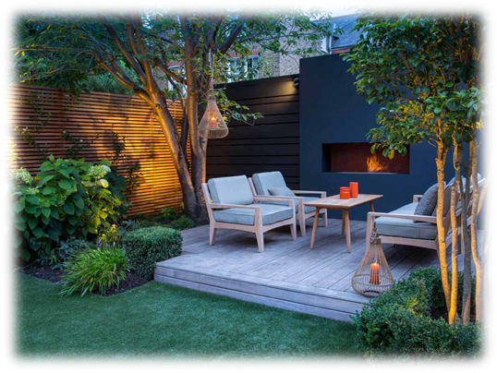
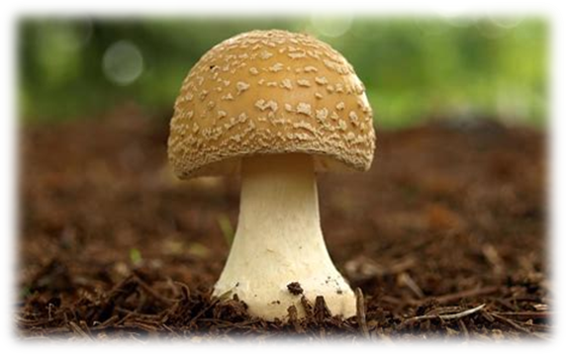
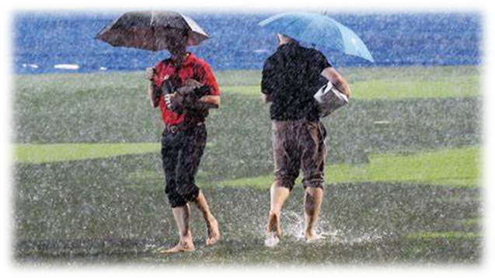
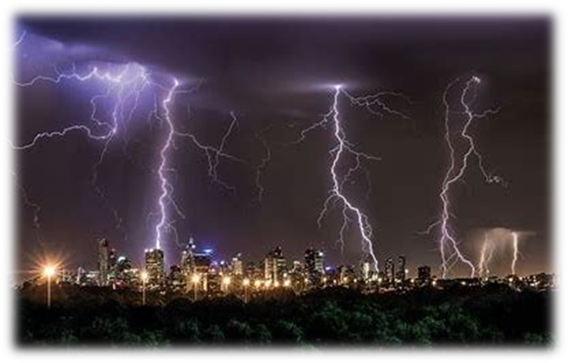

Slide 31
backyard

Slide 32
backyard
correct

Slide 33
backyard
correct
disagree

Slide 34
backyard
correct
disagree
jumped

Slide 35
backyard
correct
disagree
jumped
laptop

Slide 36
backyard
correct
disagree
jumped
laptop
magpie

Slide 37
backyard
correct
disagree
jumped
laptop
magpie
mimic

Slide 38
backyard
correct
disagree
jumped
laptop
magpie
mimic
mushroom

Slide 39
backyard
correct
disagree
jumped
laptop
magpie
mimic
mushroom
neck

Slide 40
backyard
correct
disagree
jumped
laptop
magpie
mimic
mushroom
neck
10. outing

Slide 41
backyard
correct
disagree
jumped
laptop
magpie
mimic
mushroom
neck
10. outing
11. quench

Slide 42
backyard
correct
disagree
jumped
laptop
magpie
mimic
mushroom
neck
10. outing
11. quench
12. raincoat

Slide 43
backyard
correct
disagree
jumped
laptop
magpie
mimic
mushroom
neck
10. outing
11. quench
12. raincoat
13. rapid

Slide 44
backyard
correct
disagree
jumped
laptop
magpie
mimic
mushroom
neck
10. outing
11. quench
12. raincoat
13. rapid
14. rescue

Slide 45
backyard
correct
disagree
jumped
laptop
magpie
mimic
mushroom
neck
10. outing
11. quench
12. raincoat
13. rapid
14. rescue
15. sank

Slide 46
backyard
correct
disagree
jumped
laptop
magpie
mimic
mushroom
neck
10. outing
11. quench
12. raincoat
13. rapid
14. rescue
15. sank
16. spoilsport

Slide 47
backyard
correct
disagree
jumped
laptop
magpie
mimic
mushroom
neck
10. outing
11. quench
12. raincoat
13. rapid
14. rescue
15. sank
16. spoilsport
17. swimming

Slide 48
backyard
correct
disagree
jumped
laptop
magpie
mimic
mushroom
neck
10. outing
11. quench
12. raincoat
13. rapid
14. rescue
15. sank
16. spoilsport
17. swimming
18. thunderstorm

Slide 49
Dictation

Slide 50
Dictation
1.
2.
3.

Slide 51
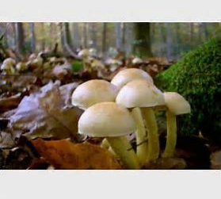
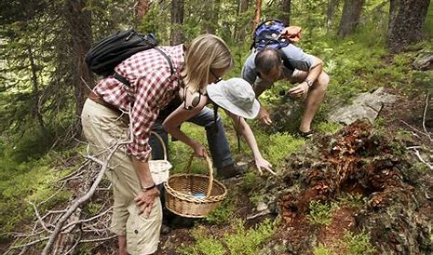

Slide 52
We went on an outing to pick mushrooms.

Slide 53
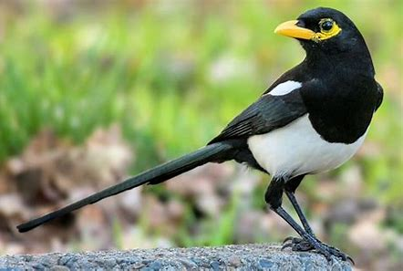

Slide 54
I saw a magpie in the backyard.

Slide 55
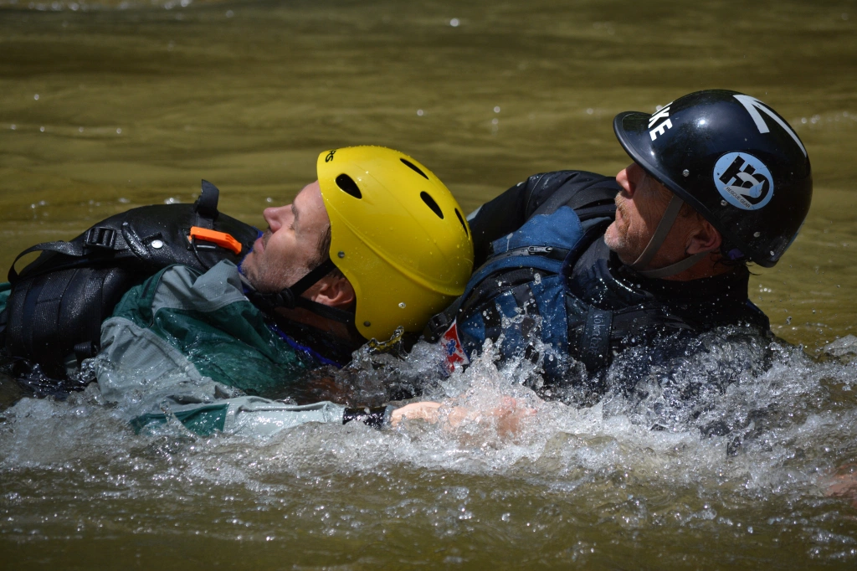

Slide 56
They had to make a rapid rescue.

