Slide 1
Jolly Grammar 2-27

Slide 2
Mini Test 26

Slide 3
land

Slide 4
land
quiz

Slide 5
land
quiz
scene

Slide 6
land
quiz
scene
scent

Slide 7
land
quiz
scene
scent
muscle

Slide 8
land
quiz
scene
scent
muscle
6. science

Slide 9
land
quiz
scene
scent
muscle
6. science
7. scissors

Slide 10
land
quiz
scene
scent
muscle
6. science
7. scissors
8. crescent

Slide 11
land
quiz
scene
scent
muscle
6. science
7. scissors
8. crescent
9. gram

Slide 12
land
quiz
scene
scent
muscle
6. science
7. scissors
8. crescent
9. gram
10. kilogram

Slide 13
Prefixes
<un->
<dis->
<mis->
<im->

Slide 14
happy

Slide 15
happy
happy

Slide 16
un-
dis-
mis-
im-
happy
happy

Slide 17
happy
unhappy

Slide 18
Activity page1

Slide 19
un- dis- mis- im-
It was possible to walk along the path.
I really like writing stories in school.
Dad packed the large suitcases.
Jason understood what he had to do.
Prefixes

Slide 20
un- dis- mis- im-
It was impossible to walk along the path.
I really like writing stories in school.
Dad packed the large suitcases.
Jason understood what he had to do.

Slide 21
un- dis- mis- im-
It was impossible to walk along the path.
I really dislike writing stories in school.
Dad packed the large suitcases.
Jason understood what he had to do.

Slide 22
un- dis- mis- im-
It was impossible to walk along the path.
I really dislike writing stories in school.
Dad unpacked the large suitcases.
Jason understood what he had to do.

Slide 23
un- dis- mis- im-
It was impossible to walk along the path.
I really dislike writing stories in school.
Dad unpacked the large suitcases.
Jason misunderstood what he had to do.

Slide 24
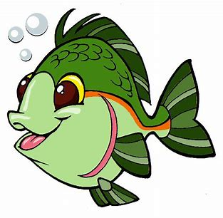
un- dis- mis- im-
happy patient lucky
appear behave lock
do take agree
dress possible comfortable

Slide 25
un- dis- mis- im-
happy patient lucky
appear behave lock
do take agree
dress possible comfortable

Slide 26
un- dis- mis- im-
happy patient lucky
appear behave lock
do take agree
dress possible comfortable

Slide 27
un- dis- mis- im-
unhappy patient lucky
appear behave lock
do take agree
dress possible comfortable

Slide 28
un- dis- mis- im-
unhappy impatient lucky
appear behave lock
do take agree
dress possible comfortable

Slide 29
un- dis- mis- im-
unhappy impatient unlucky
appear behave lock
do take agree
dress possible comfortable

Slide 30
un- dis- mis- im-
unhappy impatient unlucky
disappear behave lock
do take agree
dress possible comfortable

Slide 31
un- dis- mis- im-
unhappy impatient unlucky
disappear misbehave lock
do take agree
dress possible comfortable

Slide 32
un- dis- mis- im-
unhappy impatient unlucky
disappear misbehave unlock
do take agree
dress possible comfortable

Slide 33
un- dis- mis- im-
unhappy impatient unlucky
disappear misbehave unlock
undo take agree
dress possible comfortable

Slide 34
un- dis- mis- im-
unhappy impatient unlucky
disappear misbehave unlock
undo mistake agree
dress possible comfortable

Slide 35
un- dis- mis- im-
unhappy impatient unlucky
disappear misbehave unlock
undo mistake disagree
dress possible comfortable

Slide 36
un- dis- mis- im-
unhappy impatient unlucky
disappear misbehave unlock
undo mistake disagree
undress possible comfortable

Slide 37
un- dis- mis- im-
unhappy impatient unlucky
disappear misbehave unlock
undo mistake disagree
undress impossible comfortable

Slide 38
un- dis- mis- im-
unhappy impatient unlucky
disappear misbehave unlock
undo mistake disagree
undress impossible uncomfortable

Slide 39
Measurement Words
centimetre cm
metre m
gram g
kilogram kg
millilitre ml
litre l
weight
volume
minute
second
fraction
estimate

Slide 40
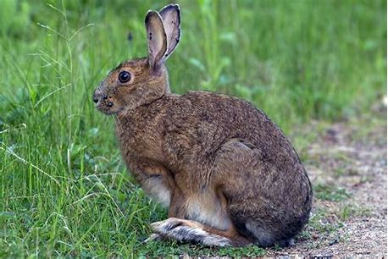
hare
/air/

Slide 41
Activity page2

Slide 42
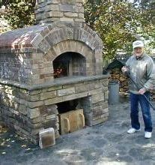
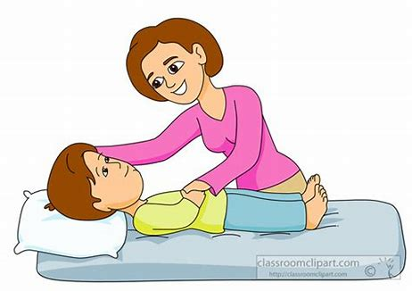
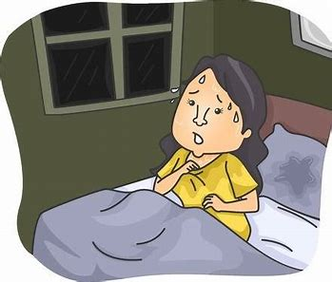
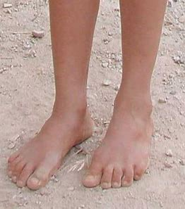
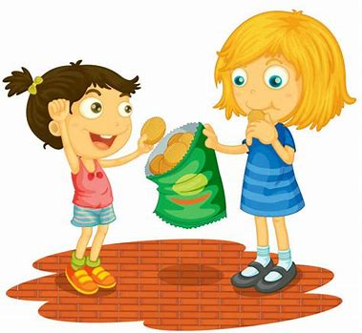
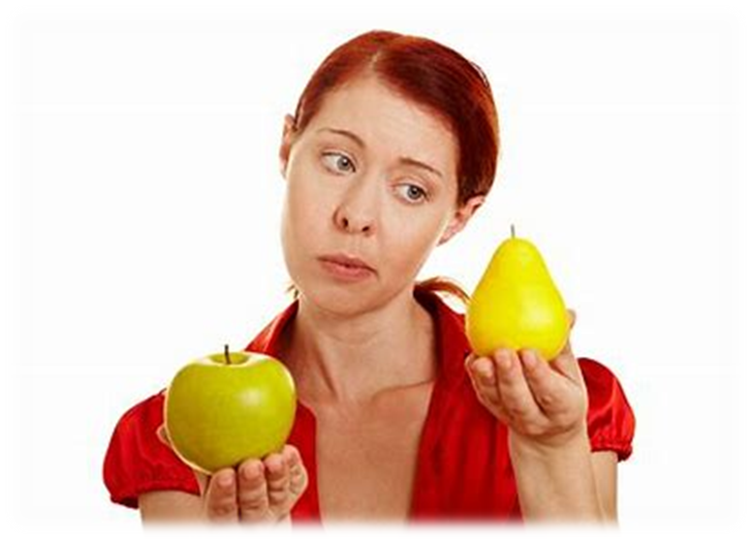
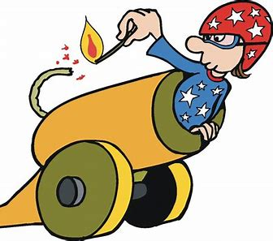
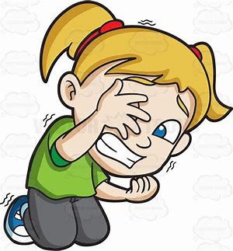
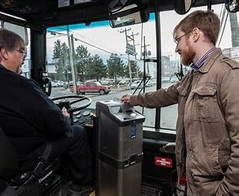
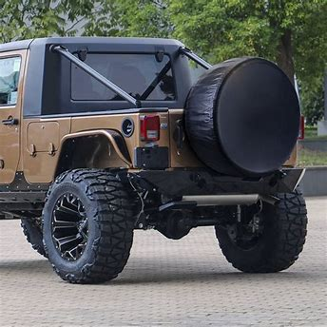
hare
square
flare
kiln
wept
hare
care
share
scare
square
nightmare
millilitre
litre
care
nightmare
bare
share
compare
dare
fare
spare
scare

Slide 43
Dictation

Slide 44
Name:
1. 2. 3.
4. 5. 6.
7.
8.
9.

Slide 45
fare

Slide 46
fare 2. flare

Slide 47
fare 2. flare 3. bare

Slide 48
fare 2. flare 3. bare
4. dare

Slide 49
fare 2. flare 3. bare
4. dare 5. share

Slide 50
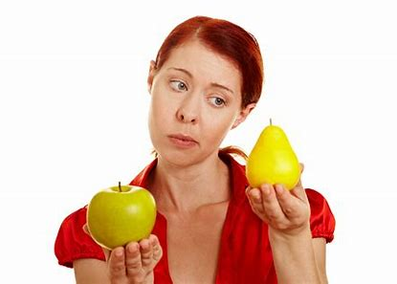
fare 2. flare 3. bare
4. dare 5. share 6. compare

Slide 51
fare 2. flare 3. bare
4. dare 5. share 6. compare
7. This story is about hares.

Slide 52
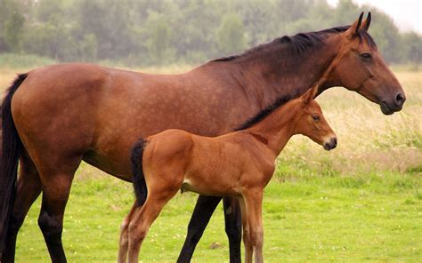
fare 2. flare 3. bare
4. dare 5. share 6. compare
7. This story is about hares.
8. The mare had a foal
last winter.

Slide 53
fare 2. flare 3. bare
4. dare 5. share 6. compare
7. This story is about hares.
8. The mare had a foal
last winter.
9. The spare wheel is in
the back of the truck.

Slide 54
Make new words by joining up the prefixes and base words below.
tele-
tri-
scope
angle
cycle
vision

Slide 55
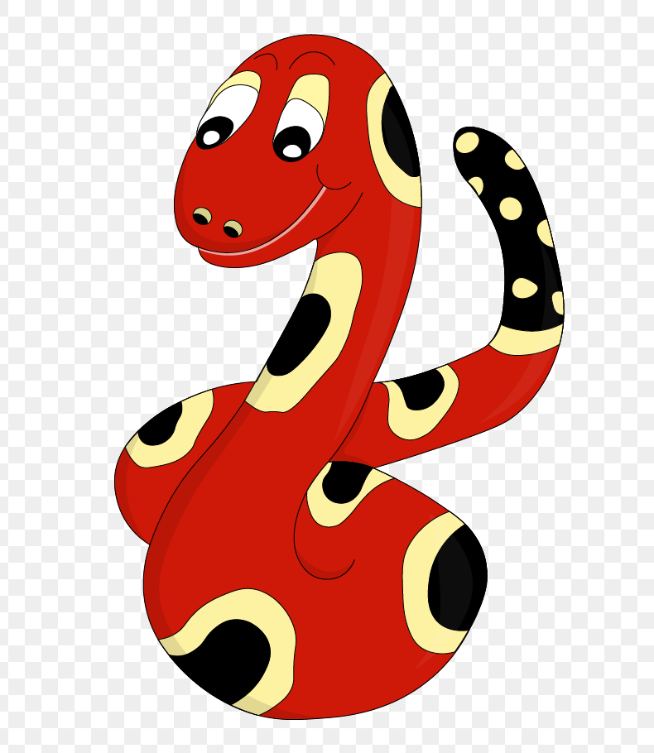
Thank you!
See you
next lesson.

