Slide 1
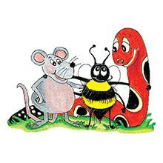
Jolly Grammar 2-26

Slide 2
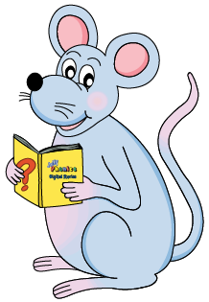
Mini Test 25

Slide 3
belt

Slide 4
belt
farm

Slide 5
belt
farm
hour

Slide 6
belt
farm
hour
ghost

Slide 7
belt
farm
hour
ghost
rhyme

Slide 8
belt
farm
hour
ghost
rhyme
6. rhythm

Slide 9
belt
farm
hour
ghost
rhyme
6. rhythm
7. honest

Slide 10
belt
farm
hour
ghost
rhyme
6. rhythm
7. honest
8. rhinoceros

Slide 11
belt
farm
hour
ghost
rhyme
6. rhythm
7. honest
8. rhinoceros
9. centimetre

Slide 12
belt
farm
hour
ghost
rhyme
6. rhythm
7. honest
8. rhinoceros
9. centimetre
10. metre

Slide 13
Proofreading

Slide 14
Proofreading a Story
aunt carol was going shopping
she decided to take her umbrella
when she arrived at the shop

Slide 15
Proofreading a Story
aunt carol was going shopping
Aunt Carol was going shopping.
she decided to take her umbrella
when she arrived at the shop

Slide 16
Proofreading a Story
aunt carol was going shopping
Aunt Carol was going shopping.
she decided to take her umbrella
She decided to take her umbrella.
when she arrived at the shop

Slide 17
Proofreading a Story
aunt carol was going shopping
Aunt Carol was going shopping.
she decided to take her umbrella
She decided to take her umbrella.
when she arrived at the shop
When does she arrive at the shop?

Slide 18
Activity page1

Slide 19
Farmer Brown has lots of animals on his farm. He has rabbits,
chicken, cows, horses, a donkey and a goat. The goat has
a very bad temper and butts his horns against the tree
trunk when he is angry. It was Monday morning and Farmer
Brown was feeding his animals.
“Good morning,” he called to
the horses.
“Here is your hay.” He gave the goat a big bag of
oats. Just then a little robin flew down and started pecking
at them. “Those are mine!” shouted the goat.

Slide 20
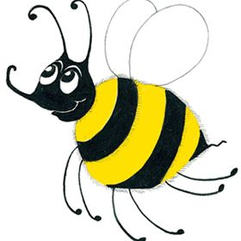
Measurement Words
centimetre cm
metre m
gram g
kilogram kg
millilitre ml
litre l
weight
volume
minute
second
fraction
estimate

Slide 21
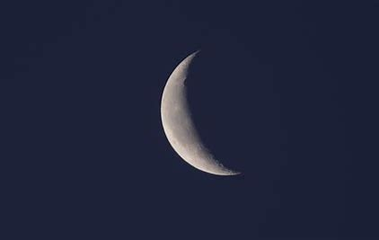
crescent
silent <c>

Slide 22
Activity page2

Slide 23
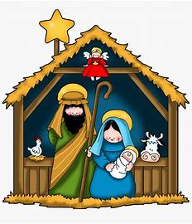
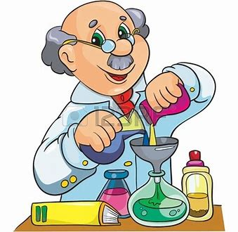
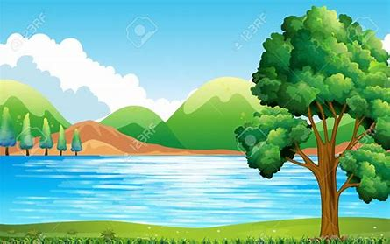
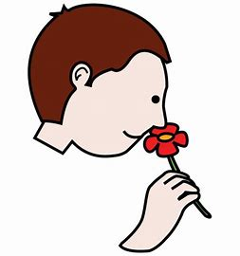
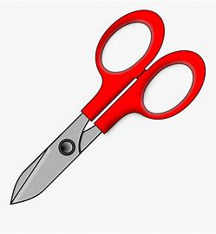
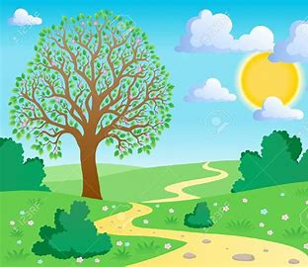
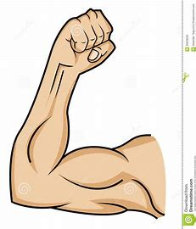
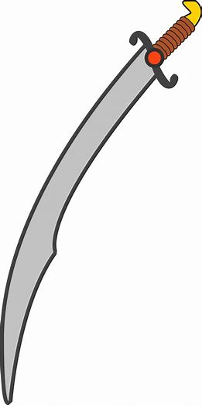
scene
science
scenic
land
quiz
scene
muscle
science
scissors
crescent
gram
kilogram
scent
scissors
scenery
muscle
crescent
scimitar

Slide 24
Dictation

Slide 25
Name:
1. 2. 3.
4. 5. 6.
7.
8.
9.

Slide 26
scent

Slide 27
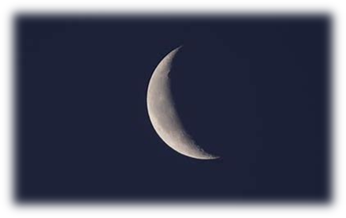
scent 2. crescent

Slide 28
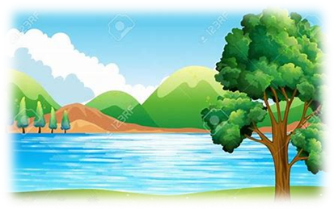
scent 2. crescent 3. scenic

Slide 29
scent 2. crescent 3. scenic
4. scissors

Slide 30
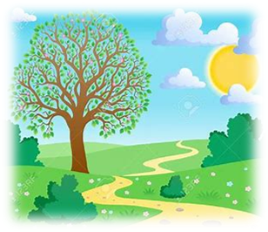
scent 2. crescent 3. scenic
4. scissors 5. scenery

Slide 31
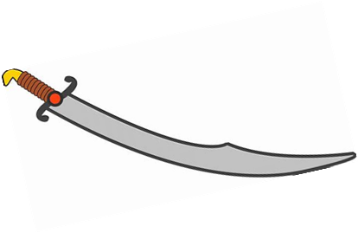
scent 2. crescent 3. scenic
4. scissors 5. scenery 6. scimitar

Slide 32
scent 2. crescent 3. scenic
4. scissors 5. scenery 6. scimitar
7. We act in the third scene.

Slide 33
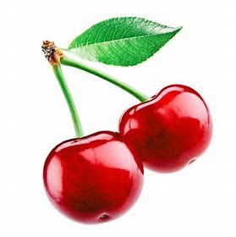
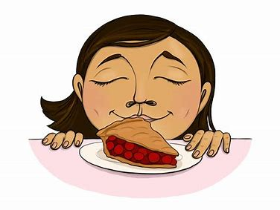
scent 2. crescent 3. scenic
4. scissors 5. scenery 6. scimitar
7. We act in the third scene.
8. I honestly like
the scent of cherries.

Slide 34
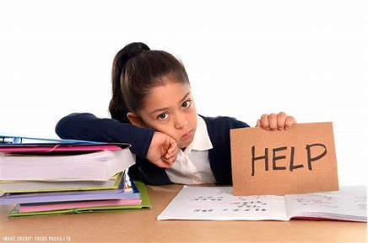
scent 2. crescent 3. scenic
4. scissors 5. scenery 6. scimitar
7. We act in the third scene.
8. I honestly like
the scent of cherries.
9. Our science homework
took hours.

Slide 35
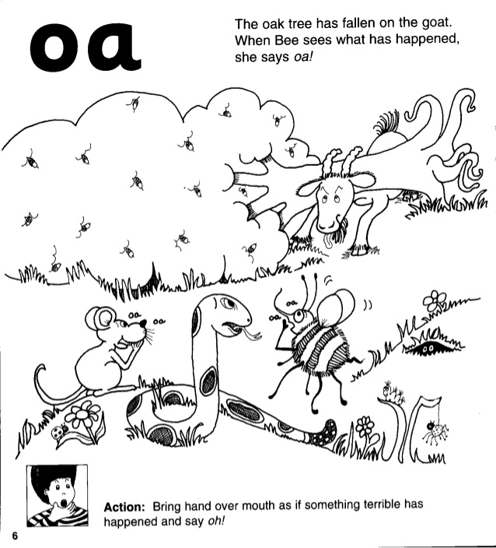
Proofread this story.
the goat was very angry that the robin had stolen sum of
his breakfast he snorted and stamped his hooves the robin
floo up into the oak tree and started singin the goat was
so angry that he charged the tree Crash a larje branch
fell on top ov him oh dear exclaimed farmer brown I shal
have to go and get my tractor to get you owt.

Slide 36
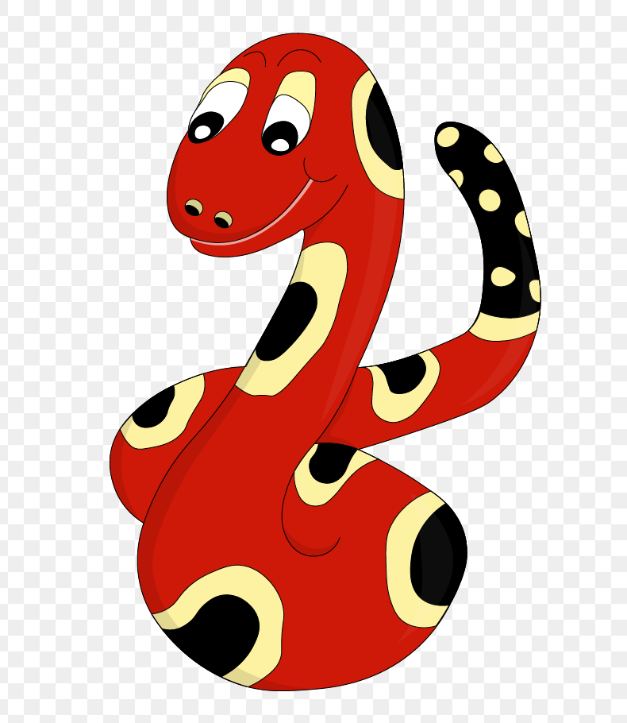
Thank you!
See you
next lesson.

