Slide 1
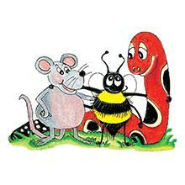
Jolly Grammar 2-24

Slide 2
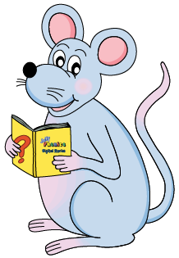
Mini Test 23

Slide 3
film

Slide 4
film
kept

Slide 5
film
kept
key

Slide 6
film
kept
key
honey

Slide 7
film
kept
key
honey
money

Slide 8
film
kept
key
honey
money
6. donkey

Slide 9
film
kept
key
honey
money
6. donkey
7. chimney

Slide 10
film
kept
key
honey
money
6. donkey
7. chimney
8. journey

Slide 11
film
kept
key
honey
money
6. donkey
7. chimney
8. journey
9. thousand

Slide 12
film
kept
key
honey
money
6. donkey
7. chimney
8. journey
9. thousand
10. million

Slide 13
Let’s revise
Conjunction

Slide 15
and but because or so while
We went indoors it started to rain.
I tried to catch the ball I missed it.
Would you rather have cake ice cream?
I would like apple pie cream, please.

Slide 16
and but because or so while
We went indoors because it started to rain.
I tried to catch the ball I missed it.
Would you rather have cake ice cream?
I would like apple pie cream, please.

Slide 17
and but because or so while
We went indoors because it started to rain.
I tried to catch the ball but I missed it.
Would you rather have cake ice cream?
I would like apple pie cream, please.

Slide 18
and but because or so while
We went indoors because it started to rain.
I tried to catch the ball but I missed it.
Would you rather have cake or ice cream?
I would like apple pie cream, please.

Slide 19
and but because or so while
We went indoors because it started to rain.
I tried to catch the ball but I missed it.
Would you rather have cake or ice cream?
I would like apple pie and cream, please.

Slide 20
Let’s revise
Singular &
Plural.

Slide 21
singular plural
dog

Slide 22
singular plural
dog
book
dogs

Slide 23
singular plural
dog
book
bench
dogs
books

Slide 24
singular plural
dog
book
bench
fox
dogs
books
benches

Slide 25
singular plural
dog
book
bench
fox
dogs
books
benches
foxes

Slide 26
Let’s learn
Singular &
Plural with
y-ending.

Slide 27
singular plural
day
key
toy
turkey
fly
puppy
party
mystery

Slide 28
singular plural
day
key
toy
turkey
fly
puppy
party
mystery
days

Slide 29
singular plural
day
key
toy
turkey
fly
puppy
party
mystery
days
keys

Slide 30
singular plural
day
key
toy
turkey
fly
puppy
party
mystery
days
keys
toys

Slide 31
singular plural
day
key
toy
turkey
fly
puppy
party
mystery
days
keys
toys
turkeys

Slide 32
singular plural
day
key
toy
turkey
fly
puppy
party
mystery
days
keys
toys
turkeys
flies

Slide 33
singular plural
day
key
toy
turkey
fly
puppy
party
mystery
days
keys
toys
turkeys
flies
puppies

Slide 34
singular plural
day
key
toy
turkey
fly
puppy
party
mystery
days
keys
toys
turkeys
flies
puppies
parties

Slide 35
singular plural
day
key
toy
turkey
fly
puppy
party
mystery
days
keys
toys
turkeys
flies
puppies
parties
mysteries

Slide 36
Activity page1

Slide 37
Write the plural for each word in the leaf. Then draw a picture for it in the daisy.
baby

Slide 38
Write the plural for each word in the leaf. Then draw a picture for it in the daisy.
baby
babies

Slide 39
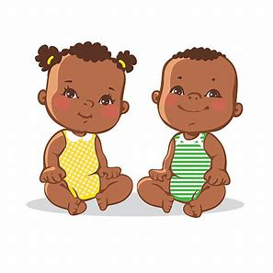
Write the plural for each word in the leaf. Then draw a picture for it in the daisy.
baby
babies

Slide 40
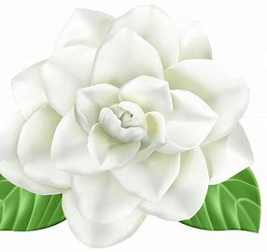
baby
monkey
daisy
fly
berry
donkey
boy
puppy
lady

Slide 41
baby
babies
monkey
daisy
fly
berry
donkey
boy
puppy
lady

Slide 42
baby
babies
monkey
monkeys
daisy
fly
berry
donkey
boy
puppy
lady

Slide 43
baby
babies
monkey
monkeys
daisy
daisies
fly
berry
donkey
boy
puppy
lady

Slide 44
baby
babies
monkey
monkeys
daisy
daisies
fly
flies
berry
donkey
boy
puppy
lady

Slide 45
baby
babies
monkey
monkeys
daisy
daisies
fly
flies
berry
berries
donkey
boy
puppy
lady

Slide 46
baby
babies
monkey
monkeys
daisy
daisies
fly
flies
berry
berries
donkey
donkeys
boy
puppy
lady

Slide 47
baby
babies
monkey
monkeys
daisy
daisies
fly
flies
berry
berries
donkey
donkeys
boy
boys
puppy
lady

Slide 48
baby
babies
monkey
monkeys
daisy
daisies
fly
flies
berry
berries
donkey
donkeys
boy
boys
puppy
puppies
lady

Slide 49
baby
babies
monkey
monkeys
daisy
daisies
fly
flies
berry
berries
donkey
donkeys
boy
boys
puppy
puppies
lady
ladies

Slide 50
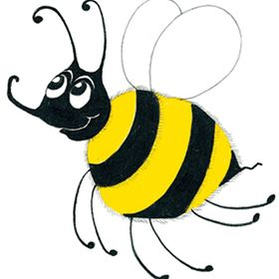
Number Words
thirty
forty
fifty
sixty
seventy
eighty
ninety
hundred 100
thousand 1000
million 10000000
zero 0
equals =

Slide 51
earrings
/ear/

Slide 52
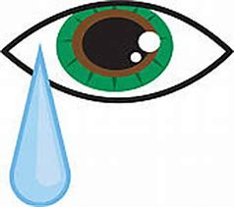
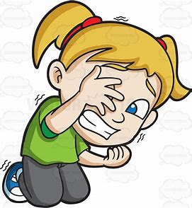
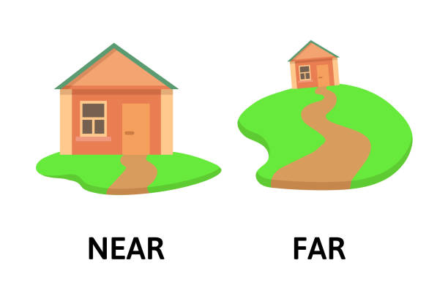
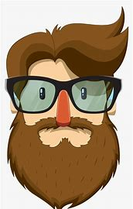
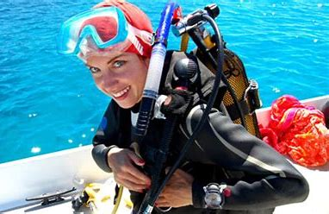
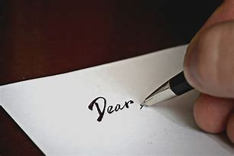
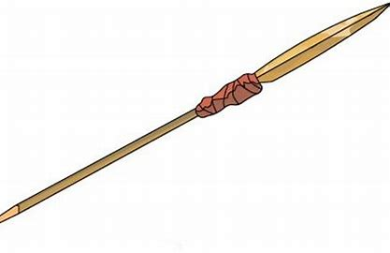
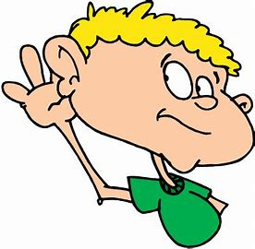
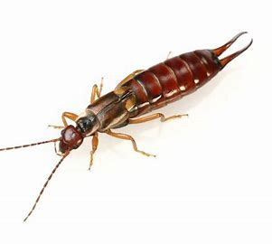
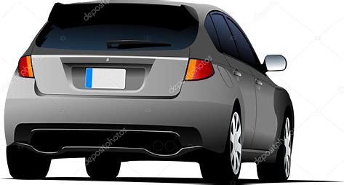
earrings
tear
clear
fear
grip
milk
ear
dear
year
tear
spear
earrings
zero
equals
dear
spear
near
beard
gear
year
hear
earwig
rear

Slide 53
Activity page2

Slide 54
Dictation

Slide 55
Name:
1. 2. 3.
4. 5. 6.
7.
8.
9.

Slide 56
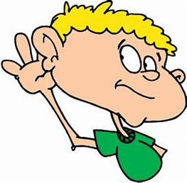
hear

Slide 57
hear 2. clear

Slide 58
hear 2. clear 3. near

Slide 59
hear 2. clear 3. near
4. earwig

Slide 60
hear 2. clear 3. near
4. earwig 5. fear

Slide 61
hear 2. clear 3. near
4. earwig 5. fear 6. beard

Slide 62
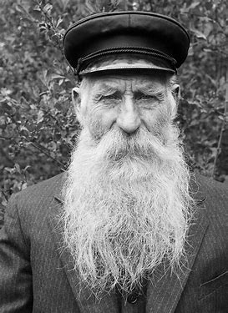
hear 2. clear 3. near
4. earwig 5. fear 6. beard
7. The old man had a long beard.

Slide 63
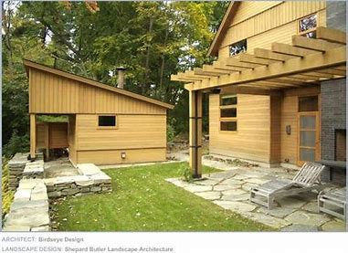
hear 2. clear 3. near
4. earwig 5. fear 6. beard
7. The old man had a long beard.
8. The shed was at the
rear of the house.

Slide 64
hear 2. clear 3. near
4. earwig 5. fear 6. beard
7. The old man had a long beard.
8. The shed was at the
rear of the house.
9. The diver had lots
of gear.

Slide 65
Each daisy has a noun in it. Write the plural of each noun on the side, and draw a picture in the daisy.
fairy
star
toy
pony

Slide 66
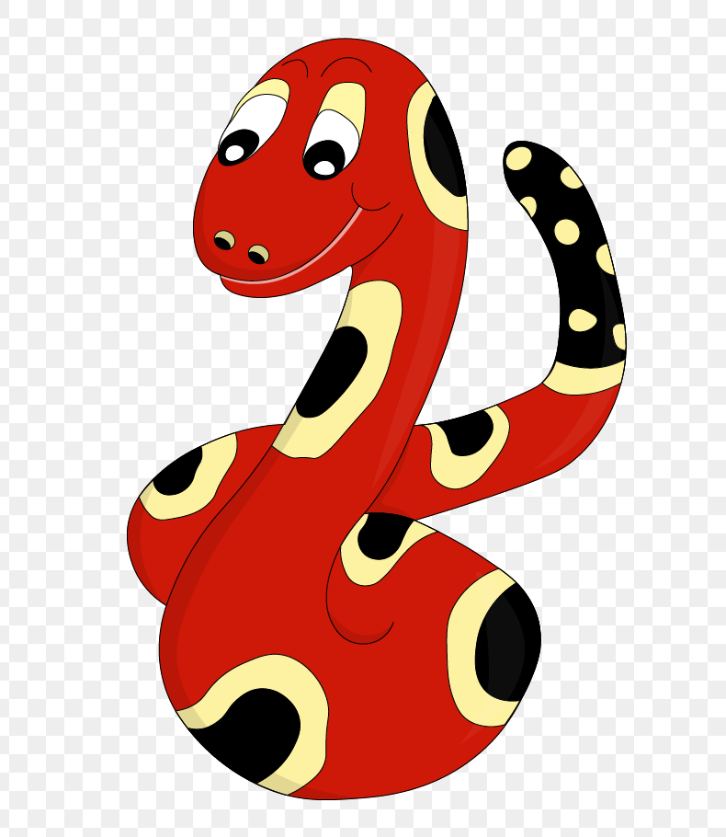
Thank you!
See you
next lesson.

