Slide 1
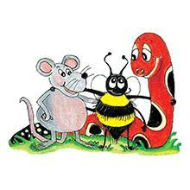
Jolly Grammar 2-23

Slide 2
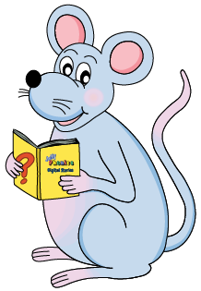
Mini Test 22

Slide 3
twig

Slide 4
twig
from

Slide 5
twig
from
torch

Slide 6
twig
from
torch
walk

Slide 7
twig
from
torch
walk
jaw

Slide 8
twig
from
torch
walk
jaw
6. north

Slide 9
twig
from
torch
walk
jaw
6. north
7. straw

Slide 10
twig
from
torch
walk
jaw
6. north
7. straw
8. saucepan

Slide 11
twig
from
torch
walk
jaw
6. north
7. straw
8. saucepan
9. ninety

Slide 12
twig
from
torch
walk
jaw
6. north
7. straw
8. saucepan
9. ninety
10. hundred

Slide 13
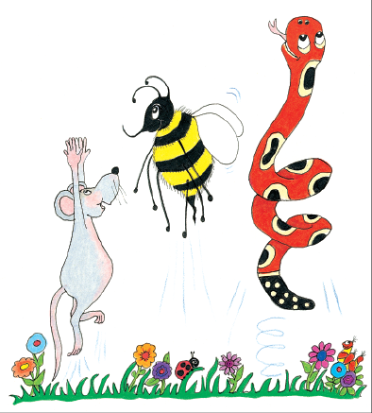
Let’s revise
adjectives
and adverbs.

Slide 14
Expand these sentences using adjectives and adverbs.
The big horse jumped happily
over the gate .
Our tall cousin
played crazily
in Hokkaido .

Slide 15
Expand these sentences using adjectives and adverbs.
The horse jumped
over .
Our cousin
played
in the .

Slide 16
Expand these sentences using adjectives and adverbs.
The big white horse jumped high
over Tokyo Tower (Mt.Everest) .
Our younger (grownup) cousin
played soccer
in the ground (rain) (snow) .

Slide 17
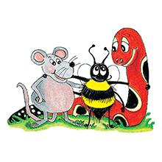
Let’s revise
Sentences.

Slide 18
Rob went to the zoo. It was his birthday. He took his friend. He was not lonely. They looked at the animals. They walked around. They saw snakes. They saw monkeys. It was cold. They had fun.
“Shall we go home? Shall we look at more animals?” asked Rob.

Slide 19
Rob went to the zoo because it was his birthday. He took his friend so he was not lonely. They looked at the animals while they walked around. They saw snakes and monkeys. It was cold but they had fun.
“Shall we go home or shall we look at more animals?” asked Rob.

Slide 20
Let’s learn
Conjunction.

Slide 22
Activity page1

Slide 23
Conjunction
There are many conjunctions,
but these are six of the most useful ones.
and but because or so while

Slide 24
Conjunction
There are many conjunctions,
but these are six of the most useful ones.
and but because or so while
Underline the conjunctions in purple.
Would you like an apple or an orange?

Slide 25
Conjunction
There are many conjunctions,
but these are six of the most useful ones.
and but because or so while
Underline the conjunctions in purple.
Would you like an apple or an orange?

Slide 26
Would you like an apple or an orange?
I did not tell anyone the news because it was a secret.
He fell over but he did not hurt himself.
We played games while we waited.
cats and dogs
It rained so she took her umbrella.

Slide 27
Would you like and apple or an orange?
I did not tell anyone the news because it was a secret.
He fell over but he did not hurt himself.
We played games while we waited.
cats and dogs
It rained so she took her umbrella.

Slide 28
Would you like and apple or an orange?
I did not tell anyone the news because it was a secret.
He fell over but he did not hurt himself.
We played games while we waited.
cats and dogs
It rained so she took her umbrella.

Slide 29
Would you like and apple or an orange?
I did not tell anyone the news because it was a secret.
He fell over but he did not hurt himself.
We played games while we waited.
cats and dogs
It rained so she took her umbrella.

Slide 30
Would you like and apple or an orange?
I did not tell anyone the news because it was a secret.
He fell over but he did not hurt himself.
We played games while we waited.
cats and dogs
It rained so she took her umbrella.

Slide 31
Would you like and apple or an orange?
I did not tell anyone the news because it was a secret.
He fell over but he did not hurt himself.
We played games while we waited.
cats and dogs
It rained so she took her umbrella.

Slide 32
Match each sentence part on the left to one on the right. Choose a conjunction to join them together, and write it the line.
and but because or so while
I was late for school
I overslept.

Slide 33
I was late for school because I overslept.

Slide 34
I was late for school because I overslept.
We brushed our teeth before we went to bed.

Slide 35
I was late for school because I overslept.
We brushed our teeth before we went to bed.
We went to the country and had a picnic.

Slide 36
I was late for school because I overslept.
We brushed our teeth before we went to bed.
We went to the country and had a picnic.
Kim ran fast in the race but she did not win.

Slide 37
I was late for school because I overslept.
We brushed our teeth before we went to bed.
We went to the country and had a picnic.
Kim ran fast in the race but she did not win.
Is there time to play or is it too late?

Slide 38
I was late for school because I overslept.
We brushed our teeth before we went to bed.
We went to the country and had a picnic.
Kim ran fast in the race but she did not win.
Is there time to play or is it too late?
The horse was hungry so he ate some oats.

Slide 39
I was late for school because I overslept.
We brushed our teeth before we went to bed.
We went to the country and had a picnic.
Kim ran fast in the race but she did not win.
Is there time to play or is it too late?
The horse was hungry so he ate some oats.
They listened quietly while the band played.

Slide 40
Choose a conjunction to complete these sentences.
The children hid Dad counted to fifty.
Have you forgiven me, are you still angry?
My feet were cold, I put on my socks.

Slide 41
Choose a conjunction to complete these sentences.
The children hid while Dad counted to fifty.
Have you forgiven me, are you still angry?
My feet were cold, I put on my socks.

Slide 42
Choose a conjunction to complete these sentences.
The children hid while Dad counted to fifty.
Have you forgiven me, or are you still angry?
My feet were cold, I put on my socks.

Slide 43
Choose a conjunction to complete these sentences.
The children hid while Dad counted to fifty.
Have you forgiven me, or are you still angry?
My feet were cold, so I put on my socks.

Slide 44
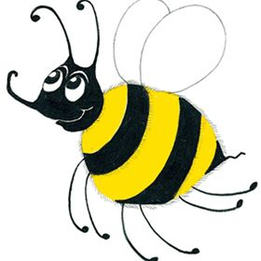
Number Words
thirty
forty
fifty
sixty
seventy
eighty
ninety
hundred 100
thousand 1000
million 1000000
zero 0
equals =

Slide 45
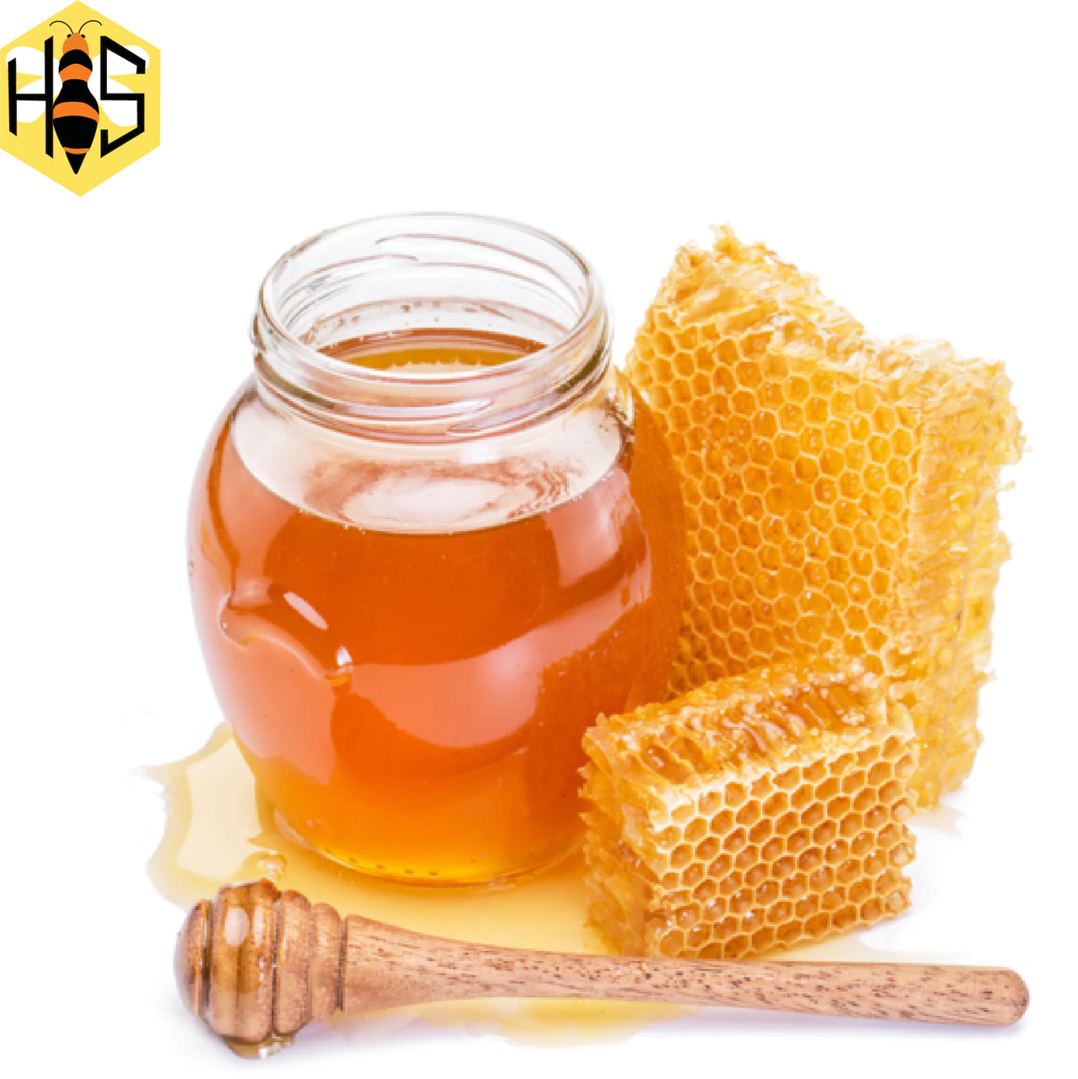
honey
/ee/

Slide 46
Activity page2

Slide 47
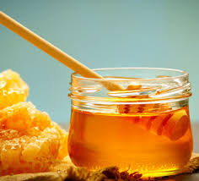
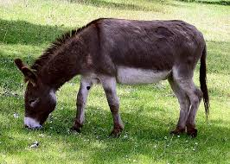
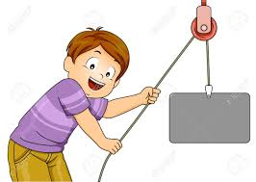
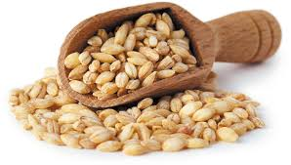
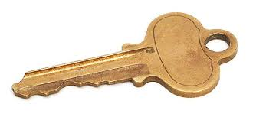
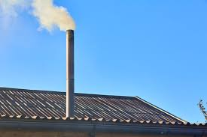
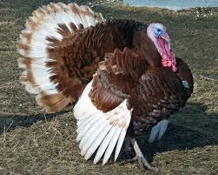
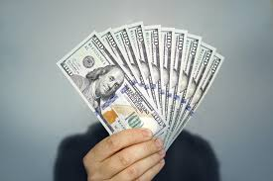
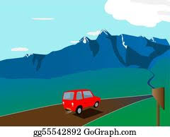
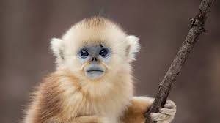
honey
donkey
pulley
barley
film
kept
honey
money
donkey
chimney
journey
thousand
million
key
chimney
turkey
keyhole
money
journey
monkey

Slide 48
Dictation

Slide 49
Name:
1. 2. 3.
4. 5. 6.
7.
8.
9.

Slide 50
key

Slide 51
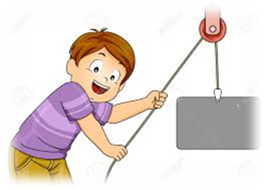
key 2. pulley

Slide 52
key 2. pulley 3. turkey

Slide 53
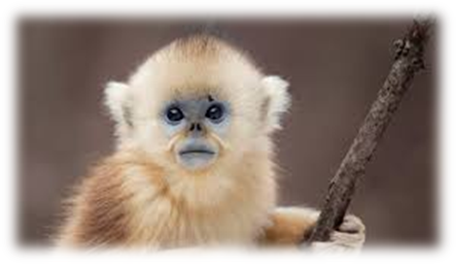
key 2. pulley 3. turkey
4. monkey

Slide 54
key 2. pulley 3. turkey
4. monkey 5. barley

Slide 55
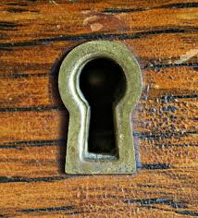
key 2. pulley 3. turkey
4. monkey 5. barley 6. keyhole

Slide 56
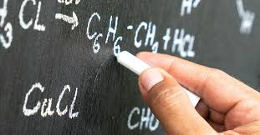
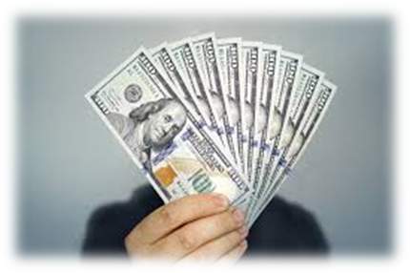
key 2. pulley 3. turkey
4. monkey 5. barley 6. keyhole
7. Here is some money for the chalk.

Slide 57
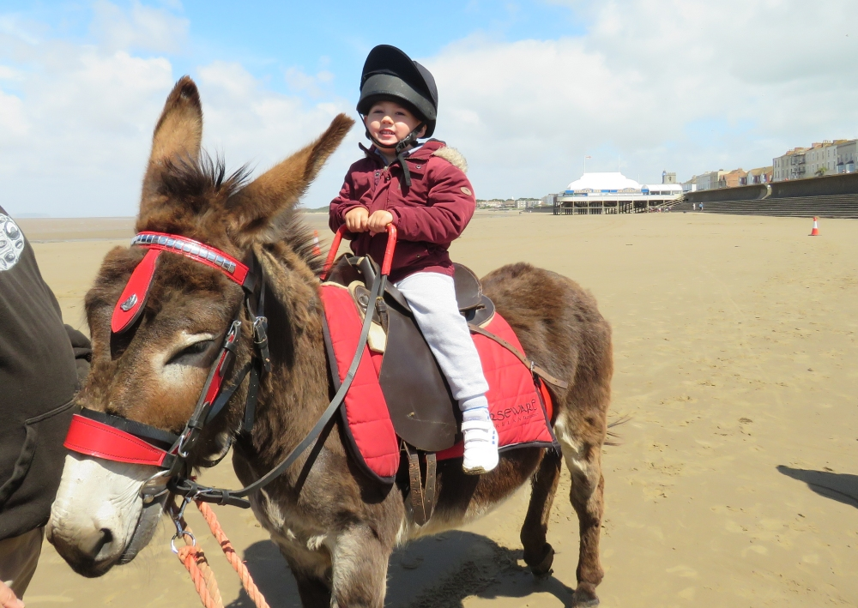
key 2. pulley 3. turkey
4. monkey 5. barley 6. keyhole
7. Here is some money for the chalk.
8. She rode a donkey
this morning.

Slide 58
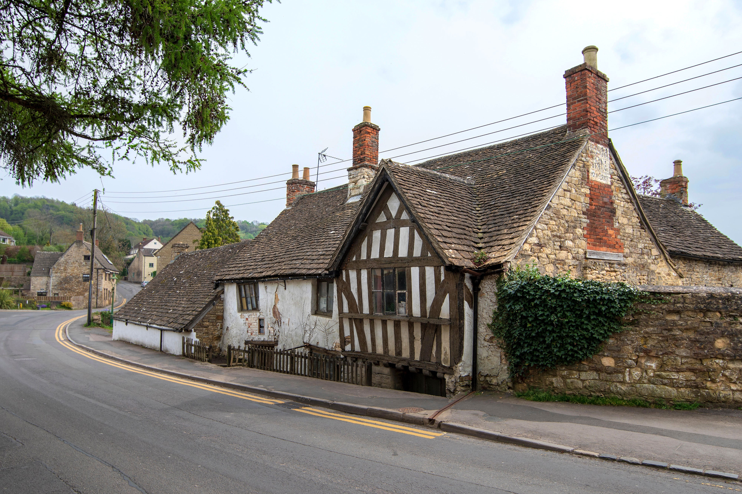
key 2. pulley 3. turkey
4. monkey 5. barley 6. keyhole
7. Here is some money for the chalk.
8. She rode a donkey
this morning.
9. They say the chimney
is haunted.

Slide 59
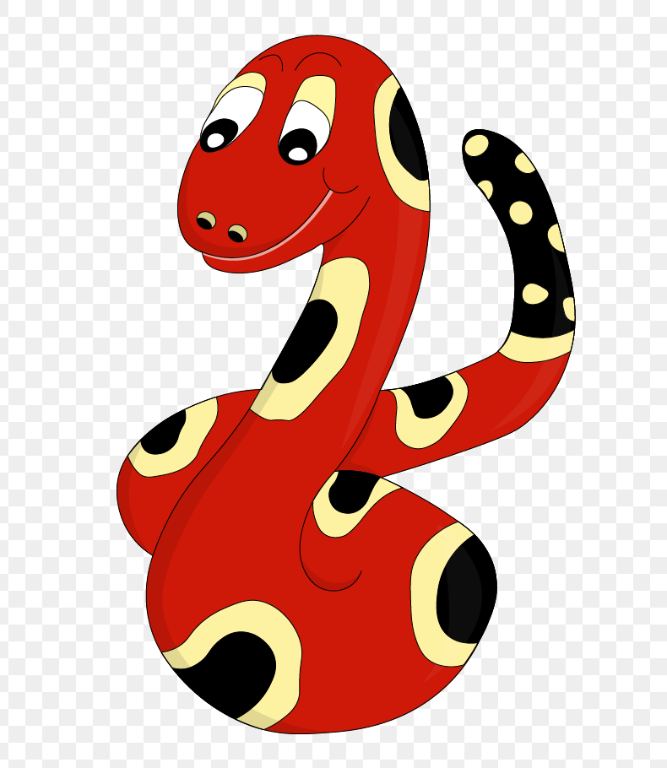
Thank you!
See you
next lesson.

