Slide 1
Jolly Grammar 2-22

Slide 2
Mini Test 21

Slide 3
snap

Slide 4
snap
swam

Slide 5
snap
swam
loud

Slide 6
snap
swam
loud
cloud

Slide 7
snap
swam
loud
cloud
found

Slide 8
snap
swam
loud
cloud
found
6. now

Slide 9
snap
swam
loud
cloud
found
6. now
7. crowd

Slide 10
snap
swam
loud
cloud
found
6. now
7. crowd
8. sunflower

Slide 11
snap
swam
loud
cloud
found
6. now
7. crowd
8. sunflower
9. seventy

Slide 12
snap
swam
loud
cloud
found
6. now
7. crowd
8. sunflower
9. seventy
10. eighty

Slide 13
Let’s revise
Verb ‘to be’
Conjugation.

Slide 14
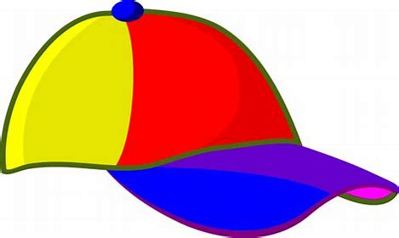
present
I
you
he/she/it
we
you
they
am

Slide 15
present
I
you
he/she/it
we
you
they
am
are

Slide 16
preset
I
you
he/she/it
we
you
they
am
are
is

Slide 17
preset
I
you
he/she/it
we
you
they
am
are
is
are

Slide 18
preset
I
you
he/she/it
we
you
they
am
are
is
are
are

Slide 19
preset
I
you
he/she/it
we
you
they
am
are
is
are
are
are

Slide 20
preset
past
I
you
he/she/it
we
you
they
am
are
is
are
are
are

Slide 21
preset
past
I
you
he/she/it
we
you
they
am
are
is
are
are
are
I
you
he/she/it
we
you
they

Slide 22
preset
past
I
you
he/she/it
we
you
they
am
are
is
are
are
are
I
you
he/she/it
we
you
they
was

Slide 23
preset
past
I
you
he/she/it
we
you
they
am
are
is
are
are
are
I
you
he/she/it
we
you
they
was
were

Slide 24
preset
past
I
you
he/she/it
we
you
they
am
are
is
are
are
are
I
you
he/she/it
we
you
they
was
were
was

Slide 25
preset
past
I
you
he/she/it
we
you
they
am
are
is
are
are
are
I
you
he/she/it
we
you
they
was
were
was
were

Slide 26
preset
past
I
you
he/she/it
we
you
they
am
are
is
are
are
are
I
you
he/she/it
we
you
they
was
were
was
were
were

Slide 27
preset
past
I
you
he/she/it
we
you
they
am
are
is
are
are
are
I
you
he/she/it
we
you
they
was
were
was
were
were
were

Slide 28
Let’s revise
Sentences.

Slide 29
He goes jogging every day.

Slide 30
He goes jogging every day.
capital letter

Slide 31
full stop
He goes jogging every day.
capital letter

Slide 32
!
full stop
He goes jogging every day.
capital letter

Slide 33
! ?
full stop
He goes jogging every day.
capital letter

Slide 34
! ?
full stop
He goes jogging every day.
capital letter

Slide 35
! ?
verb
full stop
He goes jogging every day.
capital letter

Slide 36
Let’s revise
Parts of speech:
Nouns, verbs, adjectives & adverbs
(Big Book)

Slide 37
The cat ran.

Slide 38
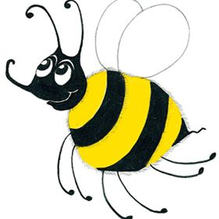
The cat ran.
….

Slide 39
The cat ran.
Describe the cat.

Slide 40
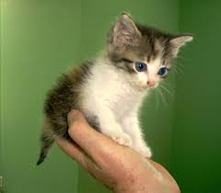
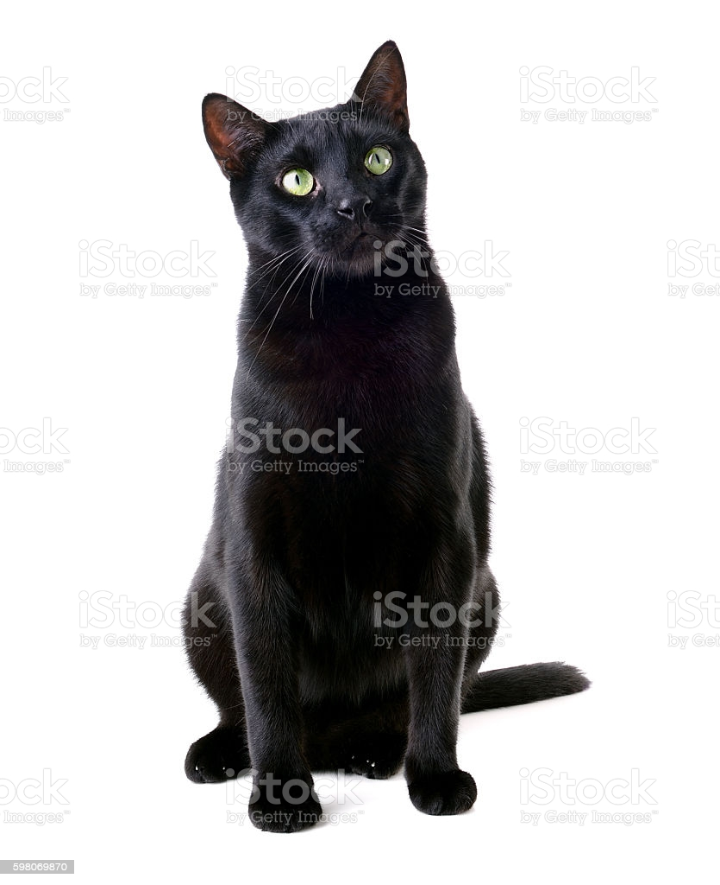
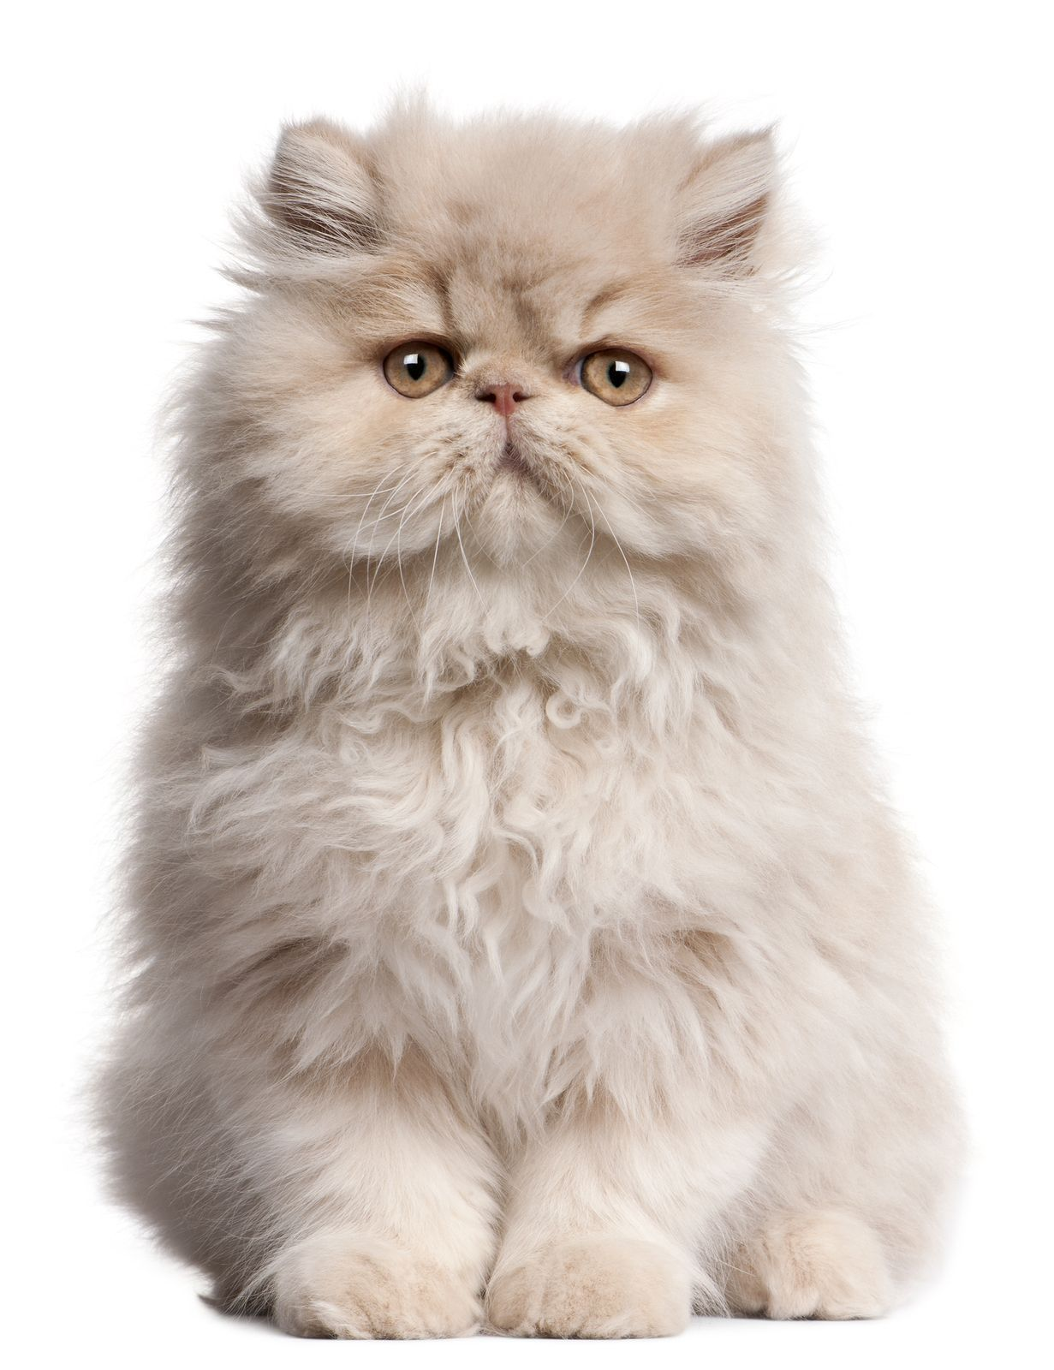
The cat ran.
Describe the cat.

Slide 41
The cat ran.
Describe the cat.

Slide 42
The cat ran.

Slide 43
The cat ran.
How did the cat run?

Slide 44
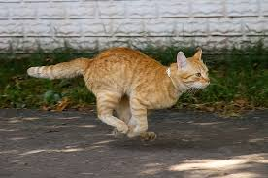
The cat ran.
How did the cat run?

Slide 45
The cat ran.
Other ideas?

Slide 46
When?
Why?
The cat ran.
Other ideas?

Slide 47
Activity page1

Slide 48
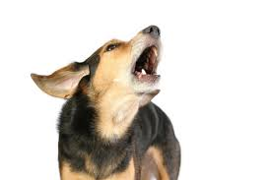
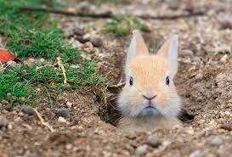
The dog barked.

Slide 49
The dog barked .
at a rabbit
at me my mom
at the house
at the cat

Slide 50
The dog barked .
loudly
noisily
happily
sadly
angrily nervously

Slide 51
The dog barked .

Slide 52
The dog barked.
sad noisy
happy loud
angry black
cute spotty white

Slide 53
The big, scary, white, fluffy dog barked loudly at a rabbit.
The dog barked loudly.
The dog barked at a rabbit.
The dog barked at a cat.

Slide 54
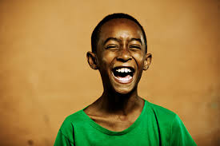
The boy laughed.

Slide 55
The bad boy laughed angrily at his friend.

Slide 56
The silly little boy laughed
loudly at school because it was funny.

Slide 57
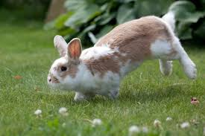
The rabbit hopped.

Slide 58
The joyful rabbit hopped sadly.
happily
angrily
cheerfully

Slide 59
The little fluffy rabbit hopped high slowly at the zoo.
because the tiger was near her.

Slide 60
Number Words
thirty
forty
fifty
sixty
seventy
eighty
ninety
hundred
thousand
million
zero
equals

Slide 61
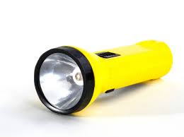
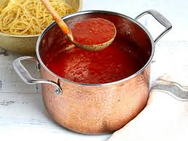
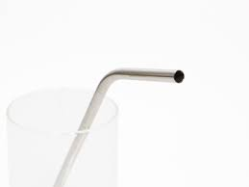
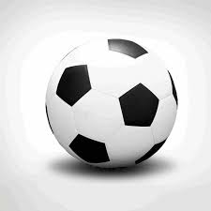
torch
/or/
sauce
/or/
ball
/or/
straw
/or/

Slide 62
torch
sauce
/or/
ball
straw

Slide 63
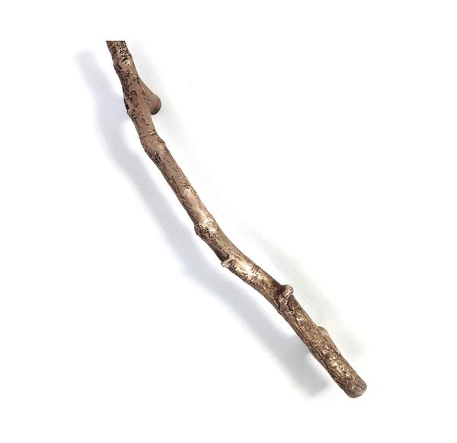
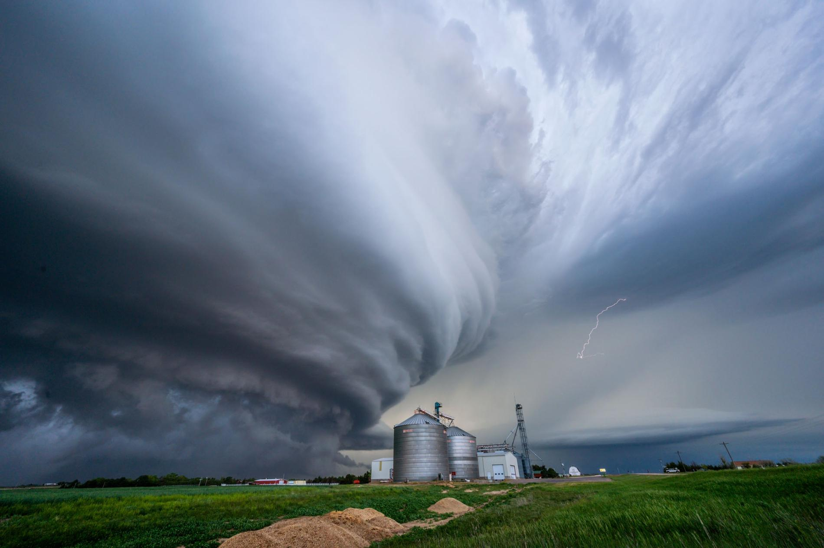
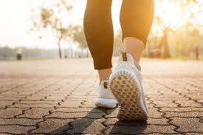
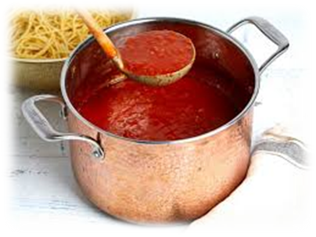
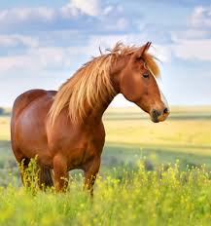
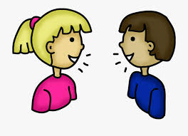
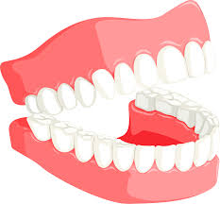
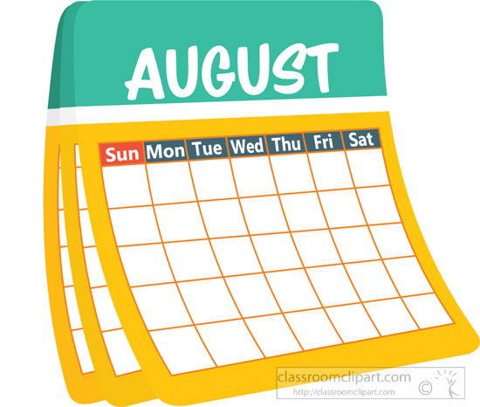
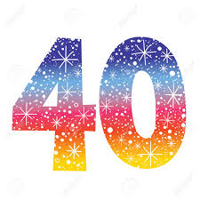
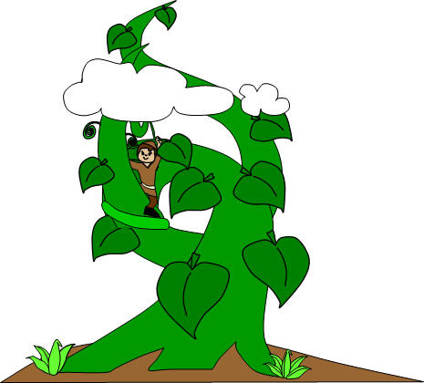
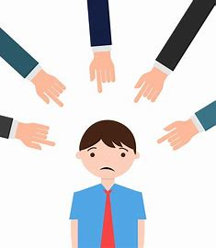
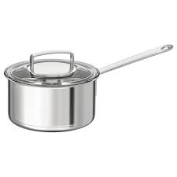
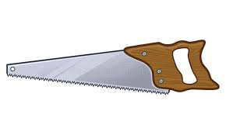
torch
storm
walk
straw
sauce
twig
from
torch
walk
jaw
north
straw
saucepan
ninety
hundred
north
horse
talk
jaw
August
fork
forty
beanstalk
fault
saw
saucepan

Slide 64
Activity page2

Slide 65
Dictation

Slide 66
Name:
1. 2. 3.
4. 5. 6.
7.
8.
9.

Slide 67
fork

Slide 68
fork 2. saw

Slide 69
fork 2. saw 3. talk

Slide 70
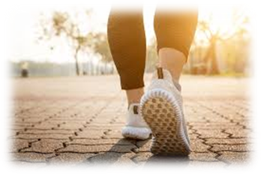
fork 2. saw 3. talk
4. walk

Slide 71
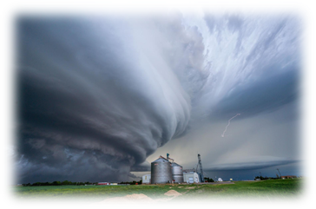
fork 2. saw 3. talk
4. walk 5. storm

Slide 72
fork 2. saw 3. talk
4. walk 5. storm 6. August

Slide 73
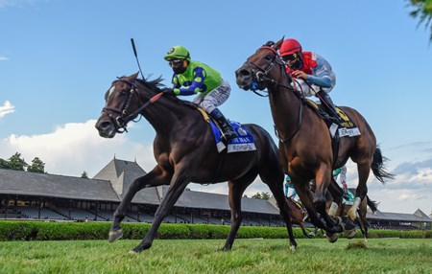
fork 2. saw 3. talk
4. walk 5. storm 6. August
7. The brown horse ran in forty races.

Slide 74
fork 2. saw 3. talk
4. walk 5. storm 6. August
7. The brown horse ran in forty races.
8. The boy climbed down
the beanstalk.

Slide 75
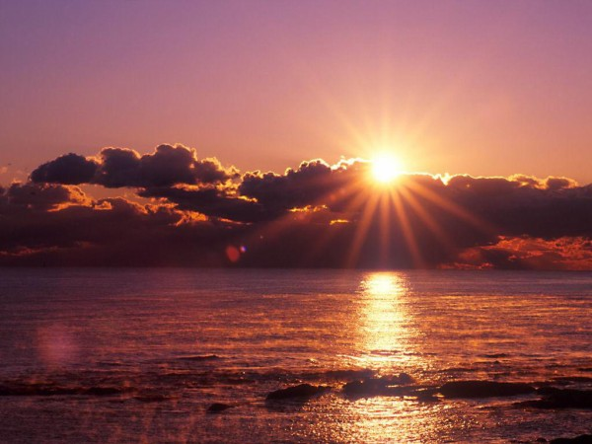
fork 2. saw 3. talk
4. walk 5. storm 6. August
7. The brown horse ran in forty races.
8. The boy climbed down
the beanstalk.
9. It was dawn on
an August morning.

Slide 76
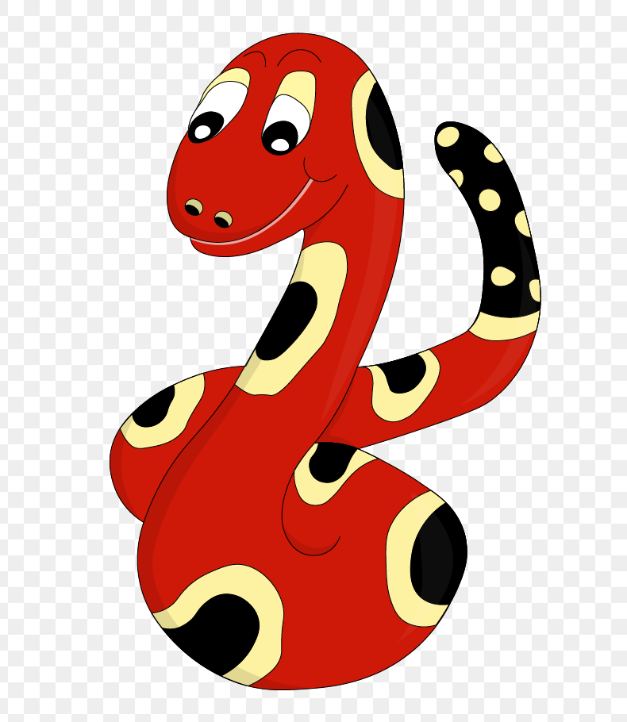
Thank you!
See you
next lesson.

