Slide 1
Jolly Grammar 2-21

Slide 2
Mini Test 20

Slide 3
drag

Slide 4
drag
trip

Slide 5
drag
trip
join

Slide 6
drag
trip
join
spoil

Slide 7
drag
trip
join
spoil
point

Slide 8
drag
trip
join
spoil
point
6. joy

Slide 9
drag
trip
join
spoil
point
6. joy
7. royal

Slide 10
drag
trip
join
spoil
point
6. joy
7. royal
8. ointment

Slide 11
drag
trip
join
spoil
point
6. joy
7. royal
8. ointment
9. fifty

Slide 12
drag
trip
join
spoil
point
6. joy
7. royal
8. ointment
9. fifty
10. sixty

Slide 13
Let’s revise
Verb ‘to be’.

Slide 14
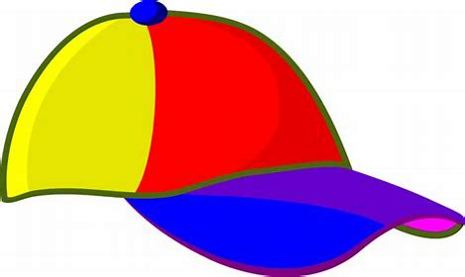
preset
I
you
he/she/it
we
you
they
am

Slide 15
preset
I
you
he/she/it
we
you
they
am
are

Slide 16
preset
I
you
he/she/it
we
you
they
am
are
is

Slide 17
preset
I
you
he/she/it
we
you
they
am
are
is
are

Slide 18
preset
I
you
he/she/it
we
you
they
am
are
is
are
are

Slide 19
preset
I
you
he/she/it
we
you
they
am
are
is
are
are
are

Slide 20
Let’s revise
Tricky pasts.

Slide 21
give
run
drink
swim
think

Slide 22
give
run
drink
swim
think
gave

Slide 23
give
run
drink
swim
think
gave
ran

Slide 24
give
run
drink
swim
think
gave
ran
drank

Slide 25
give
run
drink
swim
think
gave
ran
drank
swam

Slide 26
give
run
drink
swim
think
gave
ran
drank
swam
thought

Slide 27
Activity page1

Slide 28
Verbs
‘to be’
Present Past

Slide 29
preset
I
you
he/she/it
we
you
they
am
are
is
are
are
are

Slide 30
preset
past
I
you
he/she/it
we
you
they
am
are
is
are
are
are

Slide 31
preset
past
I
you
he/she/it
we
you
they
am
are
is
are
are
are
I
you
he/she/it
we
you
they

Slide 32
preset
past
I
you
he/she/it
we
you
they
am
are
is
are
are
are
I
you
he/she/it
we
you
they
was

Slide 33
preset
past
I
you
he/she/it
we
you
they
am
are
is
are
are
are
I
you
he/she/it
we
you
they
was
were

Slide 34
preset
past
I
you
he/she/it
we
you
they
am
are
is
are
are
are
I
you
he/she/it
we
you
they
was
were
was

Slide 35
preset
past
I
you
he/she/it
we
you
they
am
are
is
are
are
are
I
you
he/she/it
we
you
they
was
were
was
were

Slide 36
preset
past
I
you
he/she/it
we
you
they
am
are
is
are
are
are
I
you
he/she/it
we
you
they
was
were
was
were
were

Slide 37
preset
past
I
you
he/she/it
we
you
they
am
are
is
are
are
are
I
you
he/she/it
we
you
they
was
were
was
were
were
were

Slide 38
I am at school.
Yesterday,

Slide 39
I am at school.
Yesterday, I was at school.

Slide 40
It is a beautiful sunny day.
Last Monday,

Slide 41
It is a beautiful sunny day.
Last Monday, it was a beautiful sunny day.

Slide 42
We are happy.
Last week,

Slide 43
We are happy.
Last week, we were happy.

Slide 44
They are good at football.
Last year,

Slide 45
They are good at football.
Last year they were good at football.

Slide 46
Number Words
thirty
forty
fifty
sixty
seventy
eighty
ninety
hundred
thousand
million
zero
equals

Slide 47
cloud
/ou/
owl
/ou/

Slide 48
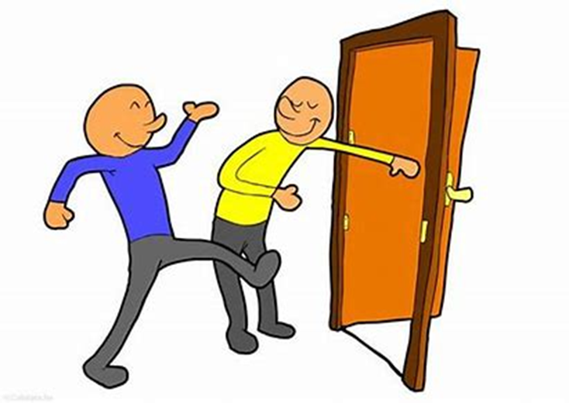
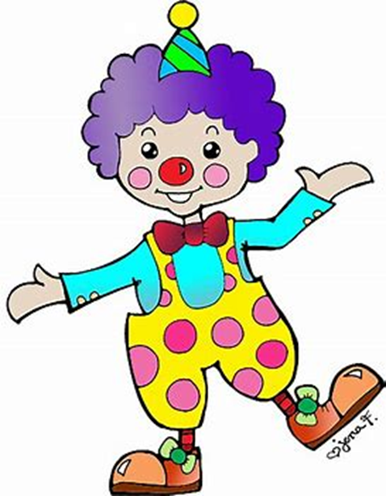
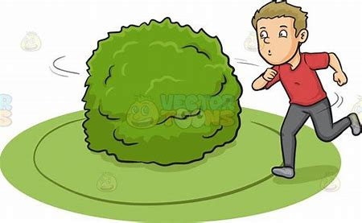
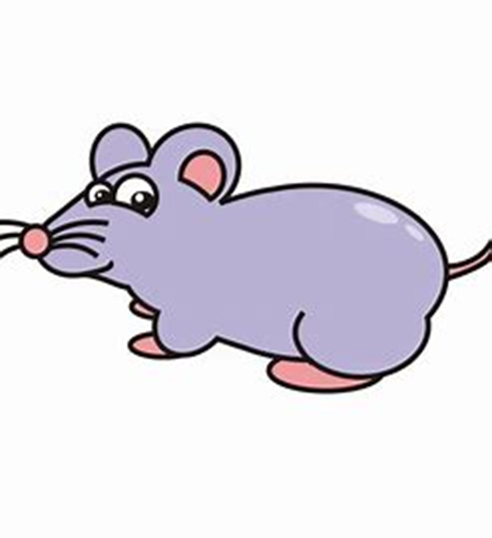
cloud
out
brown
clown
flower
crowd
snap
swam
loud
cloud
found
now
crowd
sunflower
seventy
eighty
loud
mouth
owl
shout
now
around
found
mouse
crown
sunflower
town

Slide 49
Activity page2

Slide 50
I have made a caik for yor berthday said mum.
Can you see the wite swon He asked.
The ducks kwacked lowdly as i threw them some bred.
She swimmed with dolfins last summir

Slide 51
“I have made a caik for yor berthday,” said mum.
cake your birthday
“Can you see the wite swon?” He asked.
white swan
The ducks kwacked lowdly as i threw them some bred.
quacked loudly I bread
She swimmed with dolfins last summir.
swam dolphins summer

Slide 52
Dictation

Slide 53
Name:
1. 2. 3.
4. 5. 6.
7.
8.
9.

Slide 54
out

Slide 55
out 2. clown

Slide 56
out 2. clown 3. owl

Slide 57
out 2. clown 3. owl
4. mouse

Slide 58
out 2. clown 3. owl
4. mouse 5. mouth

Slide 59
out 2. clown 3. owl
4. mouse 5. mouth 6. flower

Slide 60
out 2. clown 3. owl
4. mouse 5. mouth 6. flower
7. I saw a pair of little owls.

Slide 61
out 2. clown 3. owl
4. mouse 5. mouth 6. flower
7. I saw a pair of little owls.
8. We rode our bikes
around the town.

Slide 62
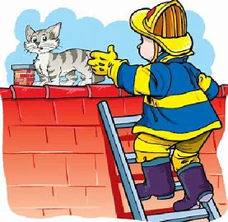
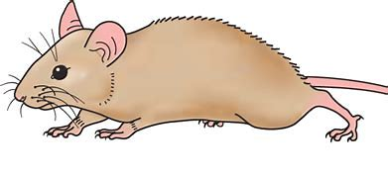
out 2. clown 3. owl
4. mouse 5. mouth 6. flower
7. I saw a pair of little owls.
8. We rode our bikes
around the town.
9. He rescued
the brown mouse.

Slide 63
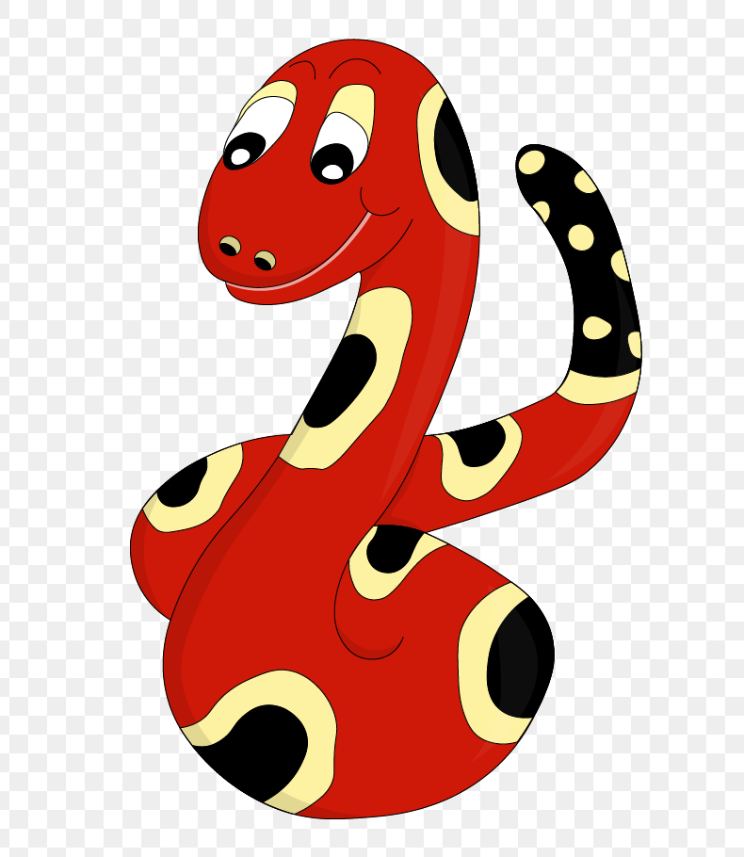
Thank you!
See you
next lesson.

