Slide 1
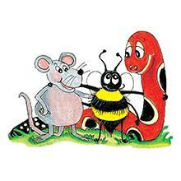
Jolly Grammar 2-20

Slide 2
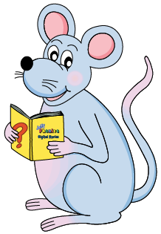
Mini Test 19

Slide 3
drip

Slide 4
drip
plug

Slide 5
drip
plug
third

Slide 6
drip
plug
third
winter

Slide 7
drip
plug
third
winter
bird

Slide 8
drip
plug
third
winter
bird
6. over

Slide 9
drip
plug
third
winter
bird
6. over
7. hurt

Slide 10
drip
plug
third
winter
bird
6. over
7. hurt
8. butterfly

Slide 11
drip
plug
third
winter
bird
6. over
7. hurt
8. butterfly
9. thirty

Slide 12
drip
plug
third
winter
bird
6. over
7. hurt
8. butterfly
9. thirty
10. forty

Slide 13
Find two new words in your dictionary.

Slide 14
Proofreading

Slide 15
“How are you?” asked Jane.

Slide 16
“How are you?” asked Jane.

Slide 17
“How are you?” asked Jane.

Slide 18
“How are you?” asked Jane.

Slide 19
“How are you?” asked Jane.

Slide 20
I like apples, lemons, grapes and strawberries!

Slide 21
I like apples, lemons, grapes and strawberries!

Slide 22
Mizuki’s signiture
Kenshi’s friends and family
Ai’s furniture
Leo’s wand
Mao’s school

Slide 23
Activity page1

Slide 24
1. Dolfins and wales live
in the sea.

Slide 25
1. Dolfins and wales live
Dolphins whale
in the sea.

Slide 26
2. I saw some sheap with
there lams on the hillsid.

Slide 27
2. I saw some sheap with
sheep
there lams on the hillsid.
their lambs hillside

Slide 28
3. it was mie berthday
partee

Slide 29
3. it was mie berthday
It my birthday
partee
party.

Slide 30
4. The dog chaist the duc.

Slide 31
4. The dog chaist the duc.
chased duck
ate

Slide 32
5. i wet camping with
my muther father sister
brother granma and
grampa

Slide 33
5. i wet camping with
I went
my muther father, sister,
mother,
brother, granma and
grandma
grampa grandpa.

Slide 35
i wet on holiday with my
I went
muther father, sister, brother,
mother,
granma and granmpa
grandma grandpa.

Slide 36
Number Words
thirty
forty
fifty
sixty
seventy
eighty
ninety
hundred
thousand
million
zero
equals

Slide 37
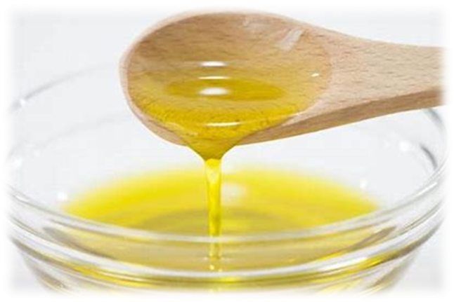
oil
/oi/
boy
/oi/

Slide 38
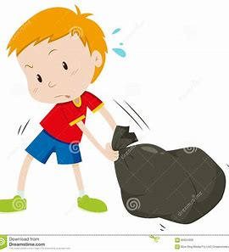
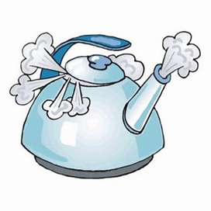
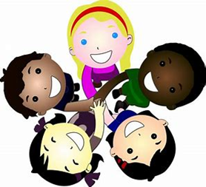
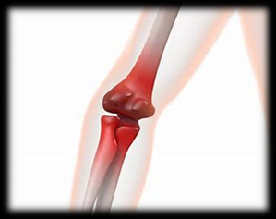
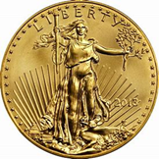
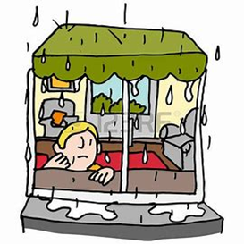
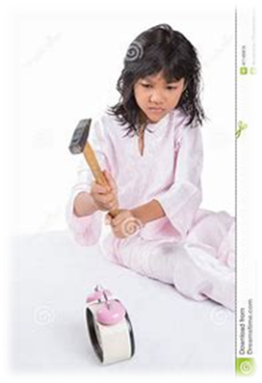
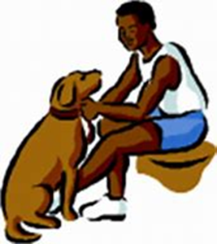
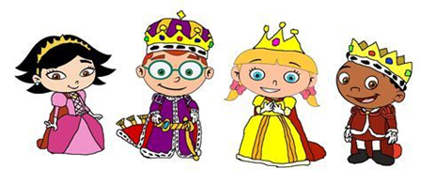
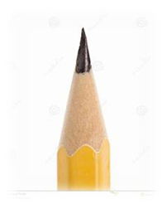
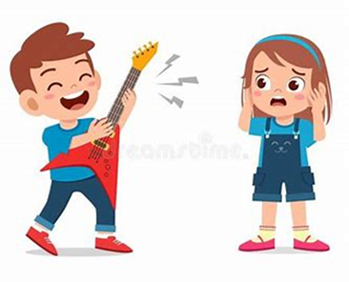
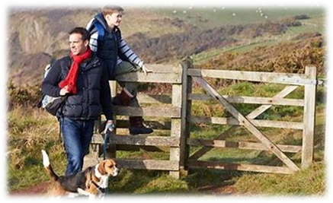
join
joy
oil
joint
boy
boil
coin
drag
trip
join
spoil
point
joy
royal
ointment
fifty
sixty
spoil
royal
toilet
destroy
loyal
point
ointment
annoy
enjoy
noise

Slide 39
Activity page2

Slide 40
Dictation

Slide 41
Name:
1. 2. 3.
4. 5. 6.
7.
8.
9.

Slide 42
Name:
1. 2. 3.
4. 5. 6.
7.
8.
9.

Slide 43
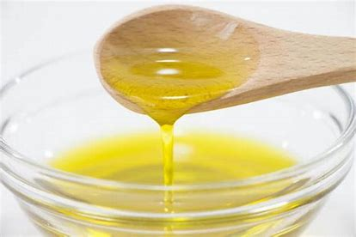
oil

Slide 44
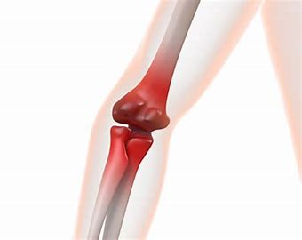
oil 2. joint

Slide 45
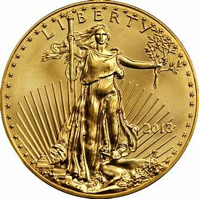
oil 2. joint 3. coin

Slide 46
oil 2. joint 3. coin
4. annoy

Slide 47
oil 2. joint 3. coin
4. annoy 5. boy

Slide 48
oil 2. joint 3. coin
4. annoy 5. boy 6. toilet

Slide 49
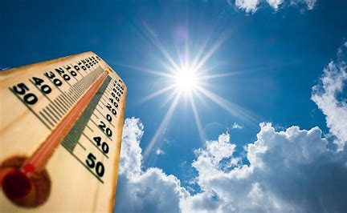
oil 2. joint 3. coin
4. annoy 5. boy 6. toilet
7. The weather was boiling hot.

Slide 50
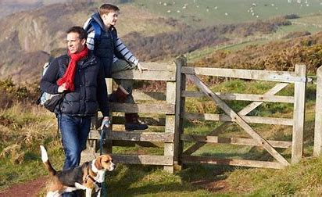
oil 2. joint 3. coin
4. annoy 5. boy 6. toilet
7. The weather was boiling hot.
8. We enjoyed our day
in the country.

Slide 51
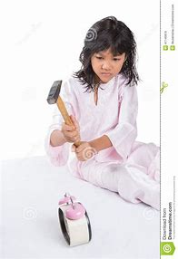
oil 2. joint 3. coin
4. annoy 5. boy 6. toilet
7. The weather was boiling hot.
8. We enjoyed our day
in the country.
9. My sister destroyed
her toy clock.

Slide 52
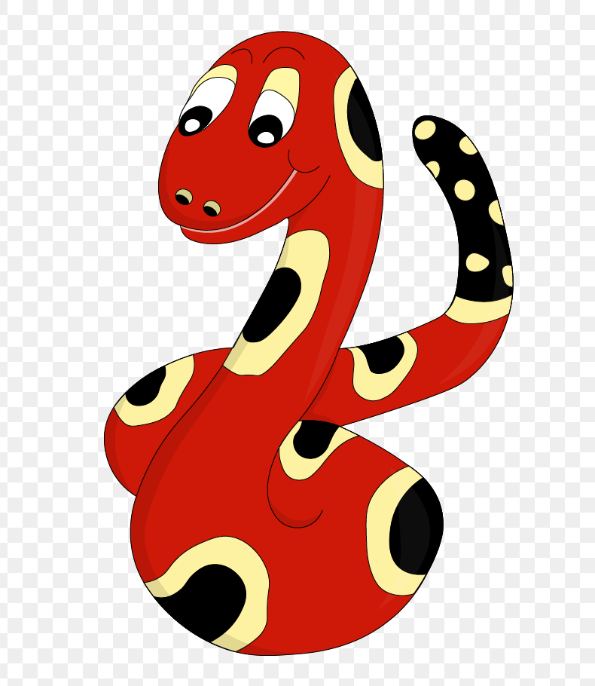
Thank you!
See you
next lesson.

