Slide 1
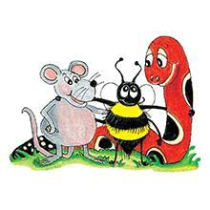
Jolly Grammar 2-19

Slide 2
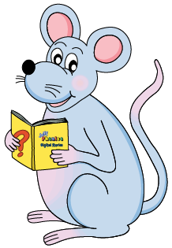
Mini Test 18

Slide 3
hook

Slide 4
hook
fork

Slide 5
hook
fork
back

Slide 6
hook
fork
back
brick

Slide 7
hook
fork
back
brick
deck

Slide 8
hook
fork
back
brick
deck
6. flock

Slide 9
hook
fork
back
brick
deck
6. flock
7. struck

Slide 10
hook
fork
back
brick
deck
6. flock
7. struck
8. backpack

Slide 11
hook
fork
back
brick
deck
6. flock
7. struck
8. backpack
9. nineteen

Slide 12
hook
fork
back
brick
deck
6. flock
7. struck
8. backpack
9. nineteen
10. twenty

Slide 13
Let’s Revise
Tricky Past.

Slide 14
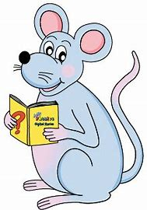
run
dig
sing
ride
swim
win

Slide 15
run
dig
sing
ride
swim
win
ran

Slide 16
run
dig
sing
ride
swim
win
ran
dug

Slide 17
run
dig
sing
ride
swim
win
ran
dug
sang

Slide 18
run
dig
sing
ride
swim
win
ran
dug
sang
rode

Slide 19
run
dig
sing
ride
swim
win
ran
dug
sang
rode
swam

Slide 20
run
dig
sing
ride
swim
win
ran
dug
sang
rode
swam
won

Slide 21
Activity page1

Slide 22
catapiller × bananar × kangeroo ×
ambulense× dinasor× calcuelaiter×

Slide 23
catapiller × bananar × kangeroo ×
caterpillar banana kangaroo
ambulense× dinasor× calcuelaiter×
ambulance dinosaur calculator
tortoise

Slide 24
hare ocean blizzard
dolphin bouquet aquarium

Slide 25
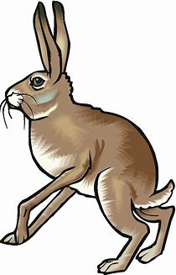
hare ocean blizzard
dolphin bouquet aquarium

Slide 26
hare ocean blizzard
dolphin bouquet aquarium

Slide 27
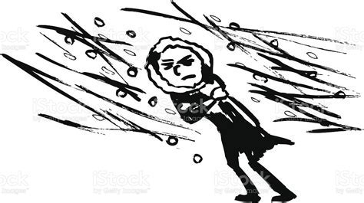
hare ocean blizzard
dolphin bouquet aquarium

Slide 28
hare ocean blizzard
dolphin bouquet aquarium

Slide 29
hare ocean blizzard
dolphin bouquet aquarium

Slide 30
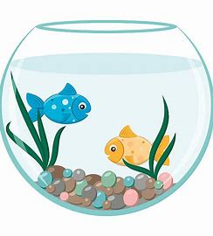
hare ocean blizzard
dolphin bouquet aquarium

Slide 31
Number Words
thirty
forty
fifty
sixty
seventy
eighty
ninety
hundred
thousand
million
zero
equals

Slide 32
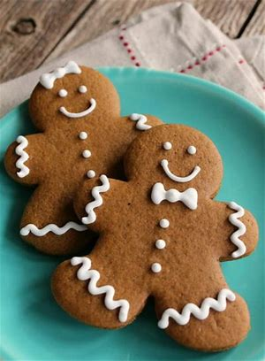
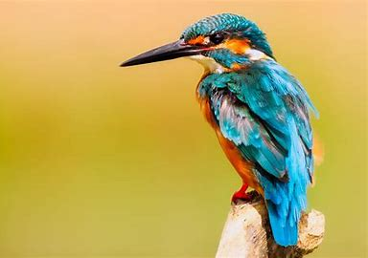
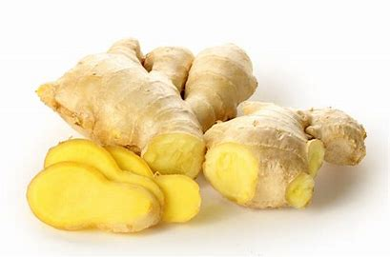
gingerbread
/er/
bird
/er/
purple
/er/

Slide 33
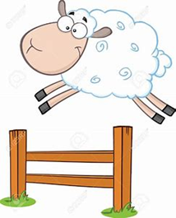
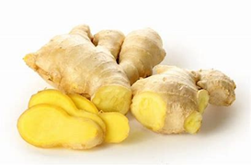
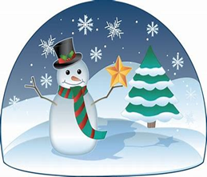
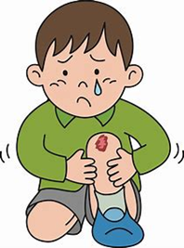
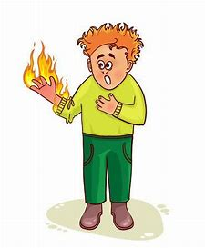
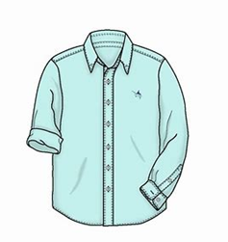
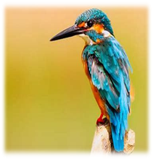
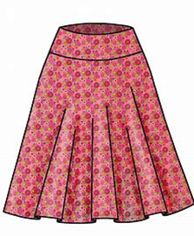
third
over
girl
purple
ginger
first
drip
plug
third
winter
bird
over
hurt
butterfly
thirty
forty
winter
hurt
Thursday
summer
burn
bird
butterfly
skirt
verb
shirt

Slide 34
Activity page2

Slide 35
Dictation

Slide 36
Name:
1. 2. 3.
4. 5. 6.
7.
8.
9.

Slide 37
girl

Slide 38
girl 2. Thursday

Slide 39
girl 2. Thursday 3. skirt

Slide 40
girl 2. Thursday 3. skirt
4. hurt

Slide 41
girl 2. Thursday 3. skirt
4. hurt 5. summer

Slide 42
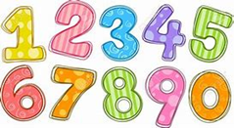
girl 2. Thursday 3. skirt
4. hurt 5. summer 6. number

Slide 43
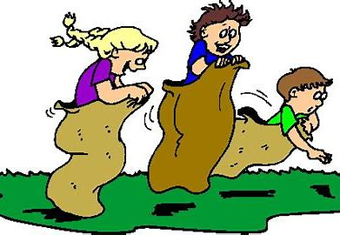
girl 2. Thursday 3. skirt
4. hurt 5. summer 6. number
7. He came first in the sack race.

Slide 44
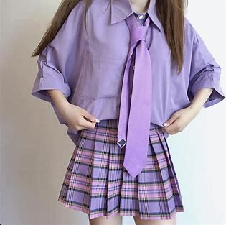
girl 2. Thursday 3. skirt
4. hurt 5. summer 6. number
7. He came first in the sack race.
8. Her shirt and skirt are purple.

Slide 45
girl 2. Thursday 3. skirt
4. hurt 5. summer 6. number
7. He came first in the sack race.
8. Her shirt and skirt are purple.
9. Turn the page over
to see the third verb.

Slide 46
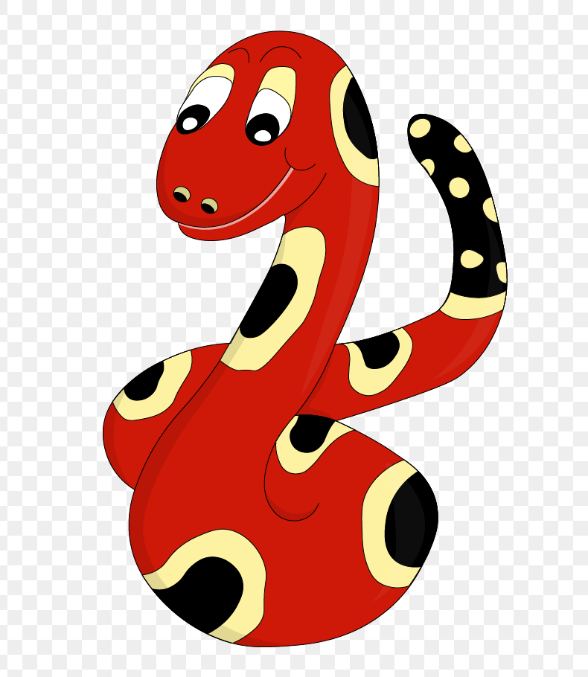
Thank you!
See you
next lesson.

