Slide 1
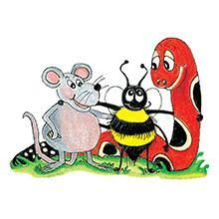
Jolly Grammar 2-18

Slide 2
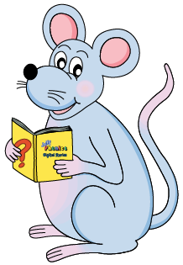
Mini Test 17

Slide 3
sunk

Slide 4
sunk
book

Slide 5
sunk
book
huge

Slide 6
sunk
book
huge
fuse

Slide 7
sunk
book
huge
fuse
rescue

Slide 8
sunk
book
huge
fuse
rescue
6. argue

Slide 9
sunk
book
huge
fuse
rescue
6. argue
7. ewe

Slide 10
sunk
book
huge
fuse
rescue
6. argue
7. ewe
8. useful

Slide 11
sunk
book
huge
fuse
rescue
6. argue
7. ewe
8. useful
9. seventeen

Slide 12
sunk
book
huge
fuse
rescue
6. argue
7. ewe
8. useful
9. seventeen
10. eighteen

Slide 13
Let’s Revise
Verbs.

Slide 15
I zip up my coat.
Yesterday,
He talks to his friend.
Last week,

Slide 16
I zip up my coat.
Yesterday, I zipped up my coat.
He talks to his friend.
Last week,

Slide 17
I zip up my coat.
Yesterday, I zipped up my coat.
He talks to his friend.
Last week, he talked to his friend.

Slide 18
Let’s Revise
Past tense.

Slide 19
I brush my hair.
She bakes.
You hop.

Slide 20
I brush my hair.
I brushed my hair.
She bakes.
You hop.

Slide 21
I brush my hair.
I brushed my hair.
She bakes.
She baked.
You hop.

Slide 22
I brush my hair.
I brushed my hair.
She bakes.
She baked.
You hop.
You hopped.

Slide 23
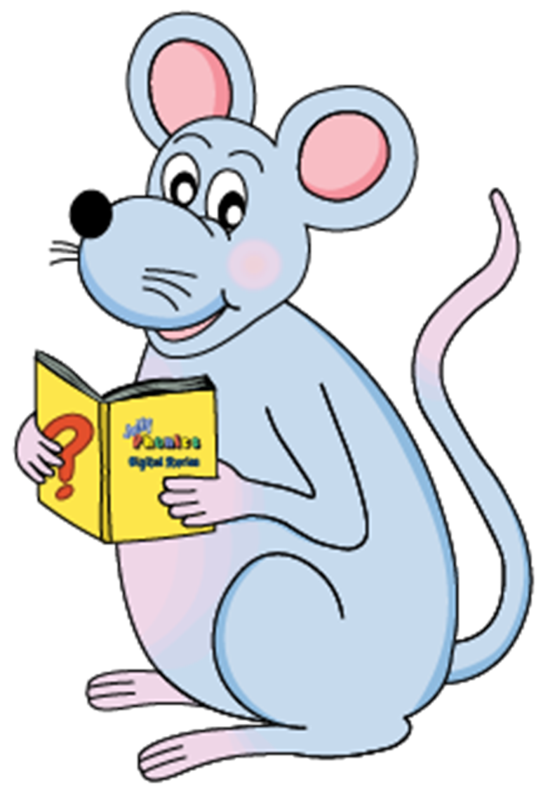
Tricky Pasts

Slide 24
come
drink
get
have
lose
ride
say
speak
take
win
dig
draw
give
hide
make
run
sing
swim
throw
write

Slide 25
come
drink
get
have
lose
ride
say
speak
take
win
came
dig
draw
give
hide
make
run
sing
swim
throw
write

Slide 26
come
drink
get
have
lose
ride
say
speak
take
win
came
drank
dig
draw
give
hide
make
run
sing
swim
throw
write

Slide 27
come
drink
get
have
lose
ride
say
speak
take
win
came
drank
got
dig
draw
give
hide
make
run
sing
swim
throw
write

Slide 28
come
drink
get
have
lose
ride
say
speak
take
win
came
drank
got
had
dig
draw
give
hide
make
run
sing
swim
throw
write

Slide 29
come
drink
get
have
lose
ride
say
speak
take
win
came
drank
got
had
lost
dig
draw
give
hide
make
run
sing
swim
throw
write

Slide 30
come
drink
get
have
lose
ride
say
speak
take
win
came
drank
got
had
lost
rode
dig
draw
give
hide
make
run
sing
swim
throw
write

Slide 31
come
drink
get
have
lose
ride
say
speak
take
win
came
drank
got
had
lost
rode
said
dig
draw
give
hide
make
run
sing
swim
throw
write

Slide 32
come
drink
get
have
lose
ride
say
speak
take
win
came
drank
got
had
lost
rode
said
spoke
dig
draw
give
hide
make
run
sing
swim
throw
write

Slide 33
come
drink
get
have
lose
ride
say
speak
take
win
came
drank
got
had
lost
rode
said
spoke
took
dig
draw
give
hide
make
run
sing
swim
throw
write

Slide 34
come
drink
get
have
lose
ride
say
speak
take
win
came
drank
got
had
lost
rode
said
spoke
took
won
dig
draw
give
hide
make
run
sing
swim
throw
write

Slide 35
come
drink
get
have
lose
ride
say
speak
take
win
came
drank
got
had
lost
rode
said
spoke
took
won
dig
draw
give
hide
make
run
sing
swim
throw
write
dug

Slide 36
come
drink
get
have
lose
ride
say
speak
take
win
came
drank
got
had
lost
rode
said
spoke
took
won
dig
draw
give
hide
make
run
sing
swim
throw
write
dug
drew

Slide 37
come
drink
get
have
lose
ride
say
speak
take
win
came
drank
got
had
lost
rode
said
spoke
took
won
dig
draw
give
hide
make
run
sing
swim
throw
write
dug
drew
gave

Slide 38
come
drink
get
have
lose
ride
say
speak
take
win
came
drank
got
had
lost
rode
said
spoke
took
won
dig
draw
give
hide
make
run
sing
swim
throw
write
dug
drew
gave
hid

Slide 39
come
drink
get
have
lose
ride
say
speak
take
win
came
drank
got
had
lost
rode
said
spoke
took
won
dig
draw
give
hide
make
run
sing
swim
throw
write
dug
drew
gave
hid
made

Slide 40
come
drink
get
have
lose
ride
say
speak
take
win
came
drank
got
had
lost
rode
said
spoke
took
won
dig
draw
give
hide
make
run
sing
swim
throw
write
dug
drew
gave
hid
made
ran

Slide 41
come
drink
get
have
lose
ride
say
speak
take
win
came
drank
got
had
lost
rode
said
spoke
took
won
dig
draw
give
hide
make
run
sing
swim
throw
write
dug
drew
gave
hid
made
ran
sang

Slide 42
come
drink
get
have
lose
ride
say
speak
take
win
came
drank
got
had
lost
rode
said
spoke
took
won
dig
draw
give
hide
make
run
sing
swim
throw
write
dug
drew
gave
hid
made
ran
sang
swam

Slide 43
come
drink
get
have
lose
ride
say
speak
take
win
came
drank
got
had
lost
rode
said
spoke
took
won
dig
draw
give
hide
make
run
sing
swim
throw
write
dug
drew
gave
hid
made
ran
sang
swam
threw

Slide 44
come
★drink
★get
have
lose
★ride
say
speak
take
★win
came
drank
got
had
lost
rode
said
spoke
took
won
★dig
draw
give
hide
make
run
★sing
swim
throw
★write
dug
drew
gave
hid
made
ran
sang
swam
threw
wrote

Slide 45
Activity page1

Slide 46
We sing a song.

Slide 47
We sing a song.
We sang a song.

Slide 48
We sang a song.

Slide 49
We sang a song.
He rode his bike.

Slide 50
We sang a song.
He rode his bike.
I wrote a letter.

Slide 51
We sang a song.
He rode his bike.
I wrote a letter.
You won a prize.

Slide 52
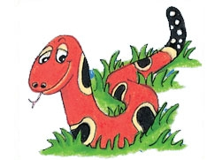
Number Words
half
quarter
eleven
twelve
thirteen
fourteen
fifteen
sixteen
seventeen
eighteen
nineteen
twenty

Slide 53
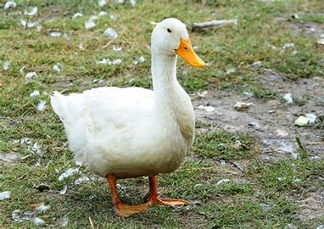
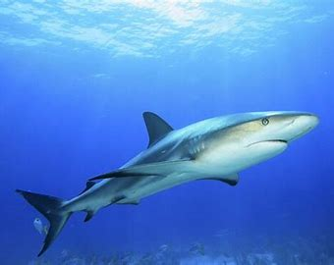
duck
/k/
shark
/k/

Slide 54
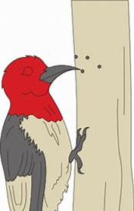
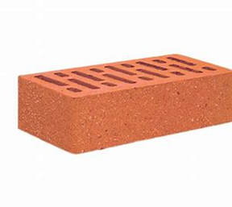
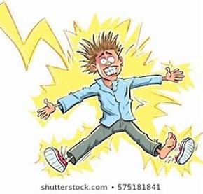
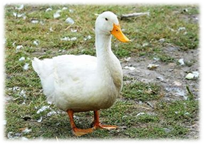
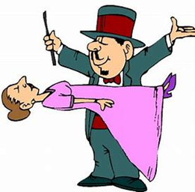
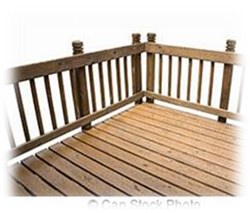
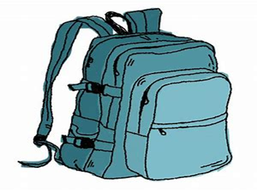
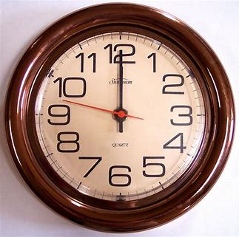
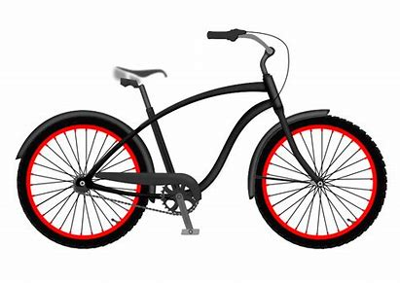
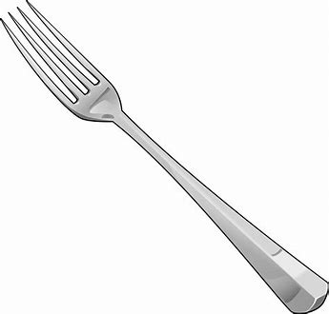
back
flock
peck
sack
neck
black
hook
fork
back
brick
deck
flock
struck
backpack
nineteen
twenty
brick
struck
duck
trick
rocket
deck
backpack
clock
chick
cake
bike
shark
oak
fork
book

Slide 55
Activity page2

Slide 56
Dictation

Slide 57
Name:
1. 2. 3.
4. 5. 6.
7.
8.
9.

Slide 58
duck

Slide 59
duck 2. clock

Slide 60
duck 2. clock 3. peck

Slide 61
duck 2. clock 3. peck
4. book

Slide 62
duck 2. clock 3. peck
4. book 5. bike

Slide 63
duck 2. clock 3. peck
4. book 5. bike 6. trick

Slide 64
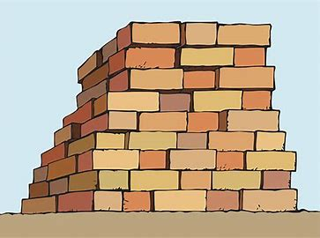
duck 2. clock 3. peck
4. book 5. bike 6. trick
7. Stack up the bricks over there.

Slide 65
duck 2. clock 3. peck
4. book 5. bike 6. trick
7. Stack up the bricks over there.
8. The ducks quacked as they
pecked at the loaf.

Slide 66
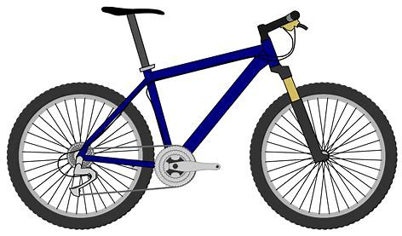
duck 2. clock 3. peck
4. book 5. bike 6. trick
7. Stack up the bricks over there.
8. The ducks quacked as they
pecked at the loaf.
9. Our cousin parked
his bike by the truck.

Slide 67
Thank you!
See you
next lesson.

