Slide 1
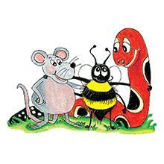
Jolly Grammar 2-17

Slide 2
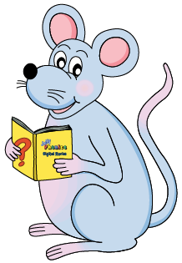
Mini Test 16

Slide 3
such

Slide 4
such
luck

Slide 5
such
luck
home

Slide 6
such
luck
home
froze

Slide 7
such
luck
home
froze
foal

Slide 8
such
luck
home
froze
foal
6. stone

Slide 9
such
luck
home
froze
foal
6. stone
7. toast

Slide 10
such
luck
home
froze
foal
6. stone
7. toast
8. snowball

Slide 11
such
luck
home
froze
foal
6. stone
7. toast
8. snowball
9. fifteen

Slide 12
such
luck
home
froze
foal
6. stone
7. toast
8. snowball
9. fifteen
10. sixteen

Slide 13
Let’s Revise
Verb ‘to be’.

Slide 14
I you he/she/it
we you they
It is quite cold today.
Today we are playing outside.
That elephant is very big.
“I am so tired,” said Sam.

Slide 15
I am you he/she/it
we you they
It is quite cold today.
Today we are playing outside.
That elephant is very big.
“I am so tired,” said Sam.

Slide 16
I am you are he/she/it
we you they
It is quite cold today.
Today we are playing outside.
That elephant is very big.
“I am so tired,” said Sam.

Slide 17
I am you are he/she/it is
we you they
It is quite cold today.
Today we are playing outside.
That elephant is very big.
“I am so tired,” said Sam.

Slide 18
I am you are he/she/it is
we are you they
It is quite cold today.
Today we are playing outside.
That elephant is very big.
“I am so tired,” said Sam.

Slide 19
I am you are he/she/it is
we are you are they
It is quite cold today.
Today we are playing outside.
That elephant is very big.
“I am so tired,” said Sam.

Slide 20
I am you are he/she/it is
we are you are they are
It is quite cold today.
Today we are playing outside.
That elephant is very big.
“I am so tired,” said Sam.

Slide 21
I am you are he/she/it is
we are you are they are
It is quite cold today.
Today we are playing outside.
That elephant is very big.
“I am so tired,” said Sam.

Slide 22
I am you are he/she/it is
we are you are they are
It is quite cold today.
Today we are playing outside.
That elephant is very big.
“I am so tired,” said Sam.

Slide 23
I am you are he/she/it is
we are you are they are
It is quite cold today.
Today we are playing outside.
That elephant is very big.
“I am so tired,” said Sam.

Slide 24
I am you are he/she/it is
we are you are they are
It is quite cold today.
Today we are playing outside.
That elephant is very big.
“I am so tired,” said Sam.

Slide 25
Let’s Revise
Verbs.

Slide 27
Let’s Revise
Past tense.

Slide 28
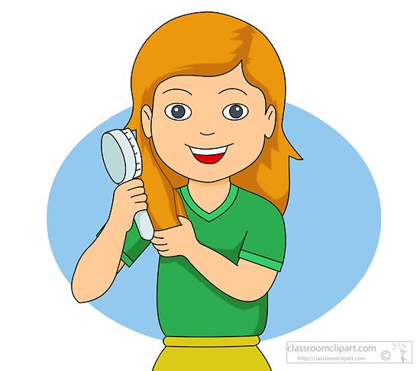
I brush my hair.

Slide 29
I brush my hair.
I brushed my hair.

Slide 30
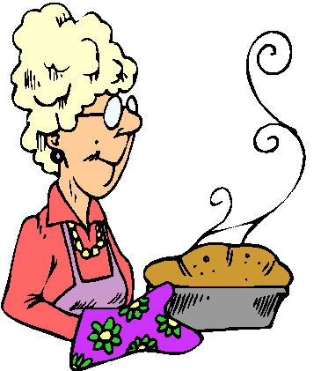
I brush my hair.
I brushed my hair.
She bakes.

Slide 31
I brush my hair.
I brushed my hair.
She bakes.
She baked.

Slide 32
I brush my hair.
I brushed my hair.
She bakes.
She baked.
You hop.

Slide 33
I brush my hair.
I brushed my hair.
She bakes.
She baked.
You hop.
You hopped.

Slide 34
Activity page1

Slide 35
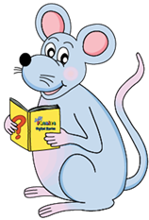
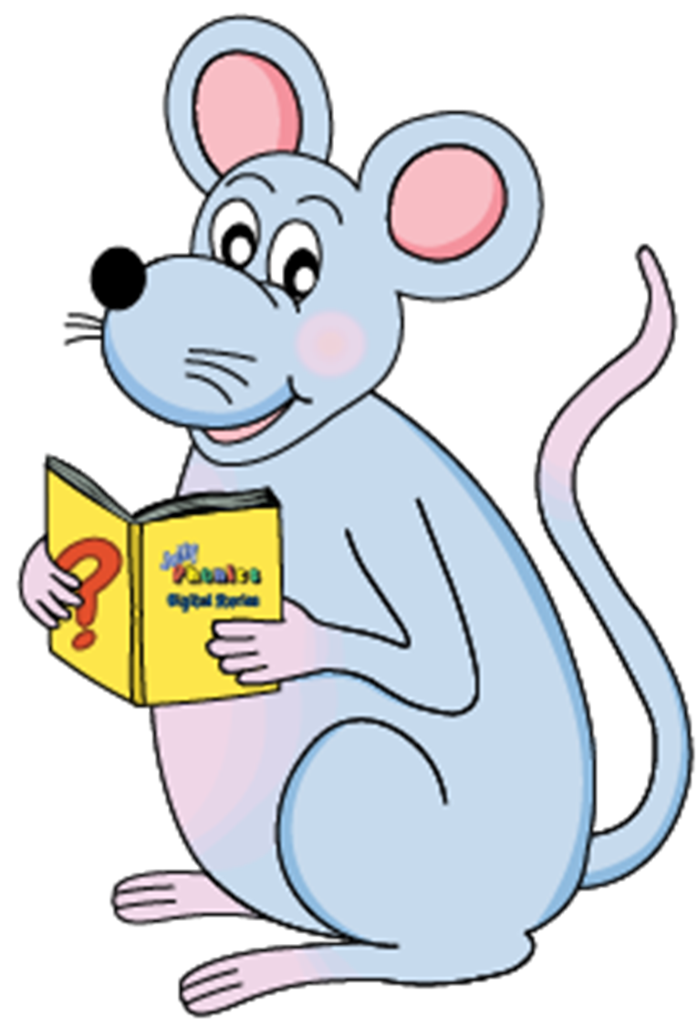
e
＋ed
double
＋ed
＋ed
look
chew
walk
wipe
hate
please
bat
hug
rip

Slide 36
e
＋ed
double
＋ed
＋ed
looked
chew
walk
wipe
hate
please
bat
hug
rip

Slide 37
e
＋ed
double
＋ed
＋ed
looked
chewed
walk
wipe
hate
please
bat
hug
rip

Slide 38
e
＋ed
double
＋ed
＋ed
looked
chewed
walked
wipe
hate
please
bat
hug
rip

Slide 39
e
＋ed
double
＋ed
＋ed
looked
chewed
walked
wiped
hate
please
bat
hug
rip

Slide 40
e
＋ed
double
＋ed
＋ed
looked
chewed
walked
wiped
hated
please
bat
hug
rip

Slide 41
e
＋ed
double
＋ed
＋ed
looked
chewed
walked
wiped
hated
pleased
bat
hug
rip

Slide 42
e
＋ed
double
＋ed
＋ed
looked
chewed
walked
wiped
hated
pleased
batted
hug
rip

Slide 43
e
＋ed
double
＋ed
＋ed
looked
chewed
walked
wiped
hated
pleased
batted
hugged
rip

Slide 44
e
＋ed
double
＋ed
＋ed
looked
chewed
walked
wiped
hated
pleased
batted
hugged
ripped

Slide 45
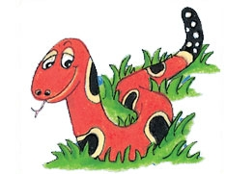
Number Words
half
quarter
eleven
twelve
thirteen
fourteen
fifteen
sixteen
seventeen
eighteen
nineteen
twenty

Slide 46
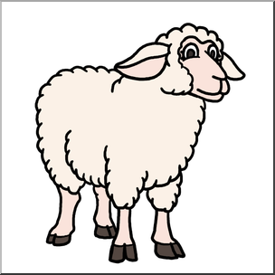
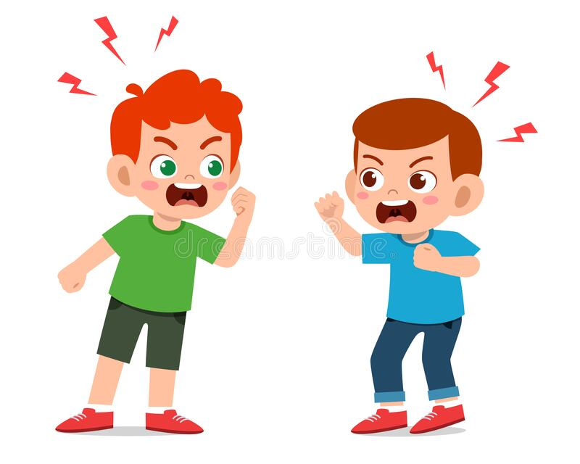
cube
/ue/
ewe
/ue/
argue
/ue/

Slide 47
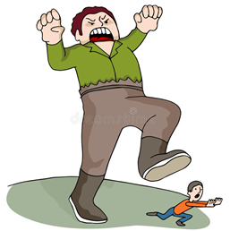
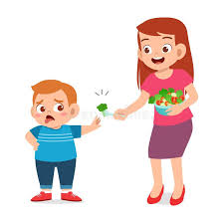
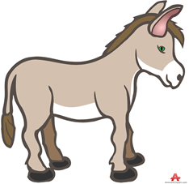
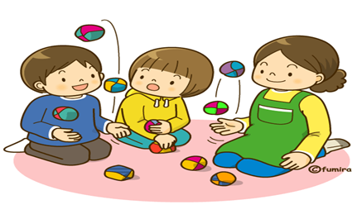
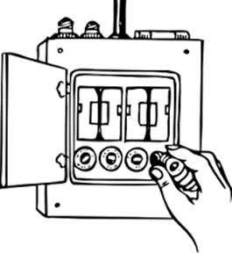
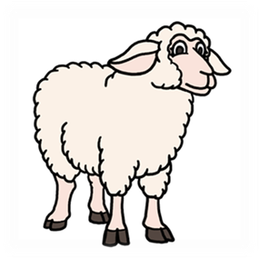
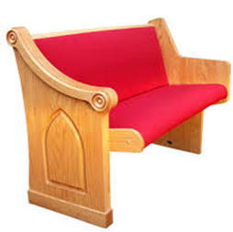
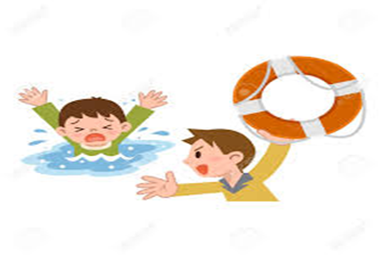
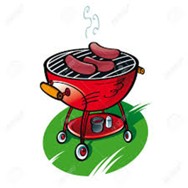
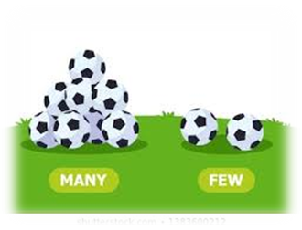
huge
argue
use
fuel
value
refuse
sunk
book
huge
fuse
rescue
argue
ewe
useful
seventeen
eighteen
fuse
ewe
pew
cube
mule
amuse
rescue
useful
few
due
barbecue

Slide 48
Activity page2

Slide 49
Dictation

Slide 50
Name:
1. 2. 3.
4. 5. 6.
7.
8.
9.

Slide 51
use

Slide 52
use 2. pew

Slide 53
use 2. pew 3. few

Slide 54
use 2. pew 3. few
4. fuel

Slide 55
use 2. pew 3. few
4. fuel 5. cube

Slide 56
use 2. pew 3. few
4. fuel 5. cube 6. mule

Slide 57
use 2. pew 3. few
4. fuel 5. cube 6. mule
7. The plug needed a new fuse.

Slide 58
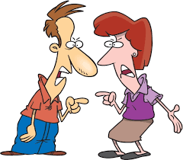
use 2. pew 3. few
4. fuel 5. cube 6. mule
7. The plug needed a new fuse.
8. The couple used to argue.

Slide 59
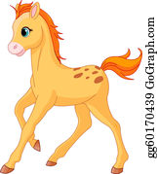
use 2. pew 3. few
4. fuel 5. cube 6. mule
7. The plug needed a new fuse.
8. The couple used to argue.
9. The foal is due
to be born in April.

Slide 60
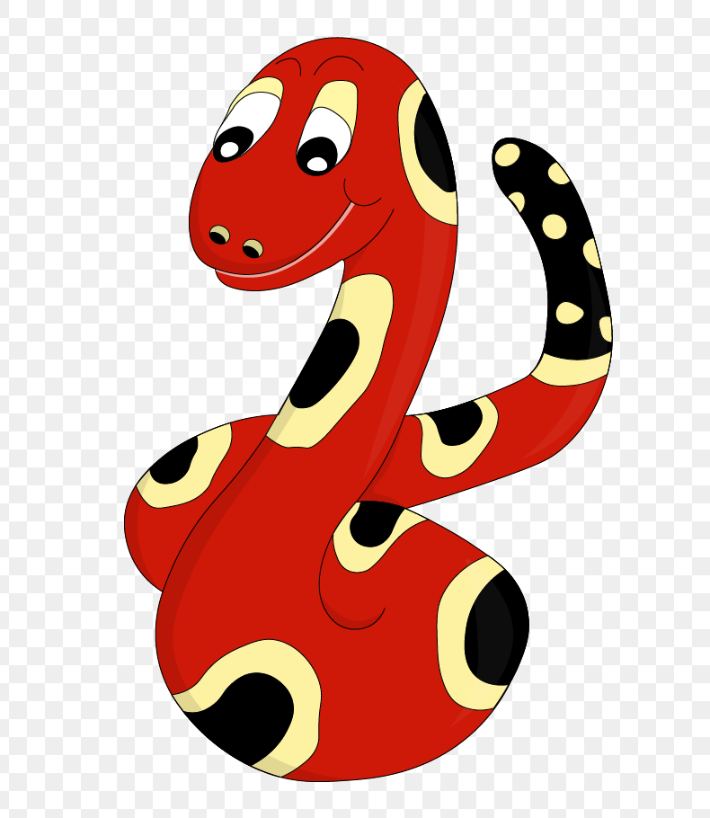
Thank you!
See you
next lesson.

