Slide 1
Jolly Grammar 2-16

Slide 2
Mini Test 15

Slide 3
snug

Slide 4
snug
flex

Slide 5
snug
flex
flying

Slide 6
snug
flex
flying
sight

Slide 7
snug
flex
flying
sight
side

Slide 8
snug
flex
flying
sight
side
6. die

Slide 9
snug
flex
flying
sight
side
6. die
7. bright

Slide 10
snug
flex
flying
sight
side
6. die
7. bright
8. sunshine

Slide 11
snug
flex
flying
sight
side
6. die
7. bright
8. sunshine
9. thirteen

Slide 12
snug
flex
flying
sight
side
6. die
7. bright
8. sunshine
9. thirteen
10. fourteen

Slide 13
Let’s Revise
Verbs.

Slide 15
Let’s Revise
conjugation.

Slide 16
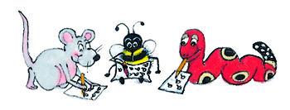
I
you
he
she
it
we
you
they
jump

Slide 17
I
you
he
she
it
we
you
they
jump
jump

Slide 18
I
you
he
she
it
we
you
they
jump
jump
jumps

Slide 19
I
you
he
she
it
we
you
they
jump
jump
jumps
jumps

Slide 20
I
you
he
she
it
we
you
they
jump
jump
jumps
jumps
jumps

Slide 21
I
you
he
she
it
we
you
they
jump
jump
jumps
jumps
jumps
jump

Slide 22
I
you
he
she
it
we
you
they
jump
jump
jumps
jumps
jumps
jump
jump

Slide 23
I
you
he
she
it
we
you
they
jump
jump
jumps
jumps
jumps
jump
jump
jump

Slide 24
I
you
he
she
it
we
you
they
(to) be

Slide 25
I
you
he
she
it
we
you
they
am

Slide 26
I
you
he
she
it
we
you
they
am
are

Slide 27
I
you
he
she
it
we
you
they
am
are
is

Slide 28
I
you
he
she
it
we
you
they
am
are
is
is

Slide 29
I
you
he
she
it
we
you
they
am
are
is
is
is

Slide 30
I
you
he
she
it
we
you
they
am
are
is
is
is
are

Slide 31
I
you
he
she
it
we
you
they
am
are
is
is
is
are
are

Slide 32
I
you
he
she
it
we
you
they
am
are
is
is
is
are
are
are

Slide 33
Activity page

Slide 34
Fill in the verb ‘to be’ in the present tense.
I
you
he/she/it
we
you
they

Slide 35
Fill in the verb ‘to be’ in the present tense.
I am
you
he/she/it
we
you
they

Slide 36
Fill in the verb ‘to be’ in the present tense.
I am
you are
he/she/it
we
you
they

Slide 37
Fill in the verb ‘to be’ in the present tense.
I am
you are
he/she/it is
we
you
they

Slide 38
Fill in the verb ‘to be’ in the present tense.
I am
you are
he/she/it is
we are
you
they

Slide 39
Fill in the verb ‘to be’ in the present tense.
I am
you are
he/she/it is
we are
you are
they

Slide 40
Fill in the verb ‘to be’ in the present tense.
I am
you are
he/she/it is
we are
you are
they are

Slide 41
You very tall.
She a girl.
Today, they happy.
Ben said, “I six years old.”
The car red.
We in the race.

Slide 42
You are very tall.
She a girl.
Today, they happy.
Ben said, “I six years old.”
The car red.
We in the race.

Slide 43
You are very tall.
She is a girl.
Today, they happy.
Ben said, “I six years old.”
The car red.
We in the race.

Slide 44
You are very tall.
She is a girl.
Today, they are happy.
Ben said, “I six years old.”
The car red.
We in the race.

Slide 45
You are very tall.
She is a girl.
Today, they are happy.
Ben said, “I am six years old.”
The car red.
We in the race.

Slide 46
You are very tall.
She is a girl.
Today, they are happy.
Ben said, “I am six years old.”
The car is red.
We in the race.

Slide 47
You are very tall.
She is a girl.
Today, they are happy.
Ben said, “I am six years old.”
The car is red.
We are in the race.

Slide 48
It is a lovely day today.
She is in the choir.
The bees are busy.
The tree is tall.
“I am sorry,” he said.
You are good at dancing.

Slide 49
It is a lovely day today.
She is in the choir.
The bees are busy.
The tree is tall.
“I am sorry,” he said.
You are good at dancing.

Slide 50
It is a lovely day today.
She is in the choir.
The bees are busy.
The tree is tall.
“I am sorry,” he said.
You are good at dancing.

Slide 51
It is a lovely day today.
She is in the choir.
The bees are busy.
The tree is tall.
“I am sorry,” he said.
You are good at dancing.

Slide 52
It is a lovely day today.
She is in the choir.
The bees are busy.
The tree is tall.
“I am sorry,” he said.
You are good at dancing.

Slide 53
It is a lovely day today.
She is in the choir.
The bees are busy.
The tree is tall.
“I am sorry,” he said.
You are good at dancing.

Slide 54
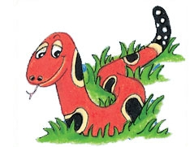
Number Words
half
quarter
eleven
twelve
thirteen
fourteen
fifteen
sixteen
seventeen
eighteen
nineteen
twenty

Slide 55
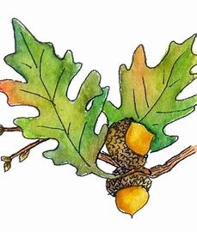
snow
/oa/
home
/oa/
oak
/oa/

Slide 56
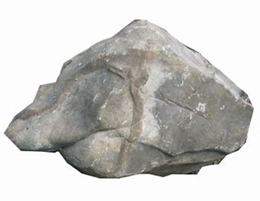
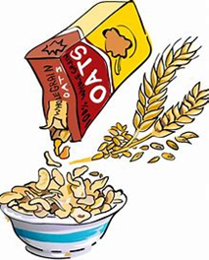
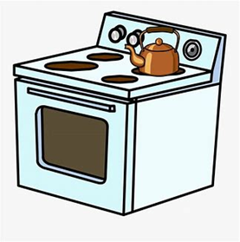
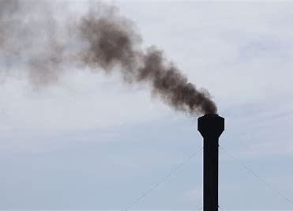
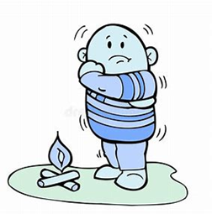
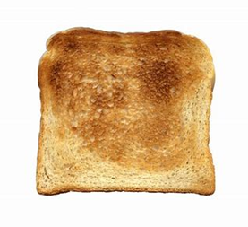
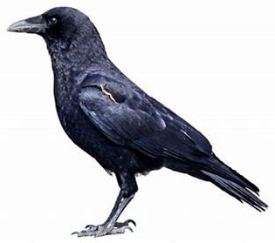
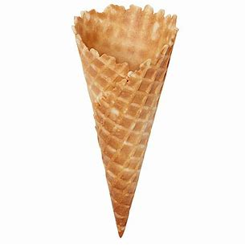
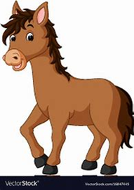
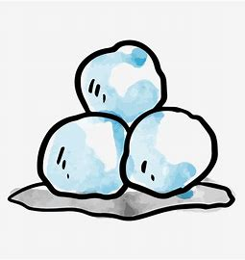
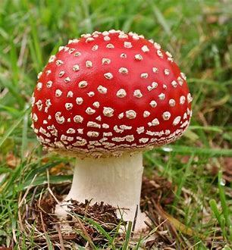
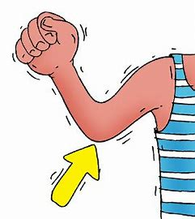
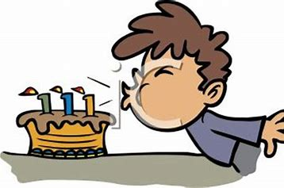
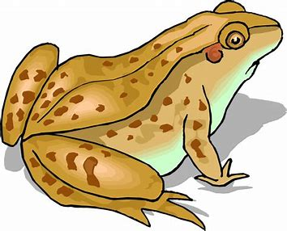
home
stone
oat
stove
smoke
such
luck
home
froze
foal
stone
toast
snowball
fifteen
sixteen
froze
toast
road
crow
cone
foal
snowball
note
toadstool
nose
elbow
toad
broke
blow
coast

Slide 57
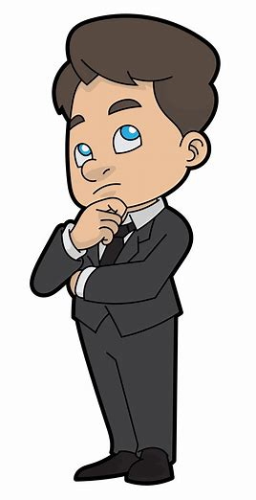
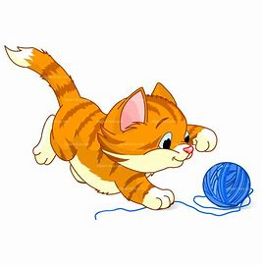
She sing .
He dresses .
The cat plays .
We cut out the pictures .

Slide 58
She sing happily.
He dresses .
The cat plays .
We cut out the pictures .

Slide 59
She sing happily.
He dresses neatly.
The cat plays .
We cut out the pictures .

Slide 60
She sing happily.
He dresses neatly.
The cat plays quietly.
We cut out the pictures .

Slide 61
She sing happily.
He dresses neatly.
The cat plays quietly.
We cut out the pictures carefully.

Slide 62
Dictation

Slide 63
Name:
1. 2. 3.
4. 5. 6.
7.
8.
9.

Slide 64
oat

Slide 65
oat 2. road

Slide 66
oat 2. road 3. note

Slide 67
oat 2. road 3. note
4. stove

Slide 68
oat 2. road 3. note
4. stove 5. crow

Slide 69
oat 2. road 3. note
4. stove 5. crow 6. toadstool

Slide 70
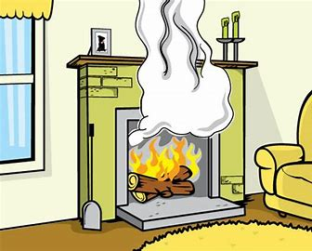
oat 2. road 3. note
4. stove 5. crow 6. toadstool
7. Smoke came from the fireplace.

Slide 71
oat 2. road 3. note
4. stove 5. crow 6. toadstool
7. Smoke came from the fireplace.
8. I ate ice cream in a cone.

Slide 72
oat 2. road 3. note
4. stove 5. crow 6. toadstool
7. Smoke came from the fireplace.
8. I ate ice cream in a cone.
9. We made toast
for breakfast.

Slide 73
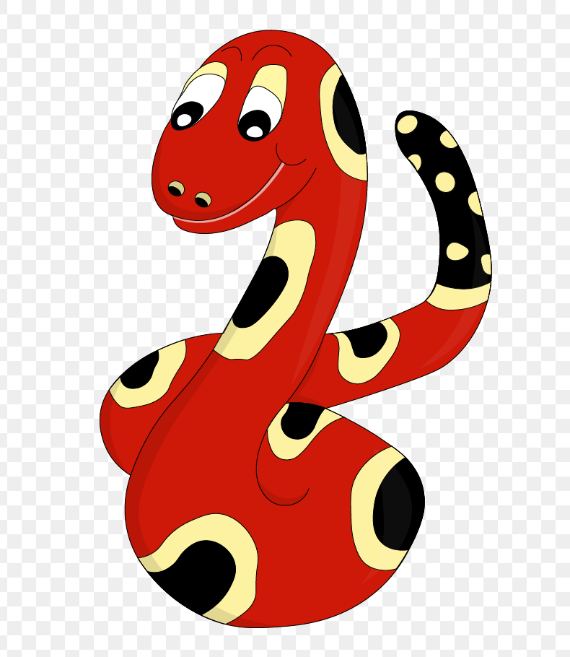
Thank you!
See you
next lesson.

