Slide 1
Jolly Grammar 2-15

Slide 2
Mini Test 14

Slide 3
arm

Slide 4
arm
shark

Slide 5
arm
shark
seen

Slide 6
arm
shark
seen
three

Slide 7
arm
shark
seen
three
seat

Slide 8
arm
shark
seen
three
seat
6. cream

Slide 9
arm
shark
seen
three
seat
6. cream
7. please

Slide 10
arm
shark
seen
three
seat
6. cream
7. please
8. teenager

Slide 11
arm
shark
seen
three
seat
6. cream
7. please
8. teenager
9. eleven

Slide 12
arm
shark
seen
three
seat
6. cream
7. please
8. teenager
9. eleven
10. twelve

Slide 13
Let’s Revise
Common Nouns,
Pronouns,
Adjectives
and Verbs.

Slide 14
Let’s Revise
Adverbs.

Slide 15
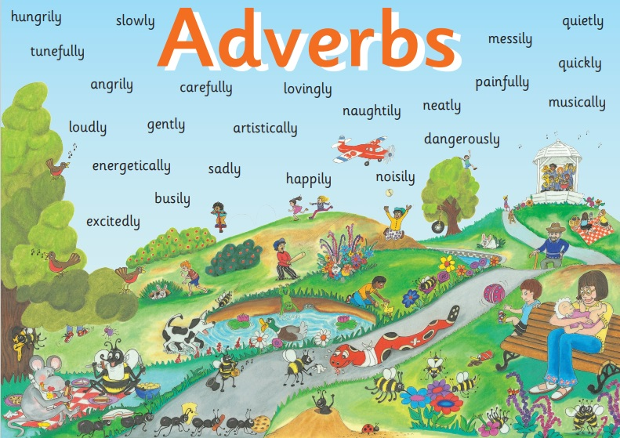

Slide 16
I speak loudly.
softly.
fast.
clearly.
slowly.
sweetly.
angrily.

Slide 17
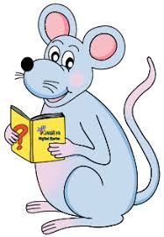
My Day

Slide 18
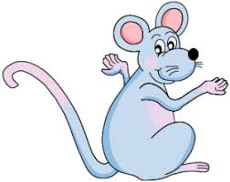
My Day
I wake suddenly,
I stretch tiredly,
I get out of bed
reluctantly,
I eat my breakfast
messily,
I go to school happily,
I work neatly,
I listen attentively,

Slide 19
My Day
I wake suddenly,
I stretch tiredly,
I get out of bed
reluctantly,
I eat my breakfast
messily,
I go to school happily,
I work neatly,
I listen attentively,
I play noisily,
I speak clearly,
I go home quickly,
I watch television
quietly,
I wash carefully,
I go to bed slowly,
I sleep soundly and
I dream sweetly.

Slide 20
Activity page

Slide 21
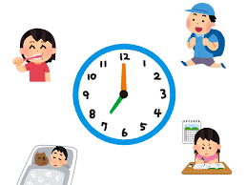
Write the adverbs on the lines to complete your poem.
My Day

Slide 22
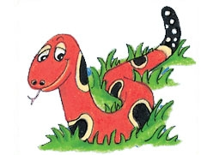
Number Words
half
quarter
eleven
twelve
thirteen
fourteen
fifteen
sixteen
seventeen
eighteen
nineteen
twenty

Slide 23
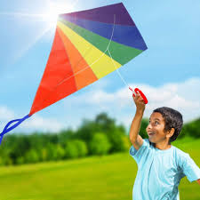
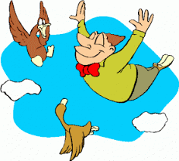
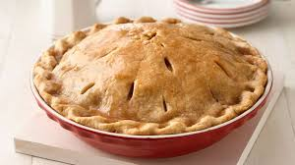
bright
/ie/
kite
/ie/
fly
/ie/
pie
/ie/

Slide 24
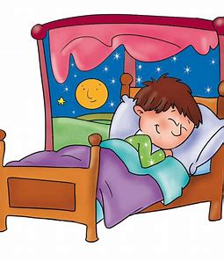
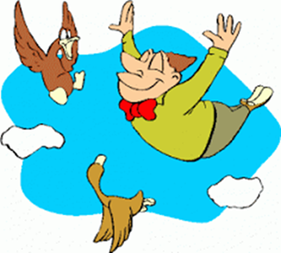
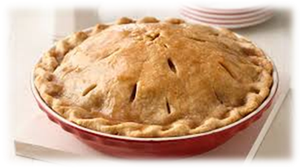
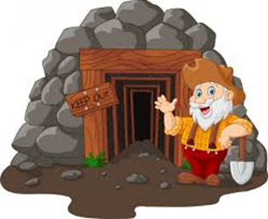
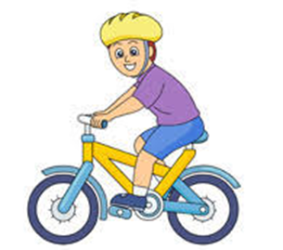
flying
die
try
my
lie
sky
snug
flex
flying
sight
side
die
bright
sunshine
thirteen
fourteen
sight
bright
pie
bike
light
by
side
sunshine
mine
daytime
ride

Slide 25
I fly my kite.
The big boat sails across the sea.
The dog barks and runs after the ball.
The children hop, skip and jump.

Slide 26
I fly my kite.
The big boat sails across the sea.
The dog barks and runs after the ball.
The children hop, skip and jump.

Slide 27
I fly my kite.
The big boat sails across the sea.
The dog barks and runs after the ball.
The children hop, skip and jump.

Slide 28
I fly my kite.
The big boat sails across the sea.
The dog barks and runs after the ball.
The children hop, skip and jump.

Slide 29
I fly my kite.
The big boat sails across the sea.
The dog barks and runs after the ball.
The children hop, skip and jump.

Slide 30
Dictation

Slide 31
Name:
1. 2. 3.
4. 5. 6.
7.
8.
9.

Slide 32
try

Slide 33
try 2. pie

Slide 34
try 2. pie 3. mine

Slide 35
try 2. pie 3. mine
4. sight

Slide 36
try 2. pie 3. mine
4. sight 5. my

Slide 37
try 2. pie 3. mine
4. sight 5. my 6. daytime

Slide 38
try 2. pie 3. mine
4. sight 5. my 6. daytime
7. She gave a nice wide smile.

Slide 39
try 2. pie 3. mine
4. sight 5. my 6. daytime
7. She gave a nice wide smile.
8. I like to ride my bike.

Slide 40
try 2. pie 3. mine
4. sight 5. my 6. daytime
7. She gave a nice wide smile.
8. I like to ride my bike.
9. The lights shine
brightly at night.

Slide 41
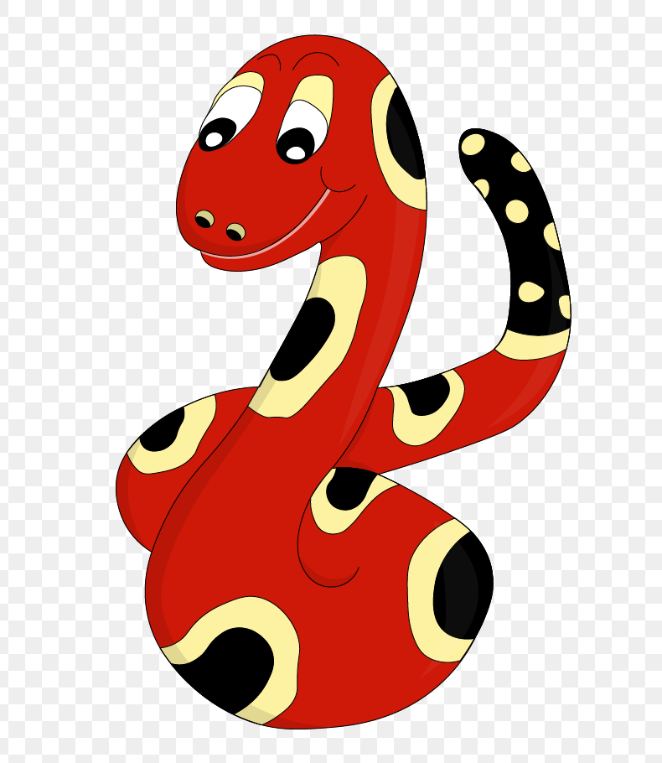
Thank you!
See you
next lesson.

