Slide 1
Jolly Grammar 2-14

Slide 2
Mini Test 13

Slide 3
next

Slide 4
next
quit

Slide 5
next
quit
make

Slide 6
next
quit
make
pay

Slide 7
next
quit
make
pay
main

Slide 8
next
quit
make
pay
main
6. clay

Slide 9
next
quit
make
pay
main
6. clay
7. waist

Slide 10
next
quit
make
pay
main
6. clay
7. waist
8. rainstorm

Slide 11
next
quit
make
pay
main
6. clay
7. waist
8. rainstorm
9. half

Slide 12
next
quit
make
pay
main
6. clay
7. waist
8. rainstorm
9. half
10. quarter

Slide 13
Let’s Revise
Verbs.

Slide 14
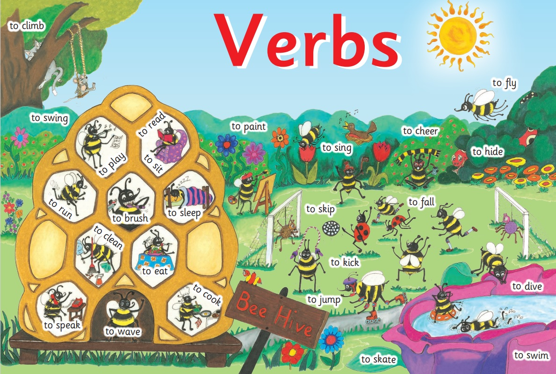

Slide 15
Let’s Revise
Pronouns.

Slide 16
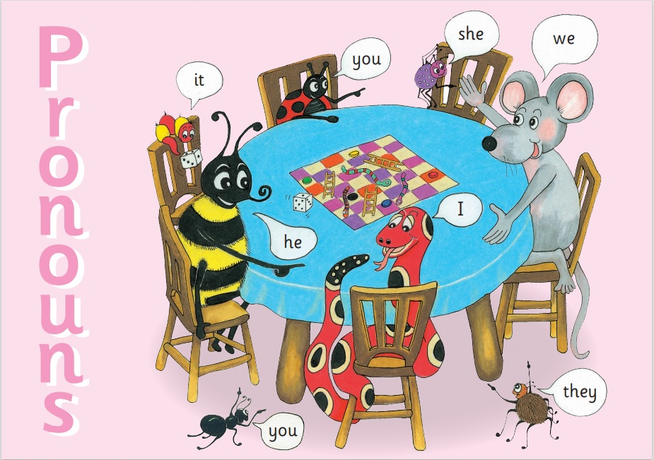

Slide 17
Let’s Revise
Conjugation
・Present
・Past
・Future.

Slide 18
a dog ran across the

Slide 19
a dog ran across the
A dog ran across the park.

Slide 20
a dog ran across the
A dog ran across the park.

Slide 21
Oranges and lemons.

Slide 22
Oranges and lemons.
×sentence

Slide 23
Activity page

Slide 24
The ducks swim on the pond.

Slide 25
The ducks swim on the pond.
☑

Slide 26
The cat watches the birds.

Slide 27
The cat watches the birds.
☑

Slide 28
A spotty dog.

Slide 29
A spotty dog.
☒

Slide 30
The girl plays on the slide.

Slide 31
The girl plays on the slide.
☑

Slide 32
The park keeper sweeps up the leaves.

Slide 33
The park keeper sweeps up the leaves.
☑

Slide 34
A wooden boat with a blue sail.

Slide 35
A wooden boat with a blue sail.
☒

Slide 36
The tall tree.

Slide 37
The tall tree.
☒

Slide 38
A bird sings.

Slide 39
A bird sings.
☑

Slide 40
A spotty dog has a stick
in his mouth.

Slide 41
A spotty dog has a stick
in his mouth.
☑

Slide 42
The boys play bat and ball.

Slide 43
The boys play bat and ball.
☑

Slide 44
The rabbit hides from the fox.

Slide 45
The rabbit hides from the fox.
☑

Slide 46
Remember
A sentence needs to have a verb, as well as
a capital letter at the beginning and a full stop at the end.

Slide 47
A bird sings.
The girl flies a kite.
The boy plays on the slide.
The squirrel eats bread.
The boy catches a ball.
The duck is swimming.
The boy plays golf.
The boy is on a boat.

Slide 48
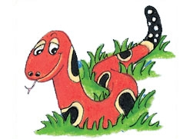
Number Words
half
quarter
eleven
twelve
thirteen
fourteen
fifteen
sixteen
seventeen
eighteen
nineteen
twenty

Slide 49
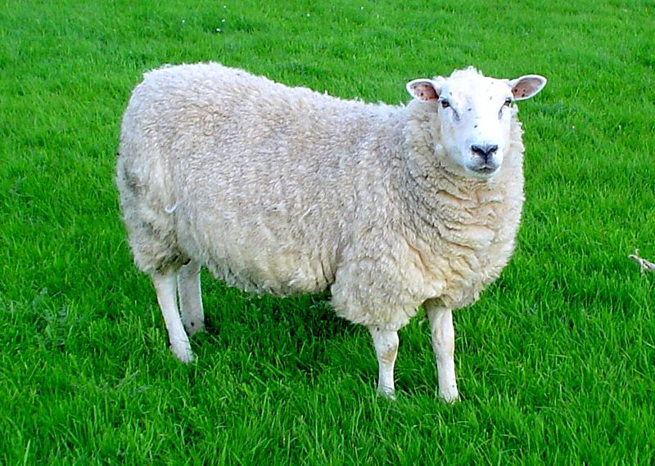
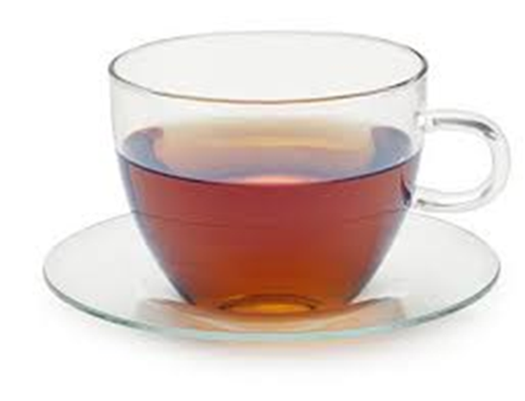
sheep
/ee/
tea
/ee/

Slide 50
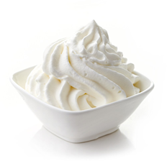
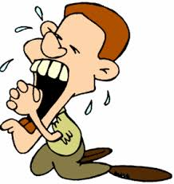
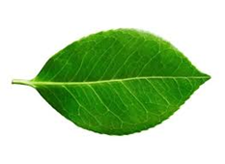
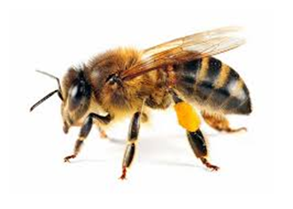
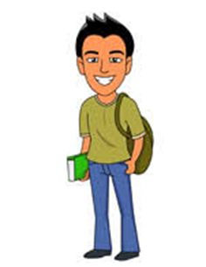
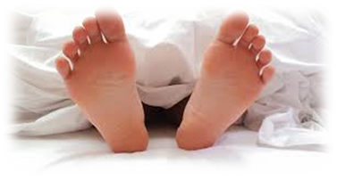
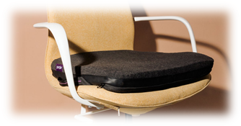
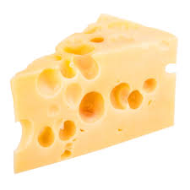
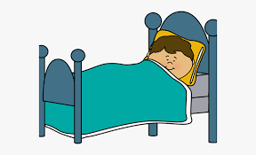
seen
cream
tea
sweet
arm
shark
seen
three
seat
cream
please
teenager
eleven
twelve
three
please
leaf
bee
seat
teenager
each
feet
east
cheese
street
dream

Slide 51
Dictation

Slide 52
Name:
1. 2. 3.
4. 5. 6.
7.
8.
9.

Slide 53
tea

Slide 54
tea 2. leaf

Slide 55
tea 2. leaf 3. each

Slide 56
tea 2. leaf 3. each
4. sweet

Slide 57
tea 2. leaf 3. each
4. sweet 5. bee

Slide 58
tea 2. leaf 3. each
4. sweet 5. bee 6. feet

Slide 59
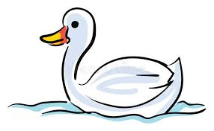
tea 2. leaf 3. each
4. sweet 5. bee 6. feet
7. A young swan was
seen on the sea.

Slide 60
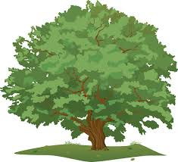
tea 2. leaf 3. each
4. sweet 5. bee 6. feet
7. A young swan was
seen on the sea.
8. We climbed
the large green tree.

Slide 61
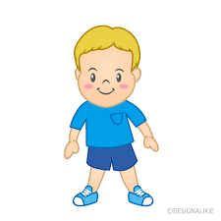
tea 2. leaf 3. each
4. sweet 5. bee 6. feet
7. A young swan was
seen on the sea.
8. We climbed
the large green tree.
9. “A cup of weak tea,
please,” said Tim.

Slide 62
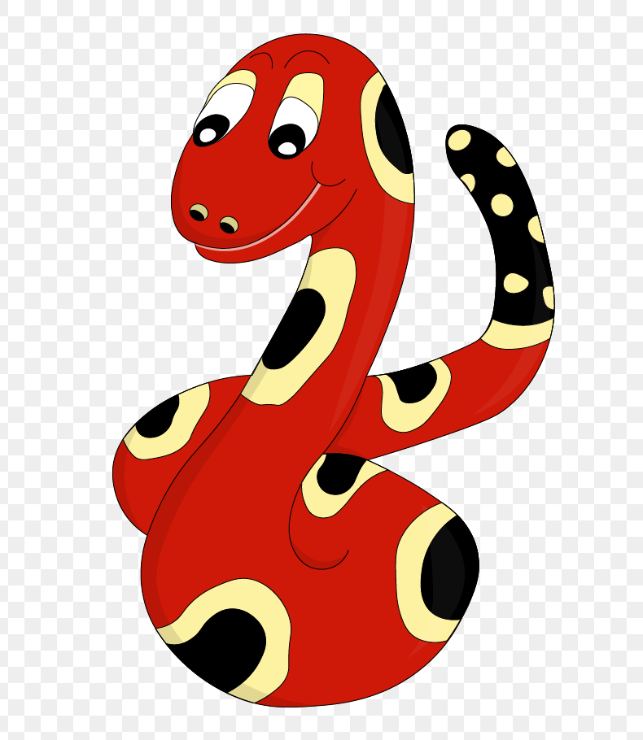
Thank you!
See you
next lesson.

