Slide 1
Jolly Grammar 2-13

Slide 2
Mini Test 12

Slide 3
buzz

Slide 4
buzz
fizz

Slide 5
buzz
fizz
echo

Slide 6
buzz
fizz
echo
choir

Slide 7
buzz
fizz
echo
choir
ache

Slide 8
buzz
fizz
echo
choir
ache
6. stomach

Slide 9
buzz
fizz
echo
choir
ache
6. stomach
7. Christmas

Slide 10
buzz
fizz
echo
choir
ache
6. stomach
7. Christmas
8. character

Slide 11
buzz
fizz
echo
choir
ache
6. stomach
7. Christmas
8. character
9. November

Slide 12
buzz
fizz
echo
choir
ache
6. stomach
7. Christmas
8. character
9. November
10. December

Slide 13
Let’s Revise
Alphabetical Order.

Slide 14
bread butter

Slide 15
bread butter

Slide 16
bread butter

Slide 17
bread butter
home house

Slide 18
bread butter
home house

Slide 19
bread butter
home house

Slide 20
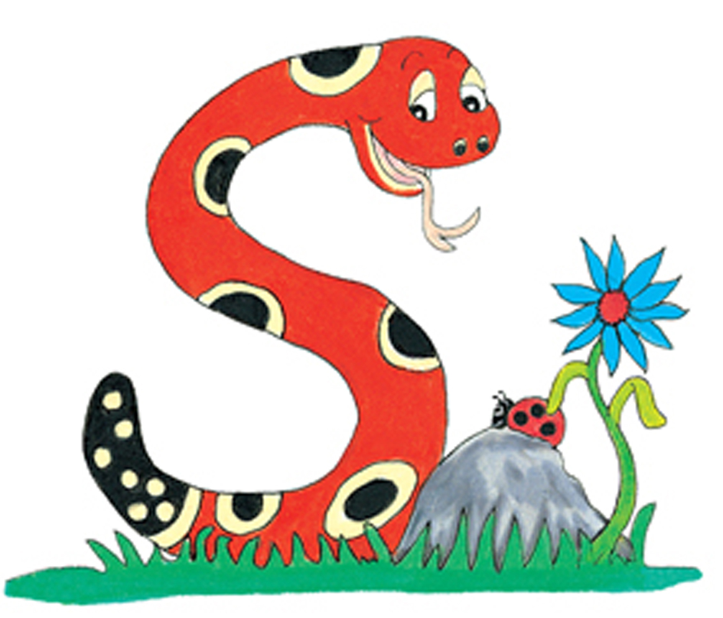
shell
shop
ship

Slide 21
shell
shop
ship
1st

Slide 22
shell
shop
ship
1st
3rd

Slide 23
shell
shop
ship
1st
3rd
2nd

Slide 24
hill
hive
hidden

Slide 25
hill
hive
hidden
2nd
3rd
1st

Slide 26
crisp
cross
crab
2nd
3rd
1st

Slide 27
Activity page

Slide 28
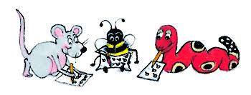
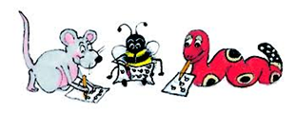
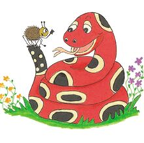
shell 1st
shop 3rd
ship 2nd
pet 3rd
pen 1st
people 2nd
march 3rd
magpie 1st
make 2nd
drink 2nd
dress 1st
drum 3rd
hill 2nd
hive 3rd
hidden 1st
rocket 1st
roof 2nd
round 3rd
eat 3rd
east 2nd
each 1st
need 1st
nest 2nd
next 3rd
crisp 2nd
cross 3rd
crab 1st
tree 2nd
train 1st
trick 3rd
world 3rd
wood 2nd
wolf 1st
knee 1st
knock 3rd
knife 2nd

Slide 29
Activity page

Slide 30
there or their?
they are! Up .
toys are over .

Slide 31
there or their?
There they are! Up there.
toys are over .

Slide 32
there or their?
There they are! Up there.
Their toys are over there.

Slide 33
are or our ?
We going to visit grandma.
They all coming to school.

Slide 34
are or our ?
We are going to visit our grandma.
They all coming to school.

Slide 35
are or our ?
We are going to visit our grandma.
They are all coming to our school.

Slide 36
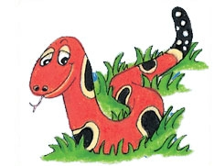
Number Words
half
quarter
eleven
twelve
thirteen
fourteen
fifteen
sixteen
seventeen
eighteen
nineteen
twenty

Slide 37
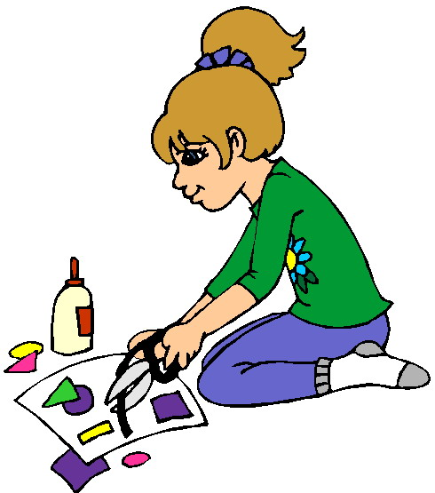
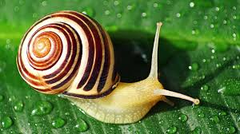
pay
/ai/
make
/ai/
snail
/ai/

Slide 38
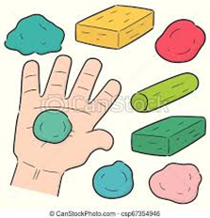
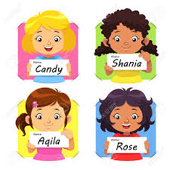
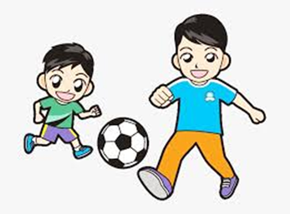
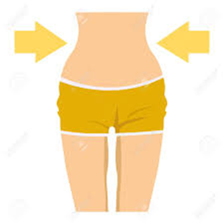
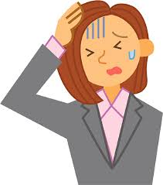
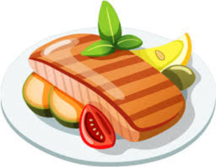
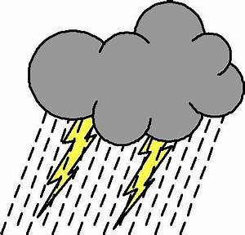
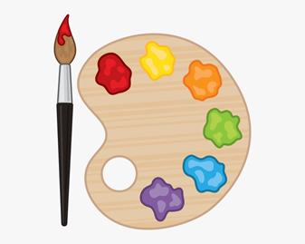
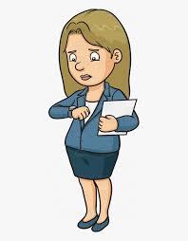
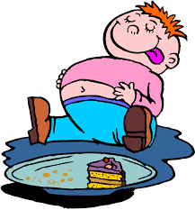
make
clay
name
play
next
quit
make
pay
main
clay
waist
rainstorm
half
quarter
pay
waist
day
mistake
main
rainstorm
paint
rain
wait
ate
snake
tray

Slide 39
Dictation

Slide 40
Name:
1. 2. 3.
4. 5. 6.
7.
8.
9.

Slide 41
name

Slide 42
name 2. play

Slide 43
name 2. play 3. day

Slide 44
name 2. play 3. day
4. paint

Slide 45
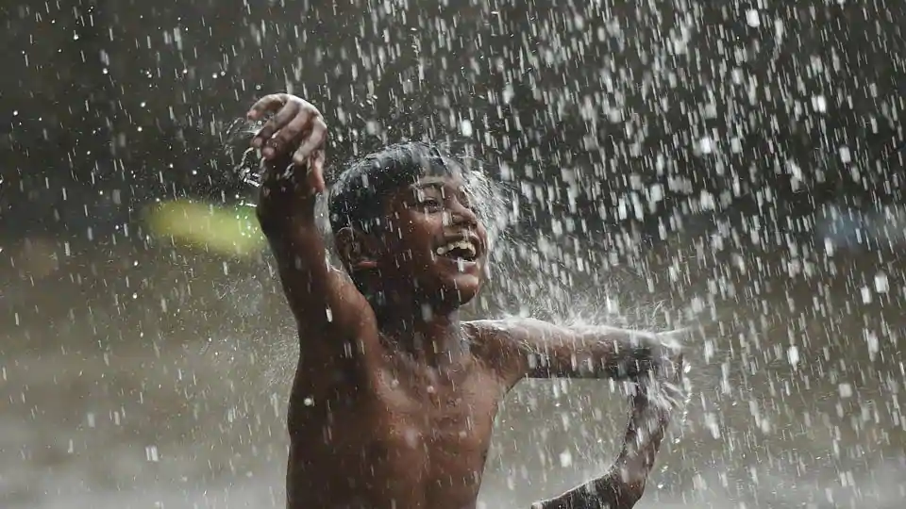
name 2. play 3. day
4. paint 5. rain

Slide 46
name 2. play 3. day
4. paint 5. rain 6. mistake

Slide 47
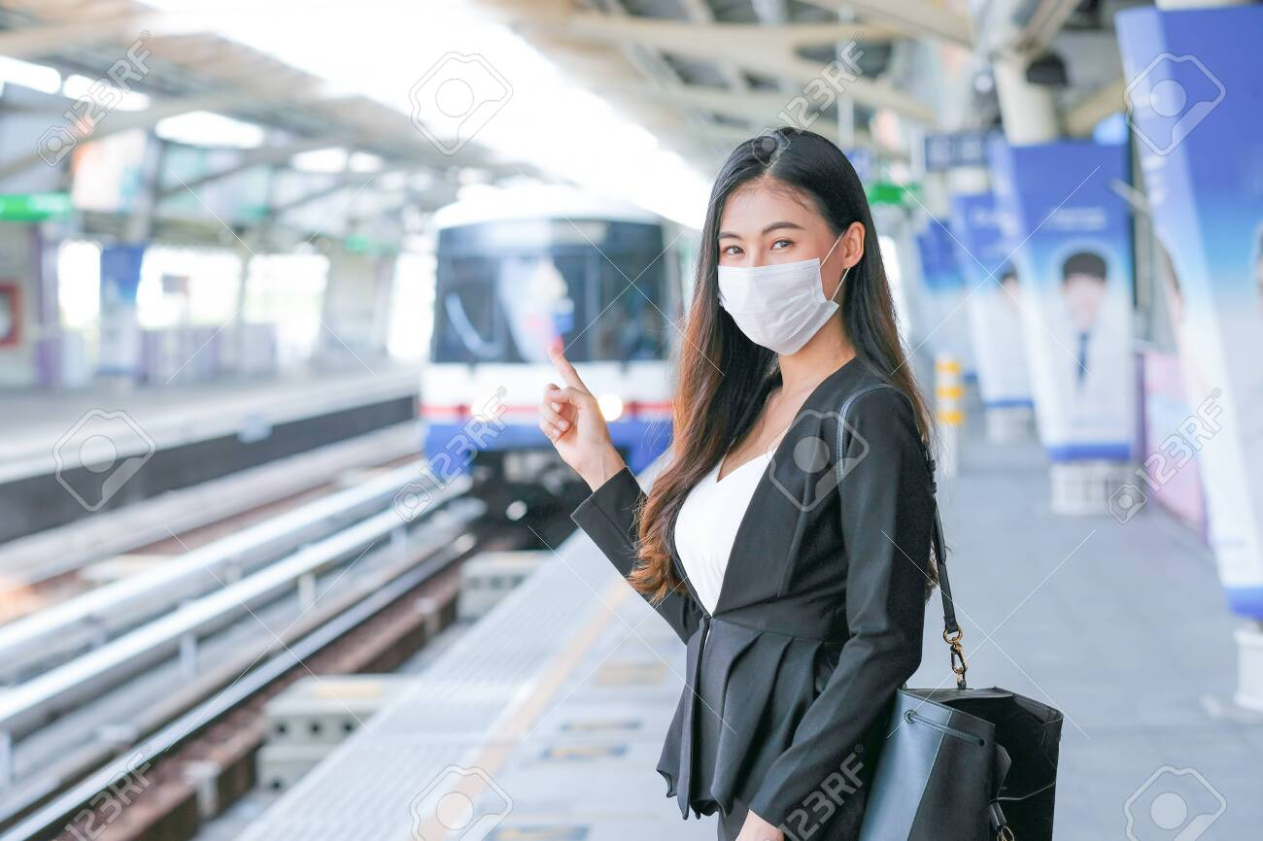
name 2. play 3. day
4. paint 5. rain 6. mistake
7. Stay and wait for the train.

Slide 48
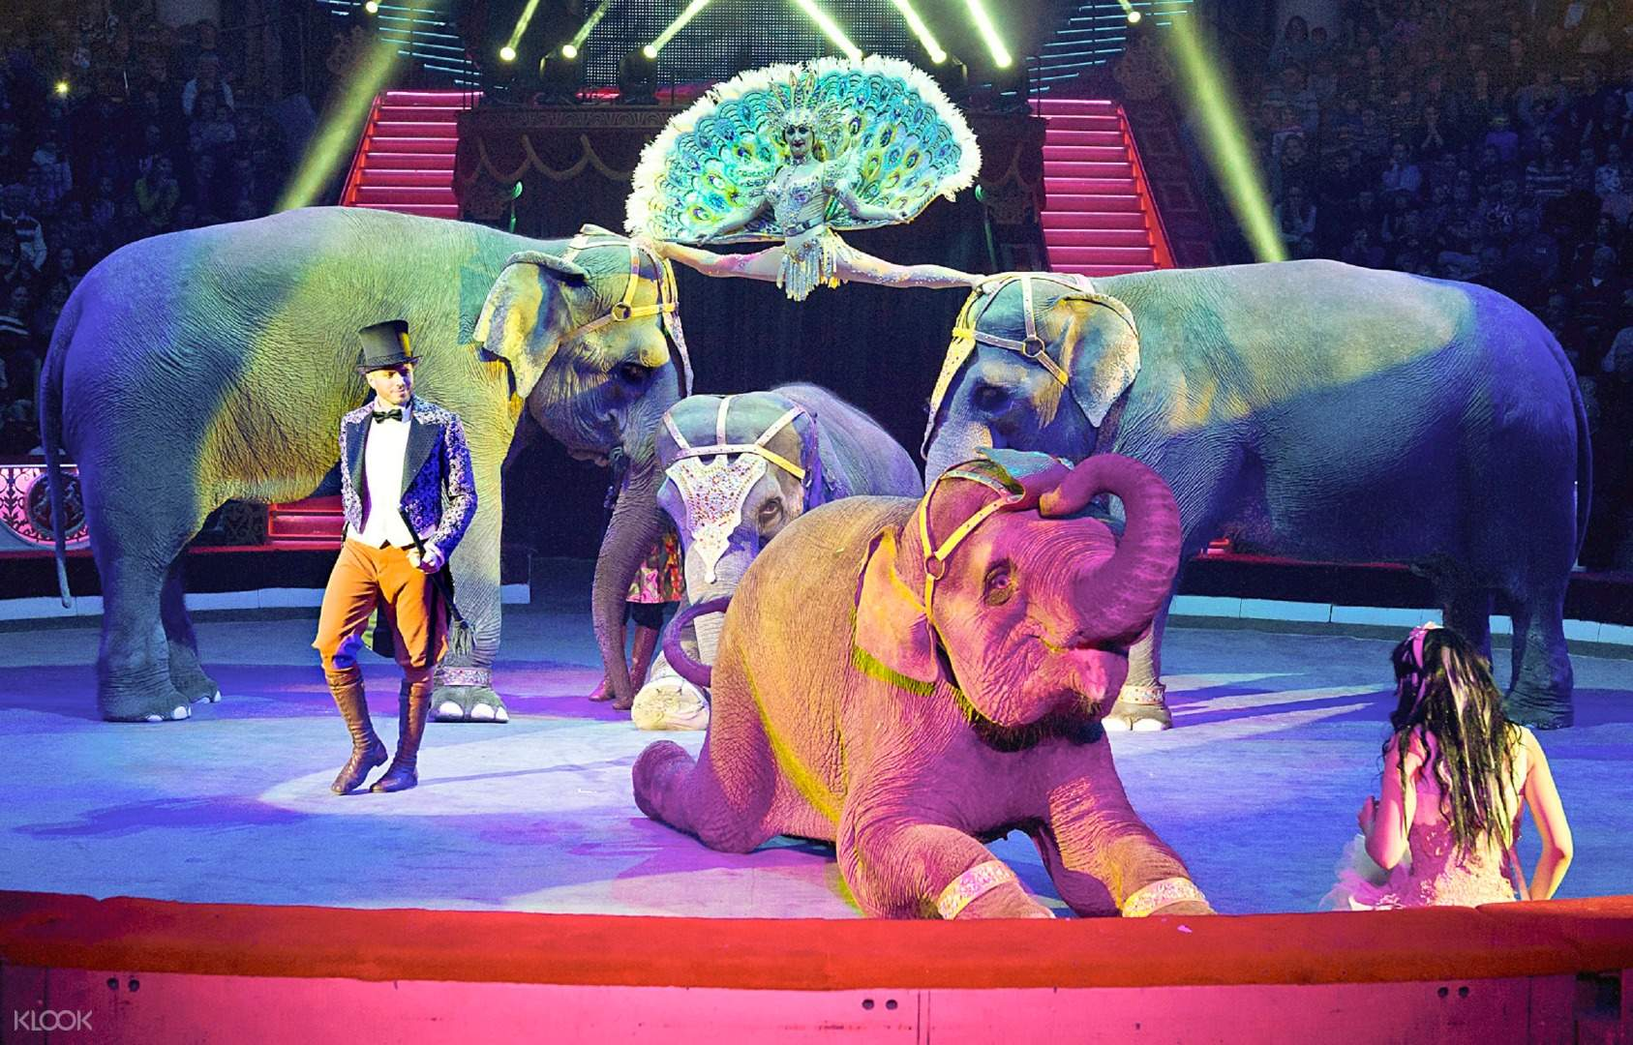
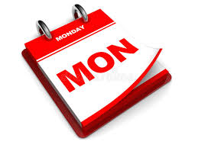
name 2. play 3. day
4. paint 5. rain 6. mistake
7. Stay and wait for the train.
8. The circus came
on Monday.

Slide 49
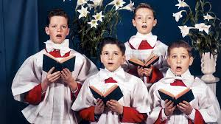
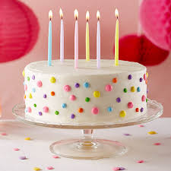
name 2. play 3. day
4. paint 5. rain 6. mistake
7. Stay and wait for the train.
8. The circus came
on Monday.
9. The choirboys ate
slices of cake.

Slide 50
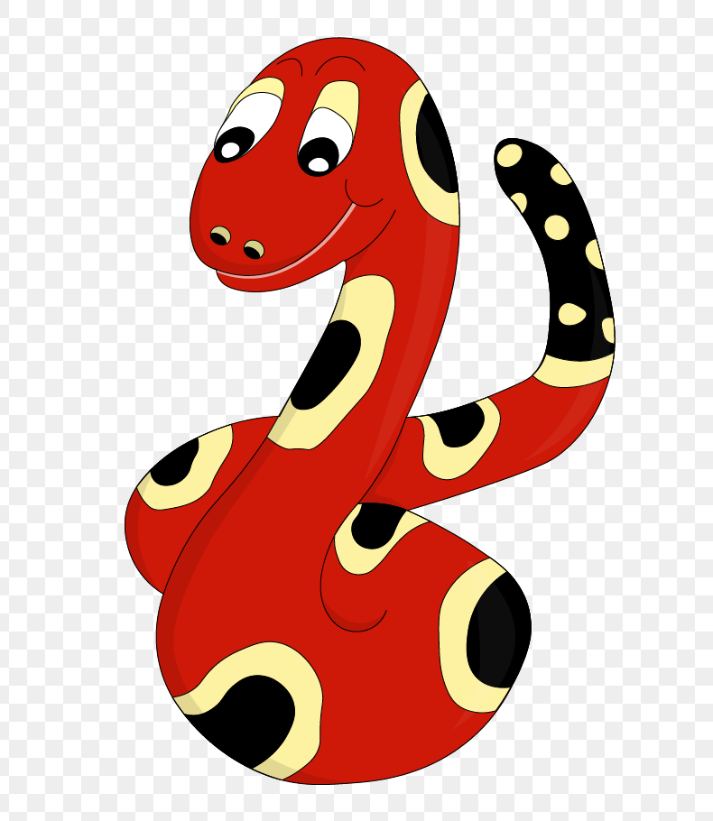
Thank you!
See you
next lesson.

