Slide 1
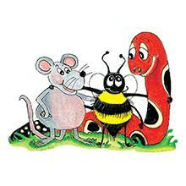
Jolly Grammar 2-11

Slide 2
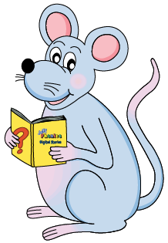
Mini Test 10

Slide 3
thin

Slide 4
thin
thick

Slide 5
thin
thick
touch

Slide 6
thin
thick
touch
young

Slide 7
thin
thick
touch
young
double

Slide 8
thin
thick
touch
young
double
6. trouble

Slide 9
thin
thick
touch
young
double
6. trouble
7. country

Slide 10
thin
thick
touch
young
double
6. trouble
7. country
8. nourish

Slide 11
thin
thick
touch
young
double
6. trouble
7. country
8. nourish
9. July

Slide 12
thin
thick
touch
young
double
6. trouble
7. country
8. nourish
9. July
10. August

Slide 13
Let’s Revise
Adjectives.

Slide 14
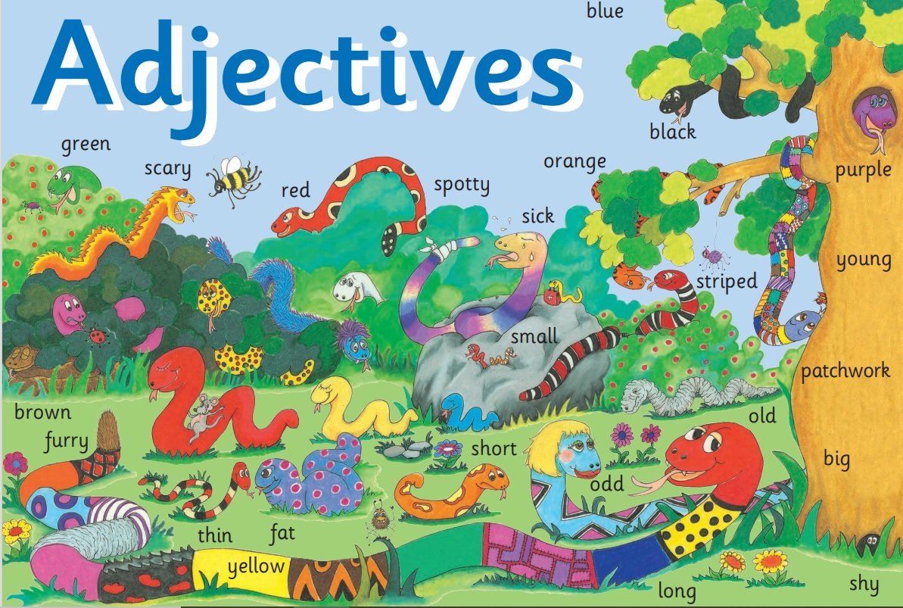

Slide 15
Let’s Revise
Pronouns.

Slide 16
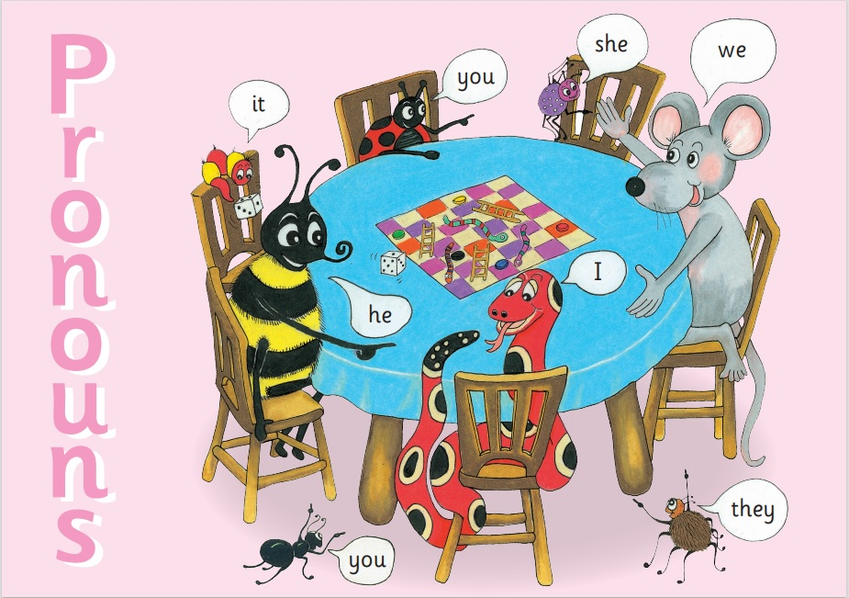

Slide 18
my

Slide 19
my
your

Slide 20
my
your
his

Slide 21
my
your
his
her

Slide 22
my
your
his
her
its

Slide 23
my
your
his
her
its
our

Slide 24
my
your
his
her
its
our
your

Slide 25
my
your
his
her
its
our
your
their

Slide 26
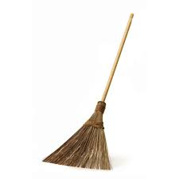
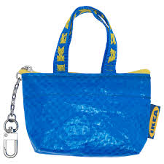
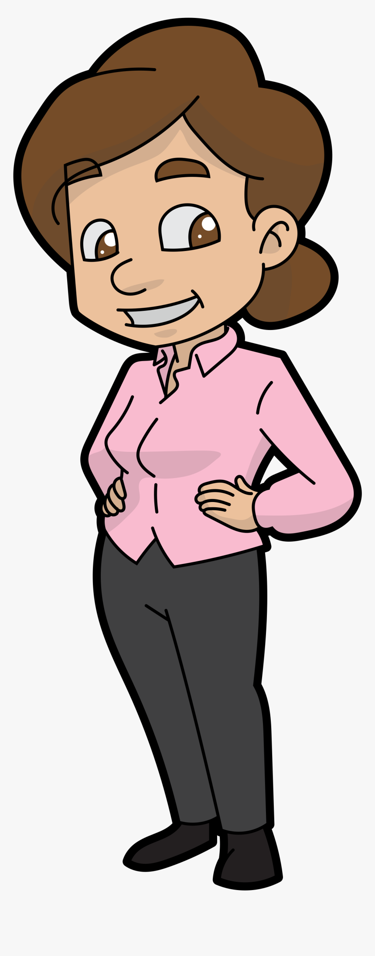
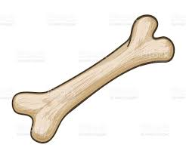
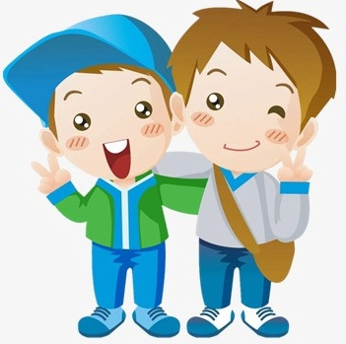
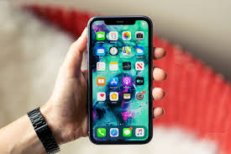
A Poem
My broom,
Your room,
His flag,
Her bag,
Its bone,
Our phone,
Your mothers
and
Their brothers.

Slide 27
Activity page

Slide 28
Choose the right possessive adjective
for each sentence.
They put on coat.

Slide 29
Choose the right possessive adjective
for each sentence.
They put on their coat.

Slide 30
They put on their coat.

Slide 31
They put on their coat.
I put on my coat.

Slide 32
They put on their coat.
I put on my coat.
He puts on his coat.

Slide 33
They put on their coat.
I put on my coat.
He puts on his coat.
We put on our coats.

Slide 34
They put on their coat.
I put on my coat.
He puts on his coat.
We put on our coats.
She puts on her coat.

Slide 35
They put on their coat.
I put on my coat.
He puts on his coat.
We put on our coats.
She puts on her coat.
You put on your coat.

Slide 36
They put on their coat.
I put on my coat.
He puts on his coat.
We put on our coats.
She puts on her coat.
You put on your coat.
You put on your coats.

Slide 37
Choose a noun for each
possessive adjective.
my

Slide 38
Choose a nouns for each
possessive adjective.
my dog

Slide 39
my dog
your
his
her
its
our
your
their

Slide 40
my dog
your cat
his
her
its
our
your
their

Slide 41
my dog
your cat
his hat
her
its
our
your
their

Slide 42
my dog
your cat
his hat
her bag
its
our
your
their

Slide 43
my dog
your cat
his hat
her bag
its tail
our
your
their

Slide 44
my dog
your cat
his hat
her bag
its tail
our school
your
their

Slide 45
my dog
your cat
his hat
her bag
its tail
our school
your cups
their

Slide 46
my dog
your cat
his hat
her bag
its tail
our school
your cups
their shirts

Slide 47
Underline the possessive adjectives in blue.
Ben’s friend, Sara, came to visit. She brought her colouring books and
pencils.
“Your books have lovely pictures in them,” said Ben.
“This is my favourite book,” replied Sarah. “If we share our coloured
Pencils, we will have plenty of colours for that picture.”
Ben fetched his pencils. He took them out of their box.

Slide 48
Underline the possessive adjectives in blue.
Ben’s friend, Sara, came to visit. She brought her colouring books and
pencils.
“Your books have lovely pictures in them,” said Ben.
“This is my favourite book,” replied Sarah. “If we share our coloured
pencils, we will have plenty of colours for that picture.”
Ben fetched his pencils. He took them out of their box.

Slide 49
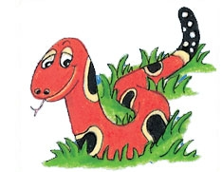
Months of the Year
January
February
March
April
May
June
July
August
September
October
November
December

Slide 50
hair
/air/

Slide 51
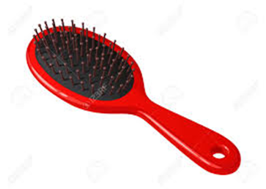
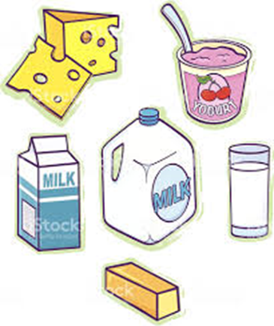
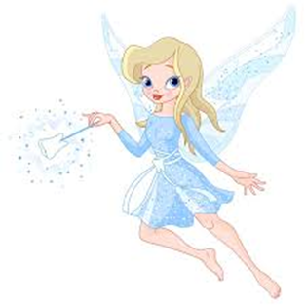
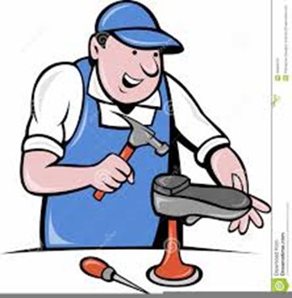
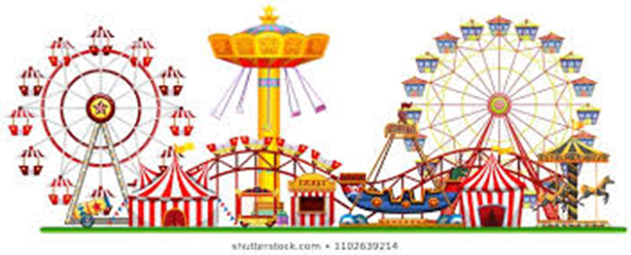
air
hairbrush
dairy
cliff
off
air
hair
pair
stair
chair
hairbrush
September
October
hair
stair
fairy
repair
pair
chair
fair

Slide 52
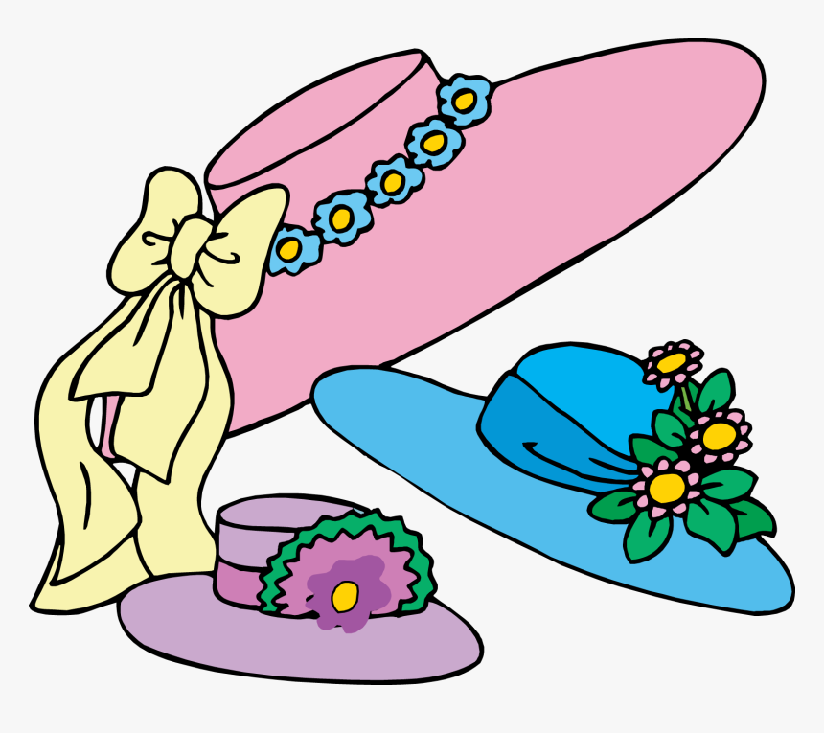
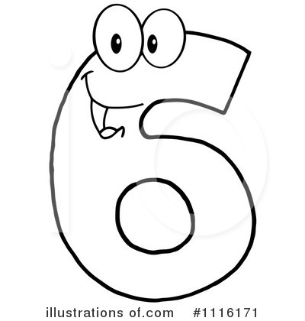
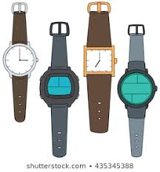
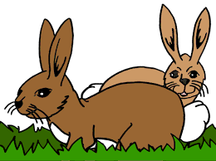

Slide 53
sixes

Slide 54
sixes
rabbits

Slide 55
hats
sixes
rabbits

Slide 56
hats
sixes
watches
rabbits

Slide 57
Dictation

Slide 58
Name:
1. 2. 3.
4. 5. 6.
7.
8.
9.

Slide 59
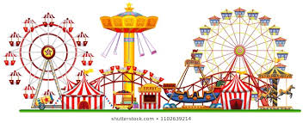
fair

Slide 60
fair 2. dairy

Slide 61
fair 2. dairy 3. pair

Slide 62
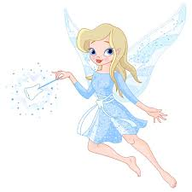
fair 2. dairy 3. pair
4. fairy

Slide 63
fair 2. dairy 3. pair
4. fairy 5. stair

Slide 64
fair 2. dairy 3. pair
4. fairy 5. stair 6. repair

Slide 65
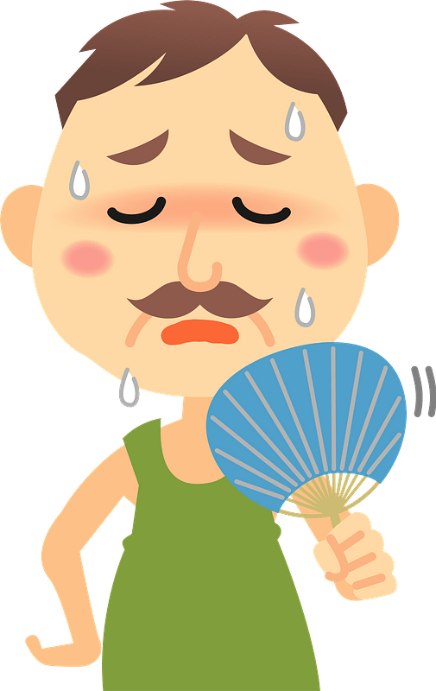
fair 2. dairy 3. pair
4. fairy 5. stair 6. repair
7. The place was hot and airless.

Slide 66
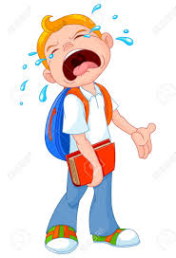
fair 2. dairy 3. pair
4. fairy 5. stair 6. repair
7. The place was hat and airless.
8. “That is unfair!”
cried the boy.

Slide 67
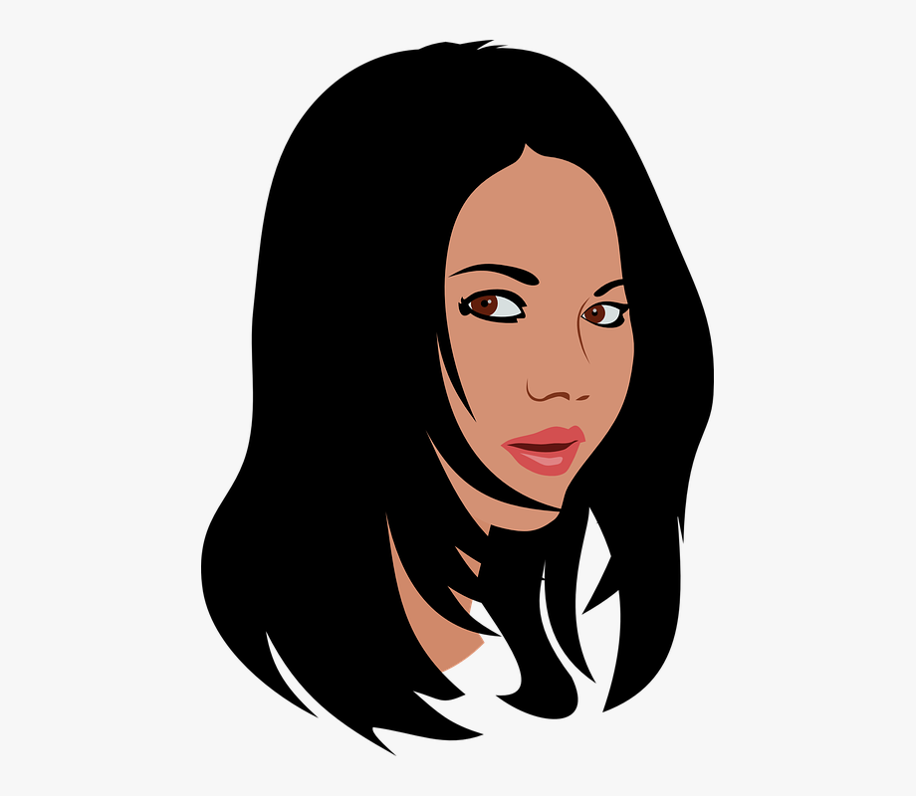
fair 2. dairy 3. pair
4. fairy 5. stair 6. repair
7. The place was hot and airless.
8. “That is unfair!”
cried the boy.
9. My young cousin
has black hair.

Slide 68
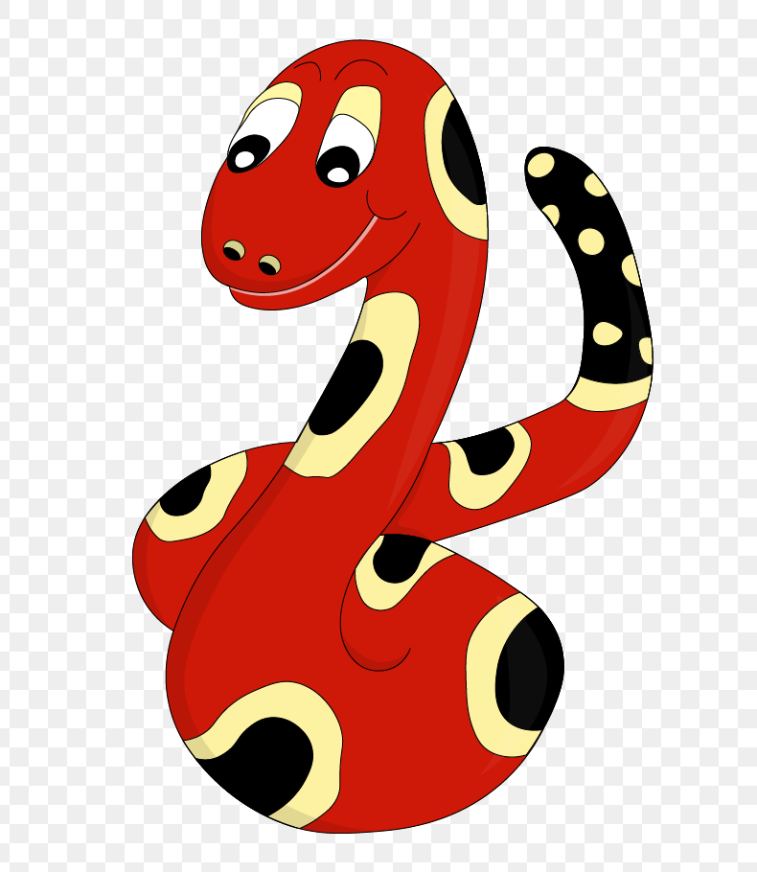
Thank you!
See you
next lesson.

