Slide 1
Jolly Grammar 2-10

Slide 2
Mini Test 9

Slide 3
duck

Slide 4
duck
click

Slide 5
duck
click
wand

Slide 6
duck
click
wand
wash

Slide 7
duck
click
wand
wash
wasp

Slide 8
duck
click
wand
wash
wasp
6. swan

Slide 9
duck
click
wand
wash
wasp
6. swan
7. watch

Slide 10
duck
click
wand
wash
wasp
6. swan
7. watch
8. swallow

Slide 11
duck
click
wand
wash
wasp
6. swan
7. watch
8. swallow
9. May

Slide 12
duck
click
wand
wash
wasp
6. swan
7. watch
8. swallow
9. May
10. June

Slide 13
Let’s Revise
Singular &
Plurals.

Slide 14
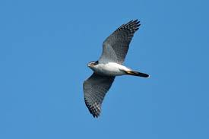

Slide 15
bird

Slide 16
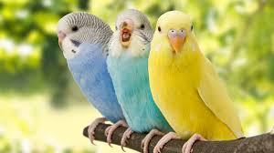
bird

Slide 17
bird
birds

Slide 18
bird
birds
singular

Slide 19
bird
birds
singular
plural

Slide 20
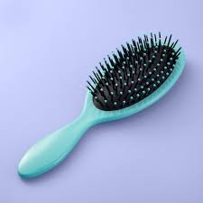

Slide 21
brush

Slide 22
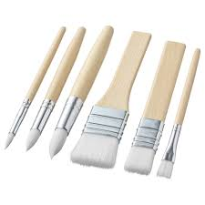
brush

Slide 23
brush
brushes

Slide 24
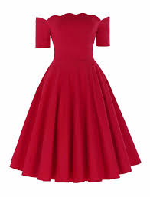

Slide 25
dress

Slide 26
dress

Slide 27
dress
dresses

Slide 28
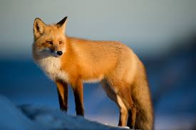

Slide 29
fox

Slide 30
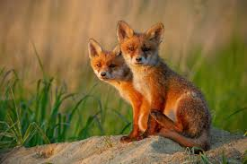
fox

Slide 31
fox
foxes

Slide 32
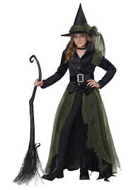

Slide 33
witch

Slide 34
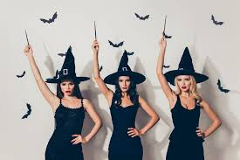
witch

Slide 35
witch
witches

Slide 36
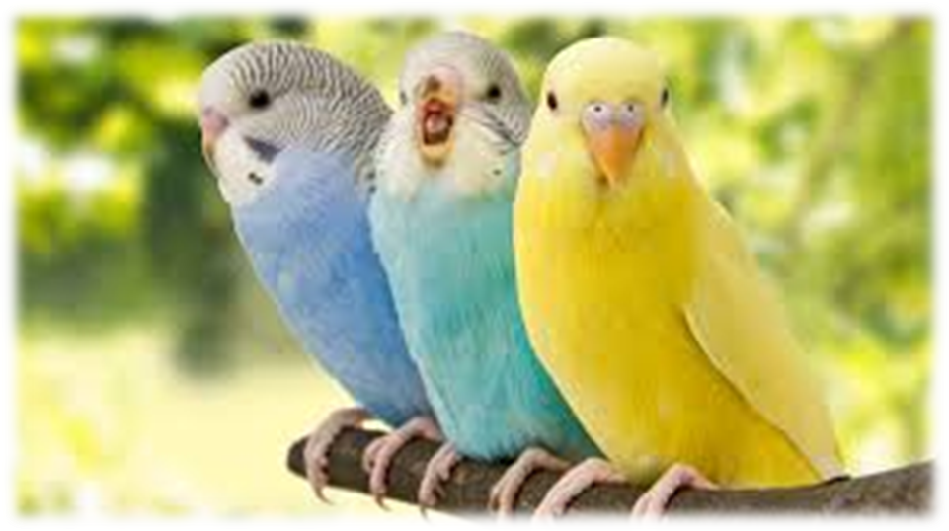
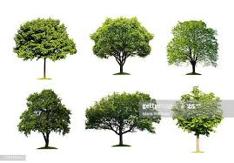
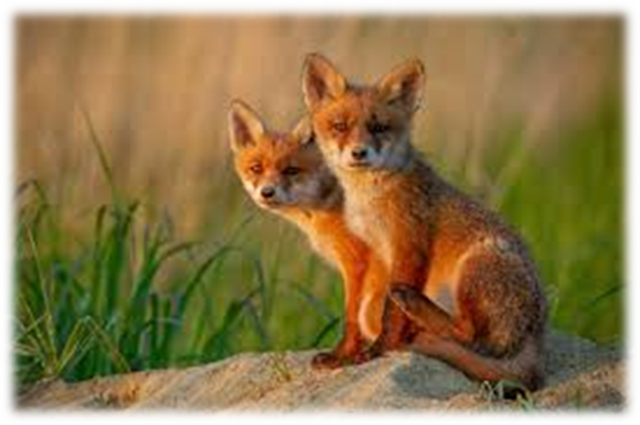
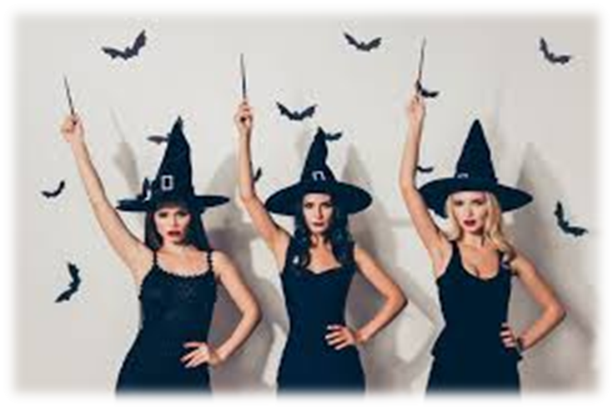
brushes
dresses
birds
trees
foxes
witches

Slide 37
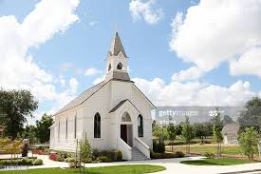
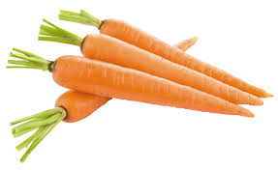
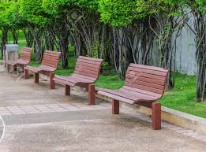
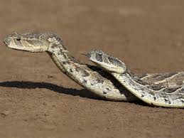
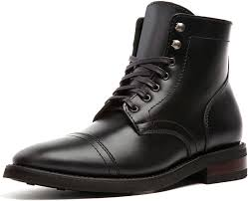

Slide 38
carrots

Slide 39
carrots
boxes

Slide 40
carrots
boxes
church

Slide 41
carrots
boxes
church
benches

Slide 42
carrots
boxes
church
benches
snakes

Slide 43
carrots
boxes
church
benches
snakes
boot

Slide 44
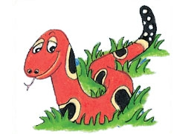
Months of the Year
January
February
March
April
May
June
July
August
September
October
November
December

Slide 45
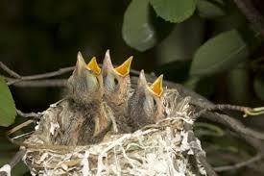
young
birds
/u/

Slide 46
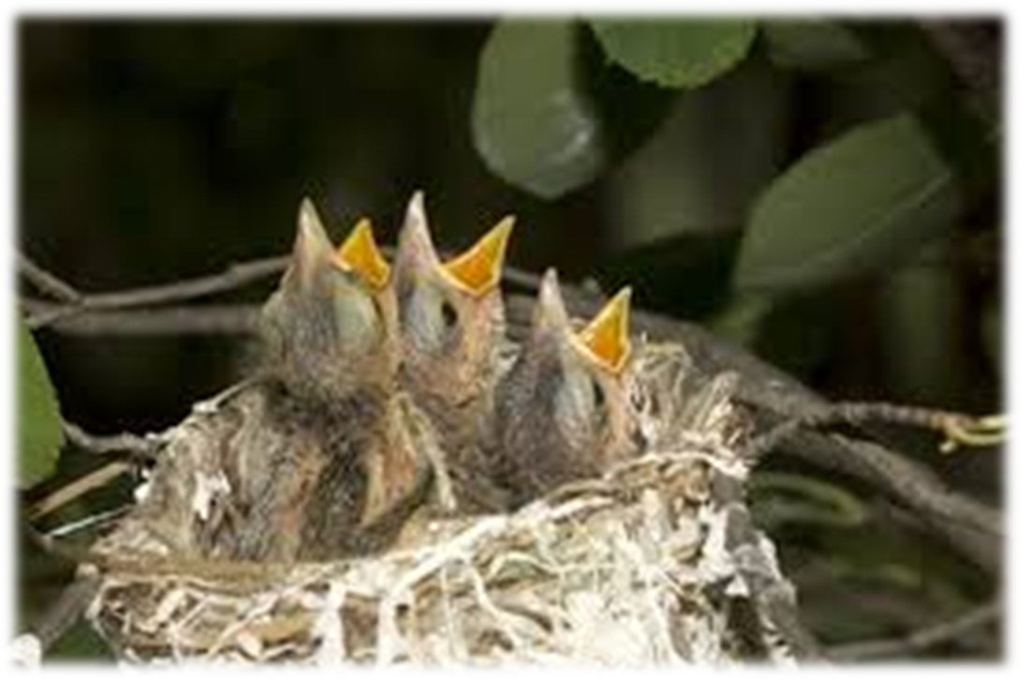
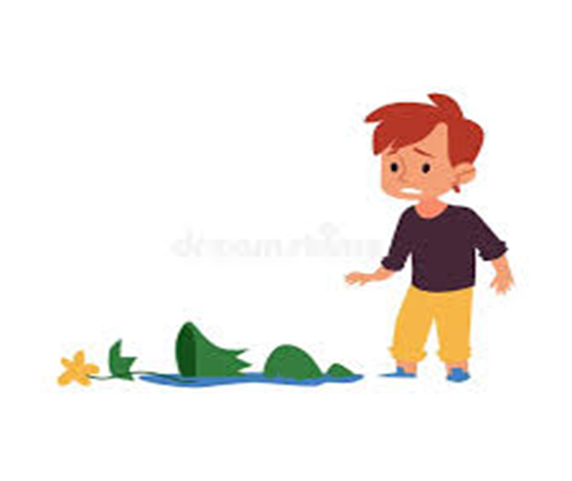
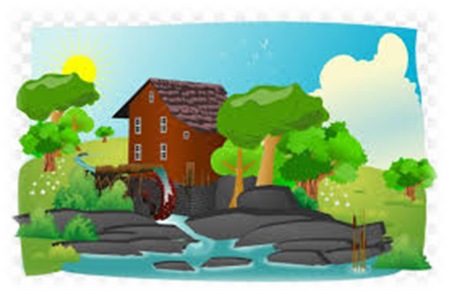
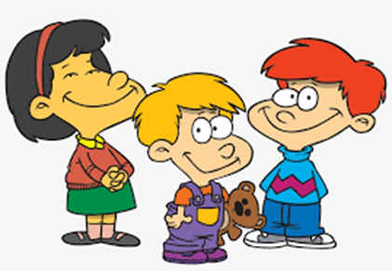
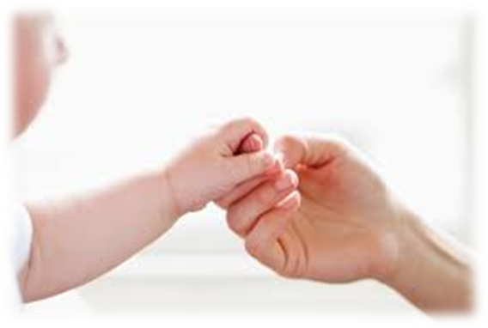
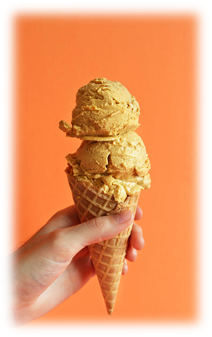
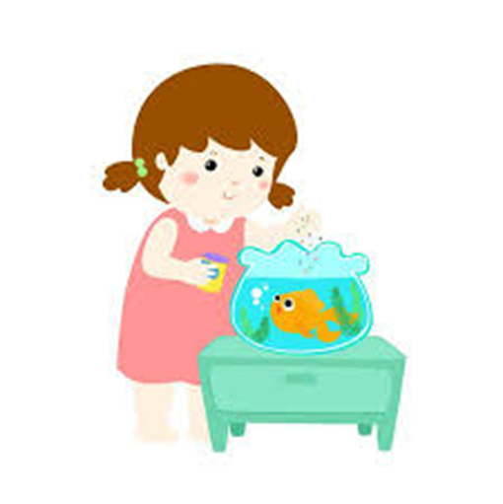
young
trouble
thin
thick
touch
young
double
trouble
country
nourish
July
August
touch
country
cousin
double
nourish
flourish

Slide 47
Is he from the town or the country?
A kitten is a young cat.
Help! We are in trouble.
The pan is hot! Do not touch it .

Slide 48
I have a dog with a bark.
The , child played football.
The tree was and .
My hair is and my eyes are .

Slide 49
I have a white dog with a loud bark.
The young, tall child played football.
The tree was old and big.
My hair is long and my eyes are green.

Slide 50
Dictation

Slide 51
Name:
1. 2. 3.
4. 5. 6.
7.
8.
9.

Slide 52
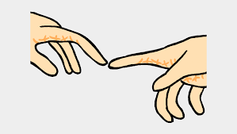
touch

Slide 53
touch 2. cousin

Slide 54
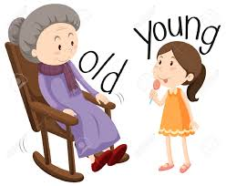
touch 2. cousin 3. young

Slide 55
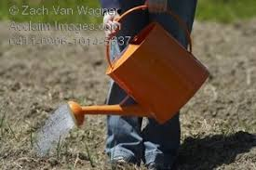
touch 2. cousin 3. young
4. nourish

Slide 56
touch 2. cousin 3. young
4. nourish 5. trouble

Slide 57
touch 2. cousin 3. young
4. nourish 5. trouble 6. flourish

Slide 58
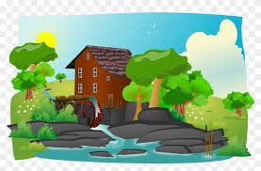
touch 2. cousin 3. young
4. nourish 5. trouble 6. flourish
7. My cousins live in
the country.

Slide 59
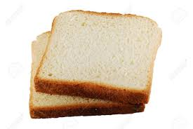
touch 2. cousin 3. young
4. nourish 5. trouble 6. flourish
7. My cousins live in
the country.
8. I ate a couple of
slices of bread.

Slide 60
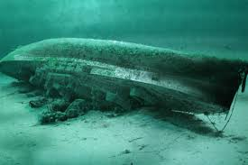
touch 2. cousin 3. young
4. nourish 5. trouble 6. flourish
7. My cousins live in
the country.
8. I ate a couple of
slices of bread.
9. He watched the
young whale swim
over the wreck.

Slide 61
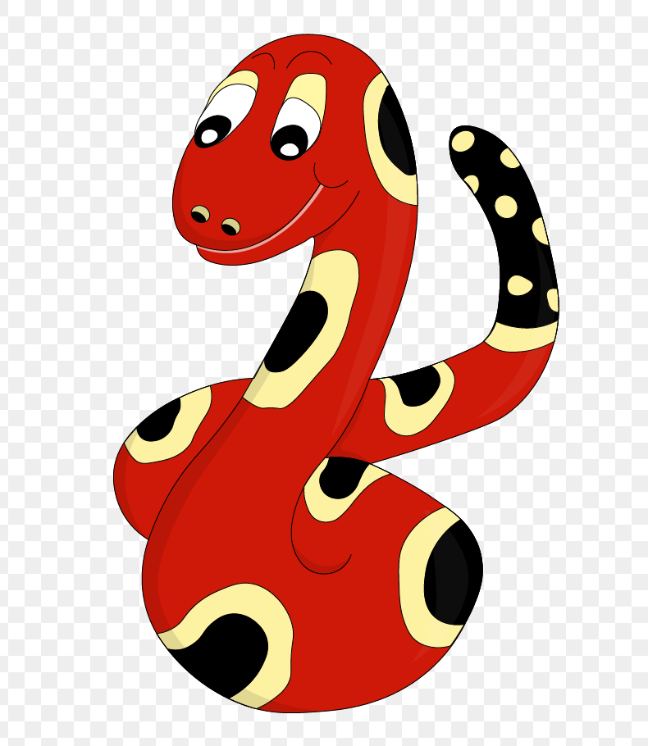
Thank you!
See you
next lesson.

