Slide 1
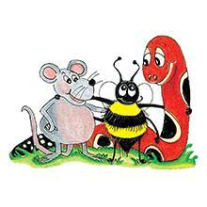
Jolly Grammar 2-9

Slide 2
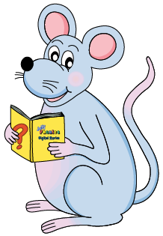
Mini Test 8

Slide 3
miss

Slide 4
miss
cross

Slide 5
miss
cross
giant

Slide 6
miss
cross
giant
magic

Slide 7
miss
cross
giant
magic
large

Slide 8
miss
cross
giant
magic
large
6. danger

Slide 9
miss
cross
giant
magic
large
6. danger
7. orange

Slide 10
miss
cross
giant
magic
large
6. danger
7. orange
8. vegetable

Slide 11
miss
cross
giant
magic
large
6. danger
7. orange
8. vegetable
9. March

Slide 12
miss
cross
giant
magic
large
6. danger
7. orange
8. vegetable
9. March
10. April

Slide 13
Let’s Revise
Nouns.

Slide 14
Let’s Revise
Adjectives.

Slide 15
Adjectives are words that describe nouns.

Slide 16
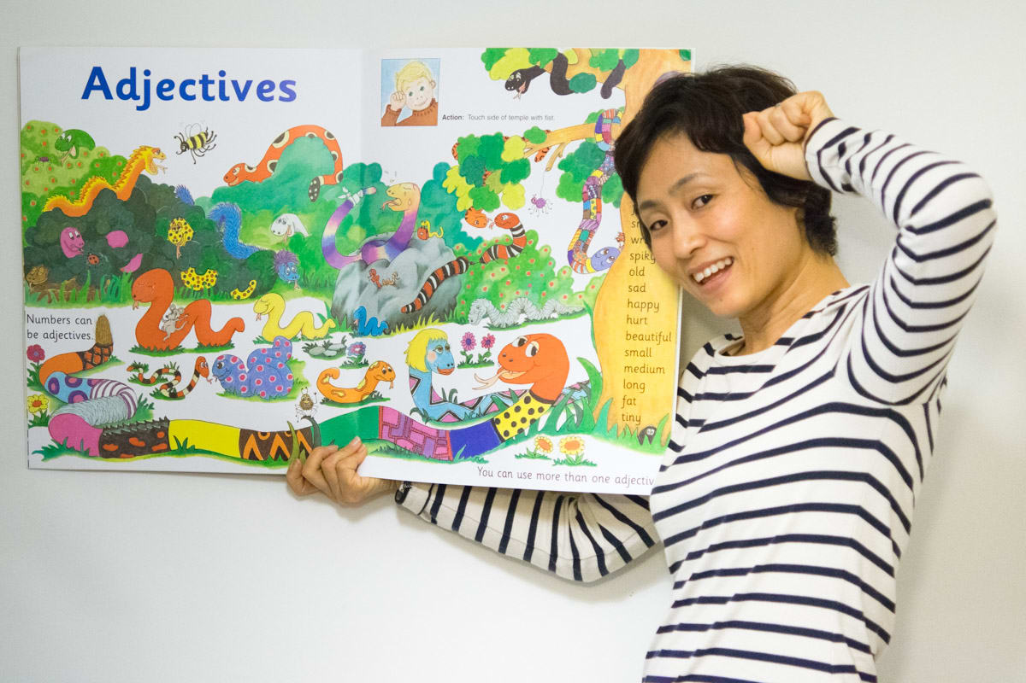

Slide 17
dog
table
book
bag

Slide 18
a big
dog
table
book
bag

Slide 19
a big
a white
dog
table
book
bag

Slide 20
a big
a white
an interesting
dog
table
book
bag

Slide 21
a big
a white
an interesting
a heavy
dog
table
book
bag

Slide 22
This dog is big.
The table is white.
My book is interesting.
Your bag is heavy

Slide 23
This dog is big.
The table is white.
My book is interesting.
Your bag is heavy.

Slide 24
This dog is big.
The table is white.
My book is interesting.
Your bag is heavy.

Slide 25
This dog is big.
The table is white.
My book is interesting.
Your bag is heavy.

Slide 26
This dog is big.
The table is white.
My book is interesting.
Your bag is heavy.

Slide 27
Identify the adjectives
Ricky was glad to take off his sweaty shoes,
Although the sand was hot under his bare feet.
He ran to paddle in the cool, green water. A big
wave made his shorts wet, so it was lucky that
they were already old and ragged.

Slide 28
Identify the adjectives
Ricky was glad to take off his sweaty shoes,
Although the sand was hot under his bare feet.
He ran to paddle in the cool, green water. A big
wave made his shorts wet, so it was lucky that
they were already old and ragged.

Slide 29
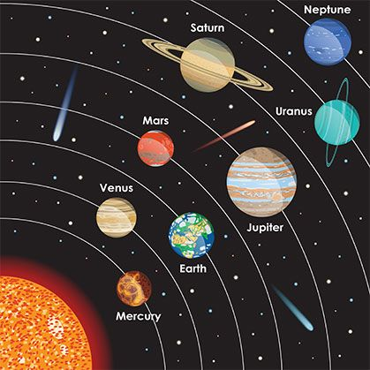

Slide 30
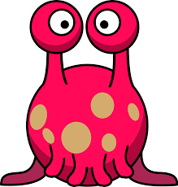
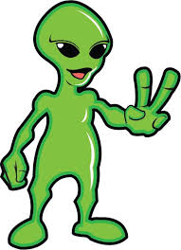
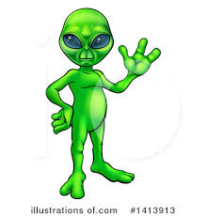
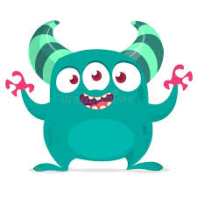
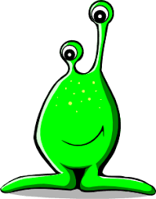
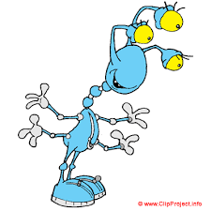

Slide 31
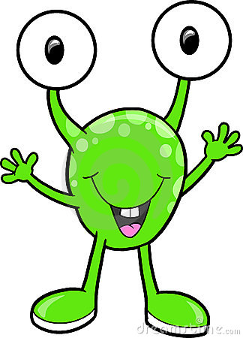
My alien has a
spotty
head…

Slide 32
My alien has a
spotty
head…
….. a
green and short
body….

Slide 33
My alien has a
spotty
head…
….. a
green and short
body….
…..and some
long
feet!

Slide 34
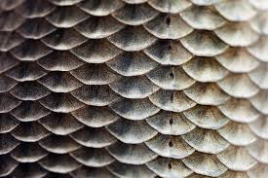
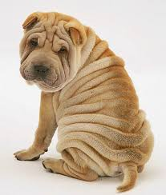
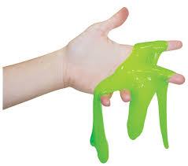
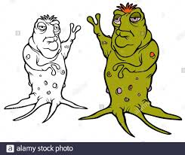
big
huge
small
tiny
green
blue
pink
purple
long
short
flat
round
one
two
three
four
scaly
wrinkly
slimy
lumpy

Slide 35
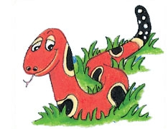
Months of the Year
January
February
March
April
May
June
July
August
September
October
November
December

Slide 36
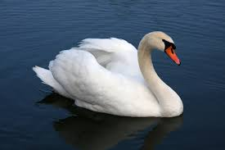
swan
/wo/

Slide 37
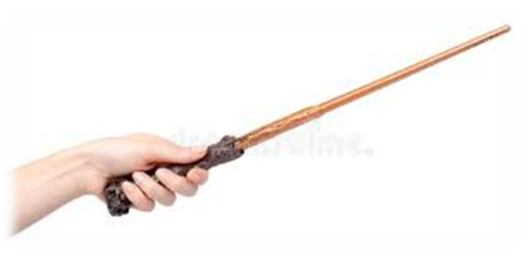
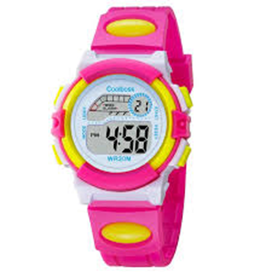
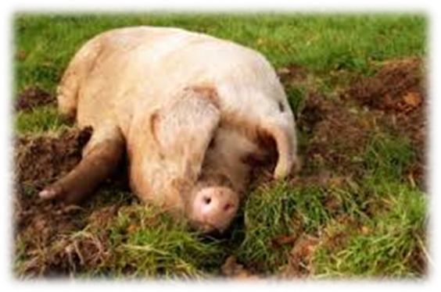
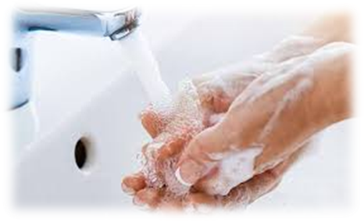
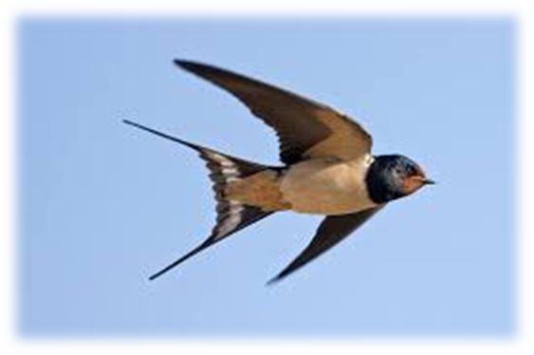
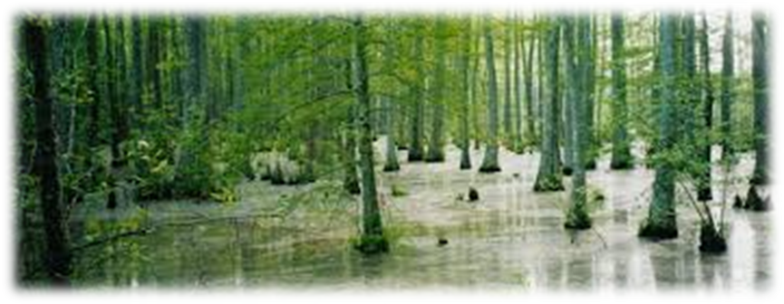
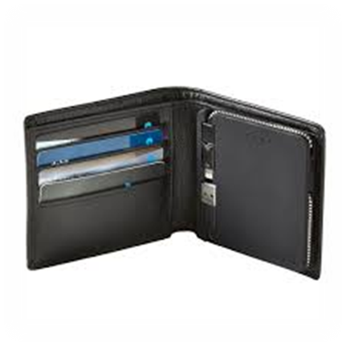
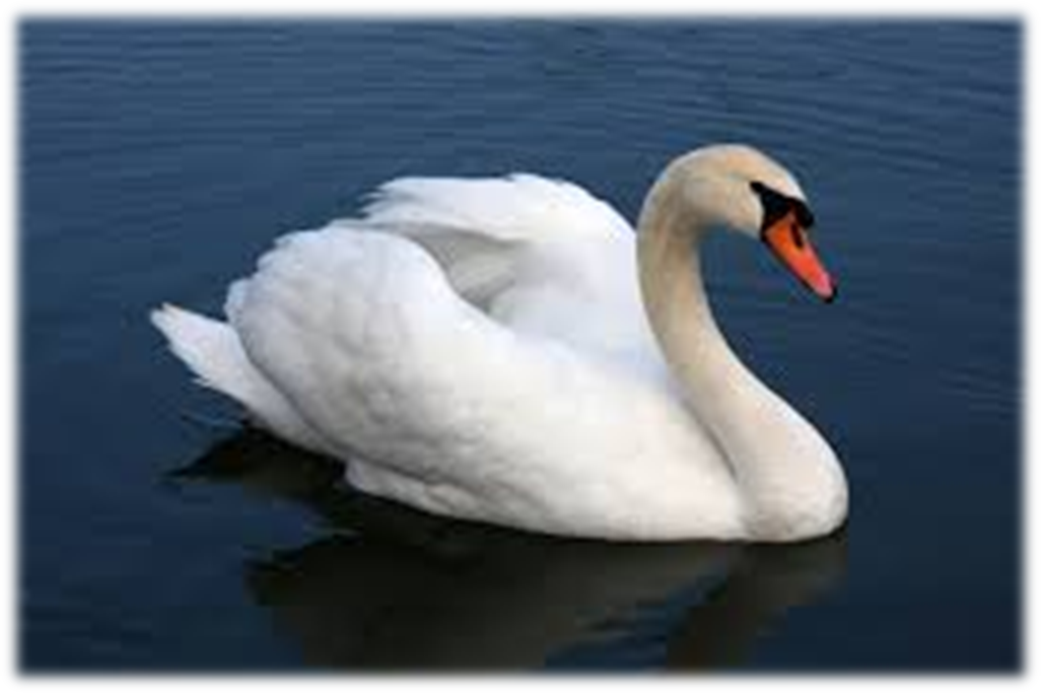
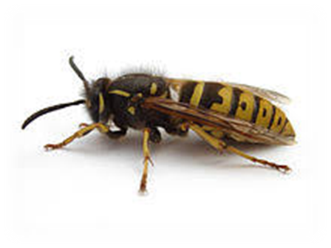
wand
watch
wallow
duck
click
wand
wash
wasp
swan
watch
swallow
May
June
wash
swallow
swamp
swan
wasp
wallet

Slide 38
Find
proper nouns!

Slide 39
England Mrs. Patel
Michael Monday
wand fire flower
Zack dog
September chair New Zealand
Mr. Brown house watch Hanah

Slide 40
Dictation

Slide 41
Name:
1. 2. 3.
4. 5. 6.
7.
8.
9.

Slide 42
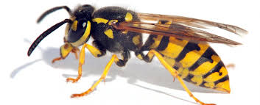
wasp

Slide 43
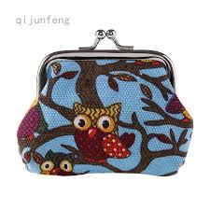
wasp 2. wallet

Slide 44
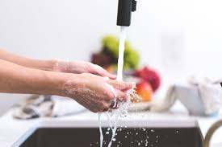
wasp 2. wallet 3. wash

Slide 45
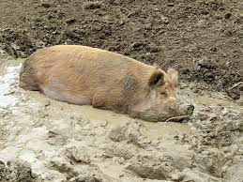
wasp 2. wallet 3. wash
4. wallow

Slide 46
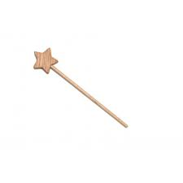
wasp 2. wallet 3. wash
4. wallow 5. wand

Slide 47
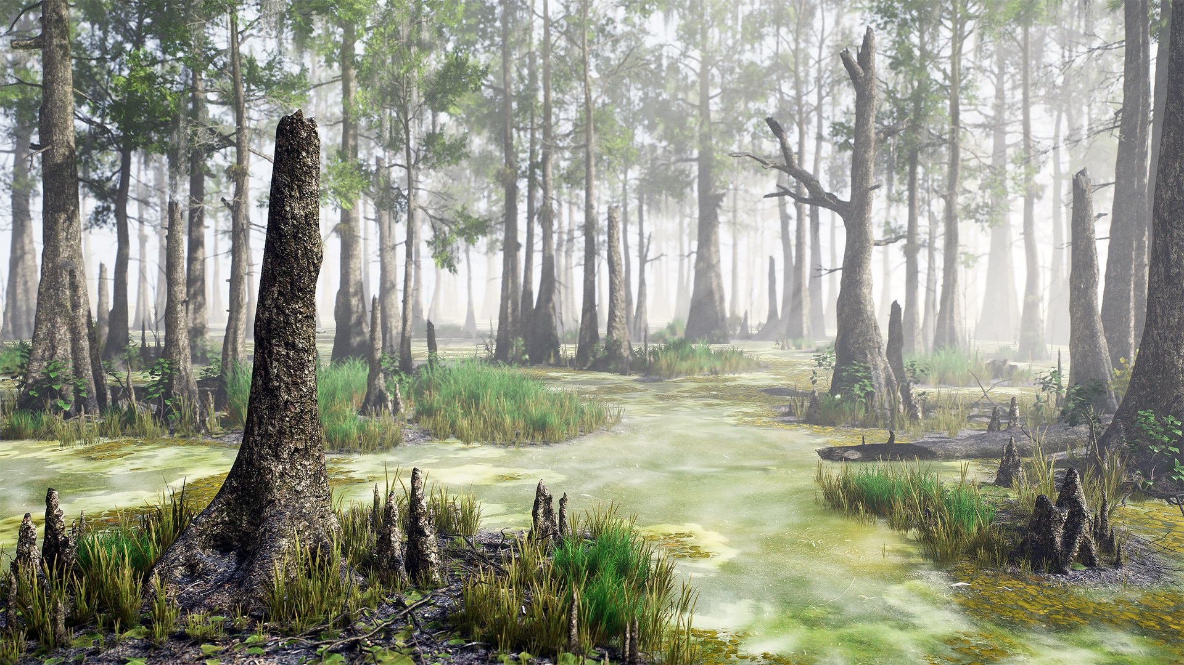
wasp 2. wallet 3. wash
4. wallow 5. wand 6. swamp

Slide 48
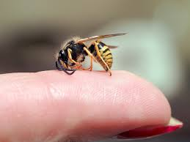
wasp 2. wallet 3. wash
4. wallow 5. wand 6. swamp
7. A wasp stung me
on the thumb.

Slide 49
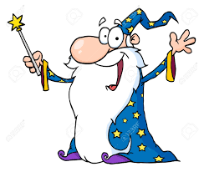
wasp 2. wallet 3. wash
4. wallow 5. wand 6. swamp
7. A wasp stung me
on the thumb.
8. The wizard waved
his magic wand.

Slide 50
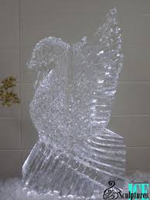
wasp 2. wallet 3. wash
4. wallow 5. wand 6. swamp
7. A wasp stung me
on the thumb.
8. The wizard waved
his magic wand.
9. The swan was
made of ice.

Slide 51
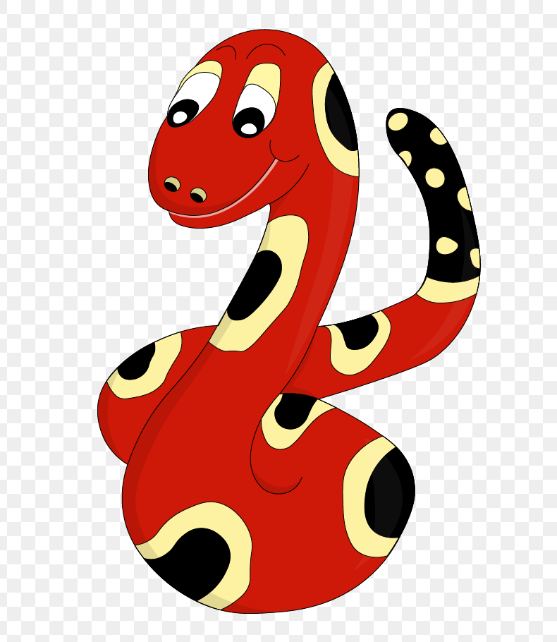
Thank you!
See you
next lesson.

