Slide 1
Jolly Grammar 2-8

Slide 2
Mini Test 7

Slide 3
mill

Slide 4
mill
tell

Slide 5
mill
tell
ice

Slide 6
mill
tell
ice
dance

Slide 7
mill
tell
ice
dance
city

Slide 8
mill
tell
ice
dance
city
6. circle

Slide 9
mill
tell
ice
dance
city
6. circle
7. police

Slide 10
mill
tell
ice
dance
city
6. circle
7. police
8. cylinder

Slide 11
mill
tell
ice
dance
city
6. circle
7. police
8. cylinder
9. January

Slide 12
mill
tell
ice
dance
city
6. circle
7. police
8. cylinder
9. January
10. February

Slide 13
Let’s Revise
Nouns.

Slide 14
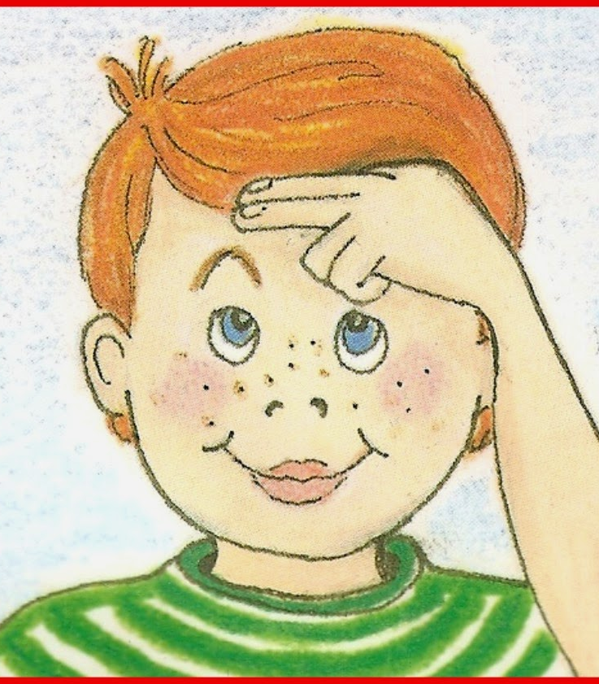
Proper Nouns

Slide 15
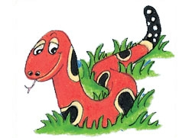
Months of the Year
January
February
March
April
May
June
July
August
September
October
November
December

Slide 16
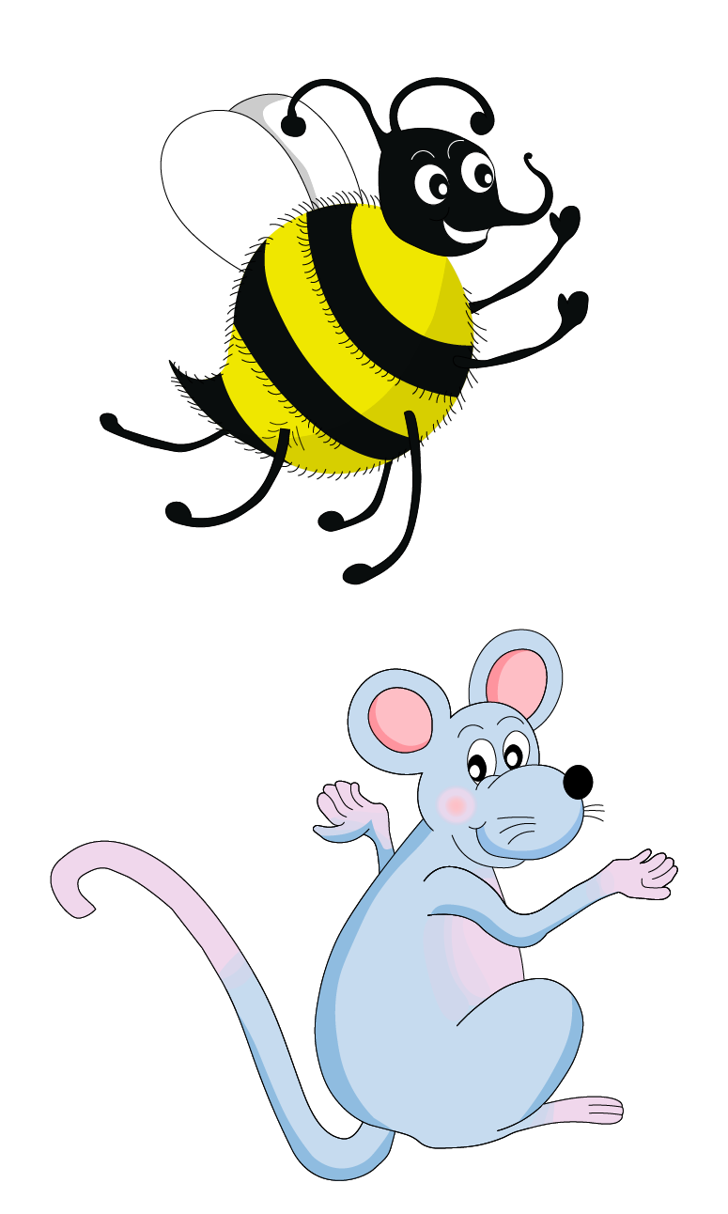
Write the months in alphabetical order!
Name:
１．
２．
３．
４．
５．
６．
７．
８．
９．
１０．
１１．
１２．

Slide 17
Write the months in alphabetical order!
Name:
１．April
２．August
３．December
４．February
５．January
６．July
７．June
８．March
９．May
１０．November
１１．October
１２．September

Slide 18
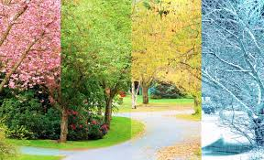
What happens
in each month?
What do you do?

Slide 19
Name:
In January, it snows a lot. I play outside everyday.
3.
4.
5.
6.
7.
8.
9.
10.
11.
12.

Slide 20
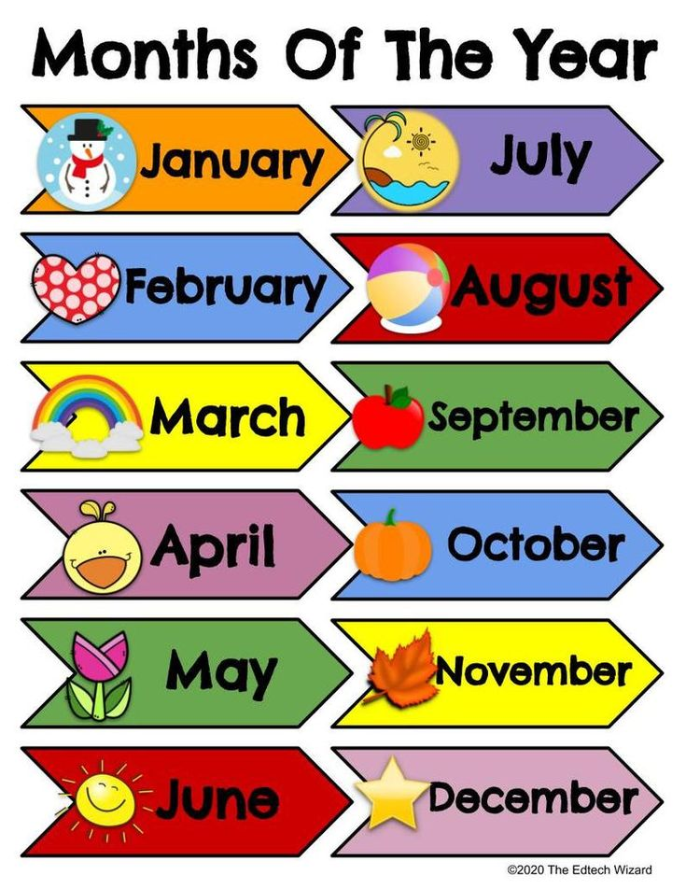

Slide 21
Months of the Year
January
February
March
April
May
June
July
August
September
October
November
December

Slide 22
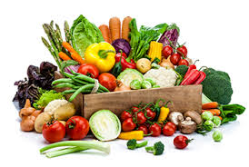
vegetable

Slide 23
soft g
ge
gi
gy

Slide 24
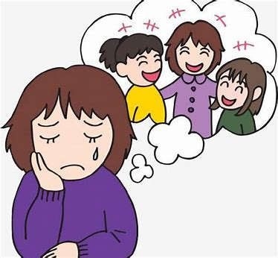
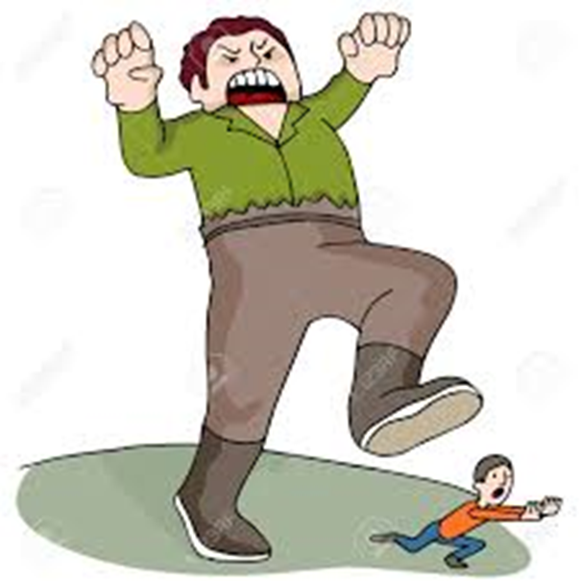
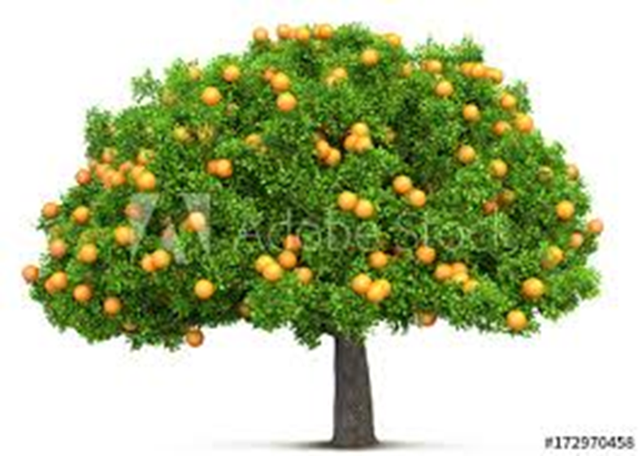
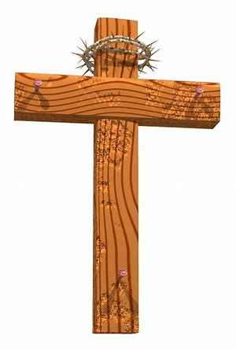
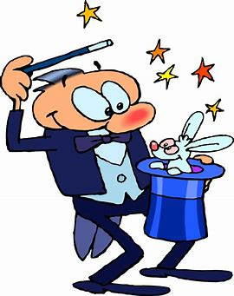
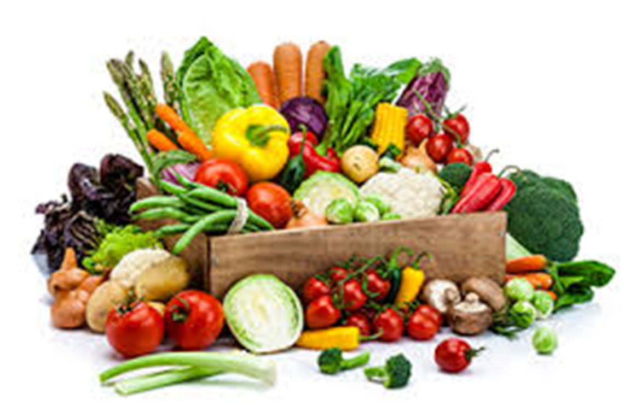
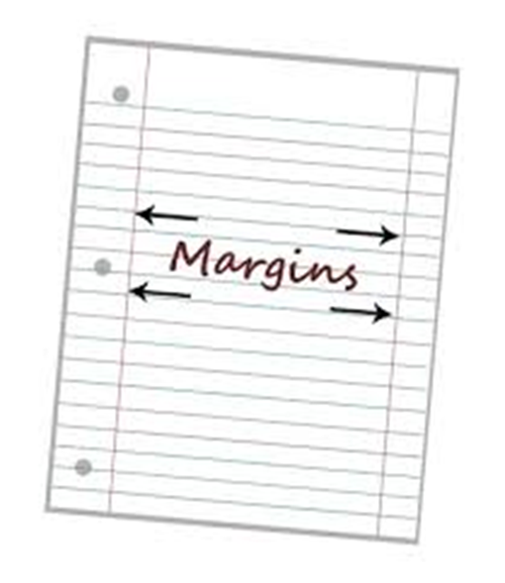
giant
orange
germ
miss
cross
giant
magic
large
danger
orange
vegetable
March
April
magic
vegetable
large
gem
urgent
margin
danger
page

Slide 25
I ate a bowl of vegetable soup.
Then I drank a glass of orange juice.
Be careful! You are in danger.
He wizard cast a magic spell.

Slide 26
Draw a ring around the word that would come first in the dictionary.
amber
acorn
vowel
vixen
raft
rook
elk
expel
gander
grammar
plural
penguin

Slide 27
Draw a ring around the word that would come first in the dictionary.
amber
acorn
vowel
vixen
raft
rook
elk
expel
gander
grammar
plural
penguin

Slide 28
Draw a ring around the word that would come first in the dictionary.
amber
acorn
vowel
vixen
raft
rook
elk
expel
gander
grammar
plural
penguin

Slide 29
Draw a ring around the word that would come first in the dictionary.
amber
acorn
vowel
vixen
raft
rook
elk
expel
gander
grammar
plural
penguin

Slide 30
Draw a ring around the word that would come first in the dictionary.
amber
acorn
vowel
vixen
raft
rook
elk
expel
gander
grammar
plural
penguin

Slide 31
Draw a ring around the word that would come first in the dictionary.
amber
acorn
vowel
vixen
raft
rook
elk
expel
gander
grammar
plural
penguin

Slide 32
Draw a ring around the word that would come first in the dictionary.
amber
acorn
vowel
vixen
raft
rook
elk
expel
gander
grammar
plural
penguin

Slide 33
Dictation

Slide 34
Name:
1. 2. 3.
4. 5. 6.
7.
8.
9.

Slide 35
gem

Slide 36
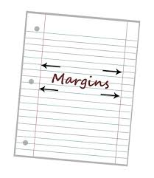
gem 2. margin

Slide 37
gem 2. margin 3. germ

Slide 38
gem 2. margin 3. germ
4. giant

Slide 39
gem 2. margin 3. germ
4. giant 5. large

Slide 40
gem 2. margin 3. germ
4. giant 5. large 6. urgent

Slide 41
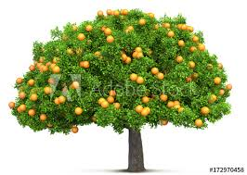
gem 2. margin 3. germ
4. giant 5. large 6. urgent
7. Oranges grow on trees.

Slide 42
gem 2. margin 3. germ
4. giant 5. large 6. urgent
7. Oranges grow on trees.
8. Leave a wide margin
on the page.

Slide 43
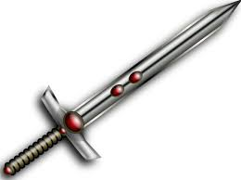
gem 2. margin 3. germ
4. giant 5. large 6. urgent
7. Oranges grow on trees.
8. Leave a wide margin
on the page.
9. There are large gems
on the old sword.

Slide 44
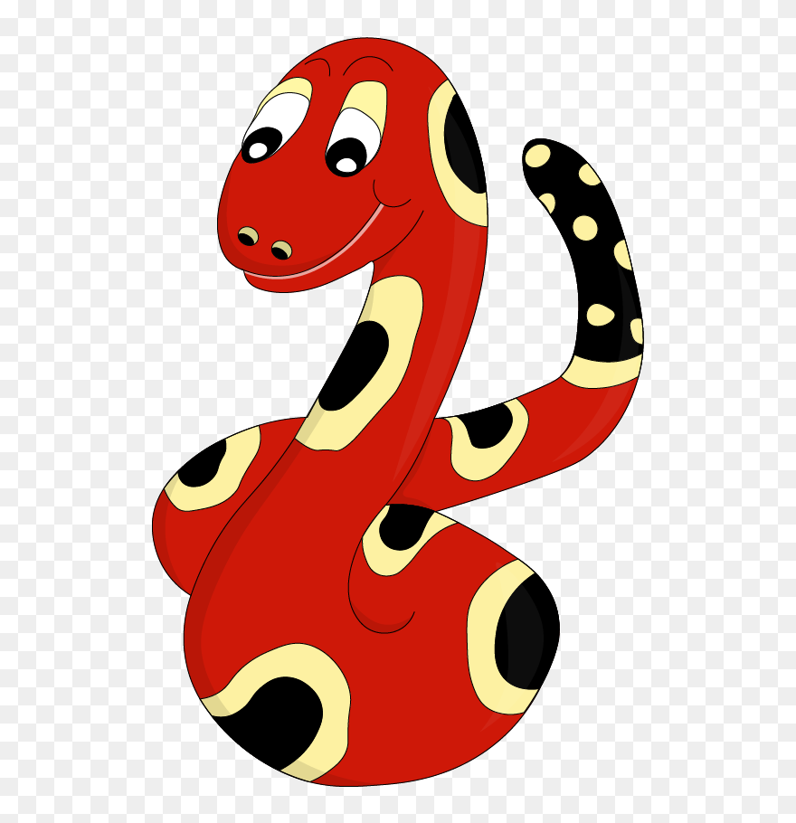
Thank you!
See you
next lesson.

