Slide 1
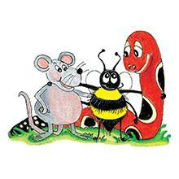
Jolly Grammar 2-5

Slide 2
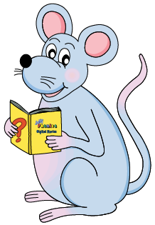
Mini Test 4

Slide 3
1. this

Slide 4
1. this
2. that

Slide 5
1. this
2. that
3. while

Slide 6
1. this
2. that
3. while
4. wheat

Slide 7
1. this
2. that
3. while
4. wheat
5. whip

Slide 8
1. this
2. that
3. while
4. wheat
5. whip
6. whistle

Slide 9
1. this
2. that
3. while
4. wheat
5. whip
6. whistle
7. whiskers

Slide 10
1. this
2. that
3. while
4. wheat
5. whip
6. whistle
7. whiskers
8. whatever

Slide 11
1. this
2. that
3. while
4. wheat
5. whip
6. whistle
7. whiskers
8. whatever
9. aunt

Slide 12
1. this
2. that
3. while
4. wheat
5. whip
6. whistle
7. whiskers
8. whatever
9. aunt
10. uncle

Slide 13
Let’s revise
Question marks
And
Full stops.

Slide 14
? or .
What time do we have to go to bed
An orphan is a child whose mother and father are dead
How old is Grandma
Whose is this photo album

Slide 15
? or .
What time do we have to go to bed?
An orphan is a child whose mother and father are dead
How old is Grandma
Whose is this photo album

Slide 16
? or .
What time do we have to go to bed?
An orphan is a child whose mother and father are dead.
How old is Grandma
Whose is this photo album

Slide 17
? or .
What time do we have to go to bed?
An orphan is a child whose mother and father are dead.
How old is Grandma?
Whose is this photo album

Slide 18
? or .
What time do we have to go to bed?
An orphan is a child whose mother and father are dead.
How old is Grandma?
Whose is this photo album?

Slide 19
Let’s revise full stops and question marks.

Slide 20
the man sat down on his head was a black hat he was carrying an umbrella a briefcase and a newspaper two old ladies were sitting opposite him

Slide 21
Activity page:
Commas in Lists

Slide 22
Red orange yellow green blue indigo and violet
are the colours of the rainbow.

Slide 23
Red, orange, yellow, green, blue, indigo and violet
are the colours of the rainbow.

Slide 24
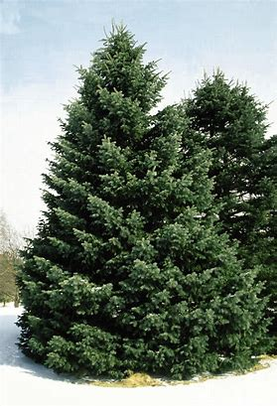
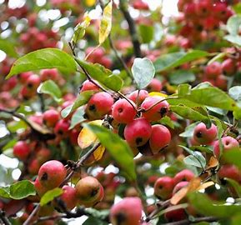
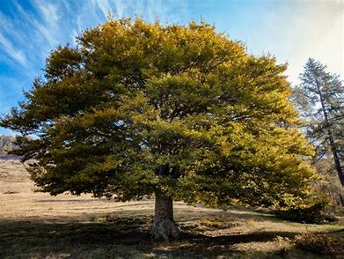
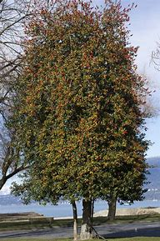
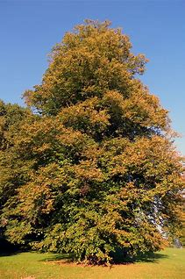
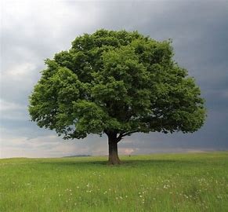
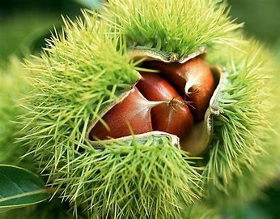
Oak elm holly fir beech apple and chestnut are all tree.

Slide 25
Oak, elm, holly, fir, beech, apple and chestnut are all tree.

Slide 26
On the farm there are cows dogs cats horses sheep
and chicken.

Slide 27
On the farm there are cows, dogs, cats, horses, sheep
and chicken.

Slide 28
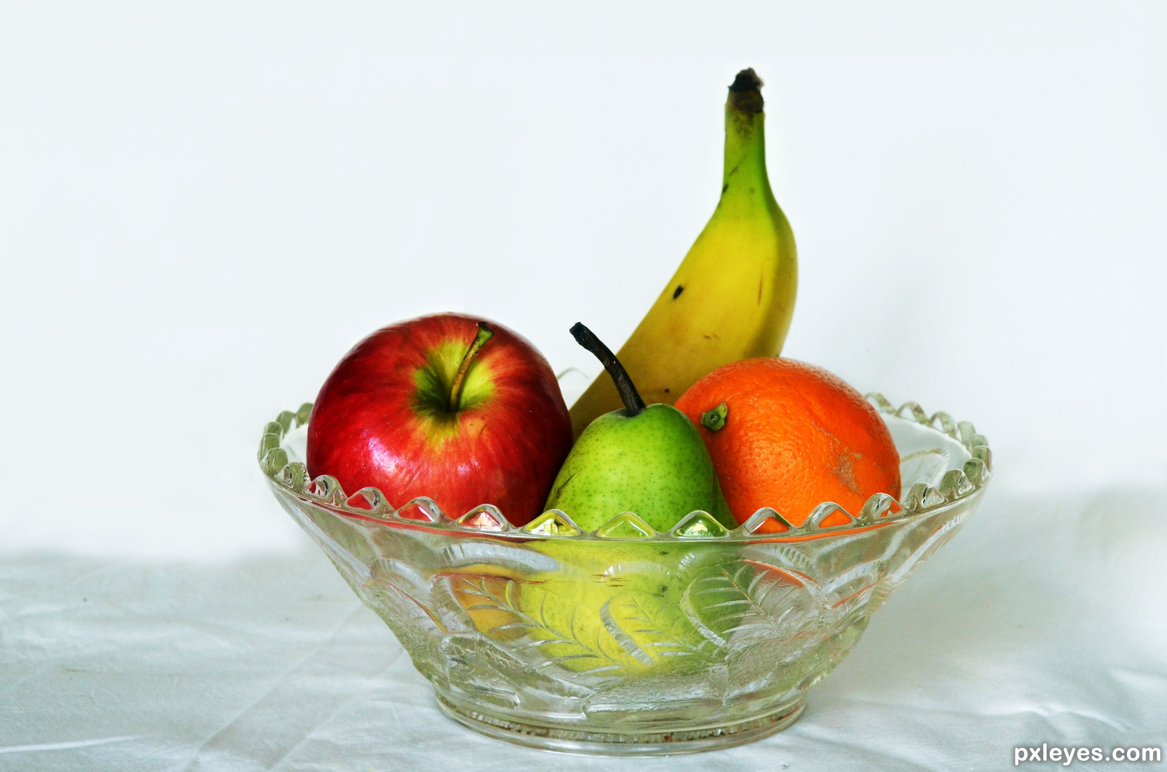
In the fruit bowl there are
grapes, oranges, bananas and tangerine.

Slide 29
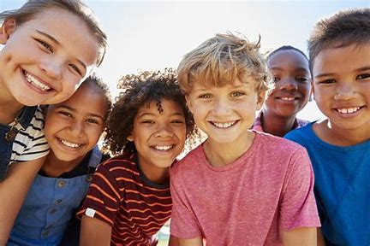
My friends are called
Kei, Miori, Hinata and Soichiro.

Slide 30
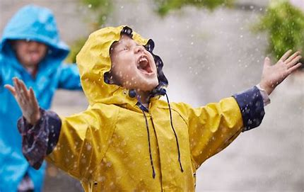
When it rains I wear
a raincoat, boots and umbrella.

Slide 31
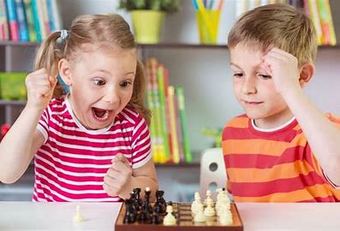
My favourite games are Japanese chess, Chinese chess and Nyanko war.

Slide 32
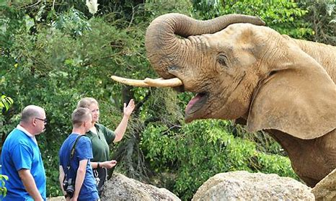
At the zoo we saw panda bears, red pandas, racoons, birds and donkeys.

Slide 33
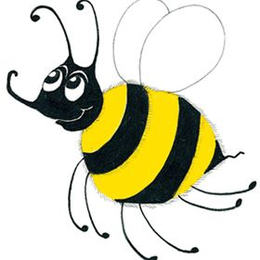
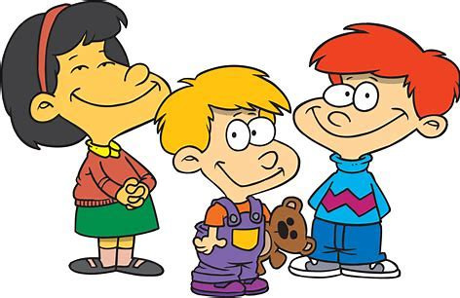
Family and Friends
mother
father
sister
brother
grandma
grandpa
aunt
uncle
nephew
niece
cousin
friend

Slide 34
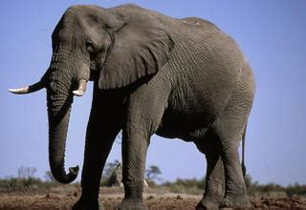
elephant
/f/

Slide 35
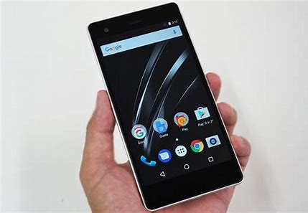
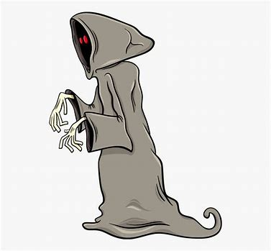
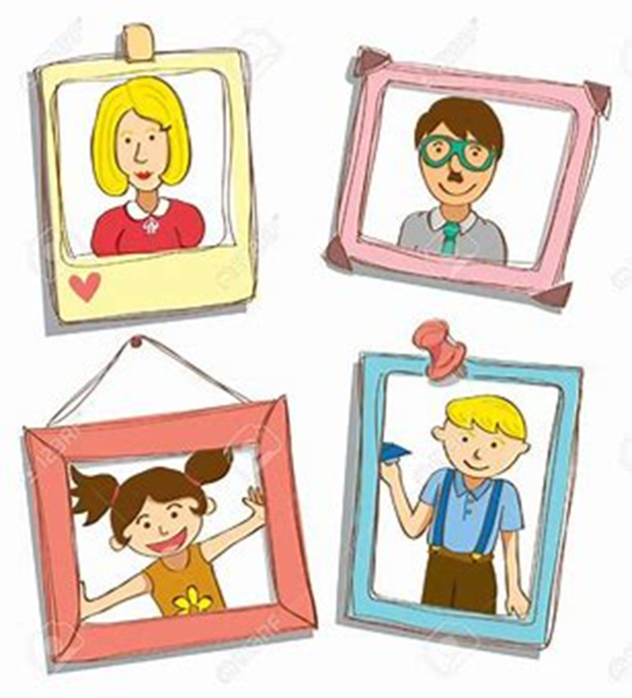
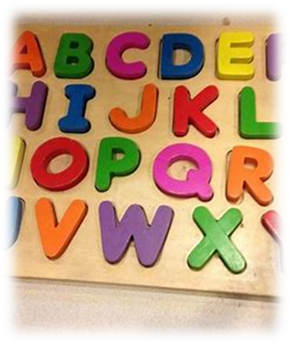
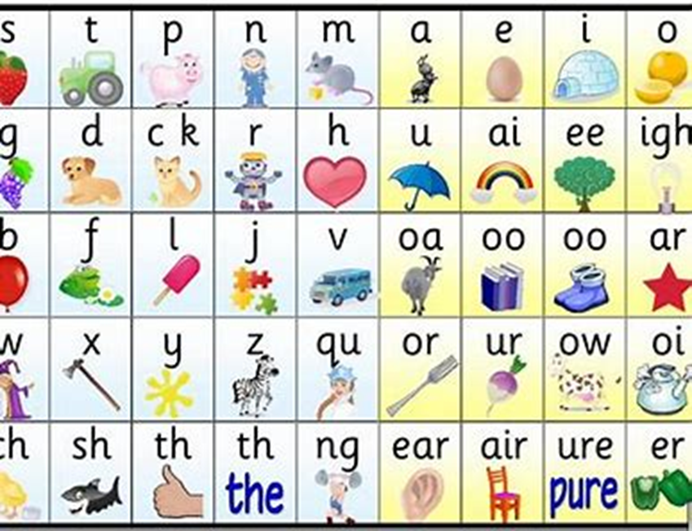
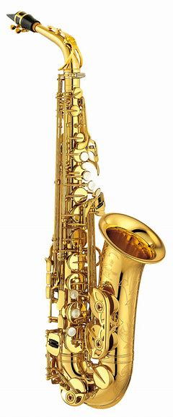
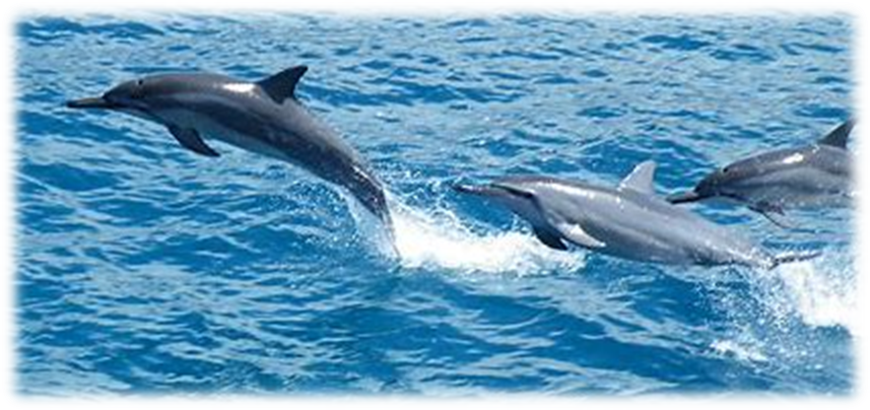
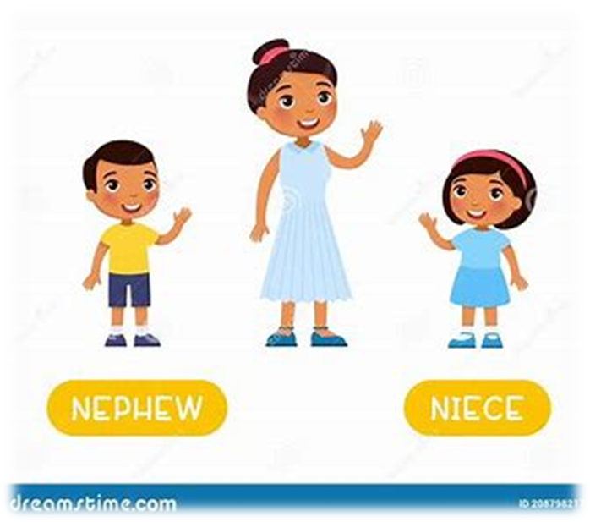
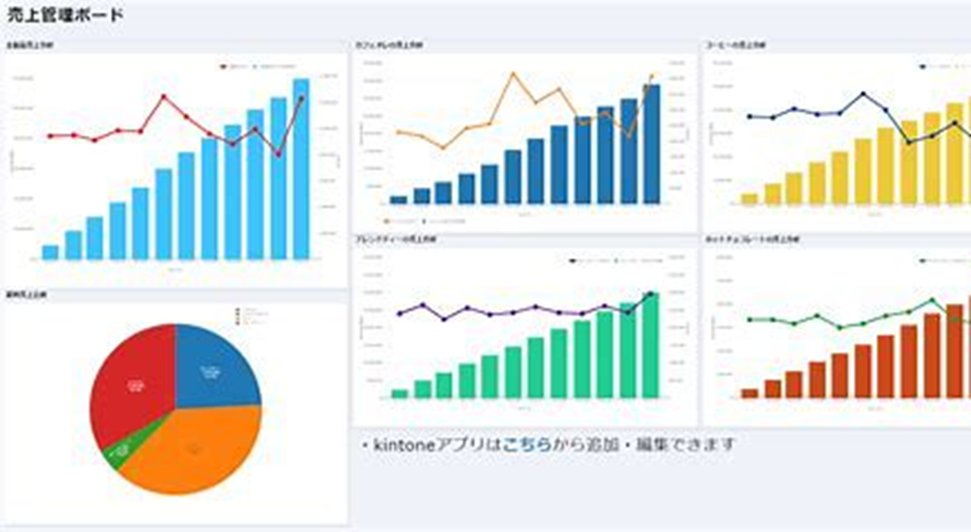
phone
sphere
phantom
club
flag
phone
photo
dolphin
elephant
sphere
alphabet
nephew
niece
photo
alphabet
phonic
dolphin
nephew
saxophone
elephant
graph
photograph

Slide 36
Activity page:
The <ph> spelling of the /f/ Sound

Slide 37
Dictation

Slide 38
Name:
1. 2. 3.
4. 5. 6.
7.
8.
9.

Slide 39
graph

Slide 40
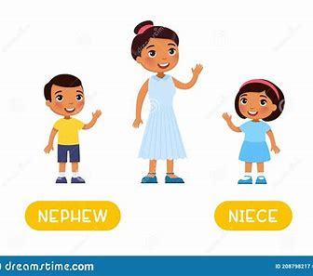
graph 2. nephew

Slide 41
graph 2. nephew 3. photo

Slide 42
graph 2. nephew 3. photo
4. phantom

Slide 43
graph 2. nephew 3. photo
4. phantom 5. phonic

Slide 44
graph 2. nephew 3. photo
4. phantom 5. phonic 6. saxophone

Slide 45
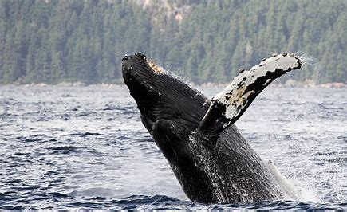
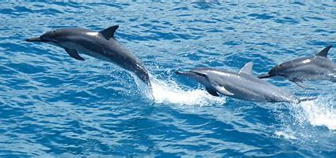
graph 2. nephew 3. photo
4. phantom 5. phonic 6. saxophone
7. Whales and dolphins live in the sea.

Slide 46
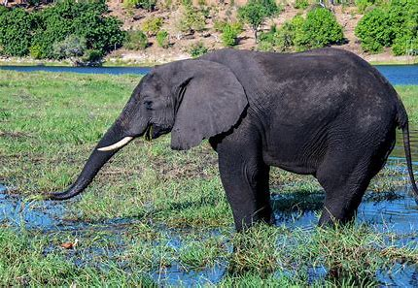
graph 2. nephew 3. photo
4. phantom 5. phonic 6. saxophone
7. Whales and dolphins live in the sea.
8. I took a photograph of the elephant.

Slide 47
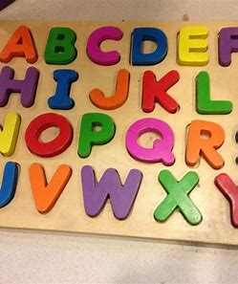
graph 2. nephew 3. photo
4. phantom 5. phonic 6. saxophone
7. Whales and dolphins live in the sea.
8. I took a photograph of the elephant.
9. We know the alphabet.

Slide 48
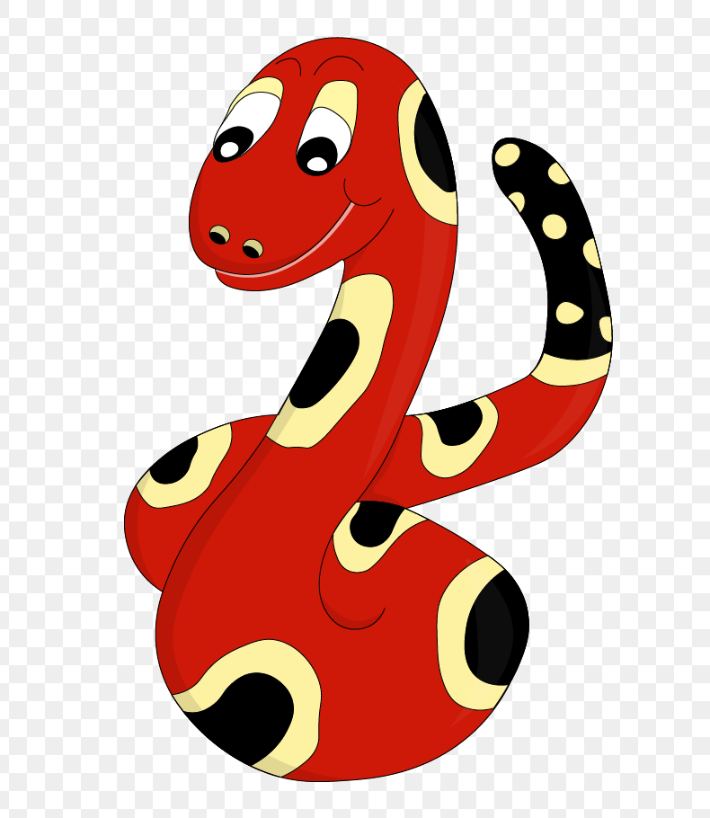
Thank you!

