Slide 1
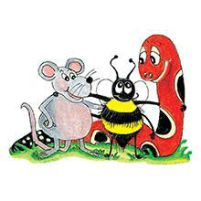
Jolly Grammar 2-3

Slide 2
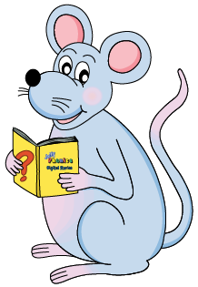
Mini Test 2

Slide 3
1. chat

Slide 4
1. chat
2. cash

Slide 5
1. chat
2. cash
3. write

Slide 6
1. chat
2. cash
3. write
4. wrist

Slide 7
1. chat
2. cash
3. write
4. wrist
5. wreck

Slide 8
1. chat
2. cash
3. write
4. wrist
5. wreck
6. wrong

Slide 9
1. chat
2. cash
3. write
4. wrist
5. wreck
6. wrong
7. answer

Slide 10
1. chat
2. cash
3. write
4. wrist
5. wreck
6. wrong
7. answer
8. swordfish

Slide 11
1. chat
2. cash
3. write
4. wrist
5. wreck
6. wrong
7. answer
8. swordfish
9. sister

Slide 12
1. chat
2. cash
3. write
4. wrist
5. wreck
6. wrong
7. answer
8. swordfish
9. sister
10. brother

Slide 13
Let’s revise sentences.

Slide 14
the girl played tennis.

Slide 15
the girl played tennis.
The girl played tennis.

Slide 16
Dad took us to the

Slide 17
Dad took us to the
Dad took us to the park.

Slide 18
It is too late to go out

Slide 19
It is too late to go out
It is too late to go out.

Slide 20
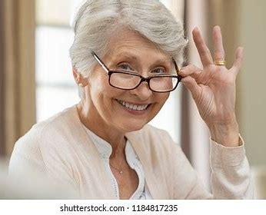
Write sentences about one of your grandparents.

Slide 21
Write sentences about one of your grandparents.
My grandfather is nice.
He always gives me money.

Slide 22
Let’s learn speech marks.

Slide 23
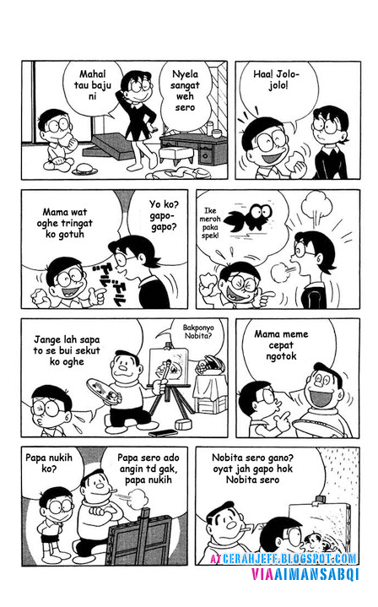

Slide 24
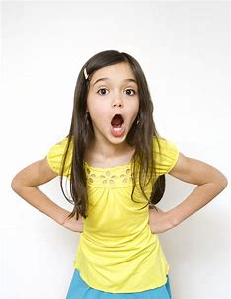
I want to
go home.
Karen

Slide 25
I want to
go home.
I want to go home.
Karen

Slide 26
I want to
go home.
“I want to go home,” said Karen.
Karen

Slide 27
Activity page:
Speech Marks

Slide 28
Hello Snake, said Inky.
We have been looking for you, buzzed Bee.
Ssss, hissed Snake. Well, here I am.
Snake looked at the letter in Inky’s hand. Is that
for me? He asked.

Slide 29
“Hello Snake,” said Inky.
We have been looking for you, buzzed Bee.
Ssss, hissed Snake. Well, here I am.
Snake looked at the letter in Inky’s hand. Is that
for me? He asked.

Slide 30
“Hello Snake,” said Inky.
“We have been looking for you,” buzzed Bee.
Ssss, hissed Snake. Well, here I am.
Snake looked at the letter in Inky’s hand. Is that
for me? He asked.

Slide 31
“Hello Snake,” said Inky.
“We have been looking for you,” buzzed Bee.
“Ssss,” hissed Snake. “Well, here I am.”
Snake looked at the letter in Inky’s hand. Is that
for me? He asked.

Slide 32
“Hello Snake,” said Inky.
“We have been looking for you,” buzzed Bee.
“Ssss,” hissed Snake. “Well, here I am.”
Snake looked at the letter in Inky’s hand.“Is that
for me?” He asked.

Slide 33
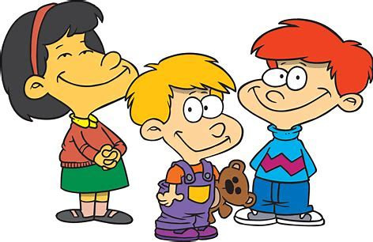
Family and Friends
mother
father
sister
brother
grandma
grandpa
aunt
uncle
nephew
niece
cousin
friend

Slide 34
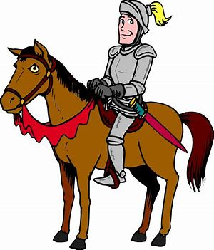
knight
(Silent k)

Slide 35
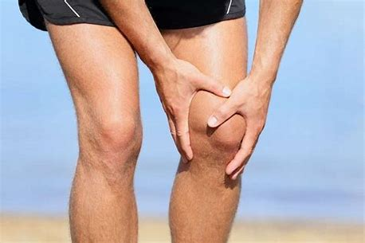
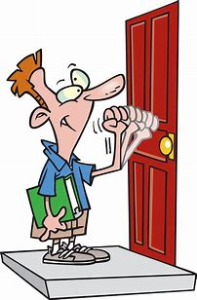
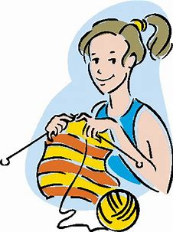
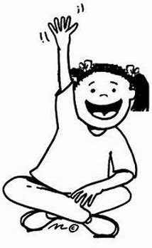
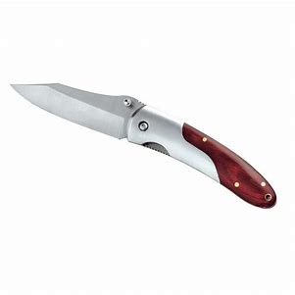
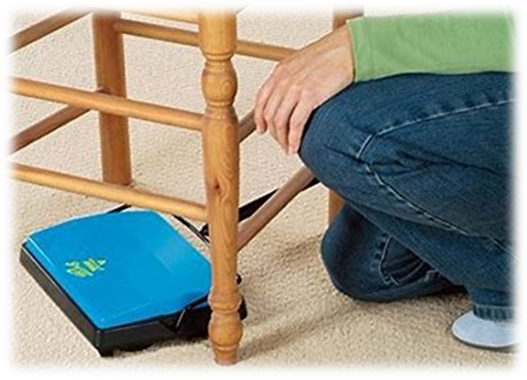
knee
knock
song
trunk
knee
knit
know
knock
knight
penknife
grandma
grandpa
knight
knit
know
penknife
kneel

Slide 36
Activity page:
Silent <k>

Slide 37
Dictation

Slide 38
Name:
1. 2. 3.
4. 5. 6.
7.
8.
9.

Slide 39
knee

Slide 40
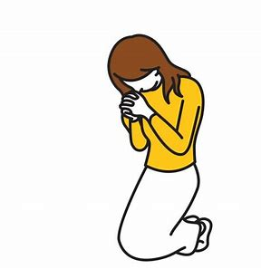
knee 2. kneel

Slide 41
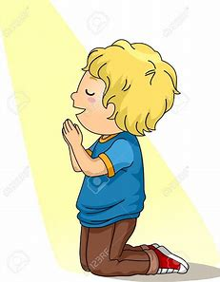
knee 2. kneel 3. kneeling

Slide 42
knee 2. kneel 3. kneeling
4. knit

Slide 43
knee 2. kneel 3. kneeling
4. knit 5. knock

Slide 44
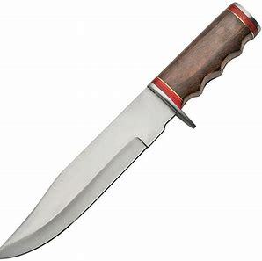
knee 2. kneel 3. kneeling
4. knit 5. knock 6. knife

Slide 45
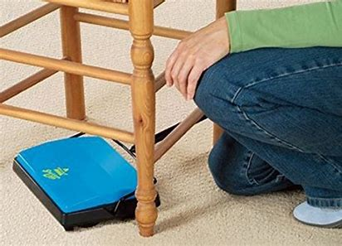
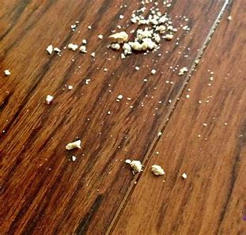
knee 2. kneel 3. kneeling
4. knit 5. knock 6. knife
7. She kneels to brush up the crumbs.

Slide 46
knee 2. kneel 3. kneeling
4. knit 5. knock 6. knife
7. She kneels to brush up the crumbs.
8. I knocked my knees as I climbed.

Slide 47
knee 2. kneel 3. kneeling
4. knit 5. knock 6. knife
7. She kneels to brush up the crumbs.
8. I knocked my knees as I climbed.
9. The knight killed the dragon
with a sword.

Slide 48
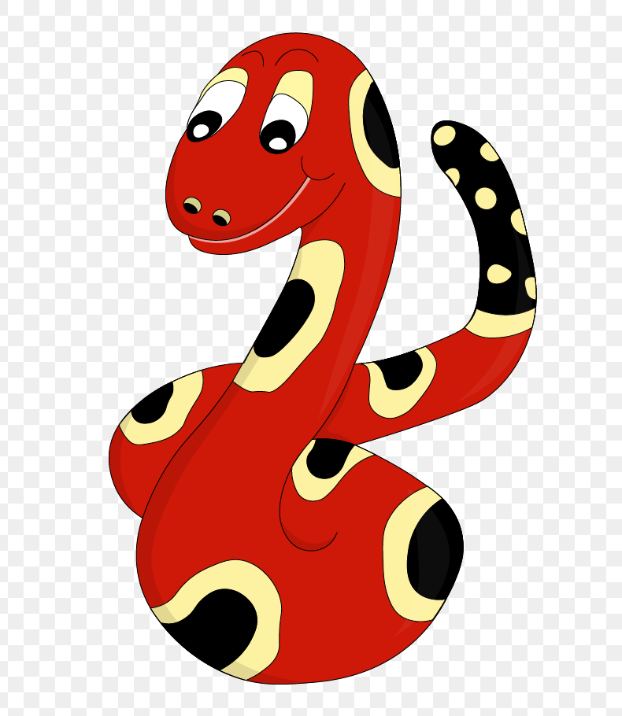
Thank you!

