Slide 1
Jolly Grammar 2-2

Slide 2
Mini Test 1

Slide 3
1. shin

Slide 4
1. shin
2. bench

Slide 5
1. shin
2. bench
3. lamb

Slide 6
1. shin
2. bench
3. lamb
4. comb

Slide 7
1. shin
2. bench
3. lamb
4. comb
5. thumb

Slide 8
1. shin
2. bench
3. lamb
4. comb
5. thumb
6. crumbs

Slide 9
1. shin
2. bench
3. lamb
4. comb
5. thumb
6. crumbs
7. plumber

Slide 10
1. shin
2. bench
3. lamb
4. comb
5. thumb
6. crumbs
7. plumber
8. climbing

Slide 11
1. shin
2. bench
3. lamb
4. comb
5. thumb
6. crumbs
7. plumber
8. climbing
9. mother

Slide 12
1. shin
2. bench
3. lamb
4. comb
5. thumb
6. crumbs
7. plumber
8. climbing
9. mother
10. father

Slide 13
Let’s revise alphabetical order.

Slide 14
trumpet
flute
drum
harp
oboe
clown
acrobat
tent
juggler

Slide 15
trumpet
flute
drum
harp
oboe
clown
acrobat
tent
juggler
drum

Slide 16
trumpet
flute
drum
harp
oboe
clown
acrobat
tent
juggler
drum
flute

Slide 17
trumpet
flute
drum
harp
oboe
clown
acrobat
tent
juggler
drum
flute
harp

Slide 18
trumpet
flute
drum
harp
oboe
clown
acrobat
tent
juggler
drum
flute
harp
oboe

Slide 19
trumpet
flute
drum
harp
oboe
clown
acrobat
tent
juggler
drum
flute
harp
oboe
trumpet

Slide 20
trumpet
flute
drum
harp
oboe
clown
acrobat
tent
juggler
drum
flute
harp
oboe
trumpet
acrobat

Slide 21
trumpet
flute
drum
harp
oboe
clown
acrobat
tent
juggler
drum
flute
harp
oboe
trumpet
acrobat
clown

Slide 22
trumpet
flute
drum
harp
oboe
clown
acrobat
tent
juggler
drum
flute
harp
oboe
trumpet
acrobat
clown
juggler

Slide 23
trumpet
flute
drum
harp
oboe
clown
acrobat
tent
juggler
drum
flute
harp
oboe
trumpet
acrobat
clown
juggler
tent

Slide 24
Let’s review
Sentences.

Slide 25
the girl played tennis.

Slide 26
the girl played tennis.
The girl played tennis.

Slide 27
Dad took us to the.

Slide 28
Dad took us to the
Dad took us to the park.

Slide 29
It is too late to go out

Slide 30
It is too late to go out
It is too late to go out.

Slide 31
Activity page:
Sentence Writing

Slide 33
A girl fell down.
The squirrel catches eggs.
The children are snow fighting.
I saw one big snowman.
The children are skating.
There is a goat on a hill.

Slide 34
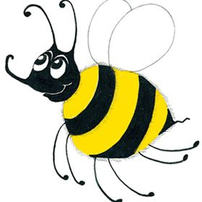
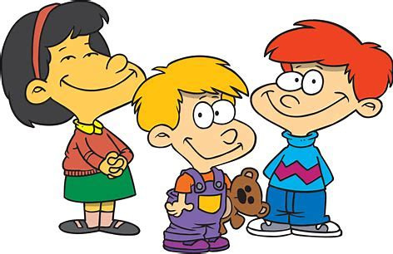
Family and Friends
mother
father
sister
brother
grandma
grandpa
aunt
uncle
nephew
niece
cousin
friend

Slide 35
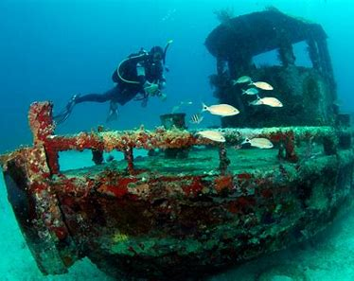

Slide 36
wreck
(Silent w)

Slide 37
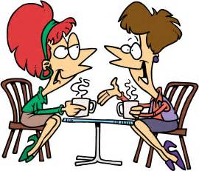
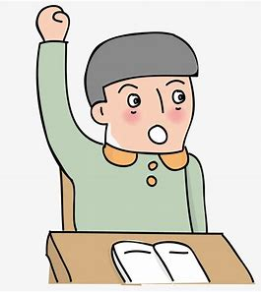
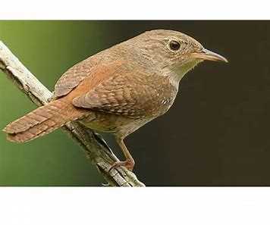
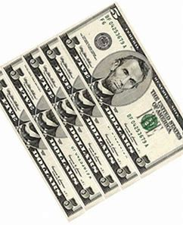
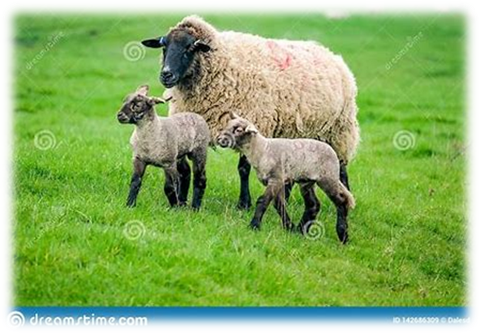
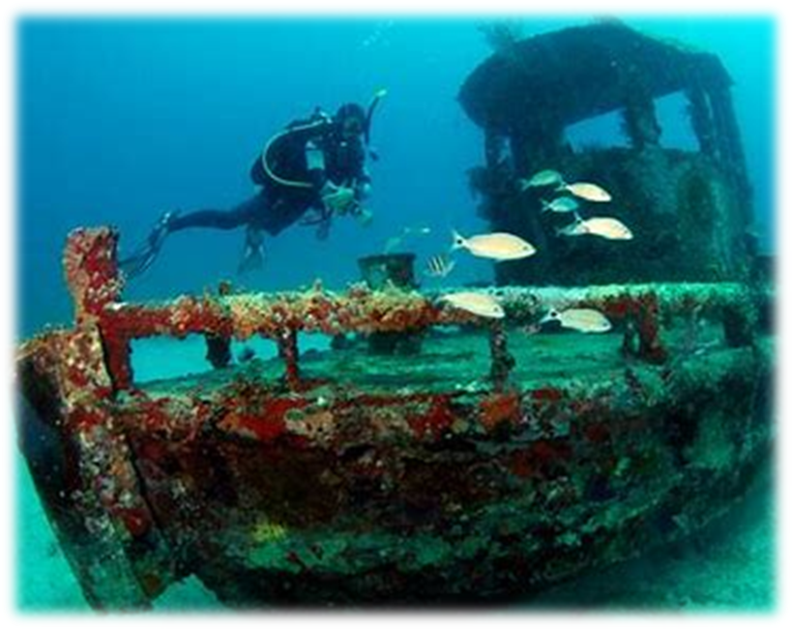
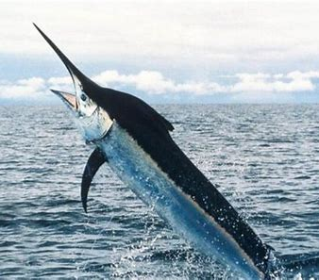
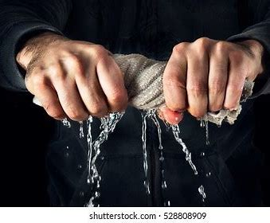
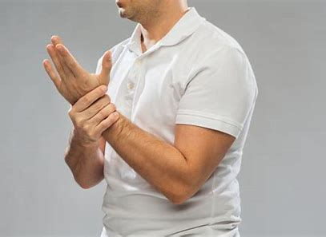
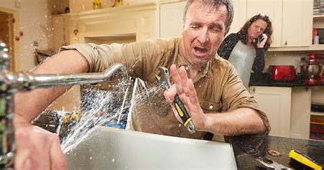
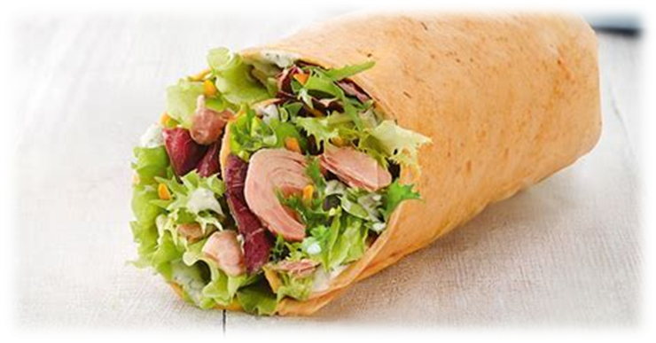
write
answer
wren
chat
cash
write
wrist
wreck
wrong
answer
swordfish
sister
brother
wreck
swordfish
two
wrap
wring
wrist
wrong

Slide 38
Activity page:
Silent <w>

Slide 39
Dictation

Slide 40
Name:
1. 2. 3.
4. 5. 6.
7.
8.
9.

Slide 41
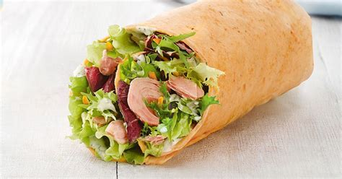
wrap

Slide 42
wrap 2. write

Slide 43
wrap 2. write 3. wren

Slide 44
wrap 2. write 3. wren
4. two

Slide 45
wrap 2. write 3. wren
4. two 5. wring

Slide 46
wrap 2. write 3. wren
4. two 5. wring 6. wreck

Slide 47
wrap 2. write 3. wren
4. two 5. wring 6. wreck
7. The plumber may be wrong.

Slide 48
wrap 2. write 3. wren
4. two 5. wring 6. wreck
7. The plumber may be wrong.
8. My wrist is numb.

Slide 49
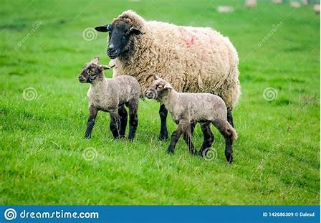
wrap 2. write 3. wren
4. two 5. wring 6. wreck
7. The plumber may be wrong.
8. My wrist is numb.
9. The sheep has two lambs.

Slide 50
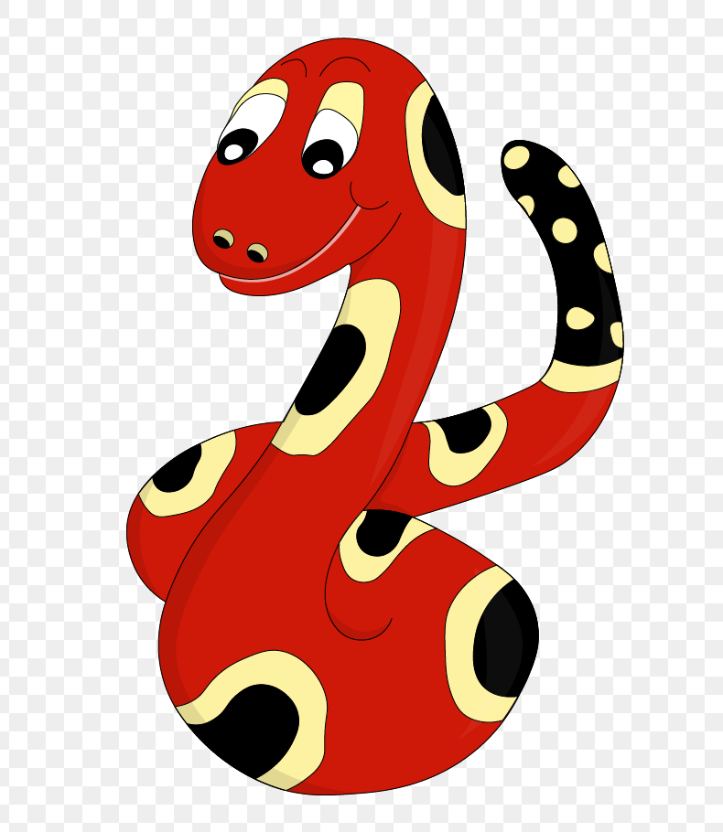
Thank you!

