Slide 1
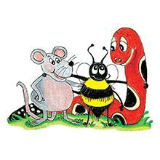
Jolly Grammar 2-1

Slide 2
Mini Test 36
(Grammar 1)

Slide 3
1. zip

Slide 4
1. zip
2. men

Slide 5
1. zip
2. men
3. pond

Slide 6
1. zip
2. men
3. pond
4. saw

Slide 7
1. zip
2. men
3. pond
4. saw
5. claw

Slide 8
1. zip
2. men
3. pond
4. saw
5. claw
6. dawn

Slide 9
1. zip
2. men
3. pond
4. saw
5. claw
6. dawn
7. prawn

Slide 10
1. zip
2. men
3. pond
4. saw
5. claw
6. dawn
7. prawn
8. mother

Slide 11
1. zip
2. men
3. pond
4. saw
5. claw
6. dawn
7. prawn
8. mother
9. father

Slide 12
1. zip
2. men
3. pond
4. saw
5. claw
6. dawn
7. prawn
8. mother
9. father
10. strawberry

Slide 13
Let’s review
Alphabetical Order.

Slide 14
Aa Bb Cc Dd Ee
Ff Gg Hh Ii Jj Kk Ll Mm
Nn Oo Pp Qq Rr Ss
Tt Uu Vv Ww Xx Yy Zz

Slide 15
Activity page:
Alphabetical Order

Slide 16
D A B E

Slide 17
D A B E
A

Slide 18
D A B E
A B

Slide 19
D A B E
A B D

Slide 20
D A B E
A B D E

Slide 21
D A B E
A B D E
M L K J
U V T W
J H G I
N A M D
P O Z Q

Slide 22
D A B E
A B D E
M L K J
J K L M
U V T W
J H G I
N A M D
P O Z Q

Slide 23
D A B E
A B D E
M L K J
J K L M
U V T W
T U V W
J H G I
N A M D
P O Z Q

Slide 24
D A B E
A B D E
M L K J
J K L M
U V T W
T U V W
J H G I
G H I J
N A M D
P O Z Q

Slide 25
D A B E
A B D E
M L K J
J K L M
U V T W
T U V W
J H G I
G H I J
N A M D
A D M N
P O Z Q

Slide 26
D A B E
A B D E
M L K J
J K L M
U V T W
T U V W
J H G I
G H I J
N A M D
A D M N
P O Z Q
O P Q Z

Slide 27
Dictionary

Slide 28
NOUN VERB PRONOUN
ADJECTIVE ADVERB
PREPOSITION CONJUNCTION

Slide 29
Activity page:
Dictionary

Slide 30
stable

Slide 31
271
NOUN
stable

Slide 32
Family and Friends
mother
father
sister
brother
grandma
grandpa
aunt
uncle
nephew
niece
cousin
friend

Slide 33
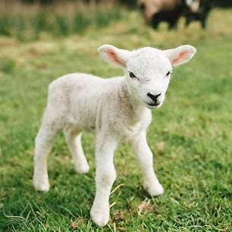
lamb
(Silent b)

Slide 34
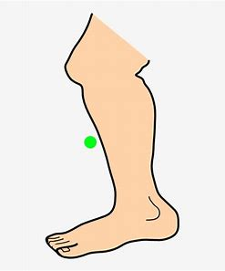
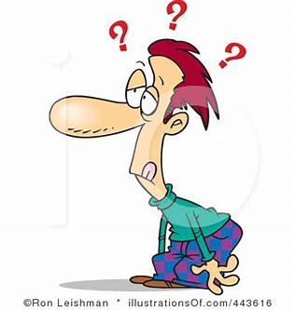
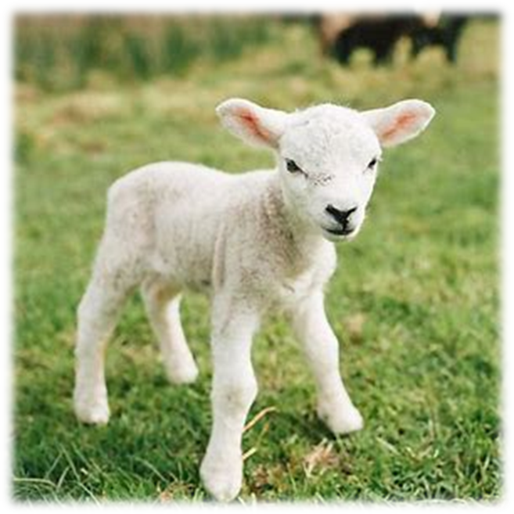
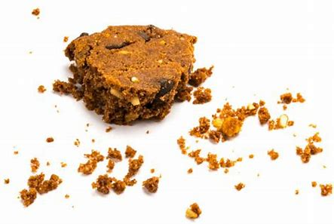
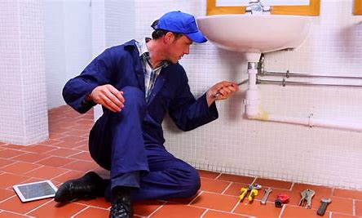
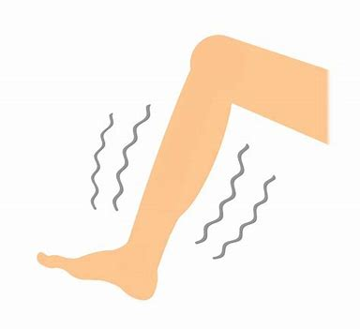
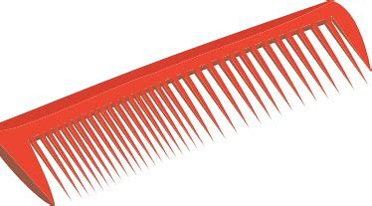
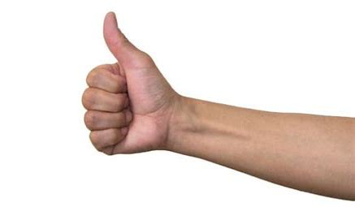
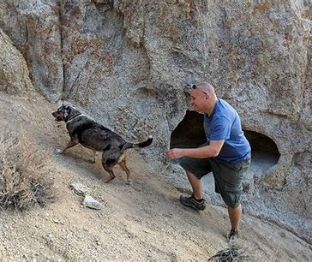
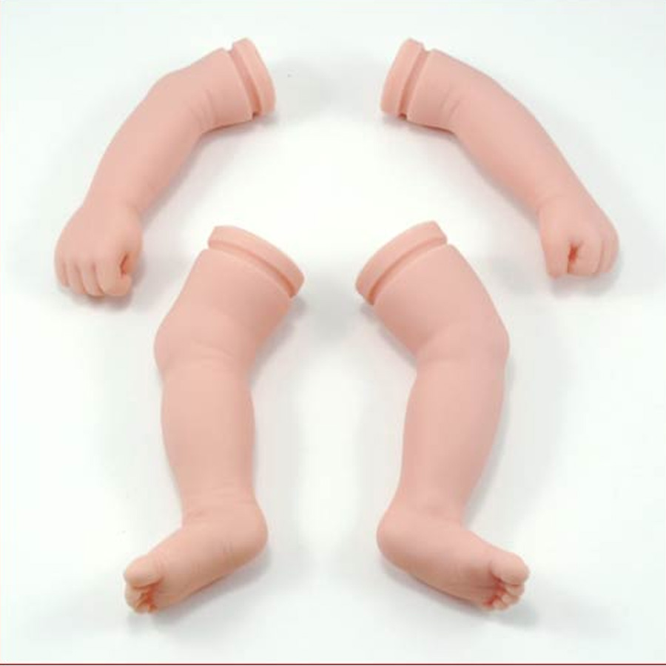
lamb
crumbs
dumb
shin
bench
lamb
comb
thumb
crumbs
plumber
climbing
mother
father
comb
plumber
numb
thumb
climbing
limb

Slide 35
Activity page:
Silent <b>

Slide 36
Dictation

Slide 37
Name:
1. 2. 3.
4. 5. 6.
7.
8.
9.

Slide 38
dumb

Slide 39
dumb 2. numb

Slide 40
dumb 2. numb 3. comb

Slide 41
dumb 2. numb 3. comb
4. climb

Slide 42
dumb 2. numb 3. comb
4. climb 5. crumb

Slide 43
dumb 2. numb 3. comb
4. climb 5. crumb 6. limb

Slide 44
dumb 2. numb 3. comb
4. climb 5. crumb 6. limb
7. The plumber went to fit the sink.

Slide 45
dumb 2. numb 3. comb
4. climb 5. crumb 6. limb
7. The plumber went to fit the sink.
8. Some crumbs fell on the carpet.

Slide 46
dumb 2. numb 3. comb
4. climb 5. crumb 6. limb
7. The plumber went to fit the sink.
8. Some crumbs fell on the carpet.
9. They climb up
the steep hill.

Slide 47
Homework

Slide 48
Thank you!

