Slide 1
Jolly Grammar 1-26

Slide 2
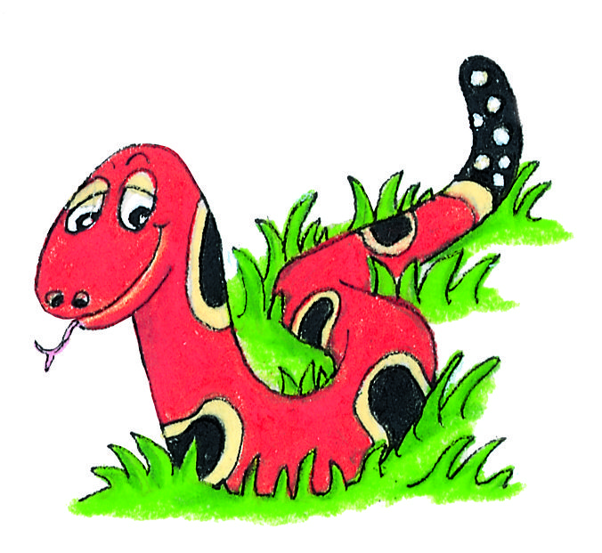
Spelling Test 25

Slide 3
bat

Slide 4
bat
pet

Slide 5
bat
pet
self

Slide 6
bat
pet
self
out

Slide 7
bat
pet
self
out
our

Slide 8
bat
pet
self
out
our
6. round

Slide 9
bat
pet
self
out
our
6. round
7. mouth

Slide 10
bat
pet
self
out
our
6. round
7. mouth
8. saw

Slide 11
bat
pet
self
out
our
6. round
7. mouth
8. saw
9. put

Slide 12
bat
pet
self
out
our
6. round
7. mouth
8. saw
9. put
10.outside

Slide 13
Let’s review
parts of speech.
Proper nouns
Common nouns
Pronouns
Verbs
adjectives

Slide 14
Activity Page:

Slide 15
Verbs
to
to
to
to
to
to
to
to
to
to
to
to
to
to

Slide 16
Verbs
to eat
to fly
to play
to fish
to read
to dive
to change
to
to
to
to
to
to
to

Slide 17
Verbs
to swim
to picnic
to fish
to read
to chase
to play
to make
to catch
to float
to wait
to dive
to stand
to shop
to change

Slide 18
Underline ate verbs in red. There can be more than one verb in a sentence.
Jenny smiled at her friend.

Slide 19
Underline ate verbs in red. There can be more than one verb in a sentence.
Jenny smiled at her friend.

Slide 20
Underline ate verbs in red. There can be more than one verb in a sentence.
Jenny smiled at her friend.
Alex sails a boat.

Slide 21
Underline ate verbs in red. There can be more than one verb in a sentence.
Jenny smiled at her friend.
Alex sails a boat.

Slide 22
Underline ate verbs in red. There can be more than one verb in a sentence.
Jenny smiled at her friend.
Alex sails a boat.
Hannah swims and dives in the sea.

Slide 23
Underline ate verbs in red. There can be more than one verb in a sentence.
Jenny smiled at her friend.
Alex sails a boat.
Hannah swims and dives in the sea.

Slide 24
Underline ate verbs in red. There can be more than one verb in a sentence.
Jenny smiled at her friend.
Alex sails a boat.
Hannah swims and dives in the sea.
The boys make a sandcastle and they play football.

Slide 25
Underline ate verbs in red. There can be more than one verb in a sentence.
Jenny smiled at her friend.
Alex sails a boat.
Hannah swims and dives in the sea.
The boys make a sandcastle and they play football.

Slide 26
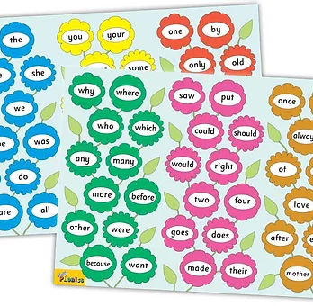
Tricky Words
^{5th} set

Slide 27
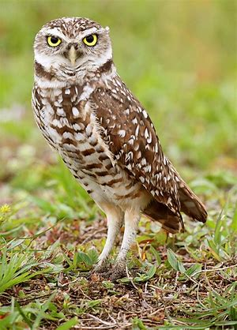
owl
/ou/

Slide 28
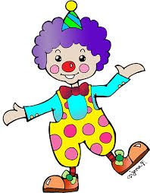
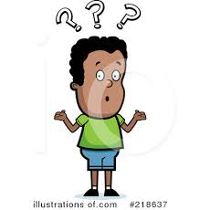
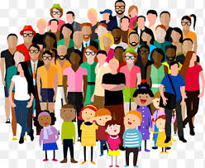
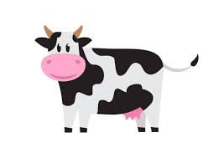
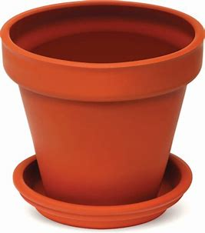
how
town
clown
shower
big
fox
milk
how
owl
brown
town
could
should
flowerpot
brown
crowd
howl
powder
owl
now
cow
down
flowerpot

Slide 29
Activity page

Slide 30
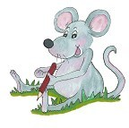
Dictation

Slide 31
cow

Slide 32
cow 2. now

Slide 33
cow 2. now 3. clown

Slide 34
cow 2. now 3. clown
4. howl

Slide 35
cow 2. now 3. clown
4. howl 5. crowd

Slide 36
cow 2. now 3. clown
4. howl 5. crowd 6. powder

Slide 37
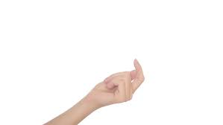
cow 2. now 3. clown
4. howl 5. crowd 6. powder
7. Come down here.

Slide 38
cow 2. now 3. clown
4. howl 5. crowd 6. powder
7. Come down here.
8. They went to town
on the bus.

Slide 39
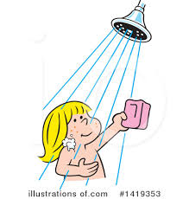
cow 2. now 3. clown
4. howl 5. crowd 6. powder
7. Come down here.
8. They went to town
on the bus.
9. She had a quick shower.

Slide 40
Thank you! See you next time.

