Slide 1
Jolly Grammar 1-23

Slide 2
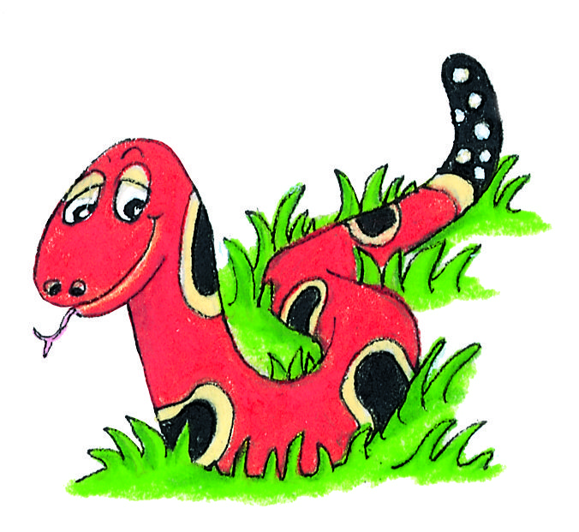
Spelling Test 22

Slide 3
win

Slide 4
win
sit

Slide 5
win
sit
stop

Slide 6
win
sit
stop
fry

Slide 7
win
sit
stop
fry
dry

Slide 8
win
sit
stop
fry
dry
6. crying

Slide 9
win
sit
stop
fry
dry
6. crying
7. sky

Slide 10
win
sit
stop
fry
dry
6. crying
7. sky
8. more

Slide 11
win
sit
stop
fry
dry
6. crying
7. sky
8. more
9. before

Slide 12
win
sit
stop
fry
dry
6. crying
7. sky
8. more
9. before
10. myself

Slide 13
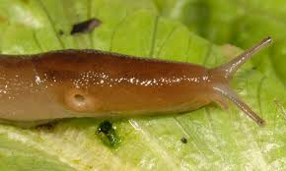
fr dr cr sm
sk
sp
gl
st
sl ug
gr
sl
fl
bl
sw cl tr sn

Slide 14
Let’s review
Initial blends.

Slide 15
Let’s learn
Final blends.

Slide 16
lamp
tent
sink
pond
tusk
bank
felt
milk
frost
bump
hand
vest
wind
cold
dust

Slide 17
Activity Page:
Final Consonant
Blends

Slide 18
mp st lt nd nt sp
sta
po
be
a
ne
ha
la
cri
te

Slide 19
mp st lt nd nt sp
sta mp
po
be
a
ne
ha
la
cri
te

Slide 20
mp st lt nd nt sp
sta mp
po st
be
a
ne
ha
la
cri
te

Slide 21
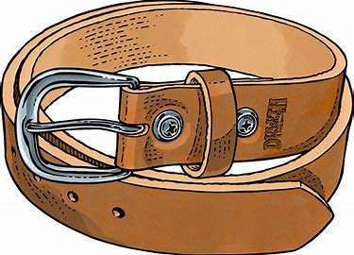
mp st lt nd nt sp
sta mp
po st
be lt
a
ne
ha
la
cri
te

Slide 22
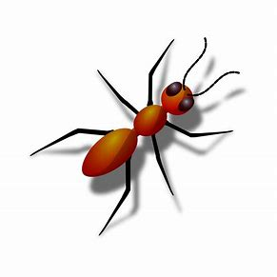
mp st lt nd nt sp
sta mp
po st
be lt
a nt
ne
ha
la
cri
te

Slide 23
mp st lt nd nt sp
sta mp
po st
be lt
a nt
ne st
ha
la
cri
te

Slide 24
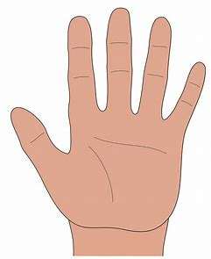
mp st lt nd nt sp
sta mp
po st
be lt
a nt
ne st
ha nd
la
cri
te

Slide 25
mp st lt nd nt sp
sta mp
po st
be lt
a nt
ne st
ha nd
la mp
cri
te

Slide 26
mp st lt nd nt sp
sta mp
po st
be lt
a nt
ne st
ha nd
la mp
cri sp
te

Slide 27
mp st lt nd nt sp
sta mp
po st
be lt
a nt
ne st
ha nd
la mp
cri sp
te nt

Slide 28
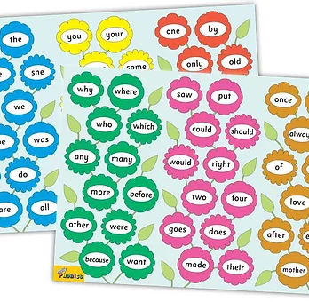
Tricky Words
^{4th} set

Slide 29
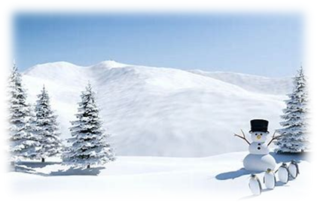
snow
/oa/

Slide 30
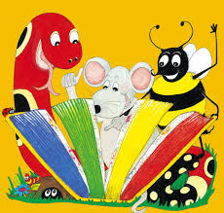
Activity page

Slide 31
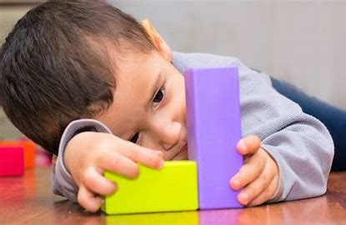
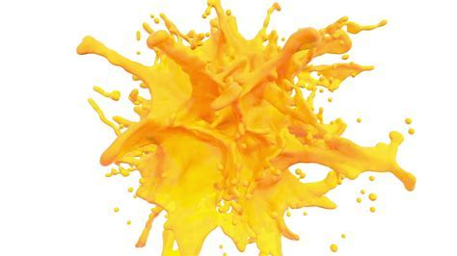
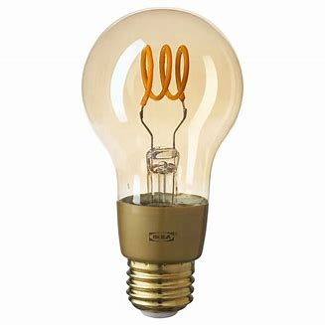
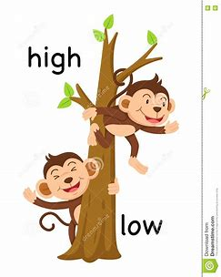
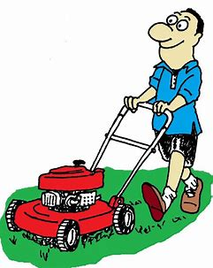
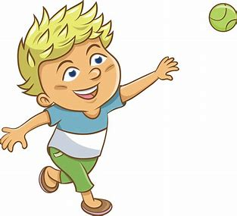
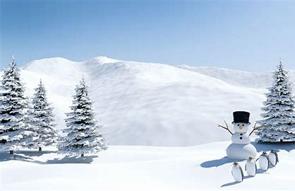
own
yellow
show
box
job
bulb
own
grow
elbow
yellow
other
were
snowman
low
mow
grow
elbow
throw
snow

Slide 32
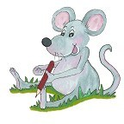
Dictation

Slide 33
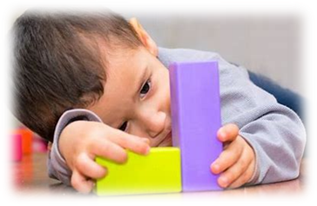
own

Slide 34
own 2. low

Slide 35
own 2. low 3. mow

Slide 36
own 2. low 3. mow
4. show

Slide 37
own 2. low 3. mow
4. show 5. grow

Slide 38
own 2. low 3. mow
4. show 5. grow 6. throw

Slide 39
own 2. low 3. mow
4. show 5. grow 6. throw
7. It has started snowing.

Slide 40
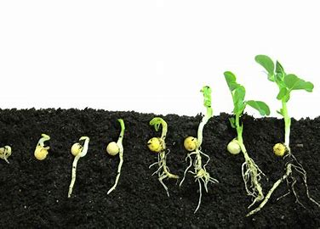
own 2. low 3. mow
4. show 5. grow 6. throw
7. It has started snowing.
8. The seeds have grown well.

Slide 41
own 2. low 3. mow
4. show 5. grow 6. throw
7. It has started snowing.
8. The seeds have grown well.
9. There is a show on Monday.

Slide 42
Thank you! See you next time.

