Slide 1
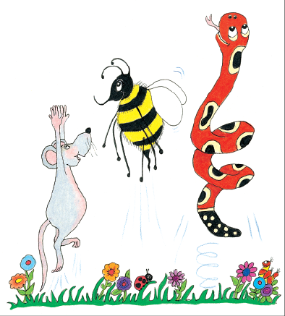
Jolly Grammar 1-22

Slide 2
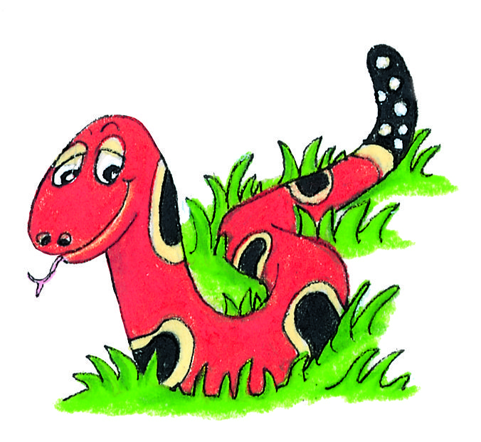
Spelling Test 21

Slide 3
lip

Slide 4
lip
his

Slide 5
lip
his
went

Slide 6
lip
his
went
night

Slide 7
lip
his
went
night
high

Slide 8
lip
his
went
night
high
6. might

Slide 9
lip
his
went
night
high
6. might
7. light

Slide 10
lip
his
went
night
high
6. might
7. light
8. any

Slide 11
lip
his
went
night
high
6. might
7. light
8. any
9. many

Slide 12
lip
his
went
night
high
6. might
7. light
8. any
9. many
10. frightening

Slide 13
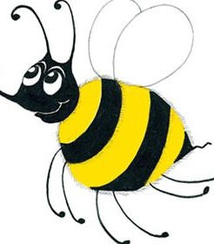
Let’s revise
Common Nouns.

Slide 14
horse

Slide 15
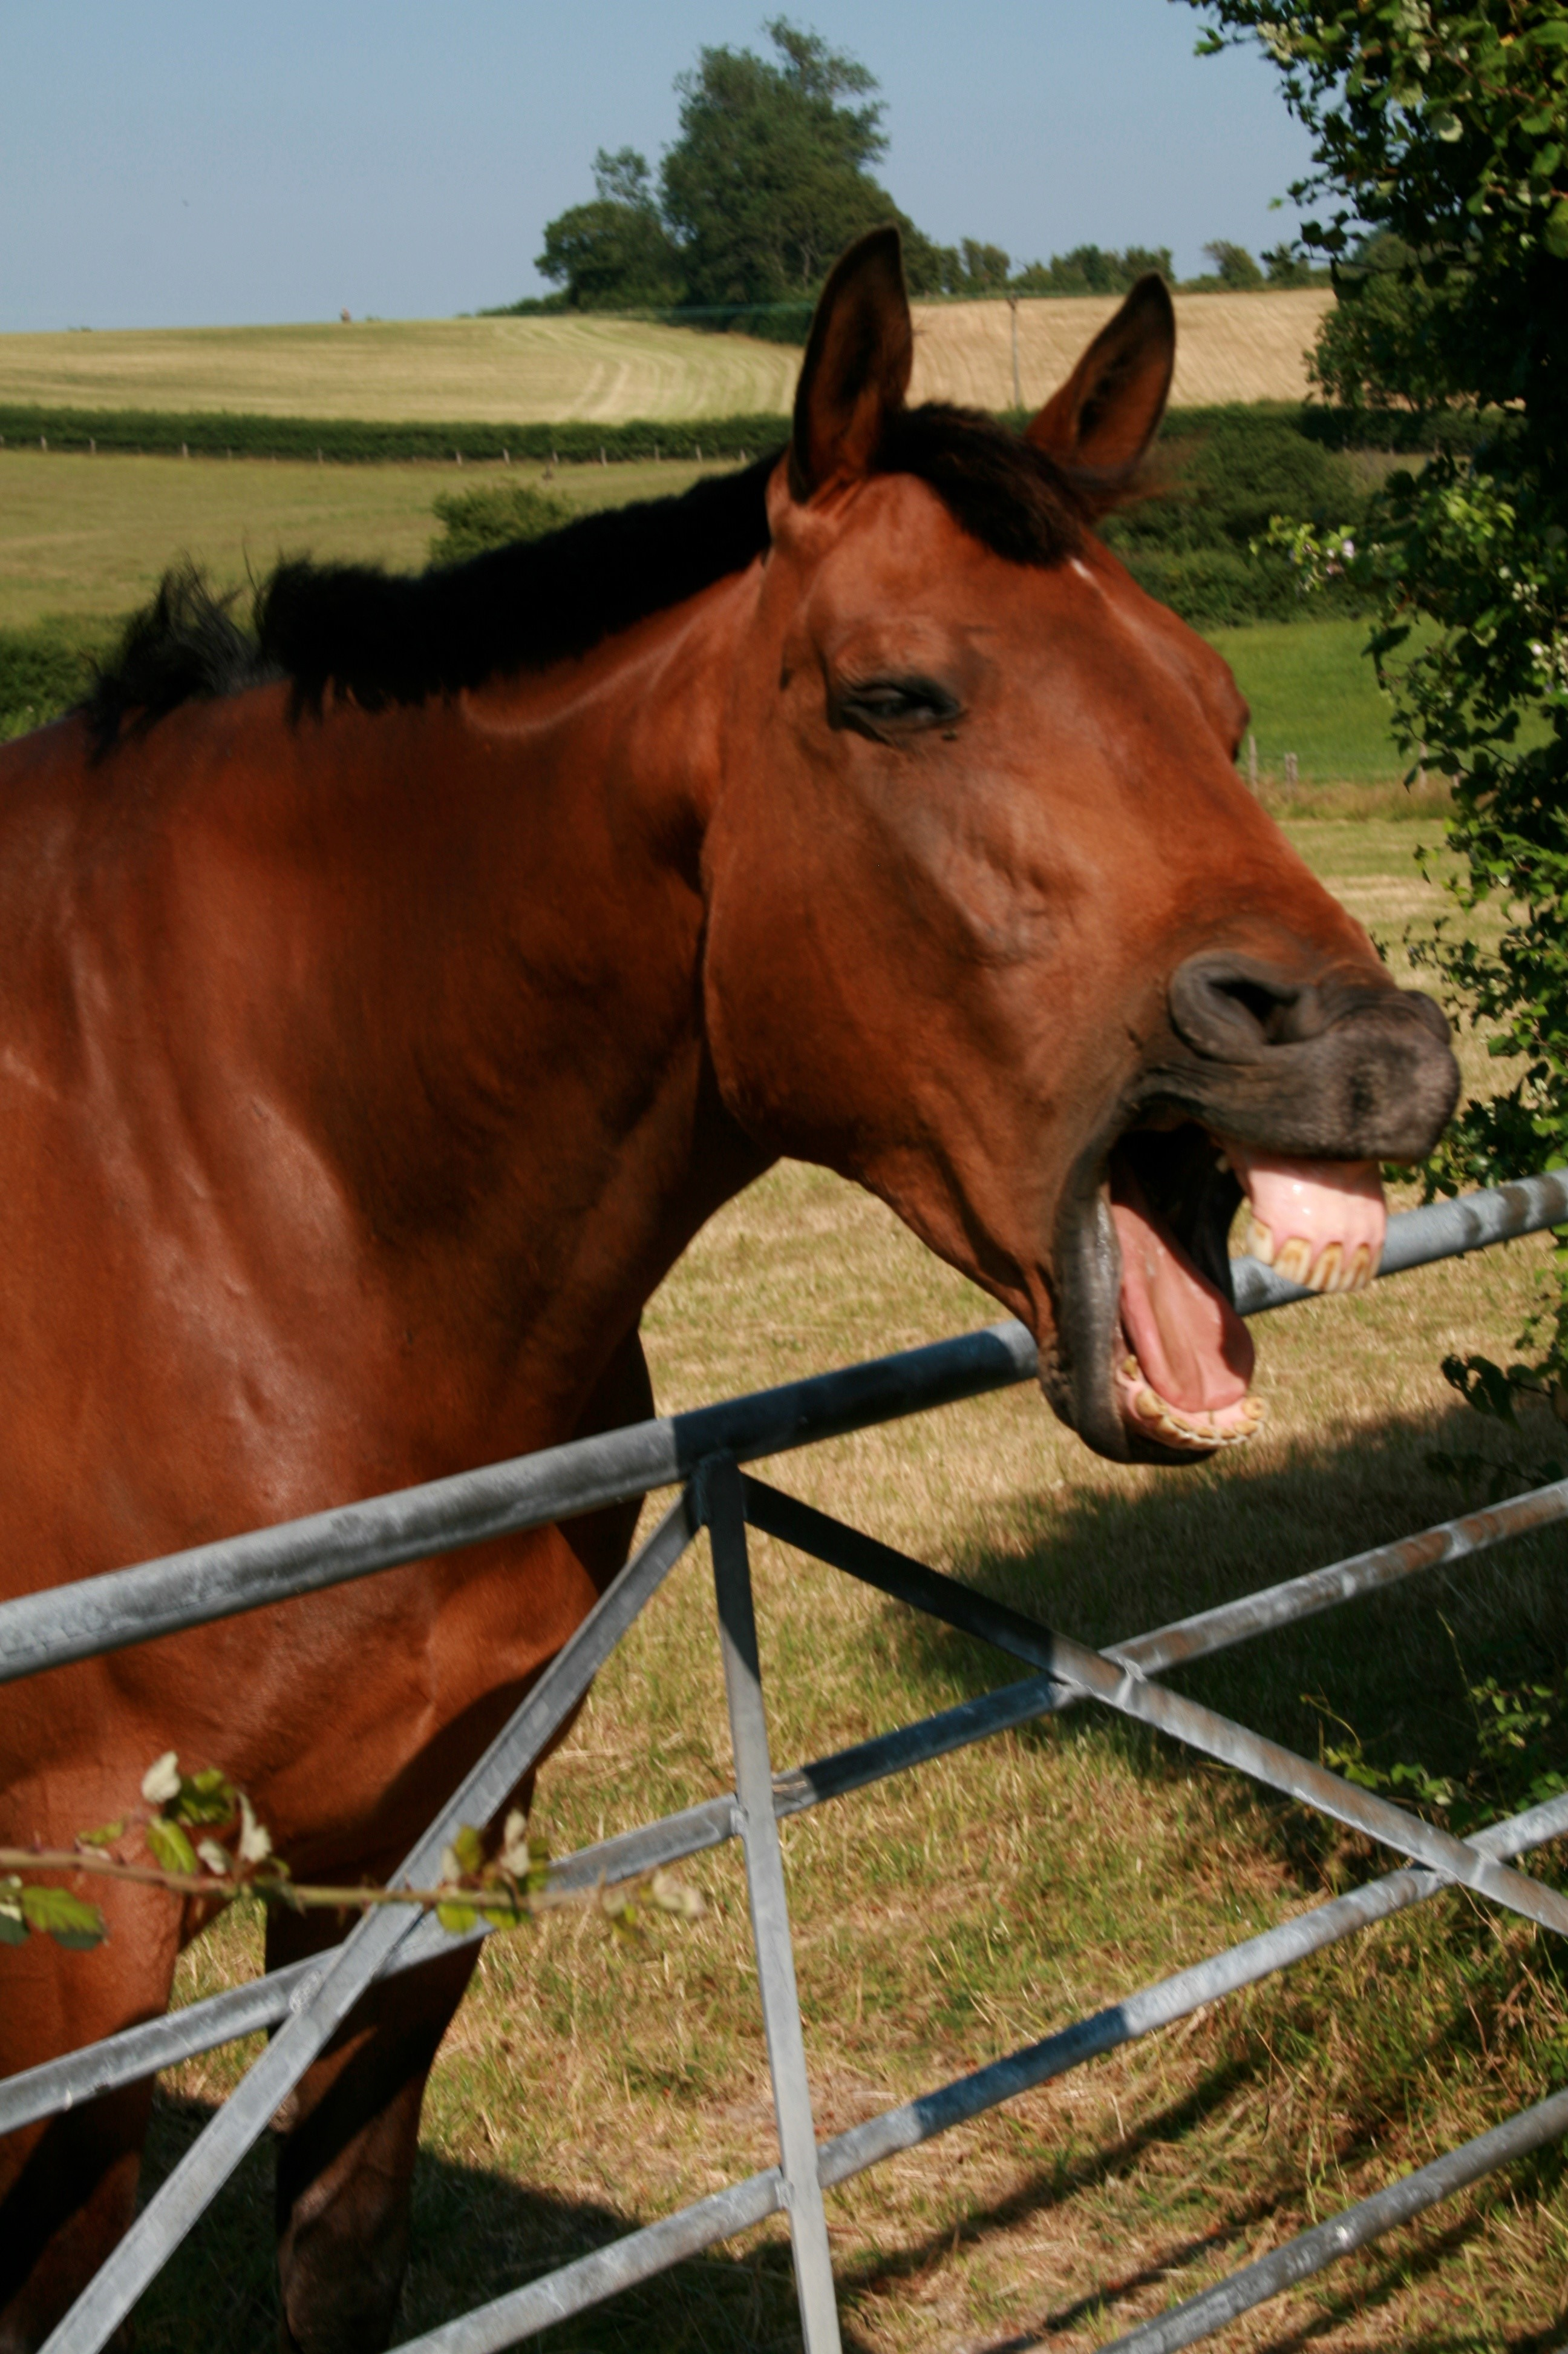
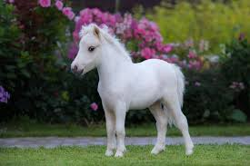
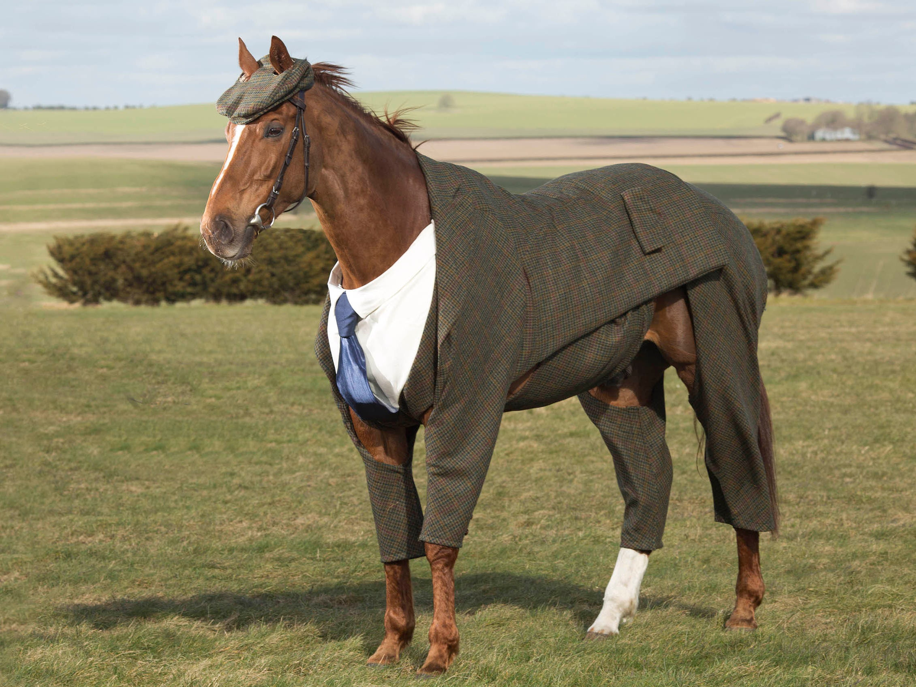
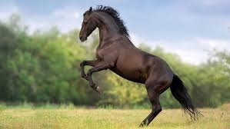
horse

Slide 16
Let’s revise
Adjectives too.

Slide 17
chair

Slide 18
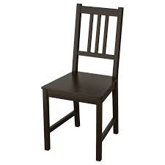
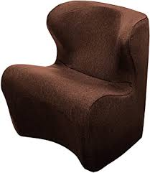
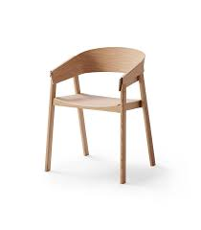
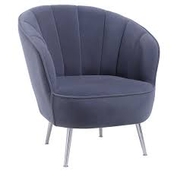
chair

Slide 19
jumper

Slide 20
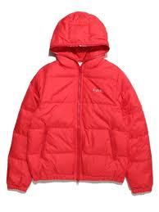
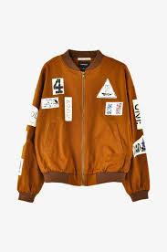
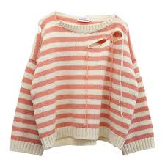
jumper

Slide 21
dog

Slide 22
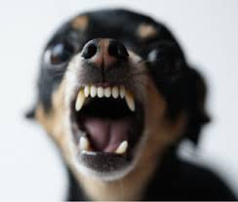
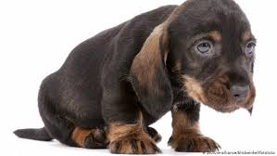
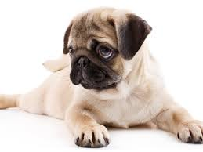
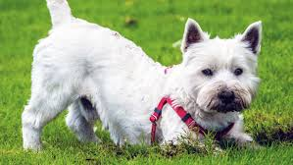
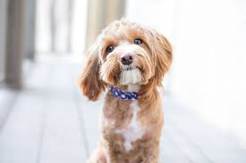
dog

Slide 23
scarf

Slide 24
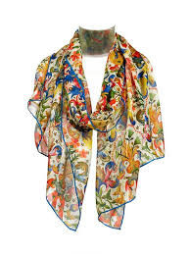
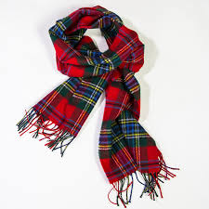
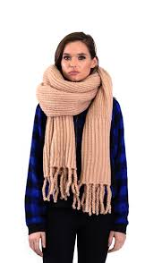
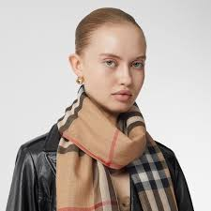
scarf

Slide 25
cat

Slide 26
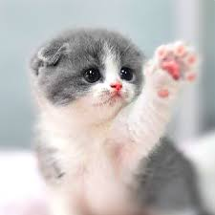
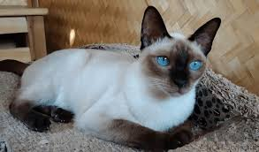
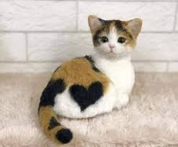
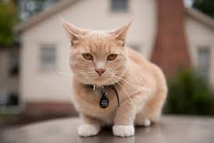
cat

Slide 27
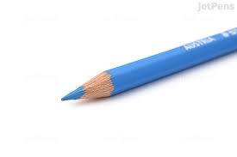
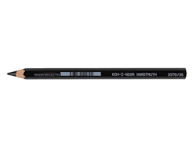
He had a little dog.
She sat on the red chair.

Slide 28
He had a little dog.
She sat on the red chair.

Slide 29
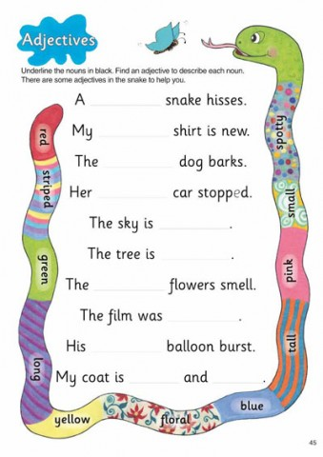
Activity Page:
Adjectives

Slide 30
A spotty snake hisses.

Slide 31
A spotty snake hisses.
My green shirt is new.

Slide 32
A spotty snake hisses.
My green shirt is new.
The grumpy dog barks.

Slide 33
A spotty snake hisses.
My green shirt is new.
The grumpy dog barks.
Her red car stopped.

Slide 34
A spotty snake hisses.
My green shirt is new.
The grumpy dog barks.
Her red car stopped.
The sky is blue.

Slide 35
A spotty snake hisses.
My green shirt is new.
The grumpy dog barks.
Her red car stopped.
The sky is blue. orange
The tree is big.

Slide 36
A spotty snake hisses.
My green shirt is new.
The grumpy dog barks.
Her red car stopped.
The sky is blue.
The tree is big.
The pink flowers smell.

Slide 37
A spotty snake hisses.
My green shirt is new.
The grumpy dog barks.
Her red car stopped.
The sky is blue.
The tree is big.
The pink flowers smell.
The film was scary.

Slide 38
A spotty snake hisses.
My green shirt is new.
The grumpy dog barks.
Her red car stopped.
The sky is blue.
The tree is big.
The pink flowers smell.
The film was scary.
His pink balloon burst.

Slide 39
A spotty snake hisses.
My green shirt is new.
The grumpy dog barks.
Her red car stopped.
The sky is blue.
The tree is big.
The pink flowers smell.
The film was scary.
His pink balloon burst.
My coat is floral and pink.

Slide 40
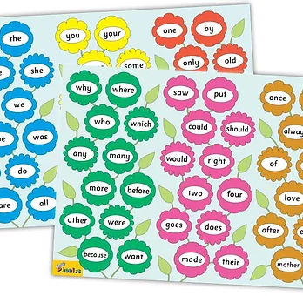
Tricky Words
^{4th} set

Slide 41
Let’s revise
/ie/
<ie><i-e><igh><y>

Slide 42
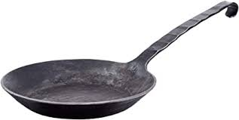
frying pan
/ie/

Slide 43
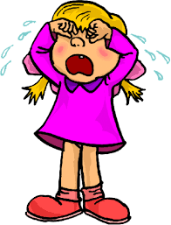
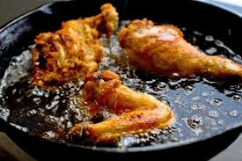
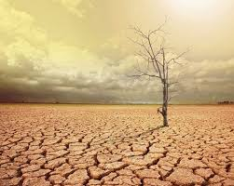
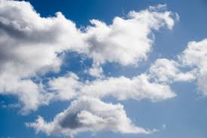
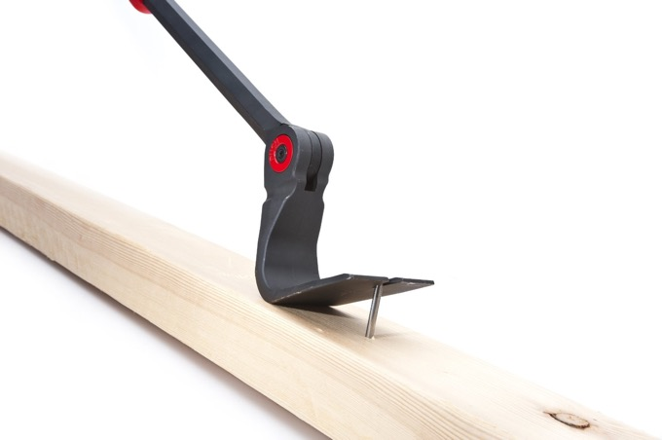
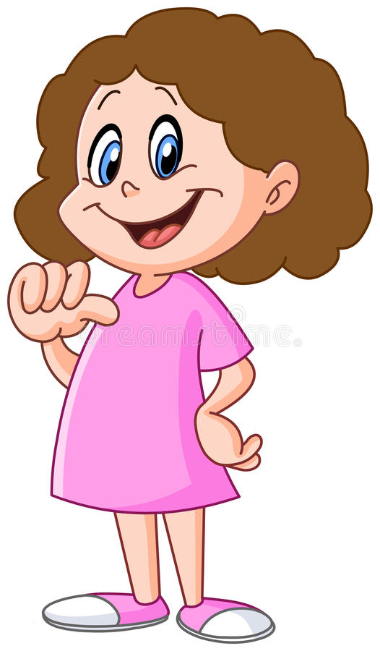
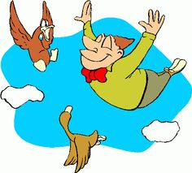
fry
crying
my
win
sit
stop
fry
dry
crying
sky
more
before
myself
dry
sky
pry
myself
flying
trying

Slide 44
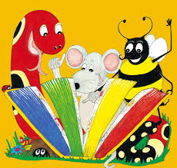
Activity page

Slide 45
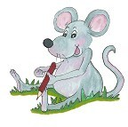
Dictation

Slide 46
my

Slide 47
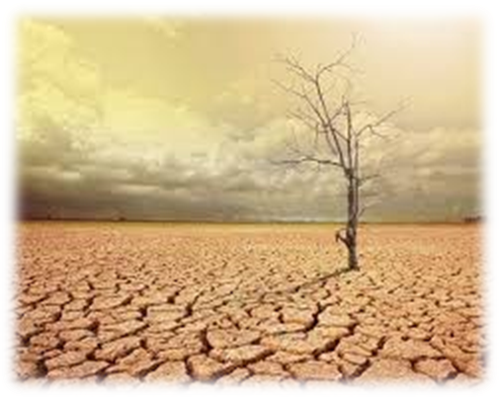
my 2.dry

Slide 48
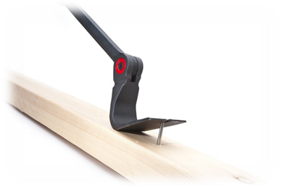
my 2.dry 3. pry

Slide 49
my 2.dry 3. pry
4. crying

Slide 50
my 2.dry 3. pry
4. crying 5. flying

Slide 51
my 2.dry 3. pry
4. crying 5. flying 6. trying

Slide 52
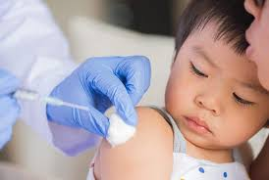
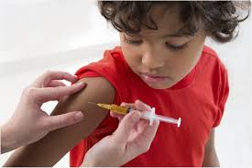
my 2.dry 3. pry
4. crying 5. flying 6. trying
7. We try not to cry.

Slide 53
my 2.dry 3. pry
4. crying 5. flying 6. trying
7. We try not to cry.
8. They are flying with me.

Slide 54
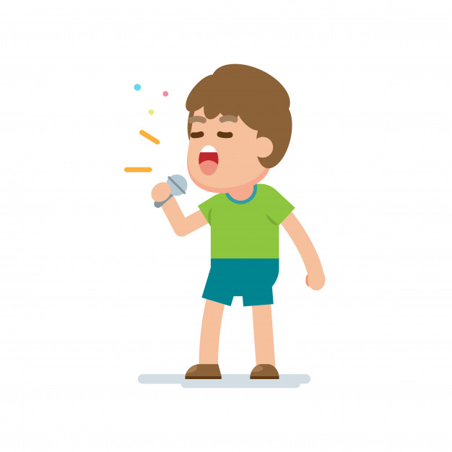
my 2.dry 3. pry
4. crying 5. flying 6. trying
7. We try not to cry.
8. They are flying with me.
9. He was trying to sing the song.

Slide 55
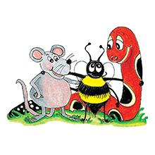
Thank you! See you next time.

