Slide 1
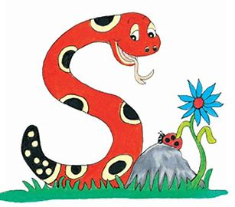
Jolly Grammar 1-21

Slide 2
Spelling Test 20

Slide 3
met

Slide 4
met
web

Slide 5
met
web
spin

Slide 6
met
web
spin
tea

Slide 7
met
web
spin
tea
heat

Slide 8
met
web
spin
tea
heat
6. leaf

Slide 9
met
web
spin
tea
heat
6. leaf
7. each

Slide 10
met
web
spin
tea
heat
6. leaf
7. each
8. who

Slide 11
met
web
spin
tea
heat
6. leaf
7. each
8. who
9. which

Slide 12
met
web
spin
tea
heat
6. leaf
7. each
8. who
9. which
10. seashell

Slide 13
Let’s revise
Parts of speech
and learn Adjectives.

Slide 14
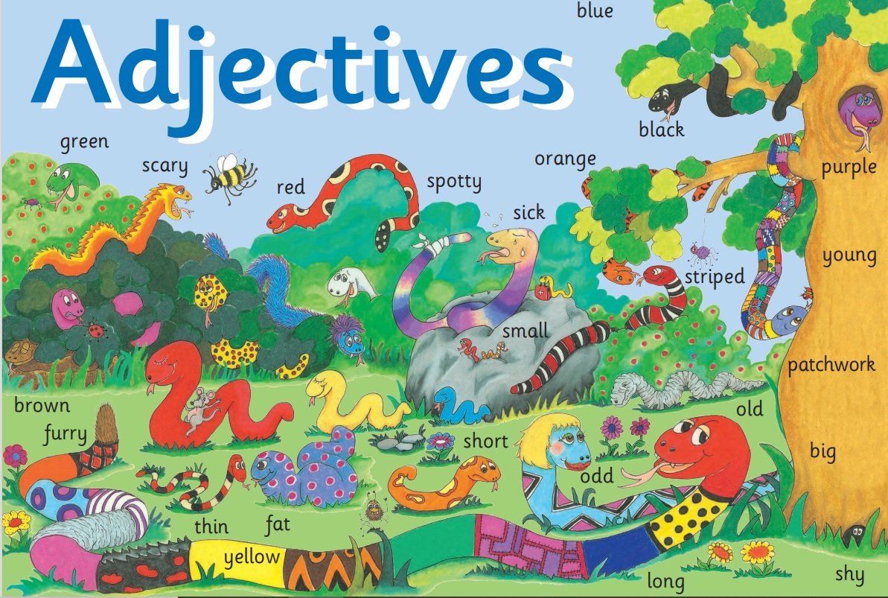

Slide 15
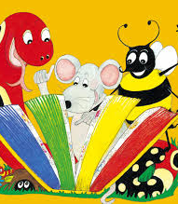
Activity page:
Adjectives

Slide 16
Let’s make it more interesting!

Slide 17
a

Slide 18
a long,

Slide 19
a long, green,

Slide 20
a long, green, spotty,

Slide 21
a long, green, spotty, spiky

Slide 22
a long, green, spotty, spiky snake

Slide 23
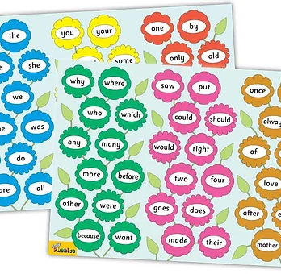
Tricky Words
^{4th} set

Slide 24
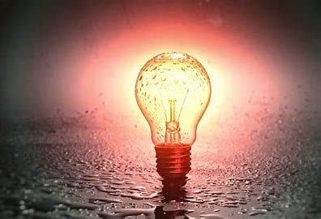
light
/ie/

Slide 25
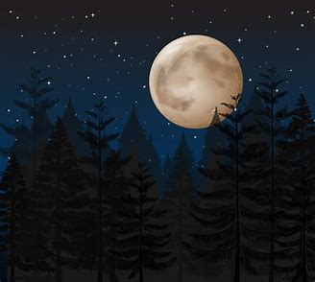
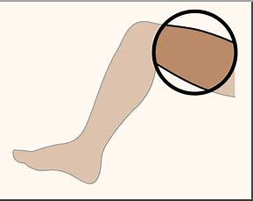
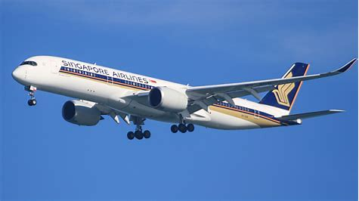
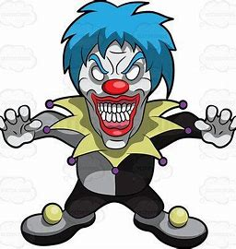
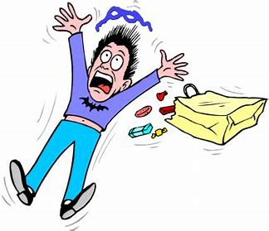
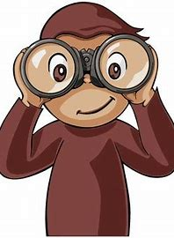
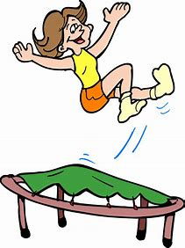
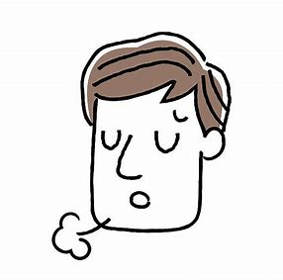
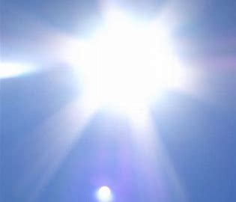
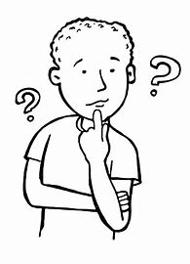
night
light
thigh
flight
lip
his
went
night
high
might
light
any
many
frightening
frightening
sight
fright
high
sigh
bright
might

Slide 26
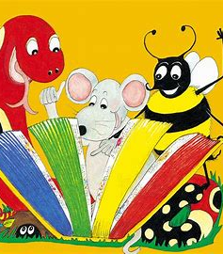
Dictation

Slide 27
high

Slide 28
high 2. sigh

Slide 29
high 2. sigh 3. thigh

Slide 30
high 2. sigh 3. thigh
4. sight

Slide 31
high 2. sigh 3. thigh
4. sight 5. bright

Slide 32
high 2. sigh 3. thigh
4. sight 5. bright 6. flight

Slide 33
high 2. sigh 3. thigh
4. sight 5. bright 6. flight
7. It was a dark night.

Slide 34
high 2. sigh 3. thigh
4. sight 5. bright 6. flight
7. It was a dark night.
8. My dad had a fright.

Slide 35
high 2. sigh 3. thigh
4. sight 5. bright 6. flight
7. It was a dark night.
8. My dad had a fright.
9. There was a bright light.

Slide 36
Thank you! See you next time.

