Slide 1
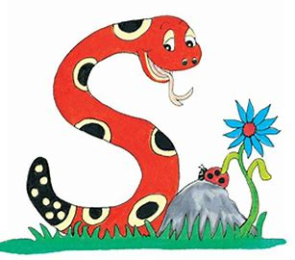
Jolly Grammar 1-20

Slide 2
Spelling Test 19

Slide 3
an

Slide 4
an
cat

Slide 5
an
cat
skin

Slide 6
an
cat
skin
say

Slide 7
an
cat
skin
say
away

Slide 8
an
cat
skin
say
away
6. play

Slide 9
an
cat
skin
say
away
6. play
7. today

Slide 10
an
cat
skin
say
away
6. play
7. today
8. why

Slide 11
an
cat
skin
say
away
6. play
7. today
8. why
9. where

Slide 12
an
cat
skin
say
away
6. play
7. today
8. why
9. where
10. playground

Slide 13
Let’s revise
Parts of speech.

Slide 14
・Proper nouns
・Common nouns
・Pronouns
・Verb

Slide 15
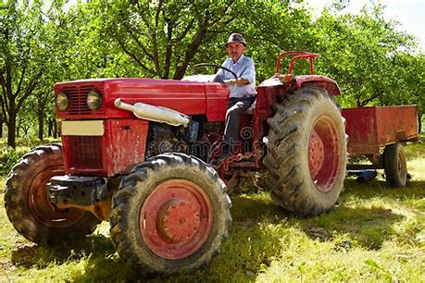
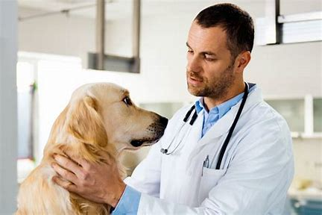
The farmer drives a tractor.
My dog goes to the vet on Monday.

Slide 16
The farmer drives a tractor.
My dog goes to the vet on Monday.

Slide 17
Activity page

Slide 18
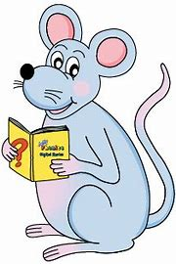
Nouns
a farm the horse
a rabbit the chicks
a dog the sheep
a cat the goat

Slide 19
Nouns
a dog the farmer
a cat the farmhouse
a rabbit the jump

Slide 20
Nouns
a tree the butterflies
a cat the horses
a hens the dog
a goat the fence
a squirrel the house

Slide 21
Let’s find
Nouns.

Slide 22
The cow is black and white.
Jim drives a red and yellow tractor.
The sheep graze on the hills.
On Andrew’s farm, there are cows, sheep, chickens and a horse.

Slide 23
The cow is black and white.
Jim drives a red and yellow tractor.
The sheep graze on the hills.
On Andrew’s farm, there are cows, sheep, chickens and a horse.

Slide 24
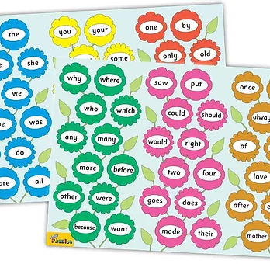
Tricky Words
^{4th} set

Slide 25
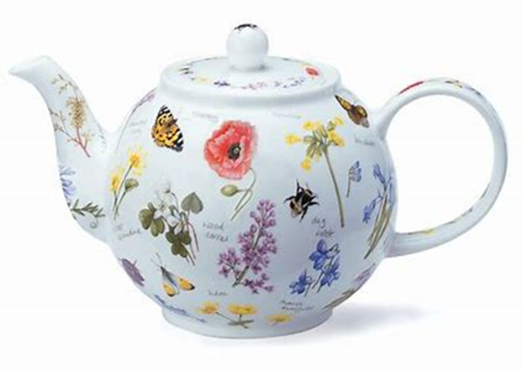
teapot
/ee/

Slide 26
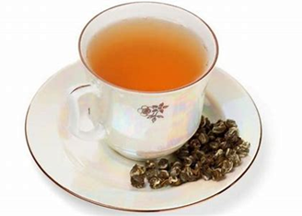
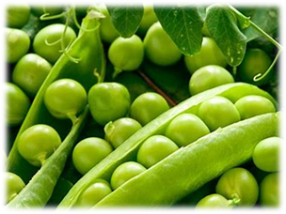
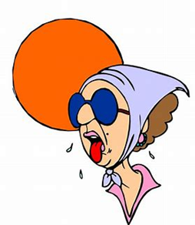
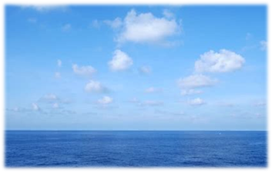
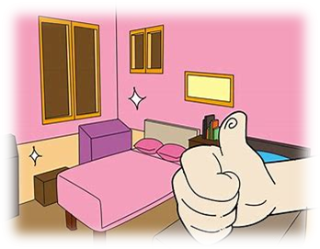
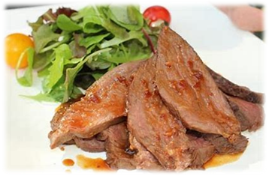
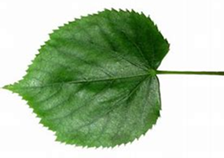
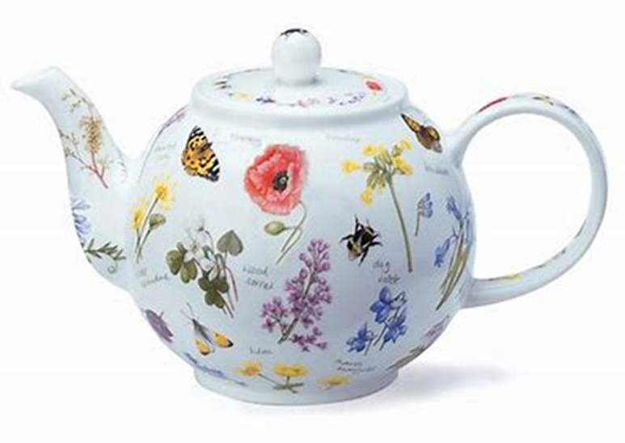
tea
each
peas
clean
met
web
spin
tea
heat
leaf
each
who
which
seashell
heat
sea
meat
neat
leaf
seashell
teapot
beach

Slide 27
Dictation

Slide 28
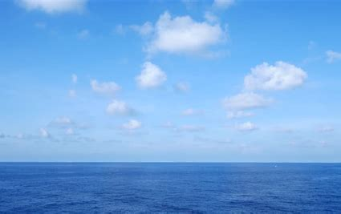
sea

Slide 29
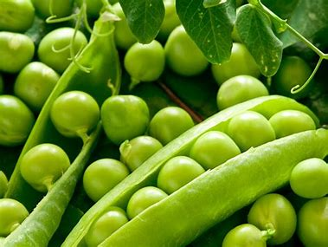
sea 2. peas

Slide 30
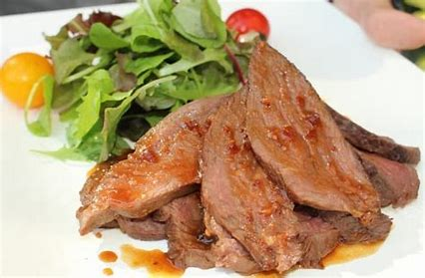
sea 2. peas 3. meat

Slide 31
sea 2. peas 3. meat
4. clean

Slide 32
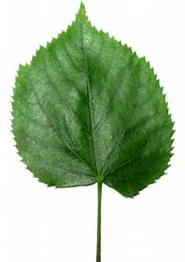
sea 2. peas 3. meat
4. clean 5. leaf

Slide 33
sea 2. peas 3. meat
4. clean 5. leaf 6. teapot

Slide 34
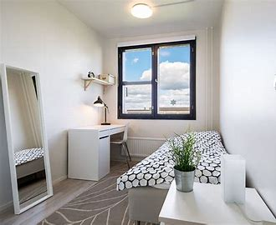
sea 2. peas 3. meat
4. clean 5. leaf 6. teapot
7. My room is neat and clean.

Slide 35
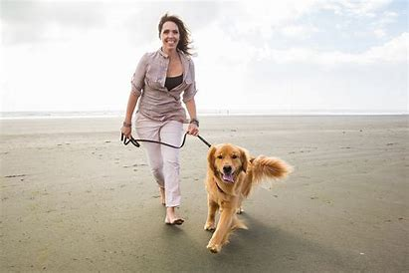
sea 2. peas 3. meat
4. clean 5. leaf 6. teapot
7. My room is neat and clean.
8. She took the dog to the beach.

Slide 36
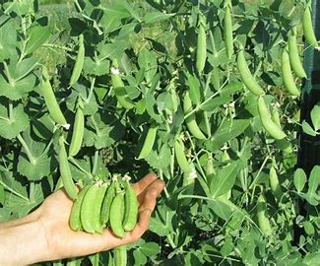
sea 2. peas 3. meat
4. clean 5. leaf 6. teapot
7. My room is neat and clean.
8. She took the dog to the beach.
9. He has peas in his garden.

Slide 37
Thank you! See you next time.

