Slide 1
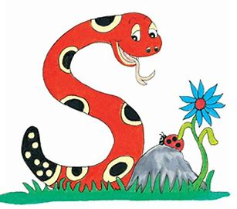
Jolly Grammar 1-19

Slide 2
Spelling Test 18

Slide 3
did

Slide 4
did
cut

Slide 5
did
cut
twin

Slide 6
did
cut
twin
whale

Slide 7
did
cut
twin
whale
wheel

Slide 8
did
cut
twin
whale
wheel
6. white

Slide 9
did
cut
twin
whale
wheel
6. white
7. whisper

Slide 10
did
cut
twin
whale
wheel
6. white
7. whisper
8. what

Slide 11
did
cut
twin
whale
wheel
6. white
7. whisper
8. what
9. when

Slide 12
did
cut
twin
whale
wheel
6. white
7. whisper
8. what
9. when
10. whenever

Slide 13
Let’s revise
Alphabet.

Slide 14
A a B b C c D d E e
F f G g H h I i J j K k L l M m
N n O o P p Q q R r S s
T t U u V v W w X x Y y Z z

Slide 15
B
F
O
X
C
H
N
T
i
q
r
w
Bee
Inky
Snake
apple
orange
pear

Slide 16
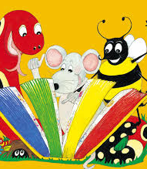
Activity page

Slide 17
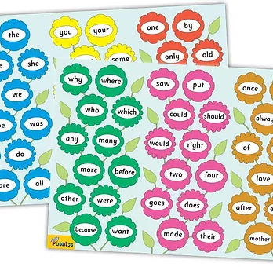
Tricky Words
^{4th} set

Slide 18
crayon
/ai/

Slide 19
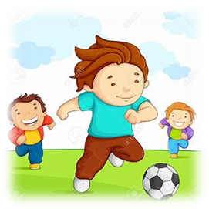
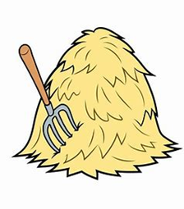
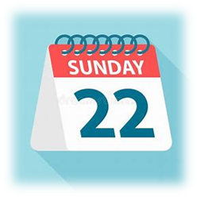
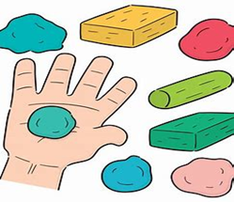
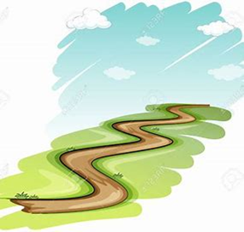
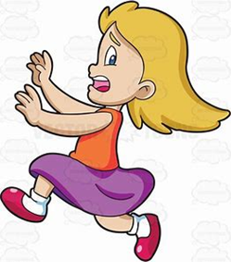
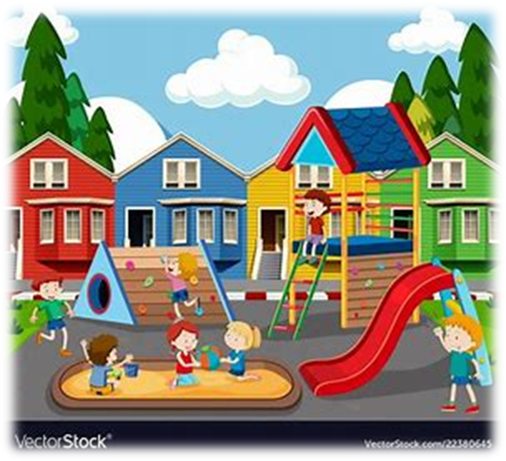
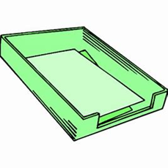
crayon
play
hay
Sunday
an
cat
skin
say
away
play
today
why
where
playground
say
today
way
stay
clay
away
playground
tray

Slide 20
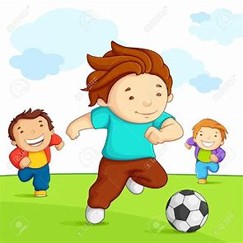
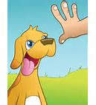
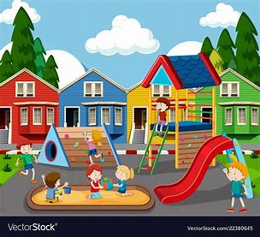
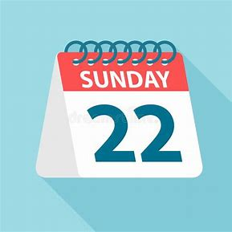
crayon
say
way
play
stay
today
tray
away
playground
Sunday
hay
clay

Slide 21
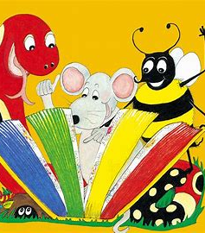
Dictation

Slide 22
hay

Slide 23
hay 2. way

Slide 24
hay 2. way 3. play

Slide 25
hay 2. way 3. play
4. tray

Slide 26
hay 2. way 3. play
4. tray 5. clay

Slide 27
hay 2. way 3. play
4. tray 5. clay 6. Sunday

Slide 28
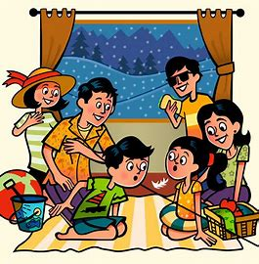
hay 2. way 3. play
4. tray 5. clay 6. Sunday
7. You can all stay here.

Slide 29
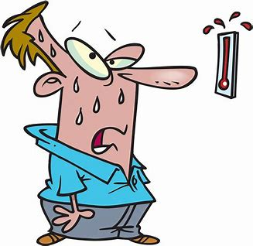
hay 2. way 3. play
4. tray 5. clay 6. Sunday
7. You can all stay here.
8. Today is hot.

Slide 30
hay 2. way 3. play
4. tray 5. clay 6. Sunday
7. You can all stay here.
8. Today is hot.
9. I made this from clay.

Slide 31
Thank you! See you next time.

